Slide 1
BrakeSim
CS 460
James Perry, Jonathan Roop, Andre Green, John Krukar, John Mohr

Slide 2
Objectives
-Physical Modeling
-Creating the environment around the car
-Encapsulating the EBS System

Slide 3
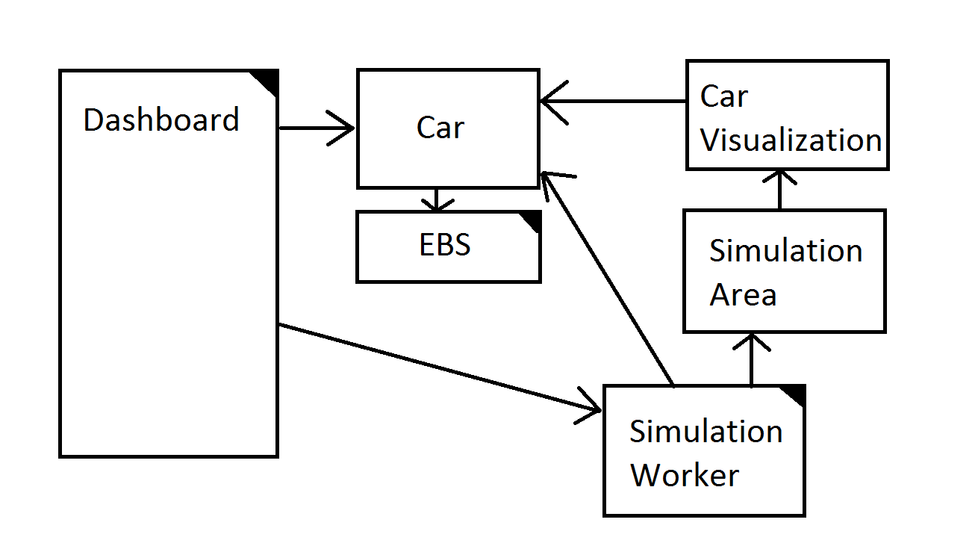
Design Diagram

Slide 4
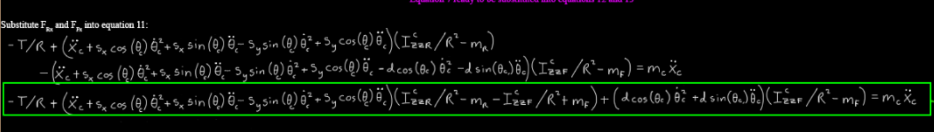
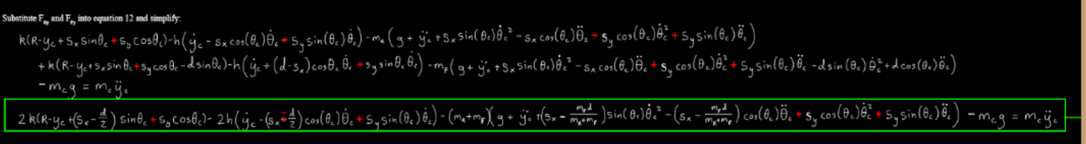
Physics

Slide 5
EBS Policy
When the “Brake” button is pushed, enter the “braking” state.
When in “braking” state, apply a constant amount of torque to the emergency brakes every second, until the velocity has reached 0.
Amount of torque to apply is determined by the car’s velocity when the brake button is pressed.
While the car is in the “braking” state, ignore button pushes.

