Slide 1
Google Data Analytics Capstone
Case Study 2: How Can a Wellness Technology Company Play It Smart?
Antonio Iannopollo
June 2, 2025

Slide 2
Business Task
Analyze FitBit data to identify smart device usage trends and recommend marketing strategies for Bellabeat’s Leaf tracker.

Slide 3
Data Sources
FitBit Fitness Tracker Data (Kaggle, CC0, 30 users, 2016).
Limitations: Small sample, no demographics, missing data (46% sleep, 34% heart rate).
Original file names were modified by adding ‘_m1’ or ‘_m2’ to distinguish between files with identical names in the dataset.
File Name | Data Type | Description
dailyActivity_merged_m1.csv | Activity | Daily steps, distance, calories (Period 1)
dailyActivity_merged_m2.csv | Activity | Daily steps, distance, calories (Period 2)
minuteSleep_merged_m1.csv | Sleep | Minute-level sleep states: asleep, restless, awake (Period 1)
minuteSleep_merged_m2.csv | Sleep | Minute-level sleep states: asleep, restless, awake (Period 2)
heartrate_seconds_merged_m1.csv | Heart Rate | Second-level heart rate measurements (Period 1)
heartrate_seconds_merged_m2.csv | Heart Rate | Second-level heart rate measurements (Period 2)

Slide 4
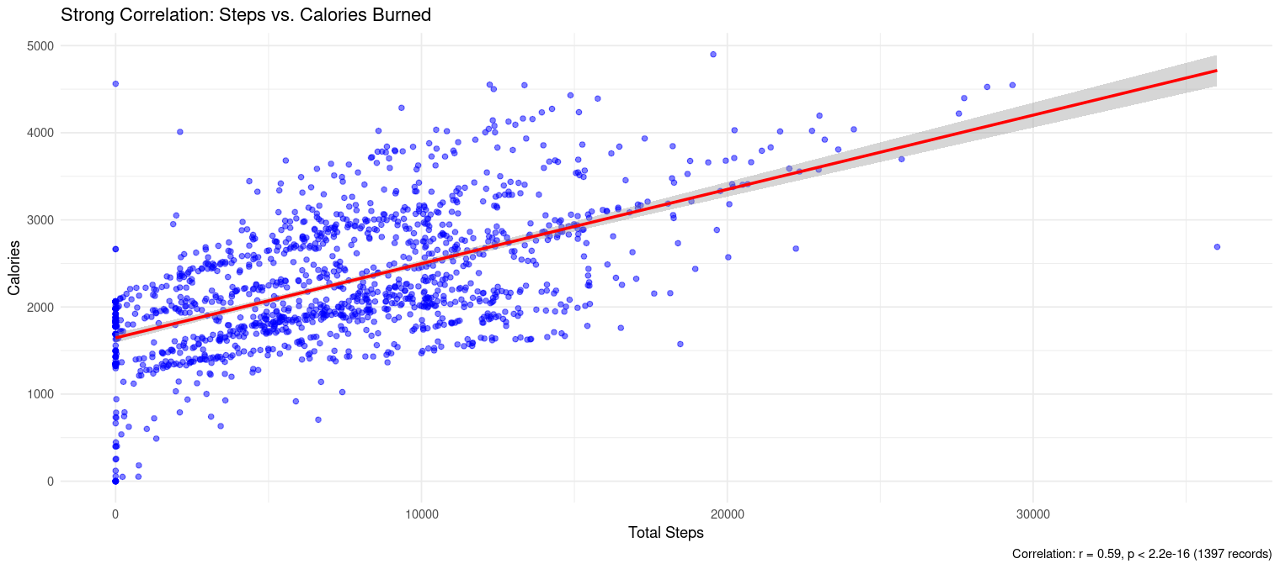
Key Findings
Users focused on fitness aspects

Slide 5
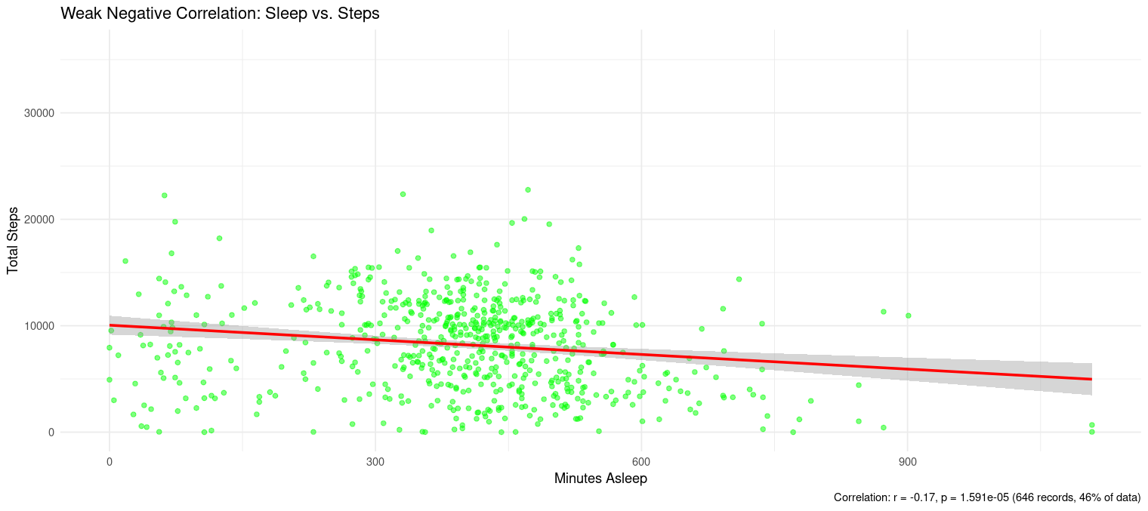
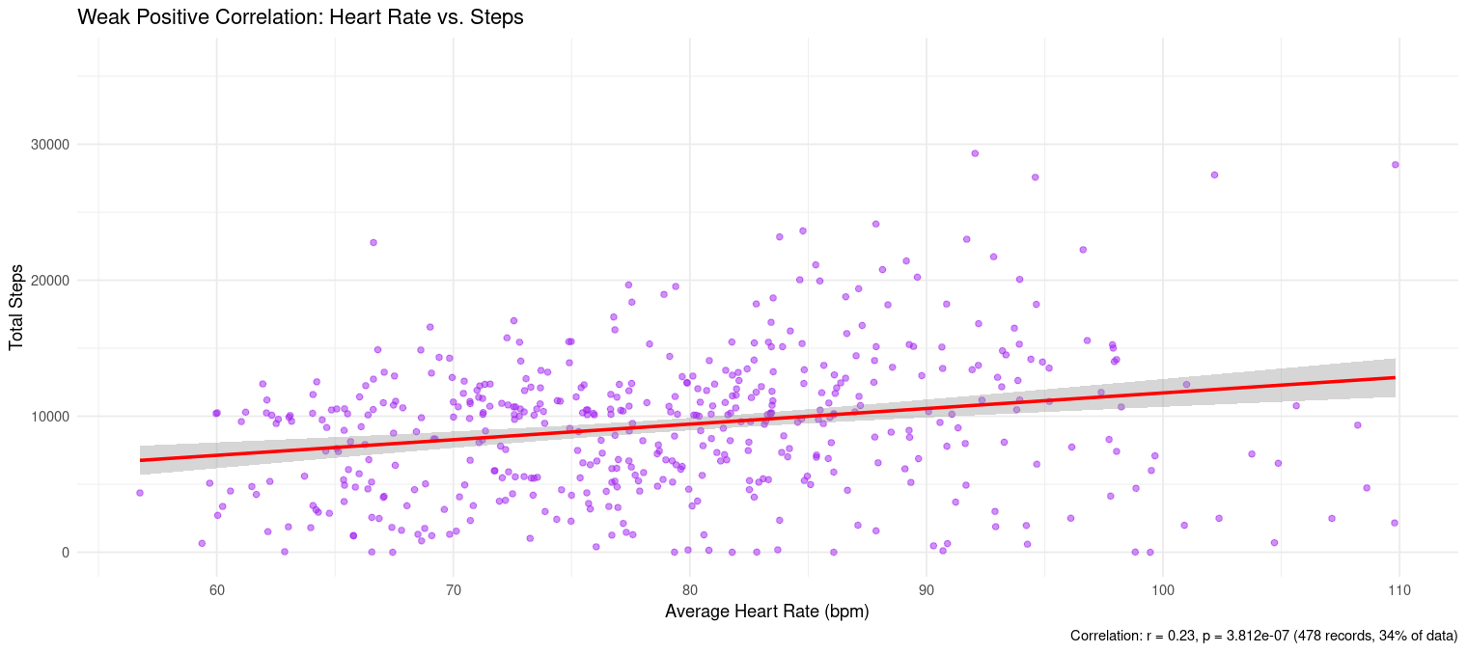
Key Findings
Weak sleep-steps and heart rate-steps correlations.

Slide 6
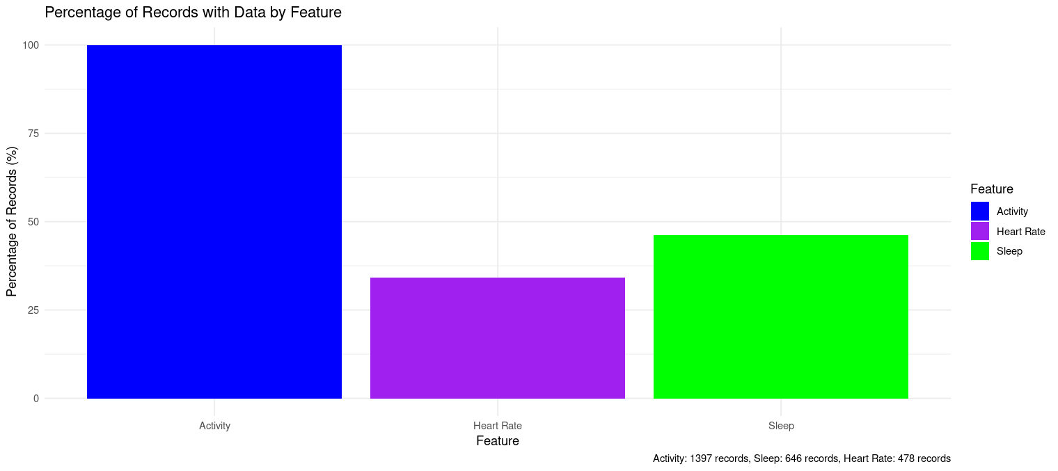
Key Findings
Usage: 100% activity, 46% sleep, 34% heart rate records.

Slide 7
Recommendations
Market Leaf for fitness: “Track steps and calories.”
Promote sleep tracking: “Discover better rest.”
Target heart rate as premium: “Monitor fitness/stress.”
Address usage barriers: (versatile design, app prompts).
Use digital marketing: (Instagram, YouTube, Google).
Collect female-specific data.

Slide 8
Conclusion
Leaf’s features align with user trends.
Targeted marketing can drive growth.

