Slide 1

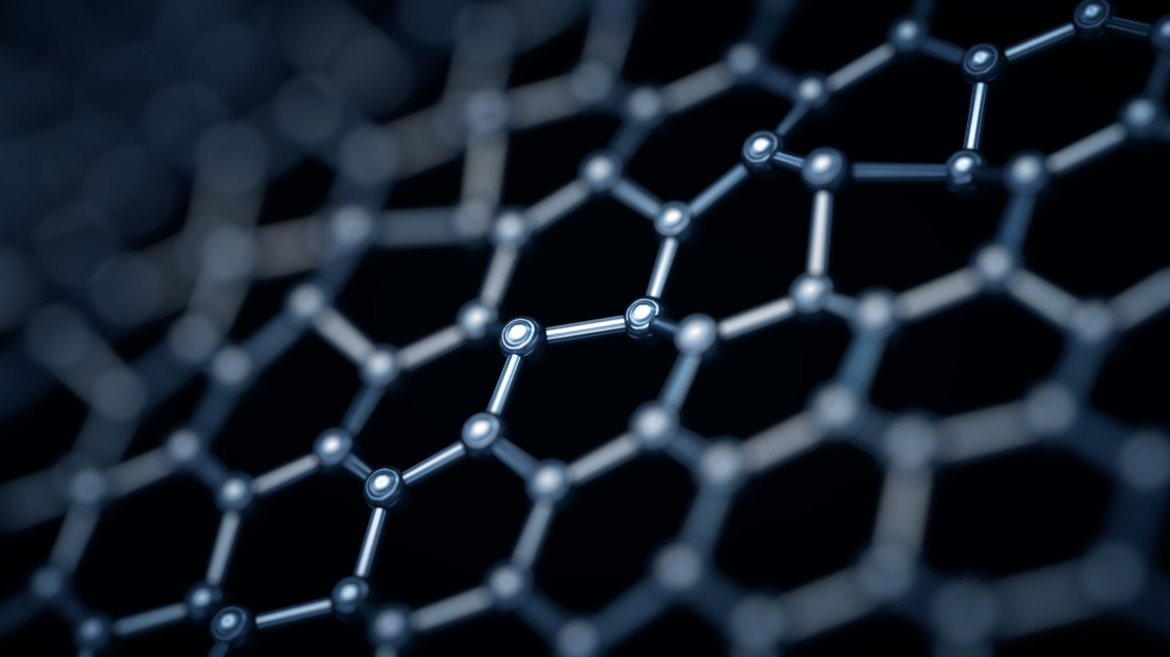
Mass Segmentation for Digital Mammography. A Deep Learning approach
DIGITAL HEALTH AND BIOINFORMATIC ENGINEERING
MEDICAL IMAGING MODULE 2019-2020
Group Members
Alessandro Montefusco
Antonio La Femina
Antonio Nappi

Slide 2
Index
Introduction
The Inbreast dataset
Dataset Preprocessing
SVM Classification
Data Preprocessing
U-Net Detection
Segmentation Process
Results
Conclusion

Slide 3
Introduction

Slide 4
Inbreast Dataset
INbreast dataset has images from screening, diagnostic, and follow-up cases.
The INbreast dataset is organized in four directories:
images: contains all the images explained before;
masks: contains the masks of all the 410 images;
groundtruth: contains the groundtruth of all the 107masses;
overlay: contains the annotations of the masses presentin patient affected by cancer.

