Slide 1
Gammapy: a science tool prototype for CTA
Roberta
http://gammapy.org/cta.html

Slide 2
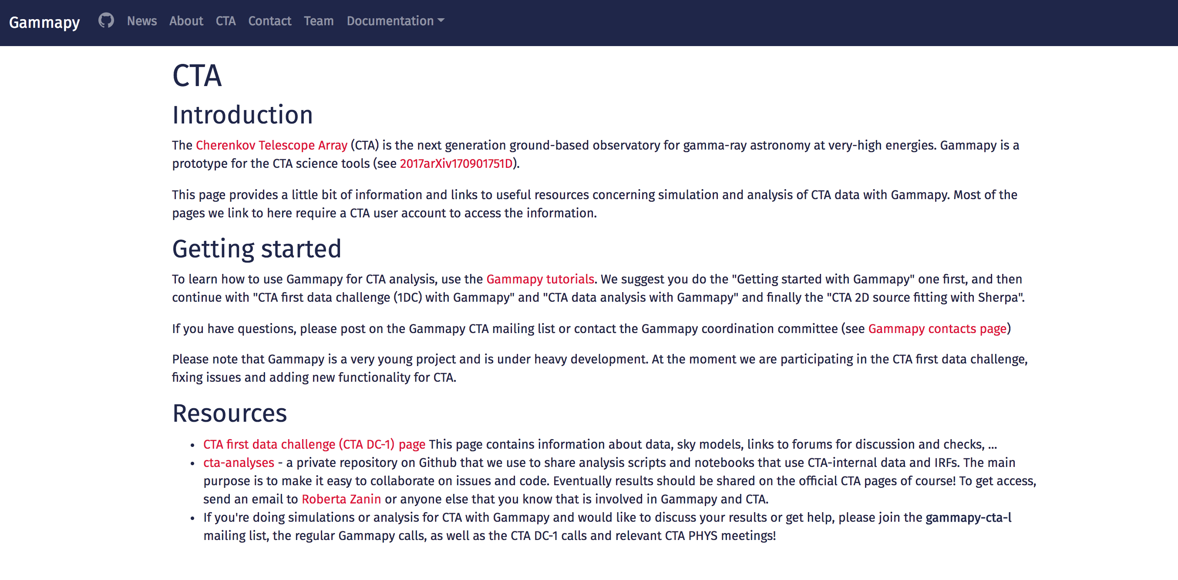
Gammapy & CTA
mailing list never used!: gammapy-cta-l@in2p3.fr

Slide 3
Data
Prod3b IRFs (now publicly available) (Karl’s talk in a while)
DC1 data
New set of AGN in wobble mode
DL3 data format (Christoph’s talk in a while)
Notes:
Gammapy is structured as a series of sub packages. Each sub-package has its documentation

Slide 4
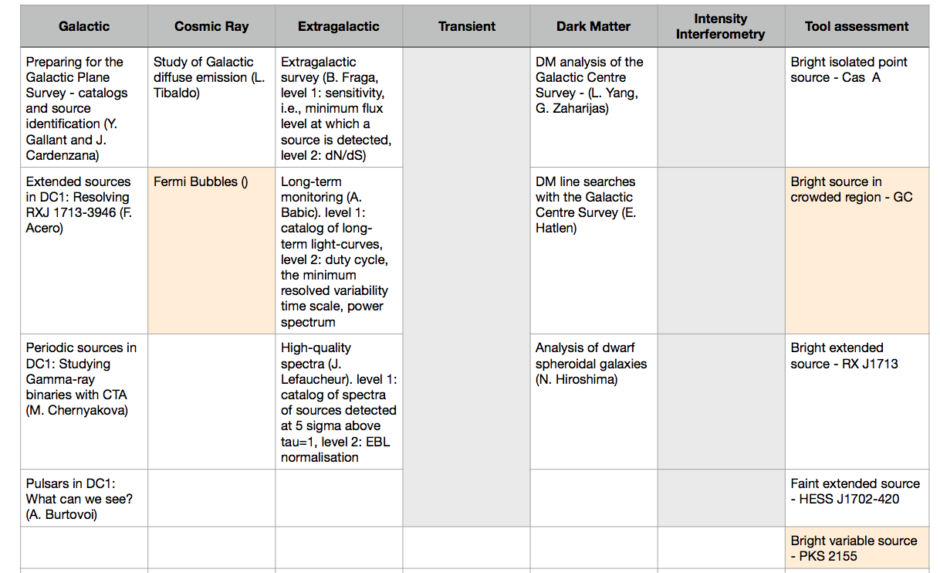
Ongoing activities
Analysis of DC1 data
Results for the closing out document
Science WGs
Assessment of tool capabilities and limitations
https://forge.in2p3.fr/projects/data-challenge-1-dc-1/wiki/Current_capabilities_and_limitations_of_the_analysis_tools
Preparation of analysis pipelines for catalogs
Preparation of new models for the Galactic sky
Notes:
Gammapy is structured as a series of sub packages. Each sub-package has its documentation

Slide 5
DC1: required results
Goal | Object | motivation | analyzer
Tools | RXJ 1713 | Bright extended | Fabio
Galactic | W28 | Extended, template | Andrea Giuliani
Tools | Cas A | Weak point-like | Emma
Tools | HESS J1702 | Weak mildly extended | Roberta
Tools | GC | Caotic region | Giovanni De Cesare
Tools | TeV 1224+212 | Variable, point-like | Julien
Galactic | LS 5039 | Lightcurve | Lab
Galactic | Pulsars |  | ?
Galactic | GPS | catalog | Yves
CR | Wd1 |  | -
CR | Diffuse | diffuse emission | -
Extragal |  | catalog | Julien
DM | Lines |  | -
Notes:
API = Application programming interface = set of subroutine definitions and tools
These are the datasets for tutorials

Slide 6
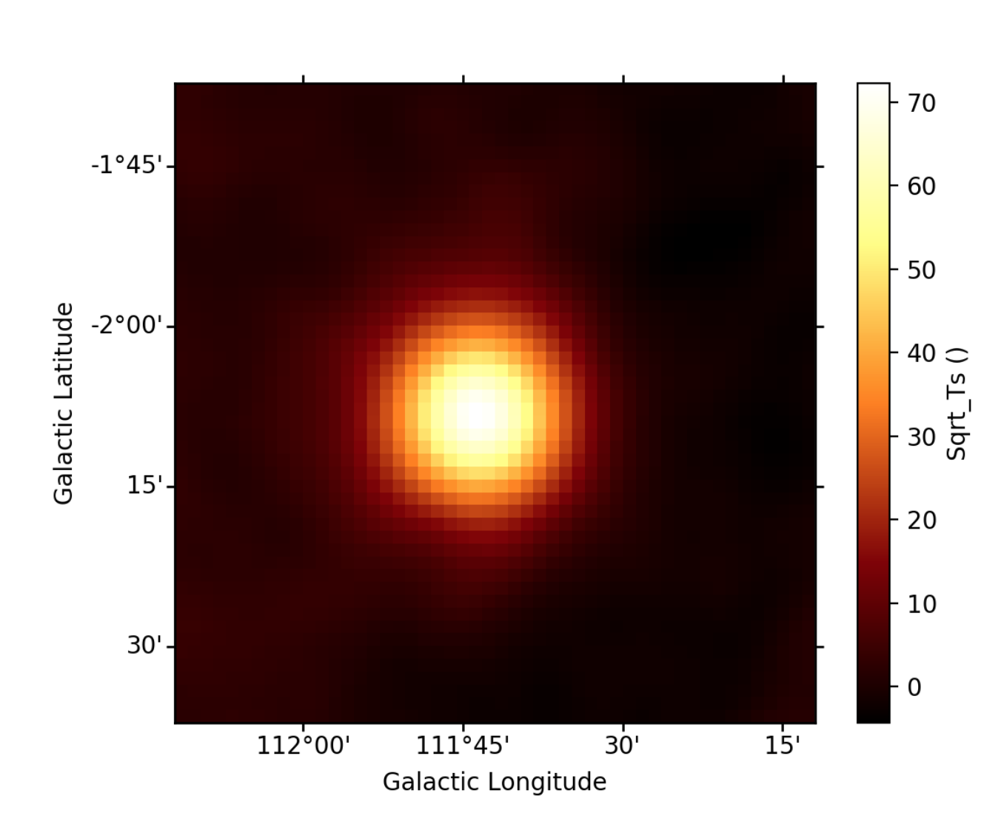
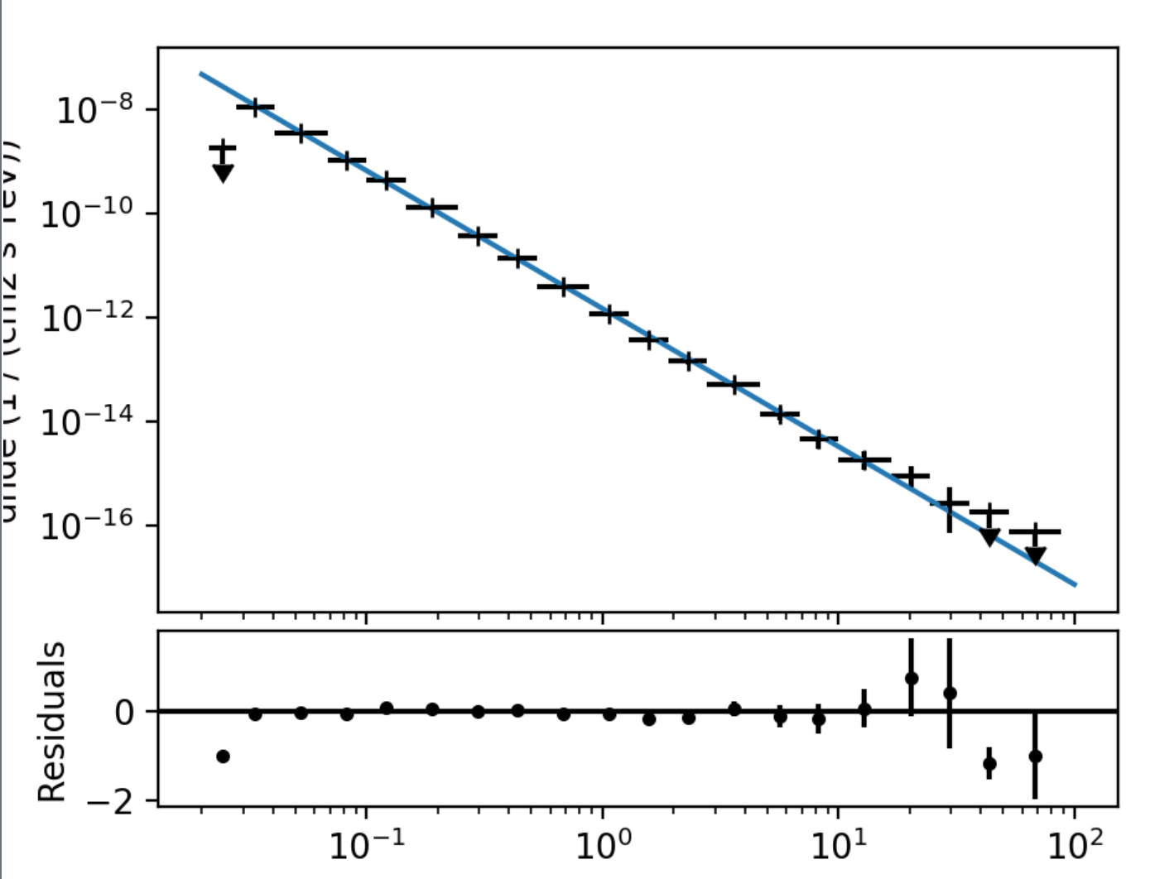
DC1: required results
1D + 2D analysis
3D is strongly recommended. Feasible? Let’s see the progresses of this week.
Not needed all the analyses required by the Science WGs
Notes:
API = Application programming interface = set of subroutine definitions and tools
These are the datasets for tutorials

Slide 7
Deadlines
External deadlines:
First preliminary results by mid of March 2018
Final results for April meeting in Barcelona (18-20 April)
Closing-out document to be delivered at Paris CM (14-18 May)
Internal (gammapy-team) deadlines:
Result status report at 2018-02-16 call (5-10’) https://github.com/gammapy/gammapy-meetings/tree/master/2018-02-16
Post results by end of February here: https://github.com/gammasky/cta-analyses
Notes:
API = Application programming interface = set of subroutine definitions and tools
These are the datasets for tutorials

Slide 8
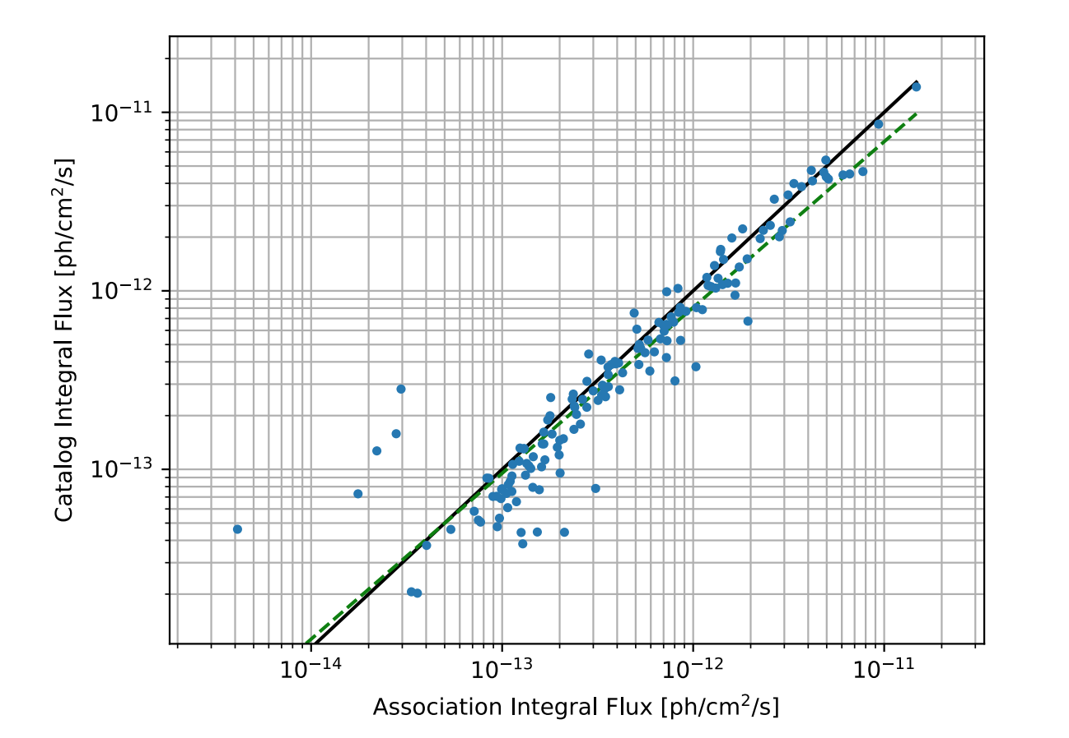
GPS pipelines
Pipelines are working (see Yves’s talks, latest: https://indico.cta-observatory.org/event/1731/contributions/15208/attachments/12900/15287/20180201_SurveyPipelineUpdate_DC1.pdf)
Comparison tool exists
TODO:
Study missed associations
Effect of diffuse
Understanding outliners
General framework for pipeline including AGNs (this week?)
Notes:
API = Application programming interface = set of subroutine definitions and tools
These are the datasets for tutorials

