Slide 1
Documentation
Roberta

Slide 2
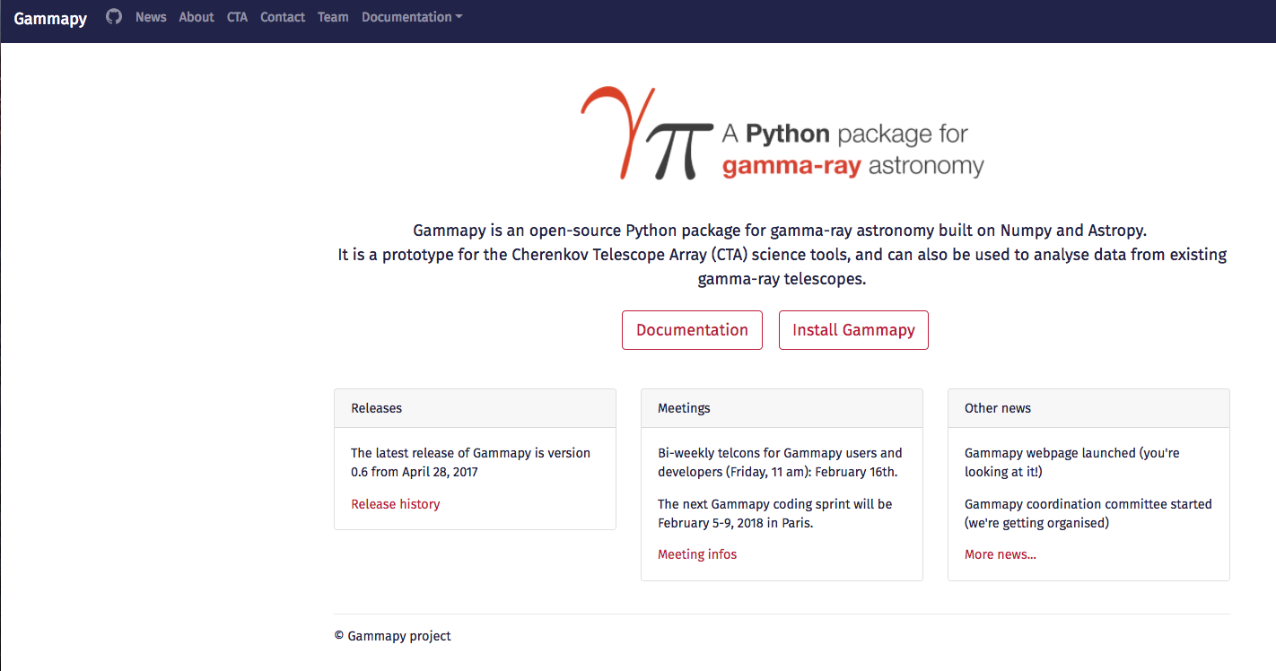
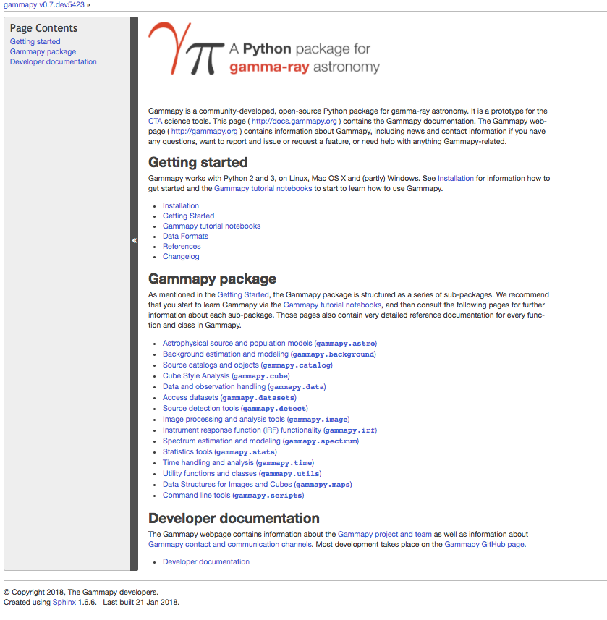
Where to find it?
1
www.gammapy.org
http://docs.gammapy.org/dev/
Notes:
When you press the documentation button this redirect you to the documentation page built in
Gammapy is structured as a series of sub packages. Each sub-package has its documentation

Slide 3
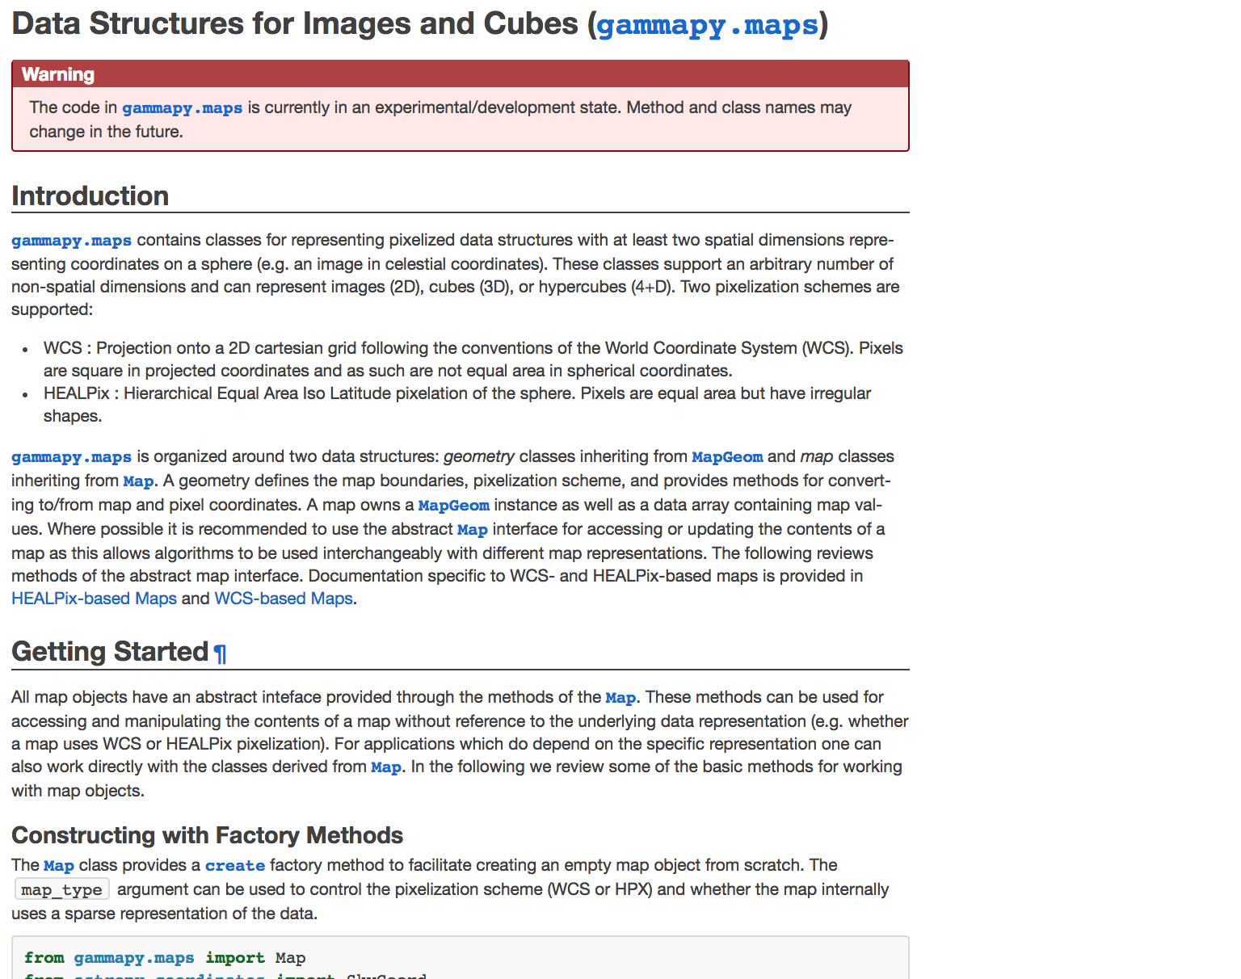
What is available?
2
Sub-package documentation:
Introduction
Getting started
Examples
API documentation
Notebook tutorials
few dataset in gammapy-extra:
HESS public release (see Christoph’s talk) https://github.com/gammasky/HESS-DL3-DR1/tree/master/release_store
CTA DC1 (see my previous talk) https://github.com/gammapy/gammapy-extra/tree/master/datasets/cta-1dc
3FHL Fermi LAT https://github.com/gammapy/gammapy-fermi-lat-data/tree/master/3fhl
All to be run with binder?
Gamma-cat?
Notes:
API = Application programming interface = set of subroutine definitions and tools
These are the datasets for tutorials

Slide 4
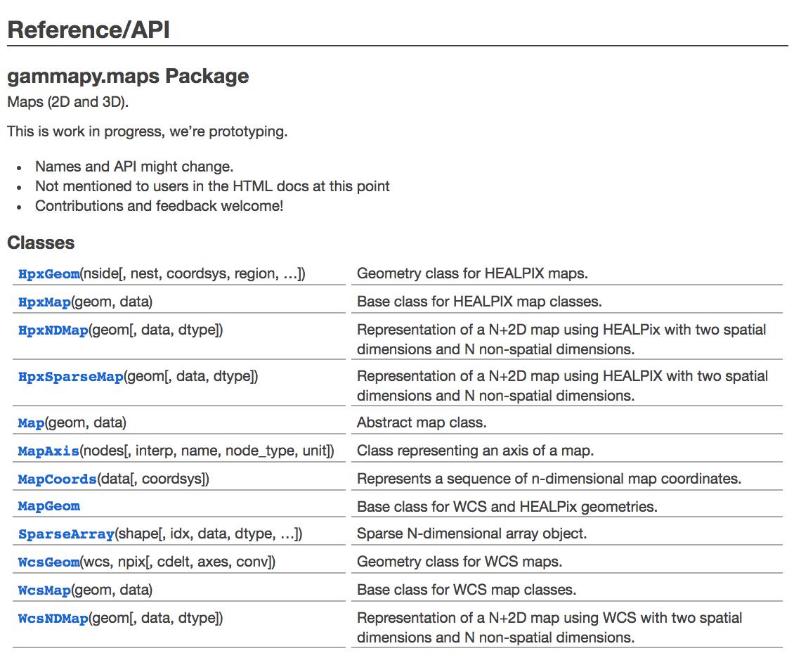
What is available?
2
Sub-package documentation:
Introduction
Getting started
Examples
API documentation
Notebook tutorials
few dataset in gammapy-extra:
HESS public release (see Christoph’s talk) https://github.com/gammasky/HESS-DL3-DR1/tree/master/release_store
CTA DC1 (see my previous talk) https://github.com/gammapy/gammapy-extra/tree/master/datasets/cta-1dc
3FHL Fermi LAT https://github.com/gammapy/gammapy-fermi-lat-data/tree/master/3fhl
All to be run with binder?
Gamma-cat?
Notes:
API = Application programming interface = set of subroutine definitions and tools
These are the datasets for tutorials

Slide 5
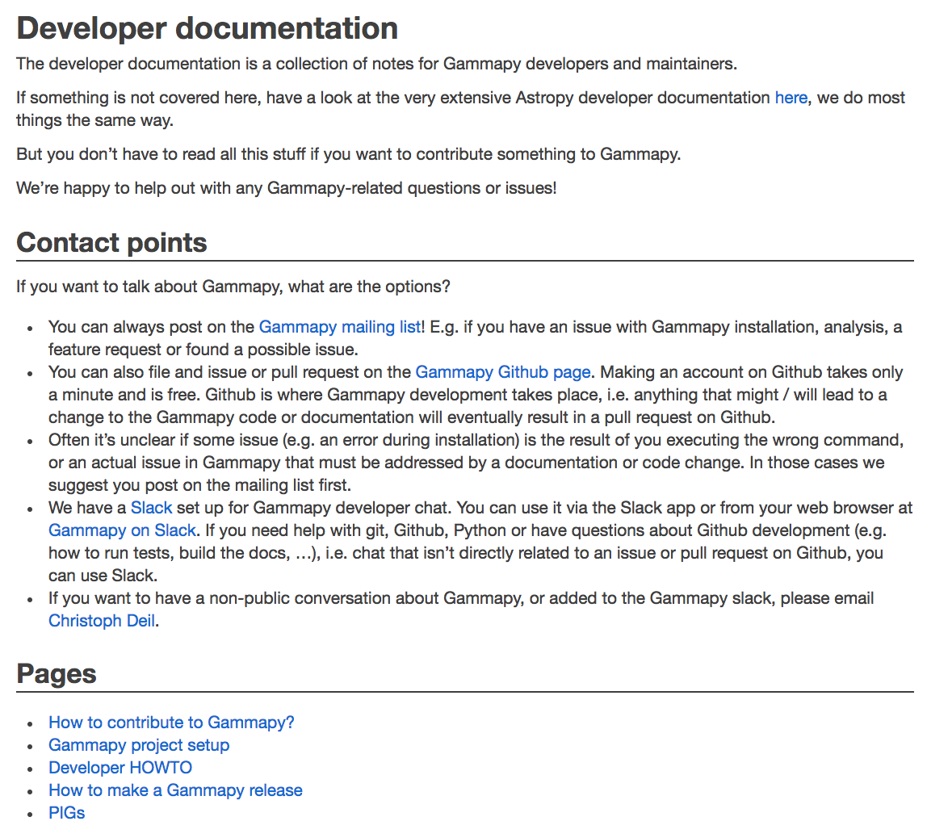
What is available?
2
Sub-package documentation:
Introduction
Getting started
Examples
API documentation
Developer documentation
Notebook tutorials
few datasets in gammapy-extra:
HESS public release (see Christoph’s talk) https://github.com/gammasky/HESS-DL3-DR1/tree/master/release_store
CTA DC1 (see my previous talk) https://github.com/gammapy/gammapy-extra/tree/master/datasets/cta-1dc
3FHL Fermi LAT https://github.com/gammapy/gammapy-fermi-lat-data/tree/master/3fhl
All to be run with binder?
Gamma-cat?
Notes:
API = Application programming interface = set of subroutine definitions and tools
These are the datasets for tutorials

Slide 6
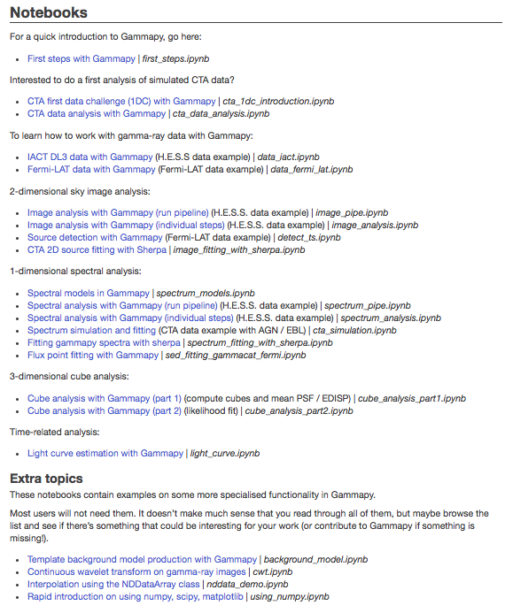
What is available?
2
Sub-package documentation:
Introduction
Getting started
Examples
API documentation
Developer documentation
Notebook tutorials
few datasets in gammapy-extra:
HESS public release (see Christoph’s talk) https://github.com/gammasky/HESS-DL3-DR1/tree/master/release_store
CTA DC1 (see my previous talk) https://github.com/gammapy/gammapy-extra/tree/master/datasets/cta-1dc
3FHL Fermi LAT https://github.com/gammapy/gammapy-fermi-lat-data/tree/master/3fhl
All to be run with binder?
Gamma-cat?
Notes:
API = Application programming interface = set of subroutine definitions and tools
These are the datasets for tutorials

Slide 7
Reorganization
3
Global reorganization needed
Many duplications
Often not reader friendly
1.5 h this week to design it and appointing responsible people
mid-term project
Sub tasks
General design for the documentation
Installation button and instruction
How to organize the “getting started”?
Polishing/updating the sub-package docs
Polishing/updating the notebooks
Polishing/updating the developer docs
Notebooks in binder?

