Slide 1

Football Shot Classifier
Antonio Inveninato Aplicaciones iot 23/24
Angelo cocuzza

Slide 2
index
Football shot classification problem
Hardware
Dataset
Neural Network 1D

Slide 3
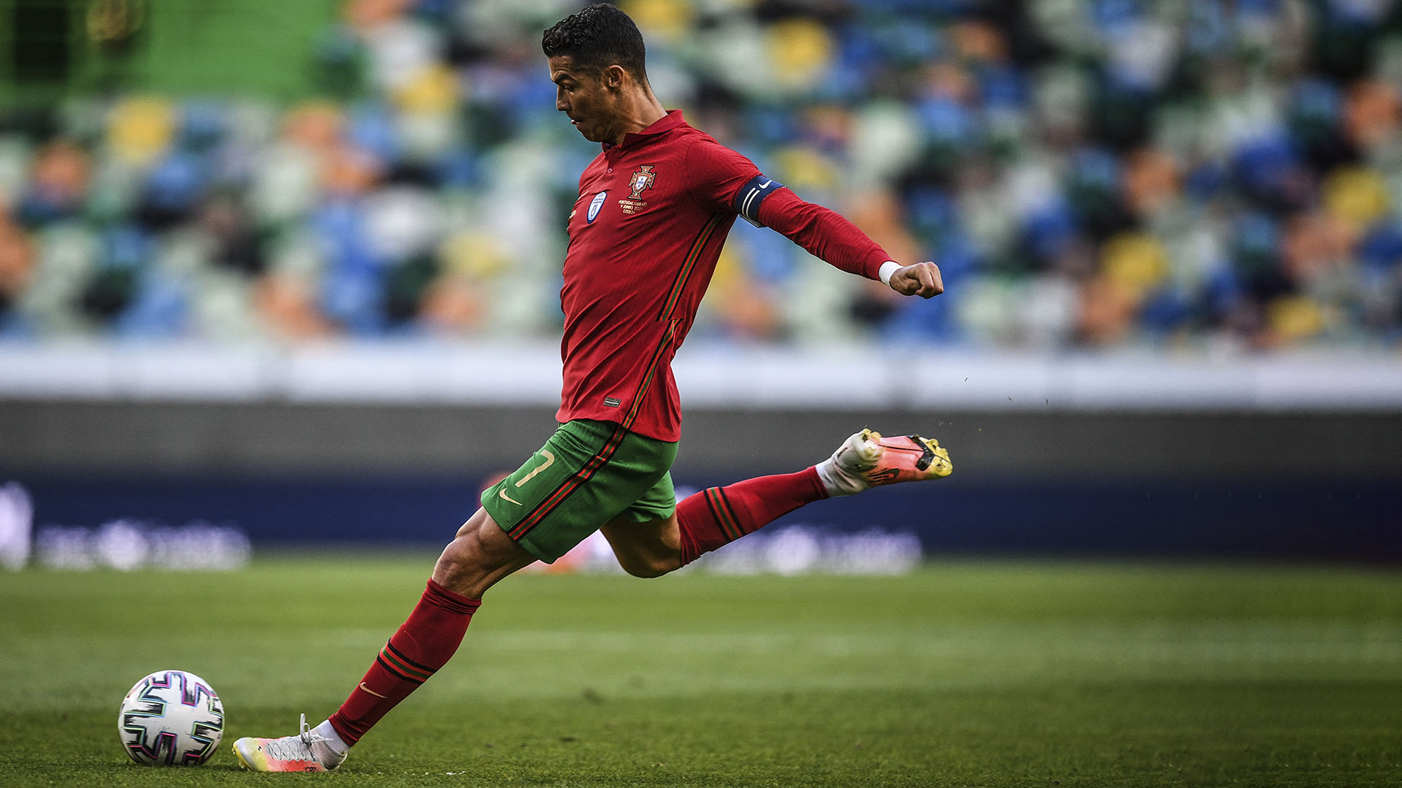
Problem
Football shot classification problem
Target:
We want to use angular velocity and acceleration data to classify the different types of shots in football

Slide 4
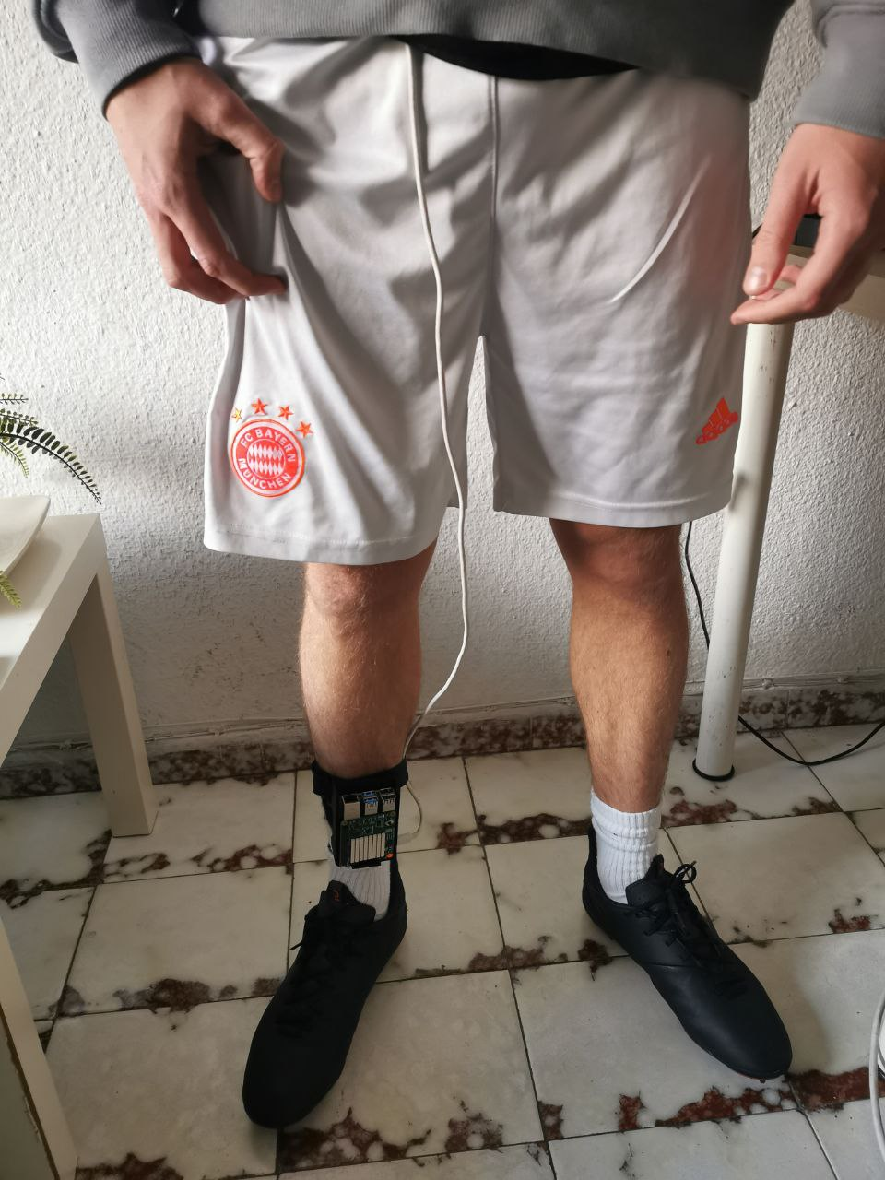
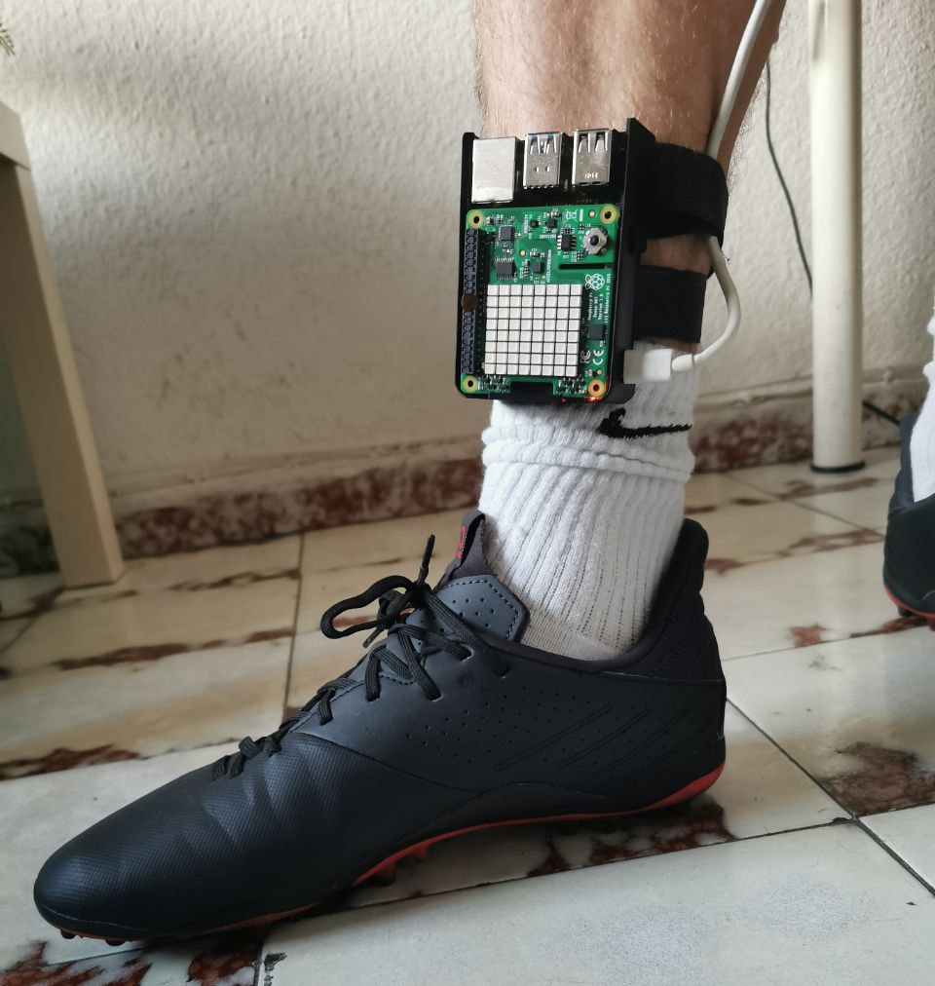
hardware
We use a Raspberry pi 4 + Sense Hat (includes acceleration and gyro sensors). Power is supplied via PowerBank.

Slide 5
DATaset
Dataset:
User ID | Sex | Foot | Age
1 | M | Dx | 23
2 | M | Dx | 24
3 | F | Dx | 21
4 | M | Dx | 22
5 | M | Dx | 23
Types of football shot:
Backheel
Laces shot
Toe shot
Volley shot
Scorpion shot

Slide 6
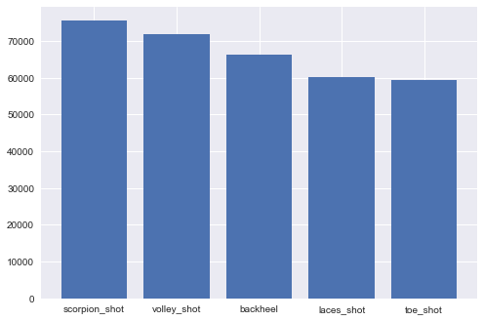
dataset
Amount of data for each shot:
n. data
type of shot

Slide 7
Dataset
Dataset file:
football_dat.txt
We have 333360 rows and 12 columns.
1200 rows correspond to a time window in which the shooting activity took place.
12 columns: 4 columns with players’ data, 1 column with activity, 1 column with timestamp, 6 columns with acceleration and angular velocity data.

Slide 8
Neural Network 1d
Data Loading: Data from a CSV file is loaded into a Pandas DataFrame.
Data Preprocessing: Data cleaning and preparation operations are performed.
Data visualization: displays the distribution of activities in the dataset and creates graphs to show the acceleration and gyroscope data for each activity.

Slide 9
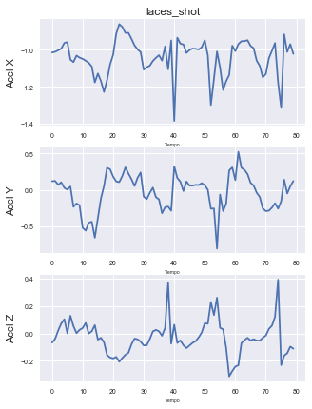
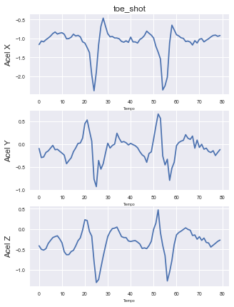
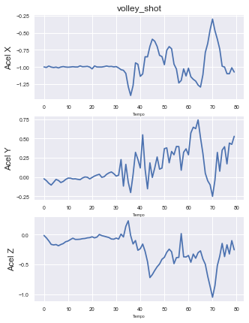
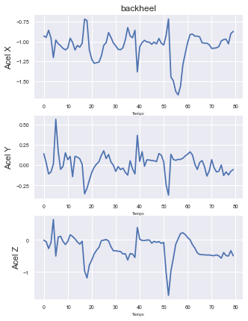
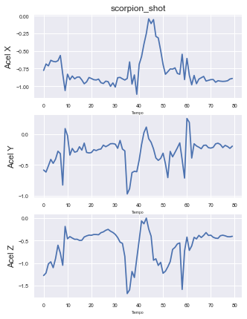
Neural Network 1d
Acceleration:

Slide 10
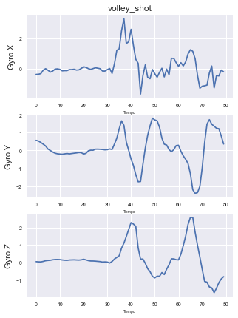
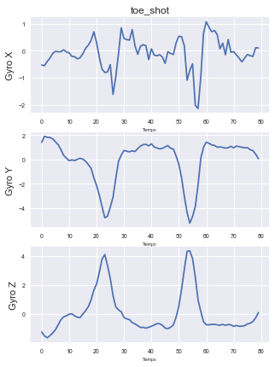
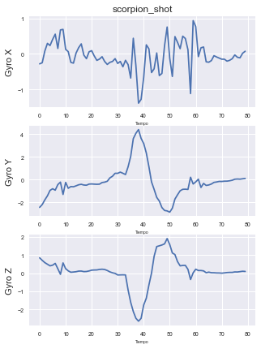
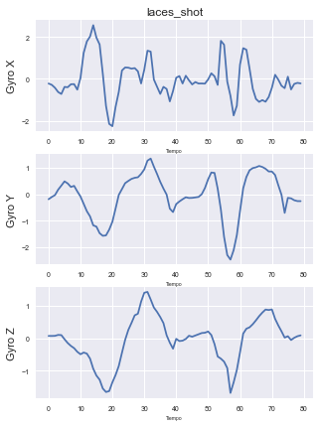
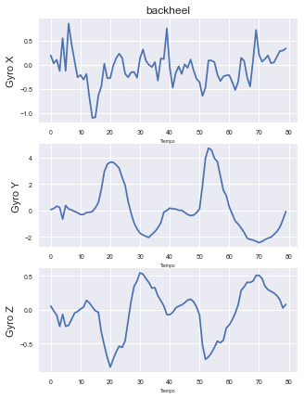
Neural Network 1d
Angular velocity:

Slide 11
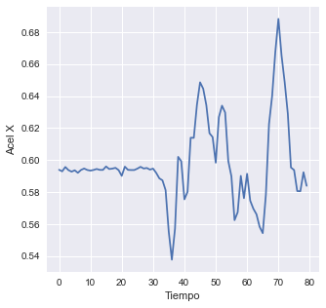
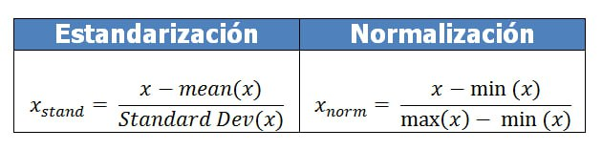
Neural Network 1d
Data normalization: for each column of interest (e.g. 'x-axis'), the minimum column value is subtracted from each value, and the result is divided by the difference between the maximum and minimum column value. This normalization process ensures that all values fall within the range [0, 1].

Slide 12


Neural Network 1d
Data division: data sequences and their labels are created for training and testing. The labels are also converted into one-hot encoding format.

Slide 13
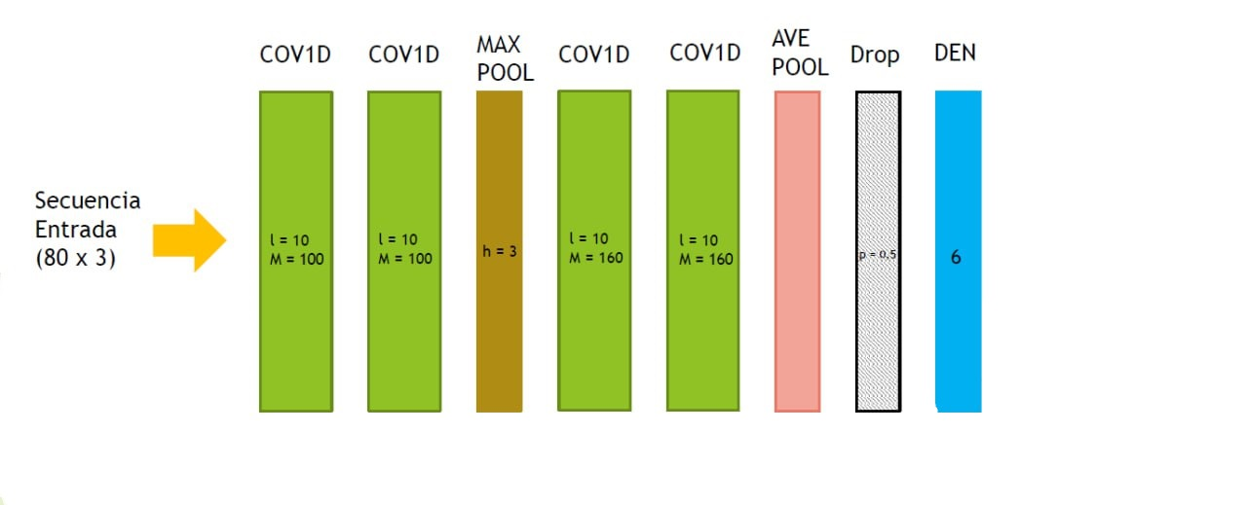
Neural Network 1d
Neural network definition: A convolutional neural network (CNN) with Conv1D and Dense layers is used. The network is designed to learn relevant features from time sequences of acceleration and gyroscope data.
Football
shots
6
5

Slide 14
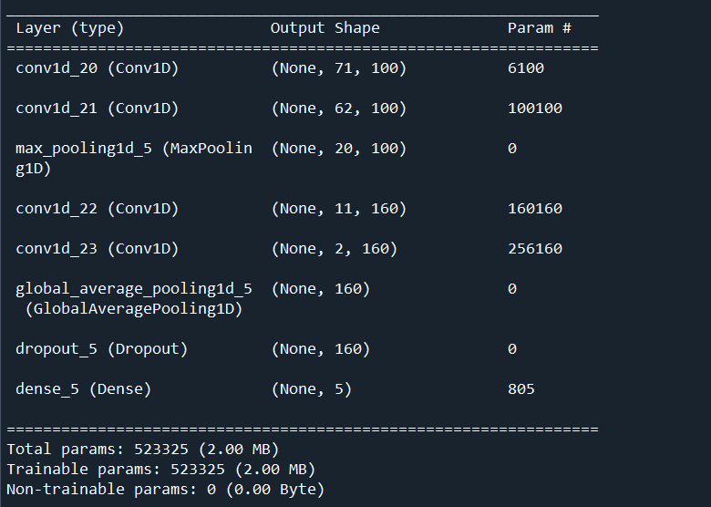
Neural Network 1d

Slide 15
Neural Network 1d
Training the model: The model is trained using the training data. The optimiser 'adam' and the loss function 'categorical_crossentropy' are used. ModelCheckpoint is also used to save the best model during training.
Evaluation of the model on test data: The trained model is evaluated using test data. Accuracy and loss metrics are displayed, and a confusion matrix is created to evaluate the model's performance in classifying physical activities.

Slide 16
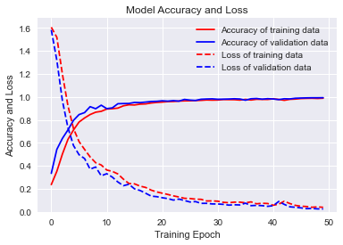

Neural Network 1d
Test results:

Slide 17
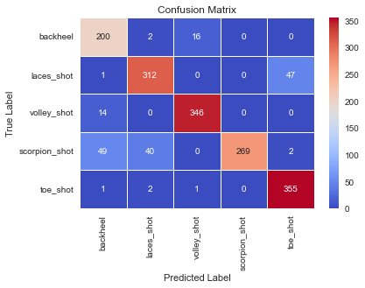
Neural Network 1d
Confusion Matrix:

Slide 18

Thank you any doubts?

