Slide 1


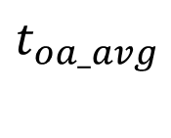









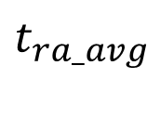


Building
i-th RTU
$$t_{ra_{i}}$$
$${\dot{Q}}_{ven}\text{≃0}$$
DX
$$t_{oa_{i}}$$
$$t_{ma_{i}},{\dot{m}}_{sa_{i}}$$
$$t_{sa_{i}},{\dot{m}}_{sa_{i}}$$
$${\dot{Q}}_{cool_{i}}$$
Aggregated zone
$${\dot{Q}}_{env}$$
$$t_{rhw},{\dot{m}}_{shv}$$
$$R_{ra}$$
HP
$$t_{oa_avg}$$
$$t_{ra_avg}$$
$${\dot{Q}}_{heat}$$
$$t_{shw},{\dot{m}}_{shv}$$
$${\dot{Q}}_{int}\text{≃0}$$
$${\dot{Q}}_{sol}\text{≃0}$$

Slide 2











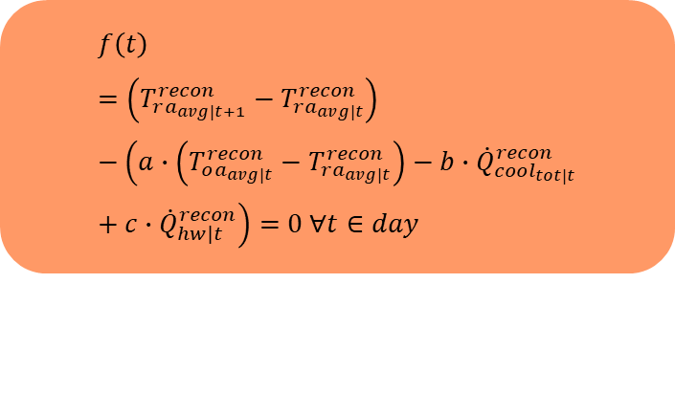

$$Multivariate_DAE_2(w,b)$$
$$Approximated ODE(a,b,c)$$
$$T_{ra_{avg}}^{corr}$$
$$T_{ra_{avg}}^{recon}$$
$$f\left(t\right)=\left(T_{ra_{avg|t+1}}^{recon}−T_{ra_{avg|t}}^{recon}\right)−\left(a∙\left(T_{oa_{avg|t}}^{recon}−T_{ra_{avg|t}}^{recon}\right)−b∙{\dot{Q}}_{cool_{tot|t}}^{recon}+c{∙\dot{Q}}_{hw|t}^{recon}\right)=0 ∀t∈day$$
$$T_{oa_{avg}}$$
$$T_{oa_{avg}}^{recon}$$
$$Encoder$$
$$Decoder$$
$${\dot{Q}}_{cool_{tot}}^{corr}$$
$${\dot{Q}}_{cool_{tot}}^{recon}$$
$${ \dot{Q}}_{hw}^{corr}$$
$${ \dot{Q}}_{hw}^{recon}$$
Loss

Slide 3
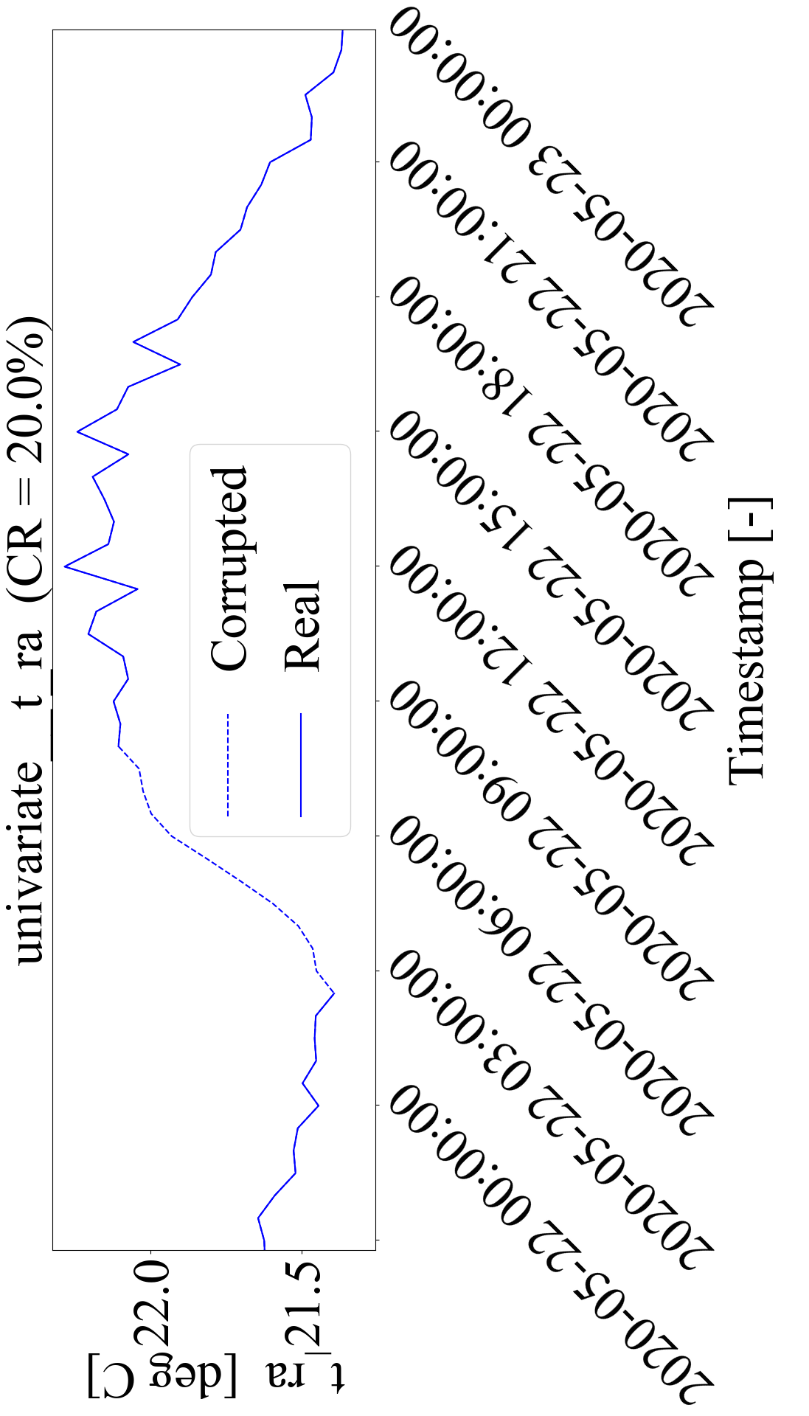
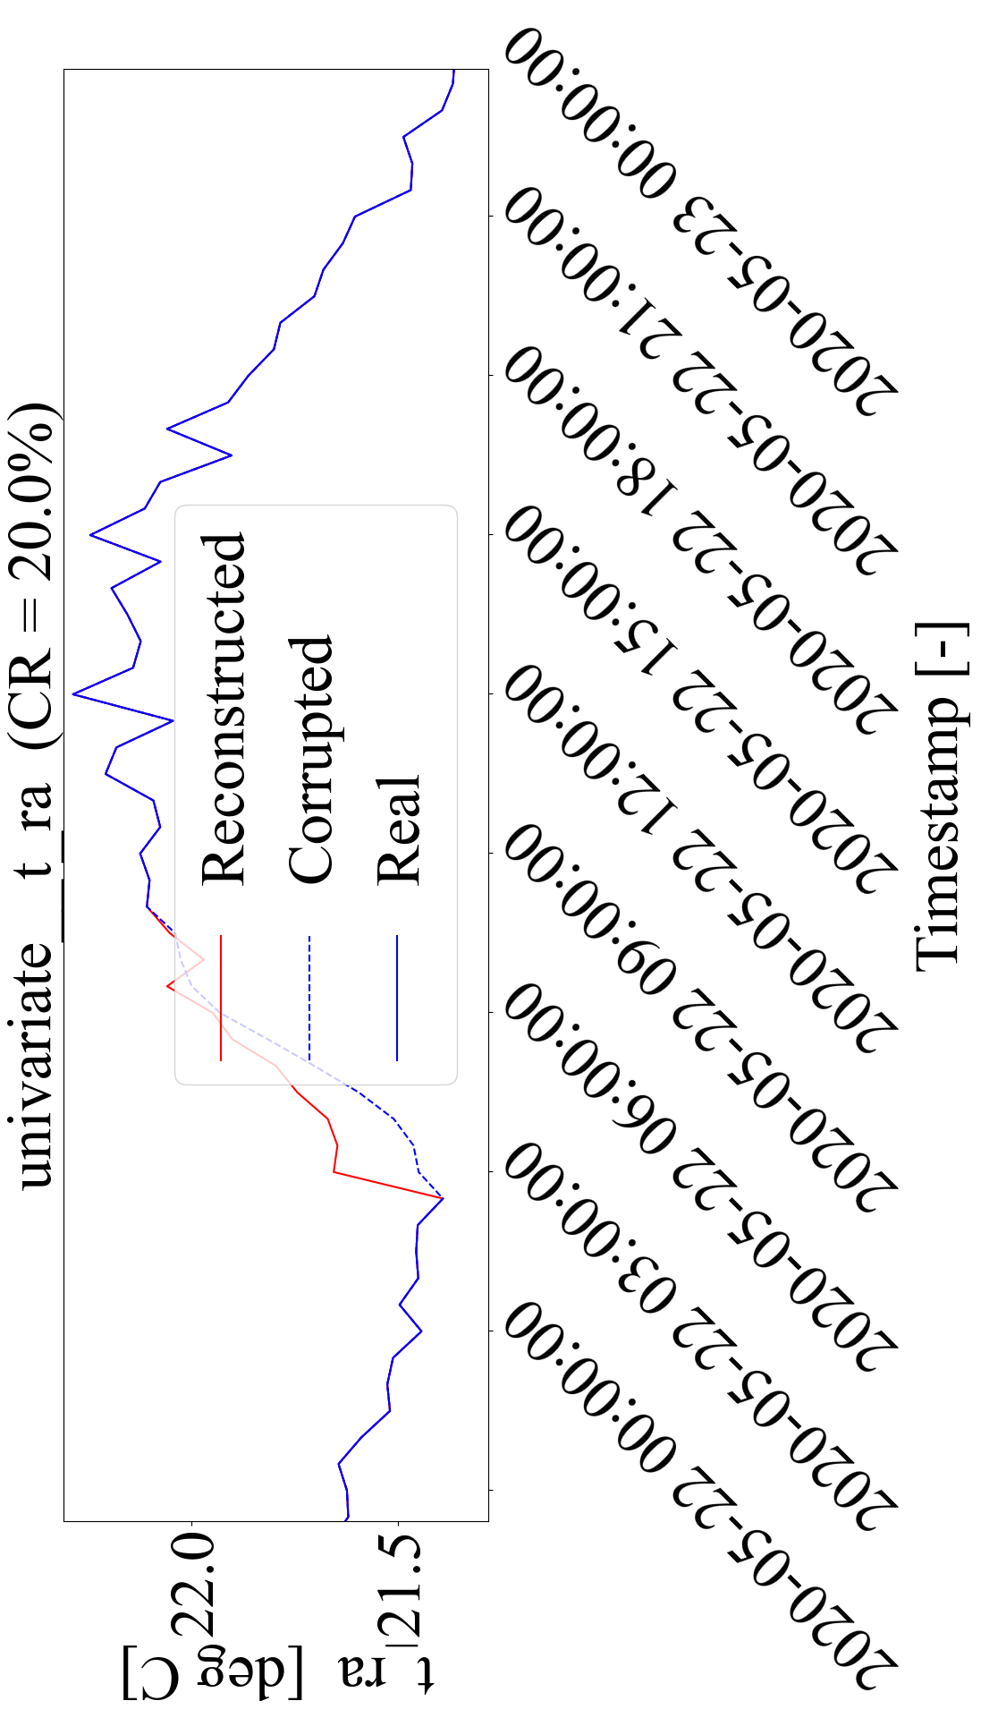
Encoder
Decoder

Slide 4
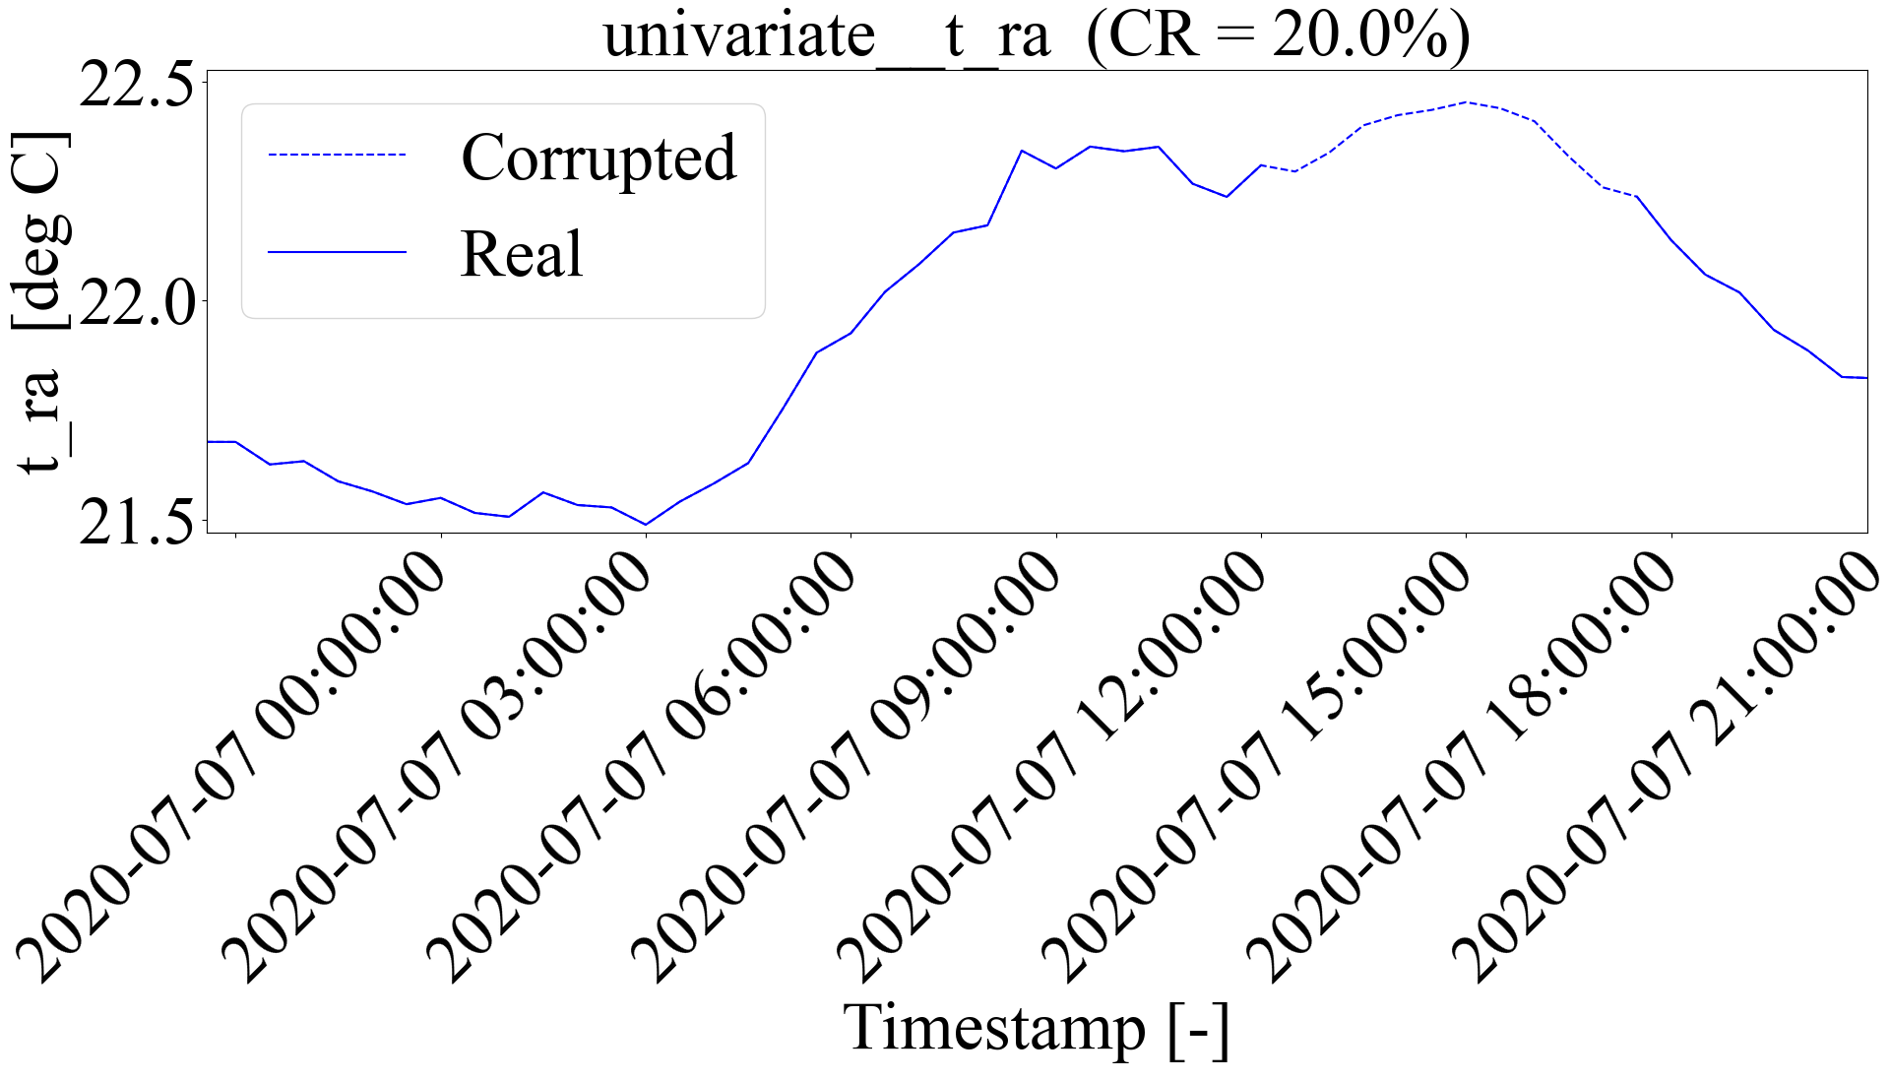
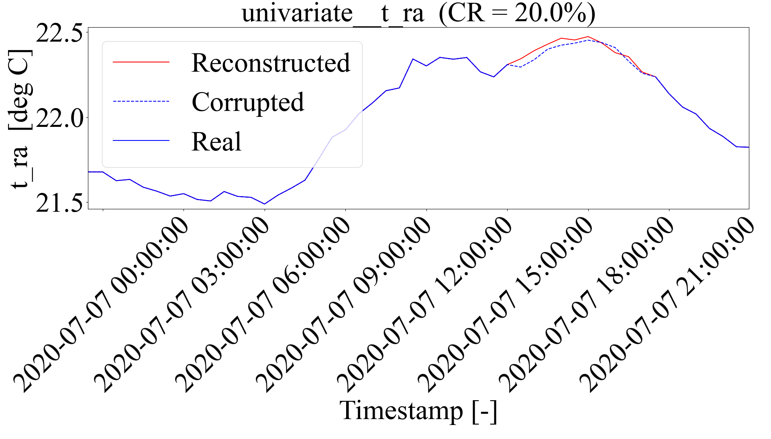
Encoder
Decoder

Slide 5
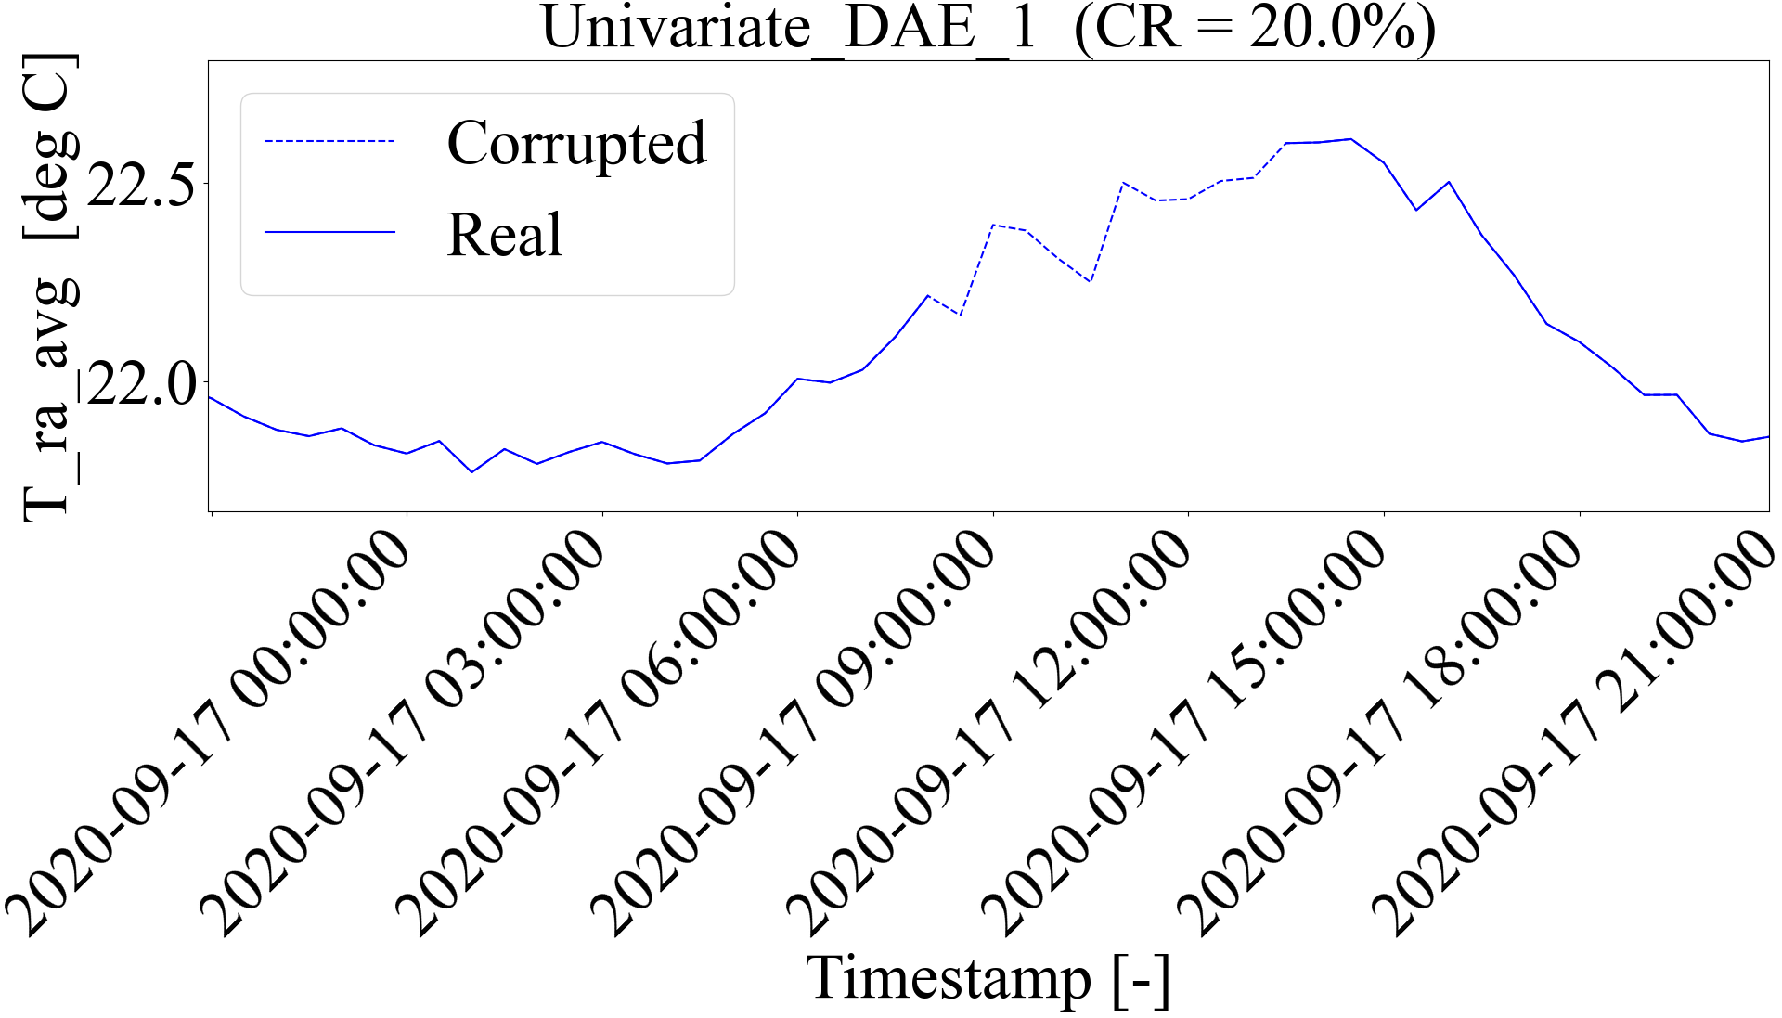
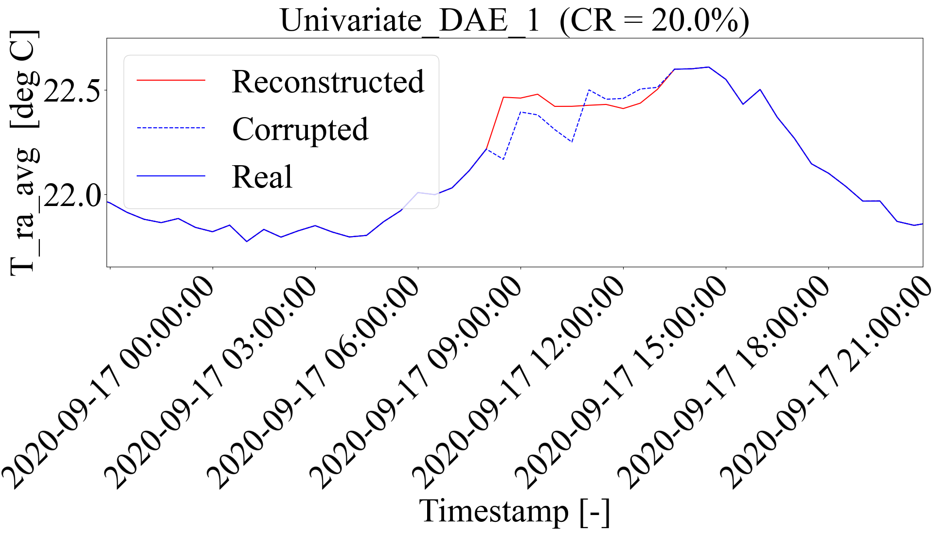
Encoder
Decoder

