Slide 1
Semantic web and linked data
Group 01
Antonio Hermose de Mingo
Jose Daniel Jimenez Delgado
Pablo Santamaría Cirac
Gonzalo Santamaría de Paredes
Alejandro Vizcaino Alemany

Slide 2
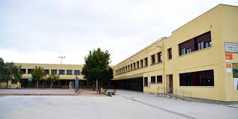
Introduction
Dataset osPublic Schools in Madrid
Composed over 240 schools and a lot of atributes

Slide 3
Assignment 1
Public Schools Madrid satisfy the requirements:
Selected smart city domains
Available as a CSV file
Dataset has an open license
Can be easily link with generic real-world entities (as District or Borough)

Slide 4
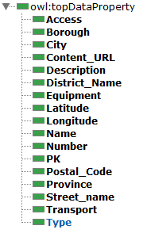


Assignmet 2
Propose Ontology
Naming strategy:
http://handsOn.org/Group1
http://handsOn.org/Group1#Resource

Slide 5
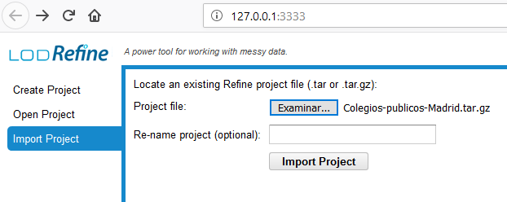
Assignment 3
1) Import Project
2) Fix data
Check for wrong characters
Check for misspelling mistakes

Slide 6
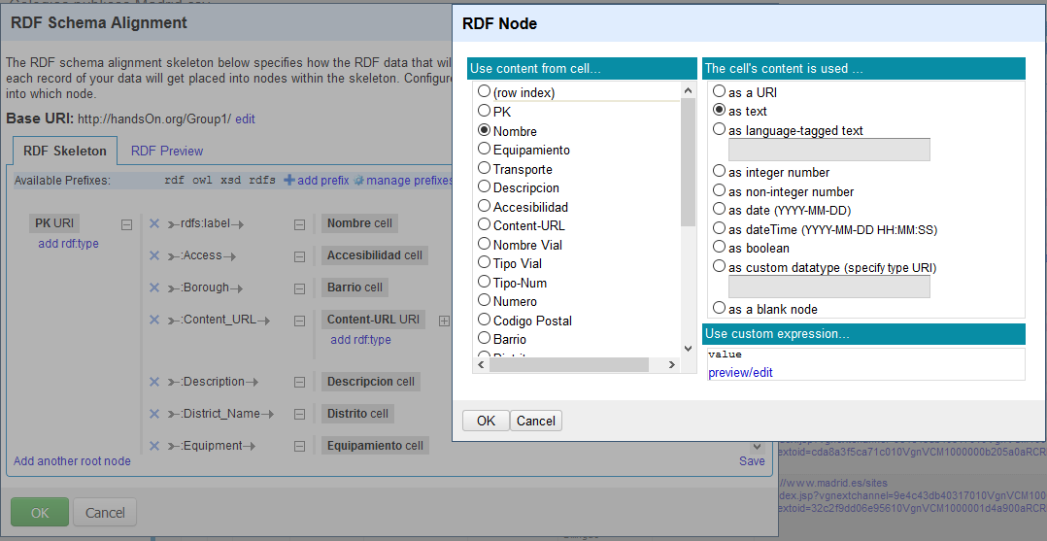
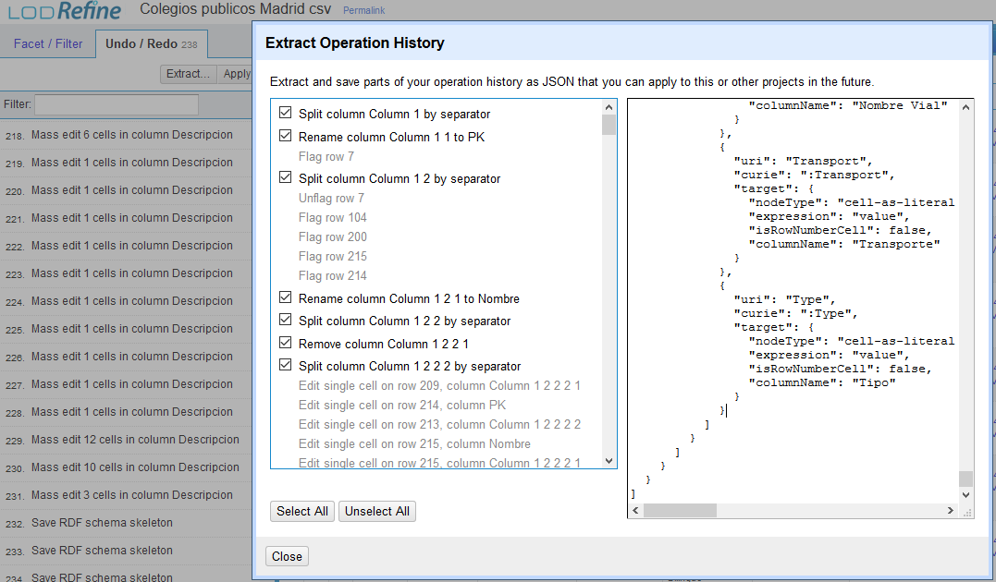
3) Create RDF
RDF -> Edit RDF skeleton…
Use ontology
4) Export JSON
Undo/Redo -> Extract…

Slide 7
Assignment 4
Data linking

Slide 8
Assignment 5
Update with existing ontologies

Slide 9
Conclussions
Wide project
Usefull real life applications

