Slide 1
Semantic web and linked data
Group 01
Antonio Hermose de Mingo
Jose Daniel Jimenez Delgado
Pablo Santamaría Cirac
Gonzalo Santamaría de Paredes
Alejandro Vizcaino Alemany

Slide 2
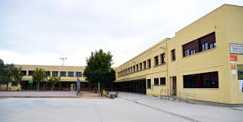
Assignment 1
Public Schools Madrid
Open Data License

Slide 3
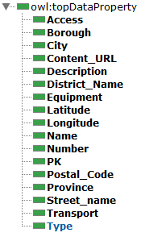


Assignmet 2
Propose Ontology
Naming strategy:
http://handsOn.org/Group1
http://handsOn.org/GroupResource

Slide 4
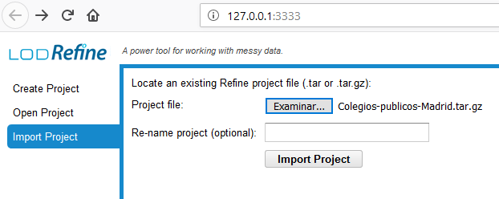
Assignment 3
1) Import Project
2) Fix data
Check for wrong characters
Check for misspelling mistakes

Slide 5
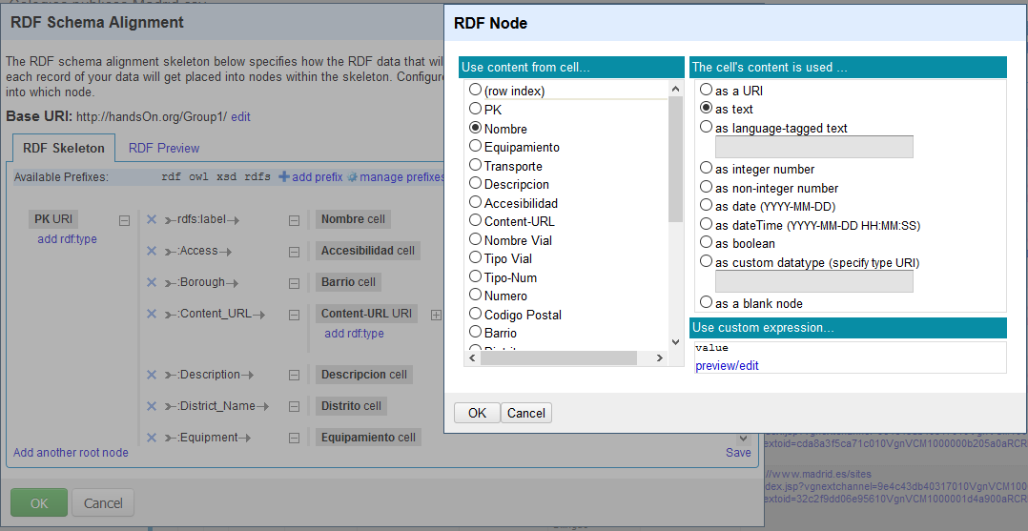
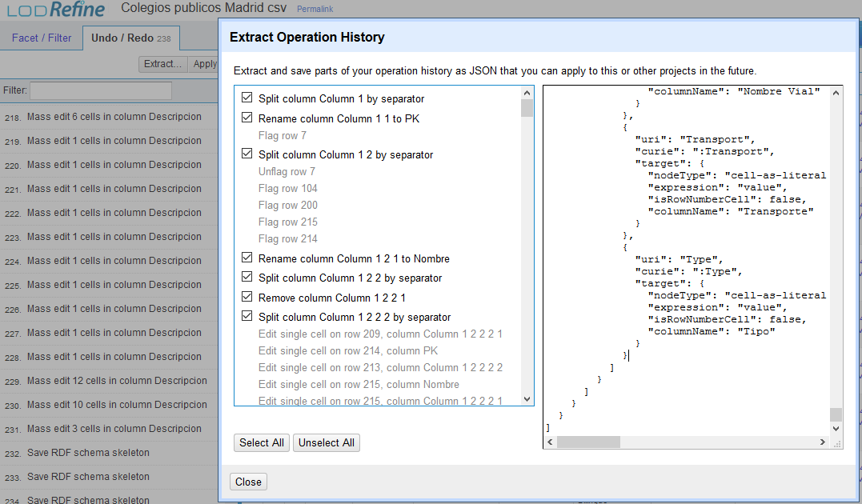
3) Create RDF
RDF -> Edit RDF skeleton…
Use ontology
4) Export JSON
Undo/Redo -> Extract…

Slide 6
Assignment 4
Data linking

Slide 7
Assignment 5
Update with existing ontologies

Slide 8
Conclussions
Wide project
Usefull real life applications

