Slide 1
Joint Detection of AI-Generated Images and Post-Processing Alterations in Real-World Scenarios
Giorgia Saolini - 1933076 & Antonio Agostini - 1995653
Computer Vision
Sapienza University of Rome

Slide 2
Outline
Problem Statement, Motivation & Research Question
Proposed Multi-Task Method
Dataset & Preparation Strategy
Experimental Setup & Evaluation Protocol
Unimodal-Baselines Comparison, Ablations & Results
Conclusions & Future Work

Slide 3
Problem Statement & State Of The Art
Problem Statement, Motivation & Research Question
Problem Statement
State Of The Art
AI-generated image detectors are evaluated on clean images.
Operations that introduce degradation patterns can hurt forensic detection.
Existing detectors often focus on authenticity under ideal conditions.
Real-world benchmarks highlight a gap between laboratory accuracy and practical robustness.
Joint Detection of AI-Generated Images and Post-Processing Alterations in Real-World Scenarios - Agostini Antonio, Giorgia Saolini

Slide 4

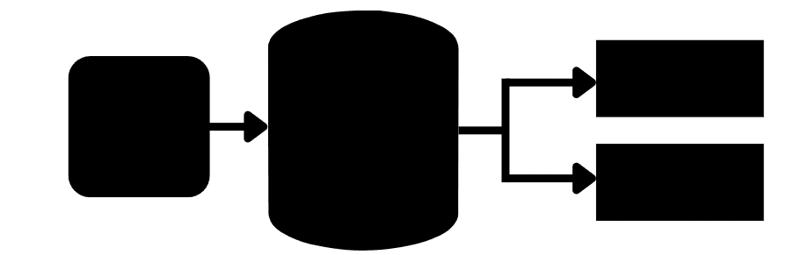
Project Goal & Research Question
Problem Statement, Motivation & Research Question
Project Goal
Research Question
Input: One single image
Target Outputs:
Real vs. AI-generated
Original vs. internet-transmitted vs. re-digitized
Can joint learning improve robustness compared to separate unimodal models?
Real / Fake
Input
Images
Proposed Method
Outputs
Transformations
Joint Detection of AI-Generated Images and Post-Processing Alterations in Real-World Scenarios - Agostini Antonio, Giorgia Saolini

Slide 5

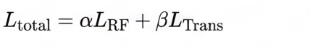
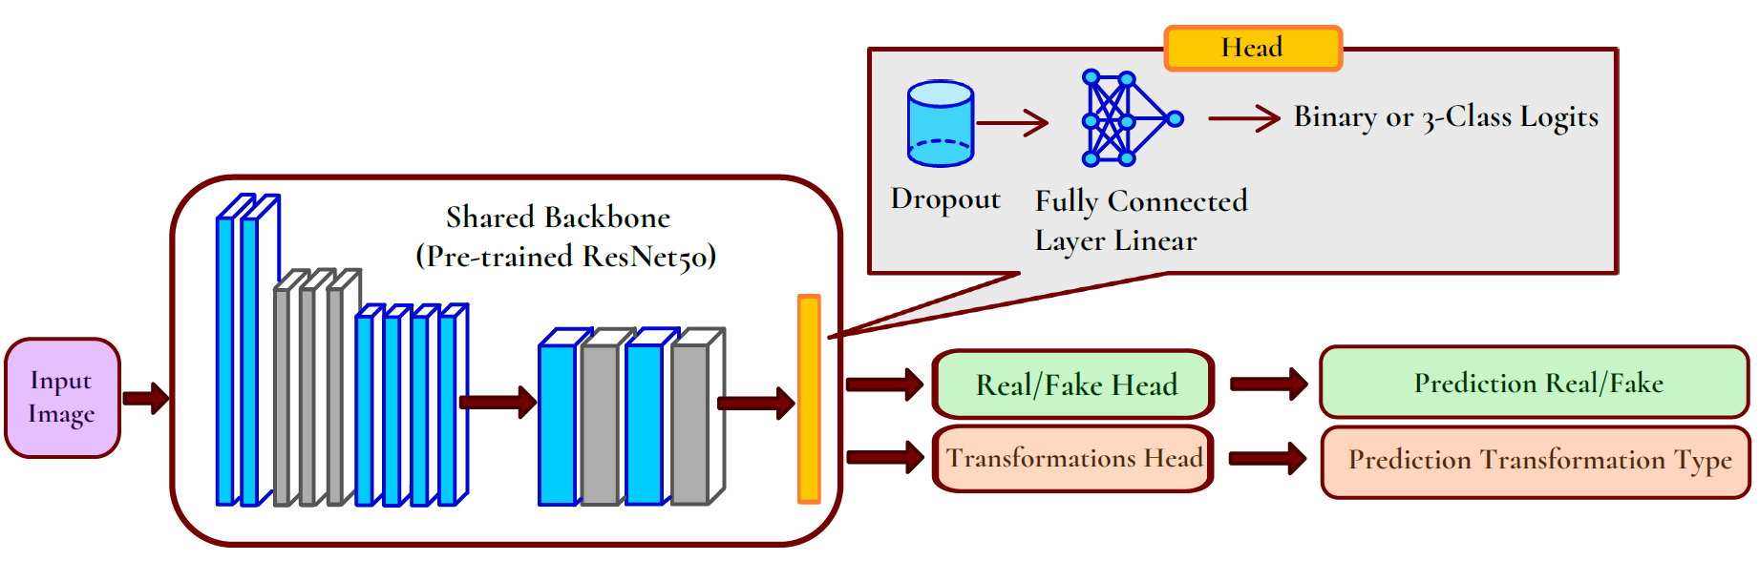
Proposed Method
Proposed Multi-Task Method
Shared backbone: pre-trained ResNet50
Final ImageNet classifier removed: fc = Identity()
Two task-specific heads: one for Real/Fake, one for Transformation type
Transformation classes: original, transfer, redigital
Joint Loss:

Slide 6
Dataset & Data Preparation Strategy
Dataset & Preparation Strategy
RRDataset
├── original
│ ├── ai
│ │ └── images...
│ └── real
│ └── images...
├── transfer
│ ├── ai
│ │ └── images...
│ └── real
│ └── images...
└── redigital
├── ai
│ └── images...
└── real
└── images...
Dataset: RRDataset
Preparation Strategy
Two image classes: Real and AI-generated
Three transformation categories:
original
internet-transmitted
re-digitized
Balanced subset selection: allowed by the project track due to hardware constraints
Built disjoint train / validation / test splits: from the real benchmark.
Balance was preserved across:
Real vs. Fake
Original / Transfer / Redigital
Preferred real benchmark transformations over synthetic on-the-fly simulation.
This approach significantly reduces the domain gap between training and evaluation.
Joint Detection of AI-Generated Images and Post-Processing Alterations in Real-World Scenarios - Agostini Antonio, Giorgia Saolini

Slide 7
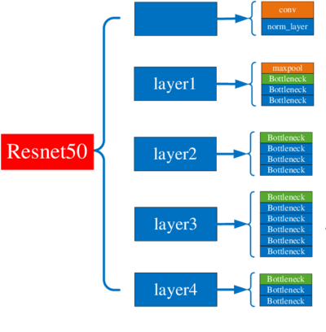
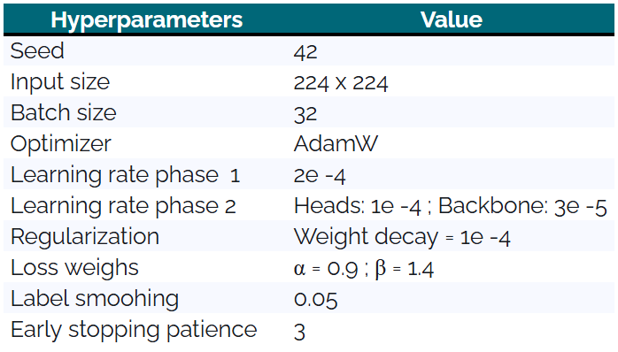

Experimental Setup
Experimental Setup & Evaluation Protocol
Training & Optimization
Training Protocol
Two-phase: Frozen backbone first, then progressive unfreezing
Optimizer
AdamW with mixed precision, label smoothing (0.05), and early stopping
Data Configuration
ResNet 50
Joint Detection of AI-Generated Images and Post-Processing Alterations in Real-World Scenarios - Agostini Antonio, Giorgia Saolini

Slide 8
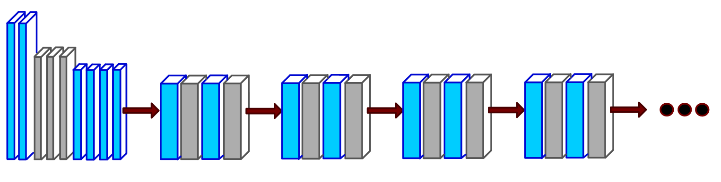
Training Pipeline Setup
Experimental Setup & Evaluation Protocol
Phase 1 — Head Warm-Up
Backbone fully frozen; only the real/fake and transformation heads are trained. This stabilizes the multitask classifier before modifying pretrained features.
Phase 2.1 — Last-Block FT
layer4 is unfrozen, while the heads remain trainable. A lower learning rate is used for the backbone and a higher one for heads to preserve knowledge.
Phase 2.2 — Deeper FT
After Phase 2 early epochs, layer3 is also unfrozen. This enables deeper adaptation of forensic representations without abruptly opening the network.
Why this strategy? Start stable, adapt late features first, then progressively refine deeper forensic representations.
Other layers (1-2)
Layer 3
Layer 4
Heads
Joint Detection of AI-Generated Images and Post-Processing Alterations in Real-World Scenarios - Agostini Antonio, Giorgia Saolini

Slide 9
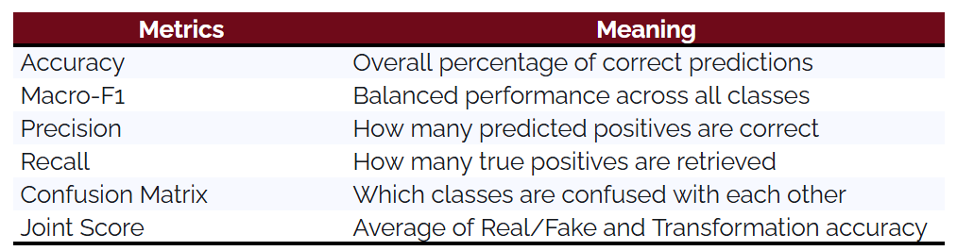
Evaluation Metrics
Experimental Setup & Evaluation Protocol
Joint Detection of AI-Generated Images and Post-Processing Alterations in Real-World Scenarios - Agostini Antonio, Giorgia Saolini

Slide 10
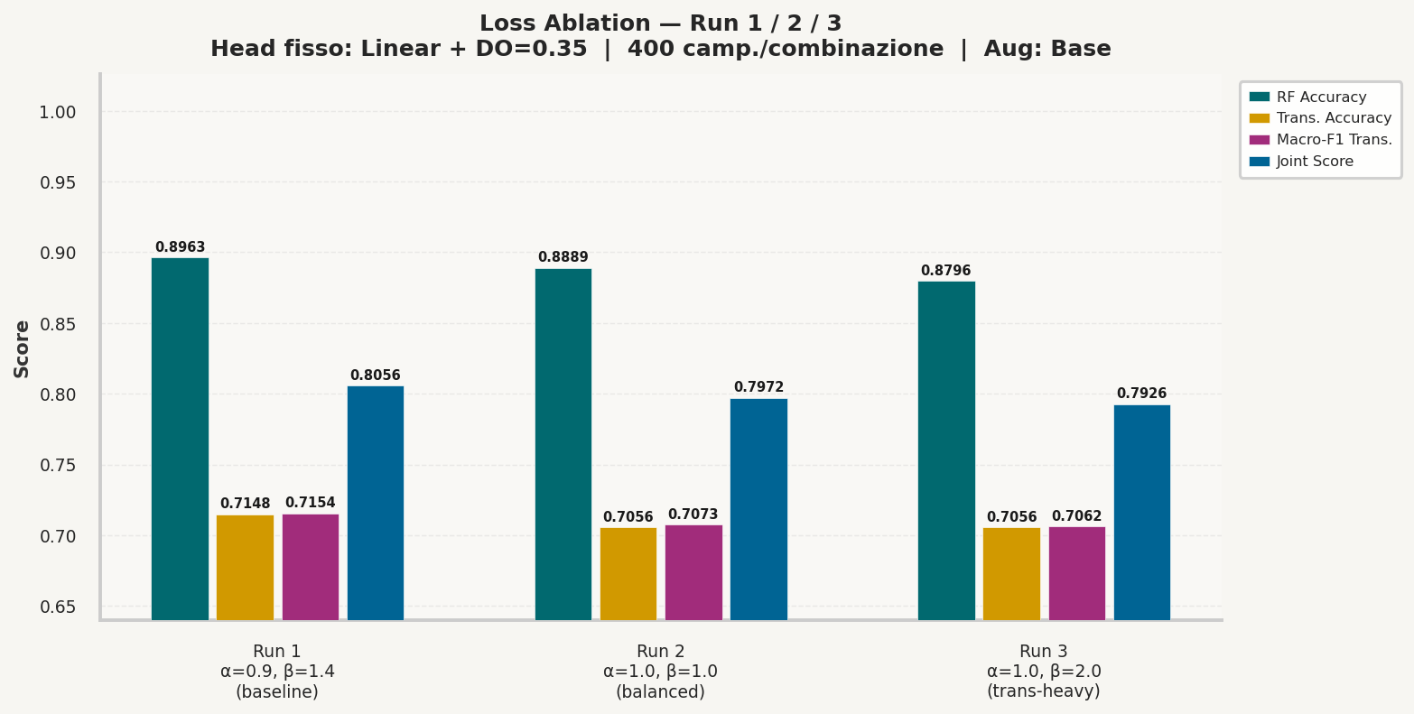
Ablation 1: Loss Weighting
Unimodal-Baselines Comparison, Ablations & Results
Best Configuration (Run 1)
Parameters: α = 0.9, β = 1.4
• RF Accuracy: 0.8963
• Trans Acc: 0.7148
• Macro-F1: 0.7154
• Joint Score: 0.8056
Key Conclusion
Simply changing the transformation loss weight does not solve the bottleneck.
The auxiliary task requires alternate optimization strategies beyond basic weighting.
Joint Detection of AI-Generated Images and Post-Processing Alterations in Real-World Scenarios - Agostini Antonio, Giorgia Saolini

Slide 11
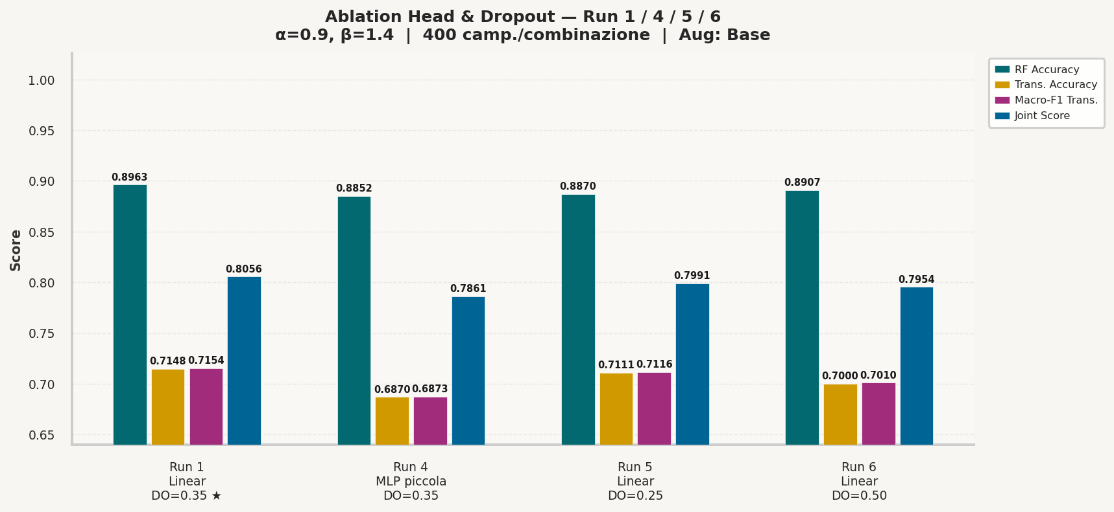

Ablation 2: Head Complexity and Dropout
Unimodal-Baselines Comparison, Ablations & Results
Tested Configurations
Ablation: MLP Head & Dropout rates (0.25, 0.50)
Result: None of these modifications improved results
Underperformed baseline config
Key Conclusion
Best compromise: Linear head + Dropout 0.35
The bottleneck resides in the robustness of the learned features under transformation variability, rather than head capacity limits.
Joint Detection of AI-Generated Images and Post-Processing Alterations in Real-World Scenarios - Agostini Antonio, Giorgia Saolini

Slide 12
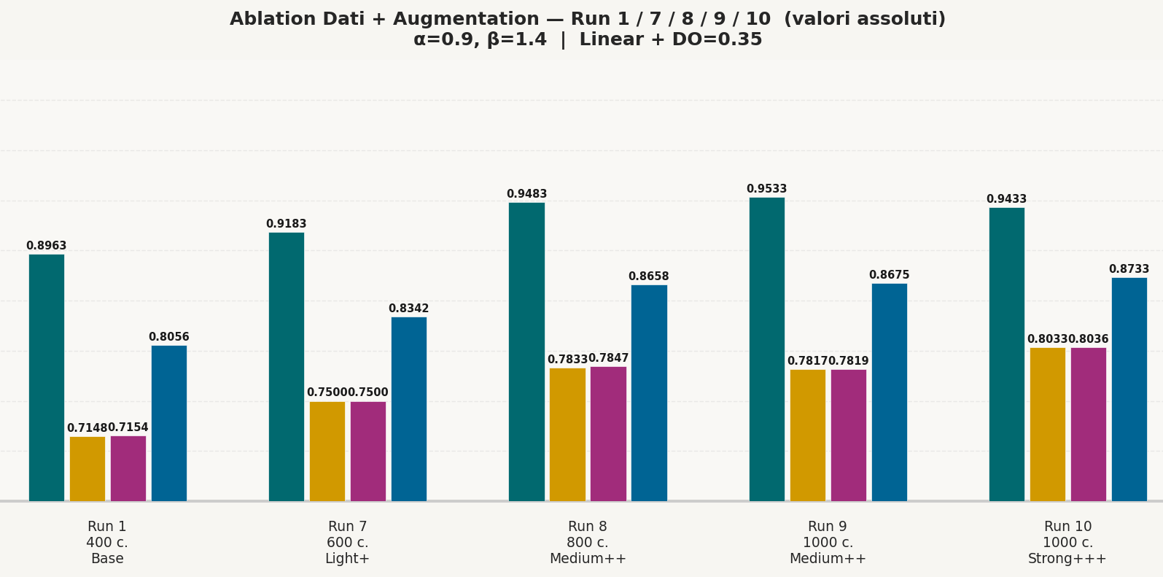
Main Improvement: More Data and Better Augmentation
Unimodal-Baselines Comparison, Ablations & Results
Data-Centric Strategy
Focus: Feature robustness through data
• Increase samples per combination: 400 → 600 → 800 → 1000
• Apply progressively richer augmentation
Key Conclusion
Data diversity improves over Head complexity
The model benefited much more from richer data variability than from a more complex classification head.
Joint Detection of AI-Generated Images and Post-Processing Alterations in Real-World Scenarios - Agostini Antonio, Giorgia Saolini

Slide 13
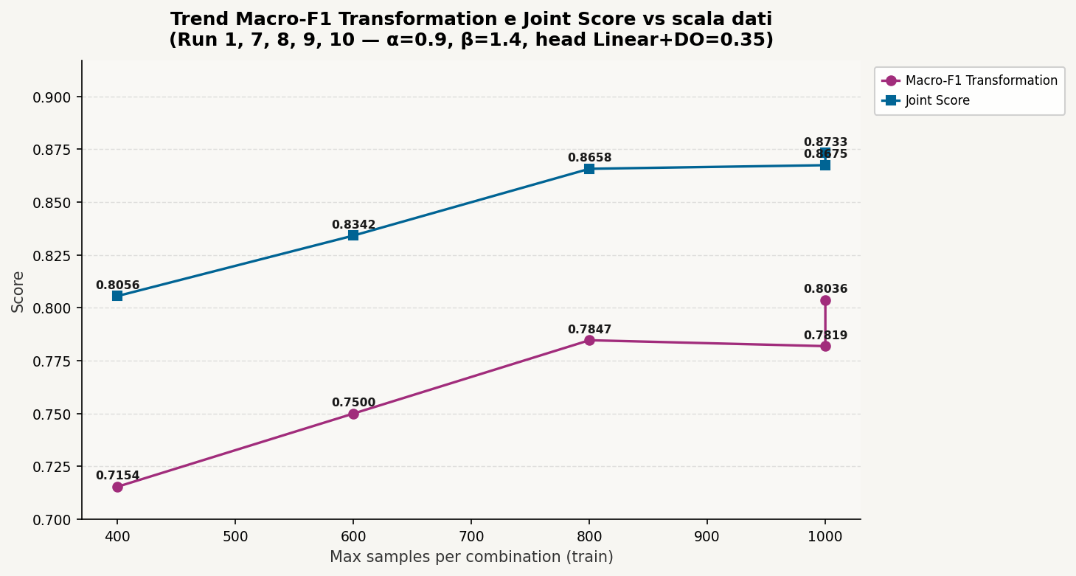
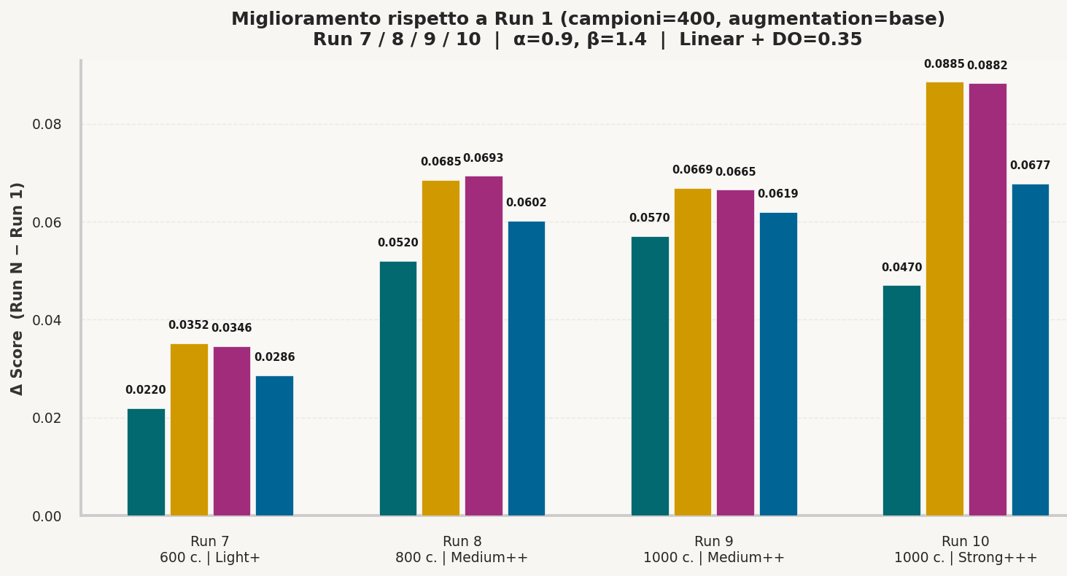
Best Multi-Task Result
Unimodal-Baselines Comparison, Ablations & Results
Configuration & Augmentation
Best configuration: Run 10
Linear heads, dropout 0.35, alpha 0.9, beta 1.4
1000 samples per combination
Augmentation: RandomResizedCrop, horizontal/vertical flip, small rotation, ColorJitter
Final Test Results
• RF Accuracy: 0.9433
• Transformation Accuracy: 0.8033
• Macro-F1 Transformation: 0.8036
• Joint Score: 0.8733
Joint Detection of AI-Generated Images and Post-Processing Alterations in Real-World Scenarios - Agostini Antonio, Giorgia Saolini

Slide 14
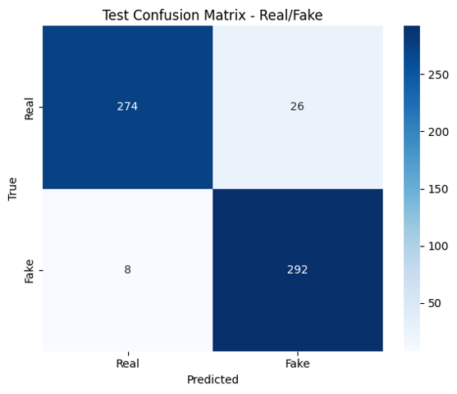
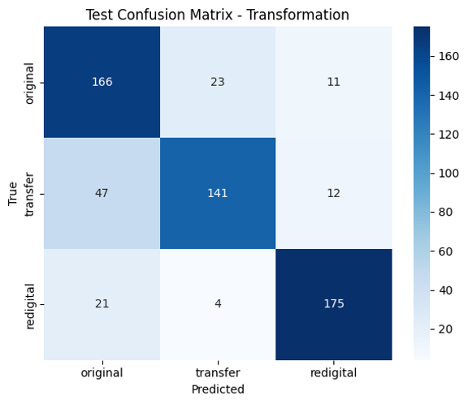
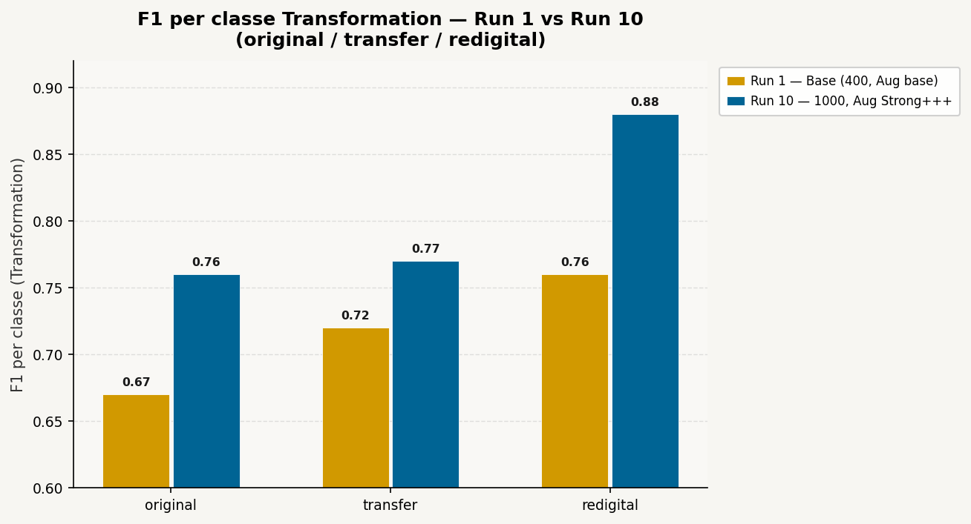
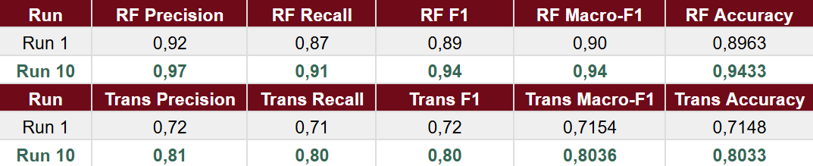
Detailed Evaluation
Unimodal-Baselines Comparison, Ablations & Results
Classification Report
• Real/Fake: Accuracy = 0.9433
• Transformation: Accuracy = 0.8033
Class Analysis
• Best Class: redigital (F1 = 0.88)
• Hard Class: original (F1 = 0.76)
• Transfer Class: F1 = 0.77
Analyzing the final evaluation in detail, the Real/Fake task proves to be extremely robust, achieving an accuracy exceeding 0.94. Transformation classification is more complex, but still achieves approximately 0.80 in accuracy and macro-F1. The easiest class to detect is the re-digitized one, characterized by a clear degradation pattern, while the original and transfer classes are closer and therefore ambiguous.
Joint Detection of AI-Generated Images and Post-Processing Alterations in Real-World Scenarios - Agostini Antonio, Giorgia Saolini

Slide 15
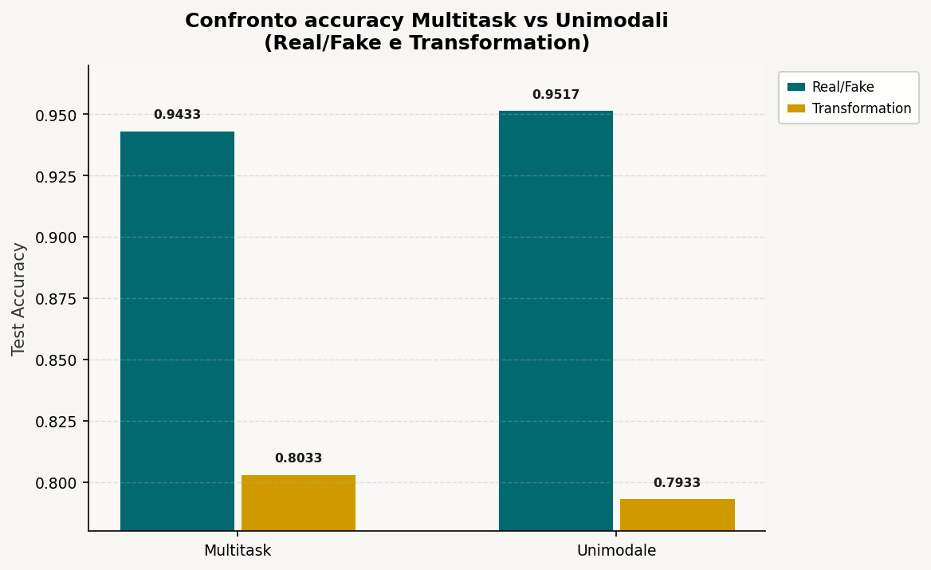
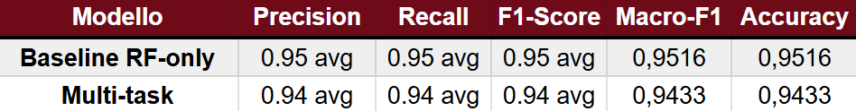
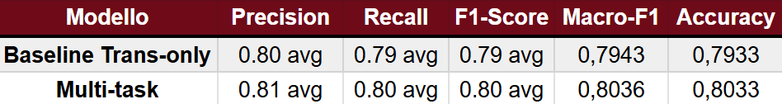
Multi-Task vs Unimodal Baselines
Unimodal-Baselines Comparison, Ablations & Results
Unimodal Baselines
• RF-Only: Accuracy = 0.9517
• Transformation: Accuracy = 0.7933
Best Multi-Task Model & Trade-off
• RF Accuracy: 0.9433 (vs 0.9517 baseline)
• Transformation Accuracy: 0.8033 (vs 0.7933 baseline)
Sacrifices 0.84% on the binary RF task to gain 1% robustness on the harder transformation task.
Task Real/Fake :
The multi-task model achieves comparable performance to specialized baselines on both tasks with a single shared model, demonstrating that the two forensic objectives are not in conflict but rather mutually reinforcing.
Task Transformation :
Joint Detection of AI-Generated Images and Post-Processing Alterations in Real-World Scenarios - Agostini Antonio, Giorgia Saolini

Slide 16
Conclusions
Conclusions & Future Work
Key Findings
A shared-backbone multi-task model is effective for realistic image forensics.
The main bottleneck was not the head design, but feature robustness under transformation variability.
More data and targeted augmentation improved generalization significantly.
Multi-task learning provided the most balanced solution for the full problem.
Project Synthesis
In conclusion, this project shows that a shared-backbone multi-task model is a good solution for realistic AI-image forensics.
The most important lesson is that the central bottleneck was not architectural complexity in the head, but robustness to domain variability in the training data.
By increasing data diversity and using more targeted augmentation, we achieved a clearly stronger and more balanced model, which we believe is the most appropriate result for the full project objective.
Joint Detection of AI-Generated Images and Post-Processing Alterations in Real-World Scenarios - Agostini Antonio, Giorgia Saolini

Slide 17

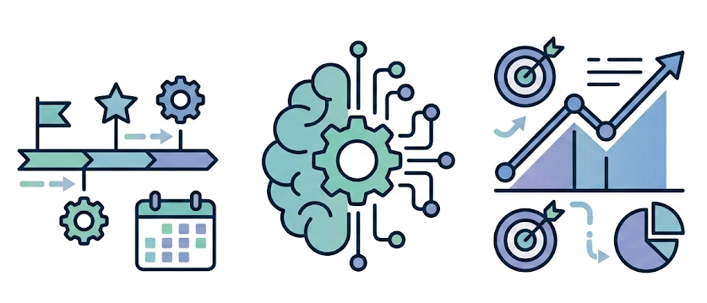
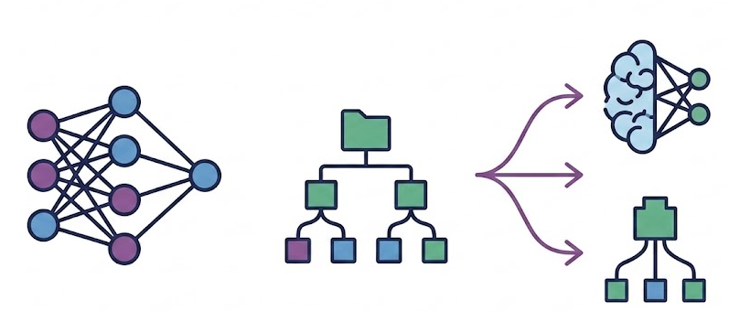
Future Work
Conclusions & Future Work
Data Directions
• Stronger semantic or frequency-aware augmentation
• More intelligent sample selection
• Larger-scale evaluation on additional real-world manipulations
Training Strategy
• Per-transformation curriculum learning
• Transformation-aware training schedules
Model Variants
• Alternative backbone comparison
• Systematic multi-task protocol evaluation
Joint Detection of AI-Generated Images and Post-Processing Alterations in Real-World Scenarios - Agostini Antonio, Giorgia Saolini

Slide 18
References
Papers
Li, Chunxiao, et al. "Bridging the Gap Between Ideal and Real-world Evaluation..." IEEE/CVF ICCV, 2025.
Shao, Rui, et al. "Detecting and grounding multi-modal media manipulation." IEEE/CVF CVPR, 2023.
Images
ResNet50 Architecture: https://www.thinkingstack.ai/blog/business-use-cases-11/a-comprehensive-guide-to-resnet50-architecture-and-implementation-56
Other Visuals: All secondary diagrams and schemes were hand drawn.
Slides & Template
Sapienza PPT Template: https://github.com/pietro-nardelli/sapienza-ppt-template
Licensing: Distributed under Attribution-NonCommercial-ShareAlike 4.0 International (CC BY-NC-SA 4.0).
Joint Detection of AI-Generated Images and Post-Processing Alterations in Real-World Scenarios - Agostini Antonio, Giorgia Saolini

Slide 19
Thank you for the attention!

