Slide 1

Accident analysis and severity prediction

Slide 2

The problem
Road accidents are a huge problem and cost (human lives, money and resources) for modern society
Estimating the likelihood of a road accident and its possible severity with a predictive model is thus a very important topic
This brief study will develop and test predictive models of accident severity, considering as input variables a set of conditions (road, time, weather, etc.)

Slide 3
Possible stakeholders:
Governments, police forces, road authorities (determine effective countermeasures)
Normal drivers, cyclists or pedestrians (warning about dangerous situations)
Producers of driving assistance systems
Self-driving systems (security protocols)
Insurance companies (risk evaluation)

Slide 4
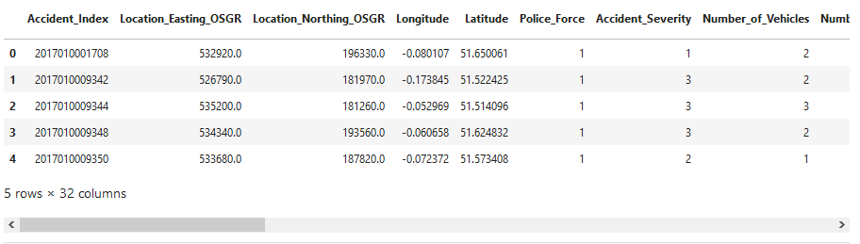
Data source
Database of UK accidents collected by police forces https://data.gov.uk/
Available under the Open Government Licence http://www.nationalarchives.gov.uk/doc/open-government-licence/version/3/
For this study, only the 2017 and 2018 ‘accident’ databases are considered; the 2016 database will be used for model test

Slide 5
Strengths of the databases:
data are rigorously validated;
they are collected with the same methodology across the whole UK;
they include a lot of details regarding the accidents.
Weaknesses:
they record only accidents involving:
at least one vehicle
in which at least one person was injured (no damage-only accidents)
and which were reported to the police (possible undersampling of slight accidents)

Slide 6
Data selection and cleaning
Original combined (2017+2018) database: 252617 rows, 32 columns; after data cleaning: 249441 rows (less than 1.5% rows lost)
Target for the model: Accident_Severity: 1 Fatal, 2 Serious, 3 Slight
10 columns used for model training:
- Day_of_Week, Time_Period, Season;
- Road_Type, Speed_limit, Junction_Detail;
- Light_Conditions, Weather_Conditions;
- Road_Surface_Conditions, Special_Conditions_at_Site

Slide 7
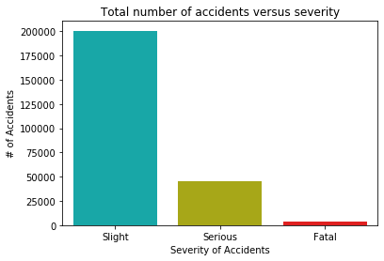
Preliminary evaluations
80.4% slight accidents
18.2% serious accidents
1.3% fatal accidents
The severity distribution is highly unbalanced towards slight injury accidents
It is very important to take into account this when building the prediction model.

Slide 8
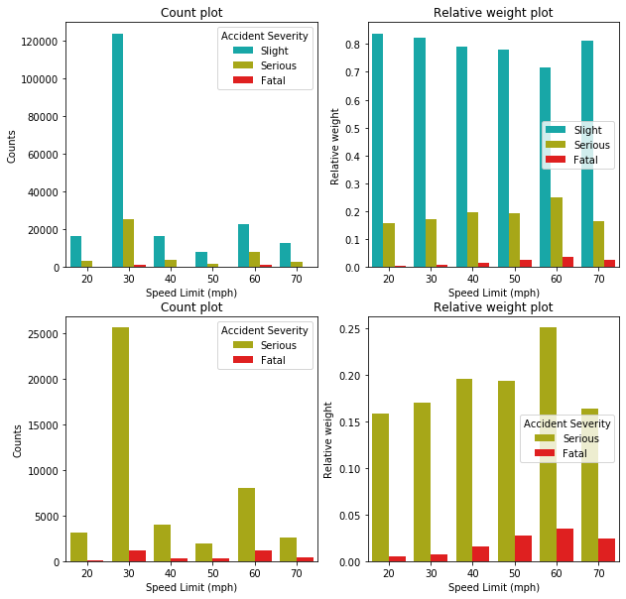
Left: Count distribution
Right: Relative Weights (to counts at that particular x-axis value)
In the bottom row, only serious and fatal cases are shown
Most of the accidents happened at low speed limit (30 mph), or 60 mph
For large speed limit, the relative weight of serious and fatal accidents is higher (max at 60 mph)

Slide 9
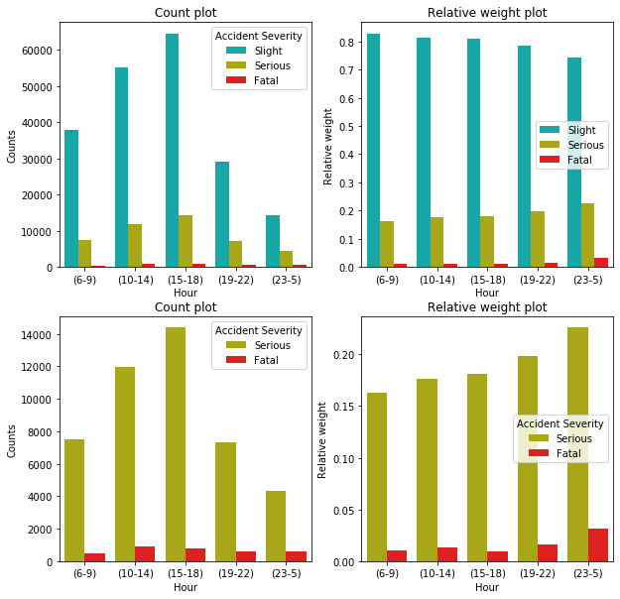
Left: Count distribution
Right: Relative Weights (to counts at that particular x-axis value)
In the bottom row, only serious and fatal cases are shown
Most of the accidents happened during rush hours (15:00-18:00)
At night (23:00-5:00) the relative weight of fatal accidents is larger (max around 4:00)

Slide 10
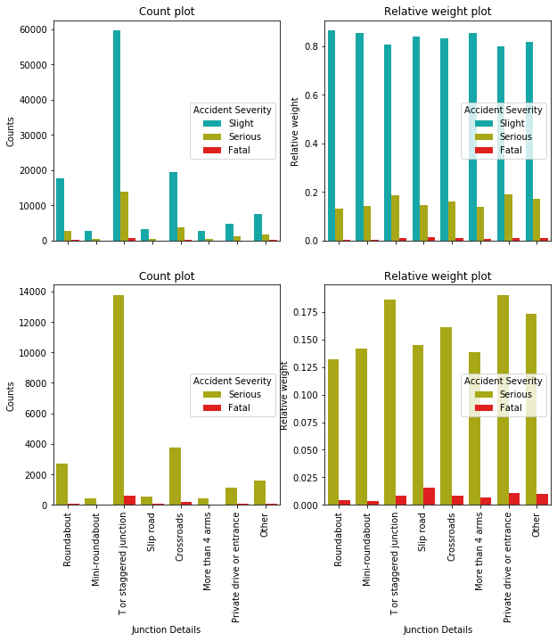
Junction Type
Most of the accidents in correspondence of junctions happened at T or staggered junctions, crossroads and roundabouts
T or staggered junctions, private drives and slip road junctions have the largest relative weight for serious and fatal accidents
Left: Count distribution
Right: Relative Weights (to counts at that particular x-axis value)
In the bottom row, only serious and fatal cases are shown

Slide 11
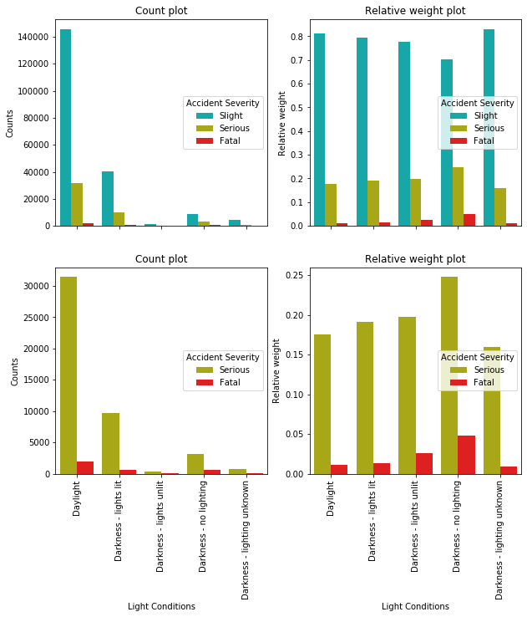
Light Conditions
Most of accidents happened during daylight
The relative weight of serious and fatal accidents is higher for darkness (max for darkness without lighting)
Left: Count distribution
Right: Relative Weights (to counts at that particular x-axis value)
In the bottom row, only serious and fatal cases are shown

Slide 12
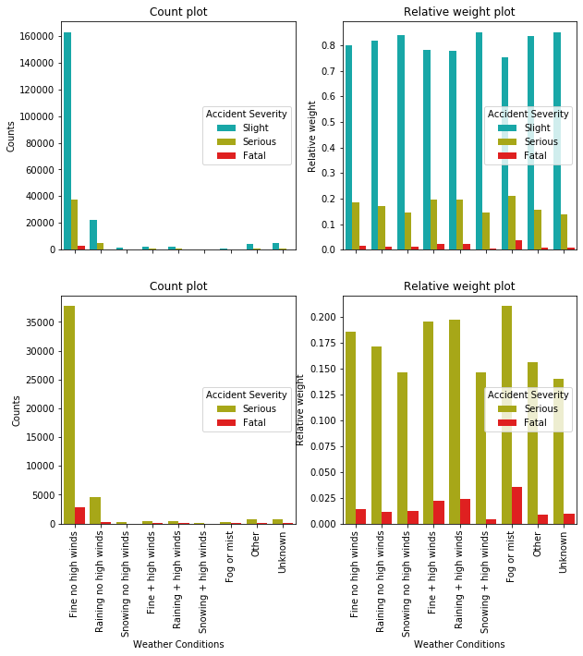
Weather Conditions
The majority of accidents happened for fine weather, followed by rain
Highest relative weights for fog and high wind conditions
Left: Count distribution
Right: Relative Weights (to counts at that particular x-axis value)
In the bottom row, only serious and fatal cases are shown

Slide 13

The models
Classification models were chosen
The following models were considered:
- K-Nearest Neighbors;
- Decision Tree;
- Bootstrap Aggregation (Bagging) Classifier;
- Adaptive Boosting (AdaBoost) Classifier;
- Random Forest Classifier.
Hyper-parameter tuning was done using balanced accuracy score: average of recall (i.e. true positives divided by the number of real positives) obtained on each class

Slide 14
option class_weight='balanced' was used: each sample contribution is weighted inversely proportional to its class frequency (i.e. total count of samples in that class). Less populated classes thus will count the same as the most populated ones. This is equivalent to oversampling.
Such option was used for Decision Tree and Random Forest Classifiers, as well as the base estimators of Bagging and AdaBoost Classifiers.
Two additional models using undersampling of the most populated classes were trained:
- Balanced Bagging Classifier;
- Balanced Random Forest Classifier.

Slide 15
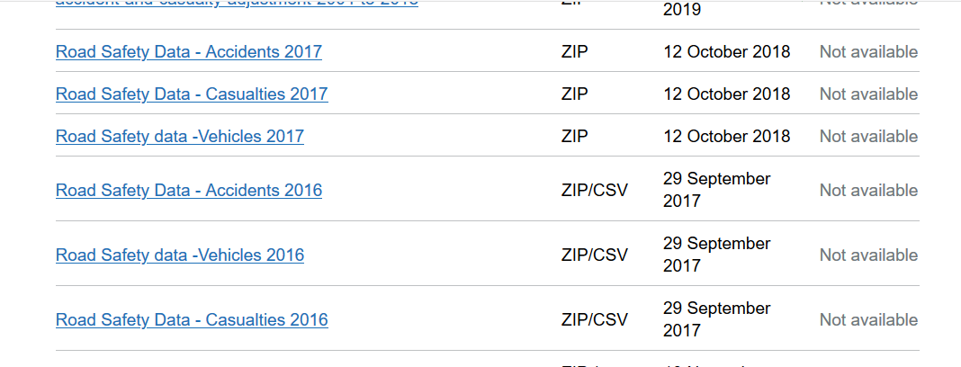
Test the model
The models were tested on the accident database from 2016
The data were prepared similarly to what done to the training dataset
After data cleaning, 135815 samples (99.4% of initial data) were in the test dataset

Slide 16

Results
Two metrics were considered:
Balanced Accuracy Score from sklearn.metrics
Geometric Mean Score from imblearn.metrics
Balanced Accuracy: average of recall scores (true positives correctly identified over the total number of true positives) per target class.
Geometric Mean (G-Mean): Nth-root of the product of class recalls; N is the number of classes.
For both: 0 worst possible value; 1 best possible value

Slide 17
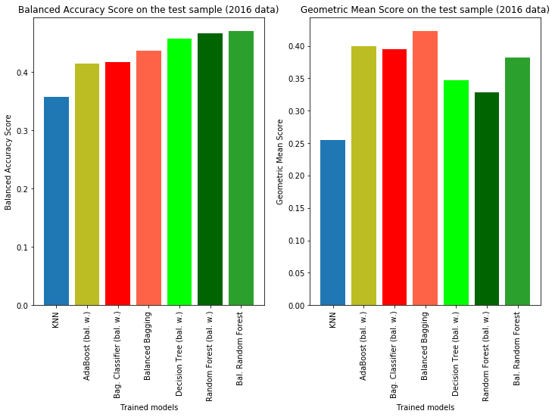
KNN scored worst
Dec. Tree and Rand. Forest models scored best in Bal. Acc. (0.46-0.47)
AdaBoost and Bagging models scored best in G-Mean (0.40-0.42)
Balanced Random Forest scored best in Bal. Acc. with 0.47
Balanced Bagging scored best in G-Mean with 0.42
Ensemble models with data undersampling performed best, according to these metrics
All scores were not extremely high

Slide 18
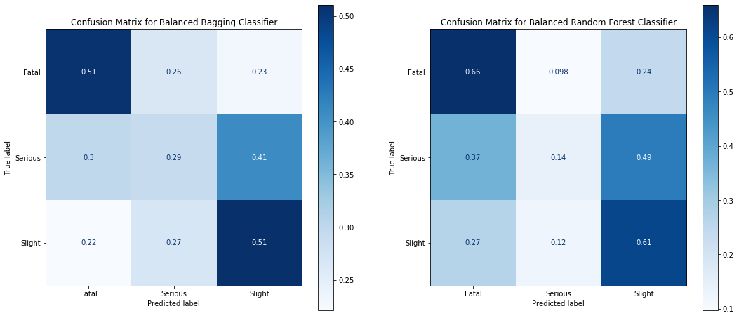
All models had problems in correctly identifying serious accident cases
Bal. Bagging had the best performance in serious class, correct predictions ~30% of actual true cases; it reached recall around 51% for both fatal and slight cases
Bal. Random Forest had recall of 66% for fatal and 61% for slight. It still wrongly predicted ~49% of true serious cases as slight; recall for serious was ~14%

Slide 19
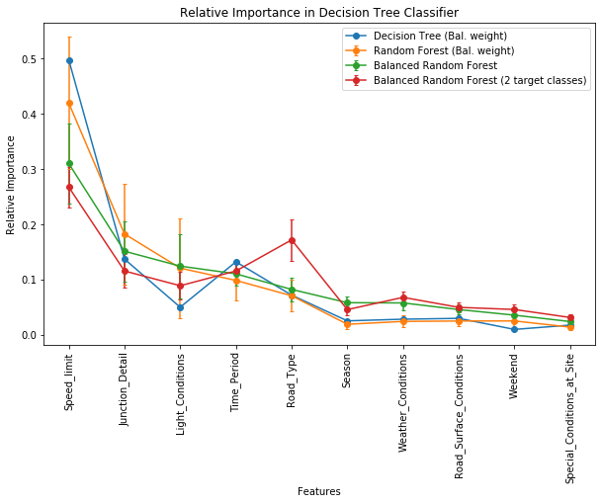
Relative Importance from trained models
Most important feature: Speed Limit
- relative weight of serious and fatal accid. increased with increasing speed limit
Next important:
- Junction Details
- Light Conditions, Time Period
- Road Type
Visibility (Light Cond. - Time Period) is an important factor in the severity of accidents
Type of junction is also a discriminant in severity prediction

Slide 20
Conclusions
This study analyzed UK accidents data from 2017 + 2018
It trained a series of models to predict the severity of accidents, concentrating on the ability to correctly predict critical accidents (fatal and serious)
The best performances, among the models tested during the study, were reached by undersampling ensemble models: Balanced Bagging and Balanced Random Forest
No model could achieve recall >50% for all the classes at the same time

Slide 21




Conclusions – contd.
It showed the relative importance of features from the trained models
Critical factors:
Speed Limit: higher speed limits had relatively larger chance of high severity accidents
Visibility Conditions: bad visibility (night, no lights) was a factor increasing the probability of high severity
Junction Types: Roundabouts were relatively more safe T or staggered junctions and slip roads were the relatively most dangerous

Slide 22
Perspectives
Possible future developments:
Generalization of the severity prediction based on road users (drivers, bikers, cyclists, pedestrians etc.) → target focused prevention measures; identify improved security devices for particularly dangerous conditions
Use other classification models, such as Gradient Boosting, or include features which were dropped in this study
Analysis of the evolution of risk factors during the years
Important note: absolute counts (count histograms) are also very important, since the total cost for the society derives from a combination of both relative weight of severity, and frequency of happening.

Slide 23
Final Remarks
This study was done in the context of the Coursera course: Applied Data Science Capstone of IBM Data Science Professional Certificate
https://www.coursera.org/learn/applied-data-science-capstone
The full notebook of the analysis can be found on Github:
https://github.com/AntonioBL/Coursera_Capstone
All the photos in this presentations are free-to-use images downloaded from https://www.pexels.com

