Slide 1

Accident analysis and severity prediction

Slide 2

The problem
Road accidents are a huge problem and cost (human lives, money and resources) for modern society
Estimating the likelihood of a road accident and its possible severity with a predictive model has become an important topic
This brief study will develop and test predictive models of accident severity, considering as input variables a set of conditions

Slide 3
Possible stakeholders:
Governments, police forces, road authorities (determine effective countermeasures)
Normal drivers, cyclists or pedestrians (warning about dangerous situations)
Producers of driving assistance systems
Self-driving systems (security protocols)
Insurance companies (risk evaluation)

Slide 4
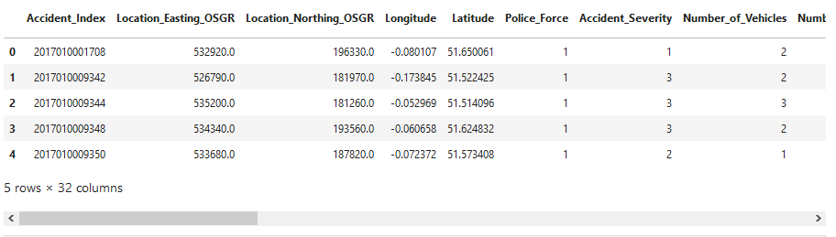
Data source
Database of UK accidents collected by police forces https://data.gov.uk/
Available under the Open Government Licence http://www.nationalarchives.gov.uk/doc/open-government-licence/version/3/
For this study, only the 2017 and 2018 ‘accident’ databases are considered; the 2016 database will be used for model test

Slide 5
Strengths of the databases:
data are rigorously validated;
they are collected with the same methodology across the whole UK;
they include a lot of details regarding the accidents.
Weaknesses: they record only accidents involving:
at least one vehicle
in which at least one person was injured (no damage-only accidents)
and which were reported to the police (possible undersampling of slight accidents)

Slide 6
Data selection and cleaning
Original combined (2017+2018) database: 252617 rows, 32 columns; after data cleaning: 249441 rows (less than 1.5% rows lost)
Target for the model: Accident_Severity: 1 Fatal, 2 Serious, 3 Slight
10 columns used for model training:
- Day_of_Week, Time_Period, Season;
- Road_Type, Speed_limit, Junction_Detail;
- Light_Conditions, Weather_Conditions;
- Road_Surface_Conditions, Special_Conditions_at_Site

Slide 7
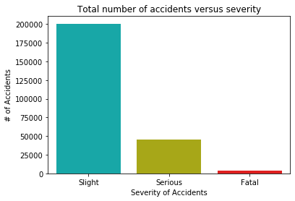
Preliminary evaluations
80.4% slight accidents
18.2% serious accidents
1.3% fatal accidents
The severity distribution is highly unbalanced towards slight injury accidents
It is very important to take into account this when building the prediction model.

Slide 8
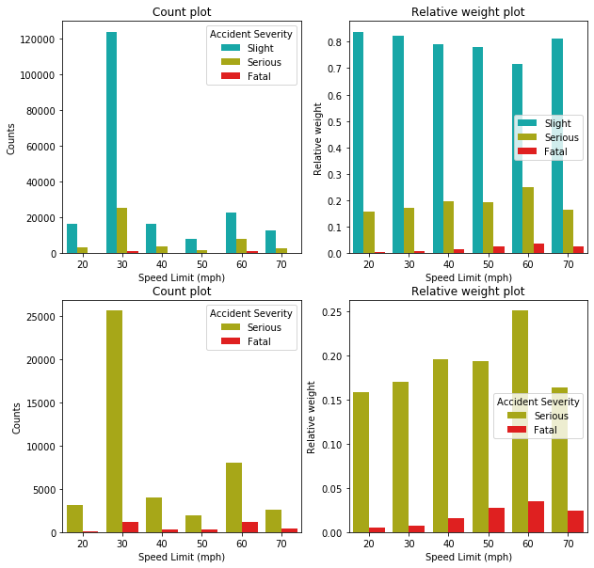
Left: Count distribution
Right: Relative Weights (to counts at that particular x-axis value)
In the bottom row, only serious and fatal cases are shown
Most of the accidents happened at low speed limit (30 mph), or 60 mph
For large speed limit, the relative weight of serious and fatal accidents is higher (max at 60 mph)

Slide 9
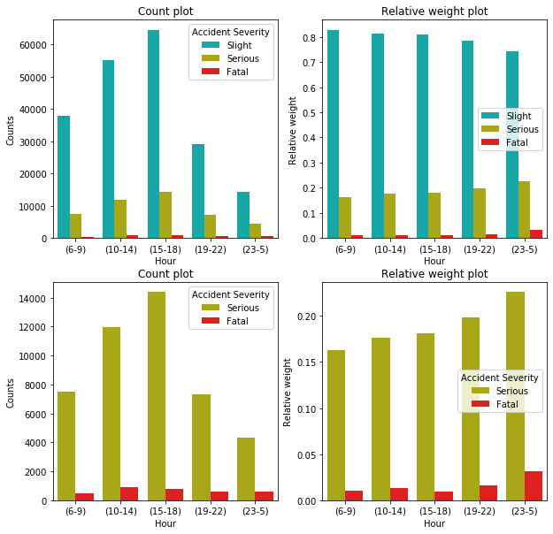
Left: Count distribution
Right: Relative Weights (to counts at that particular x-axis value)
In the bottom row, only serious and fatal cases are shown
Most of the accidents happened during rush hours (15:00-18:00)
At night (23:00-5:00) the relative weight of fatal accidents is larger (max around 4:00)

Slide 10
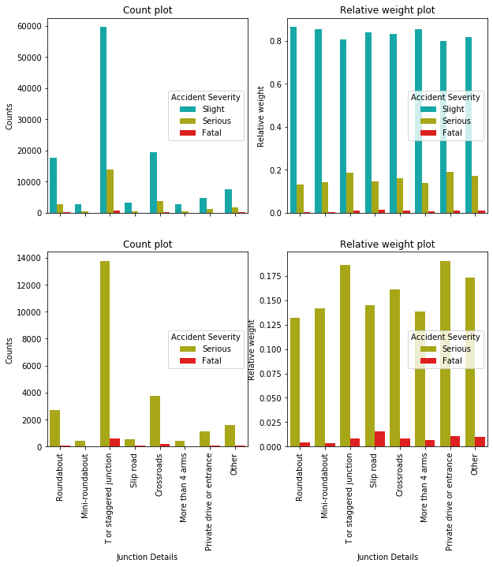
Junction Type
Most of the accidents in correspondence of junctions happened at T or staggered junctions, crossroads and roundabouts
T or staggered junctions, private drives and slip road junctions have the largest relative weight for serious and fatal accidents
Left: Count distribution
Right: Relative Weights (to counts at that particular x-axis value)
In the bottom row, only serious and fatal cases are shown

Slide 11
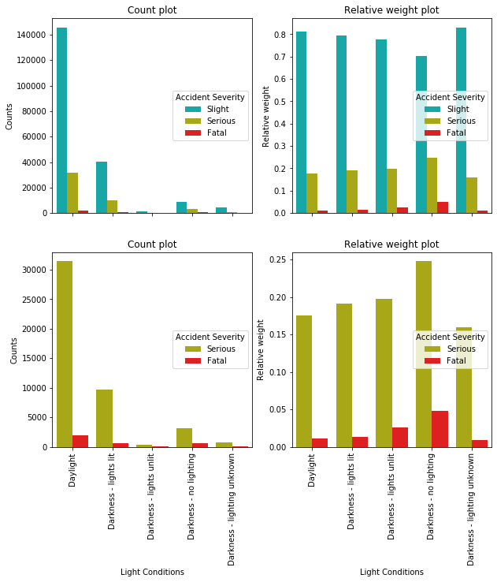
Light Conditions
Most of accidents happened during daylight
The relative weight of serious and fatal accidents is higher for darkness (max for darkness without lighting)
Left: Count distribution
Right: Relative Weights (to counts at that particular x-axis value)
In the bottom row, only serious and fatal cases are shown

Slide 12
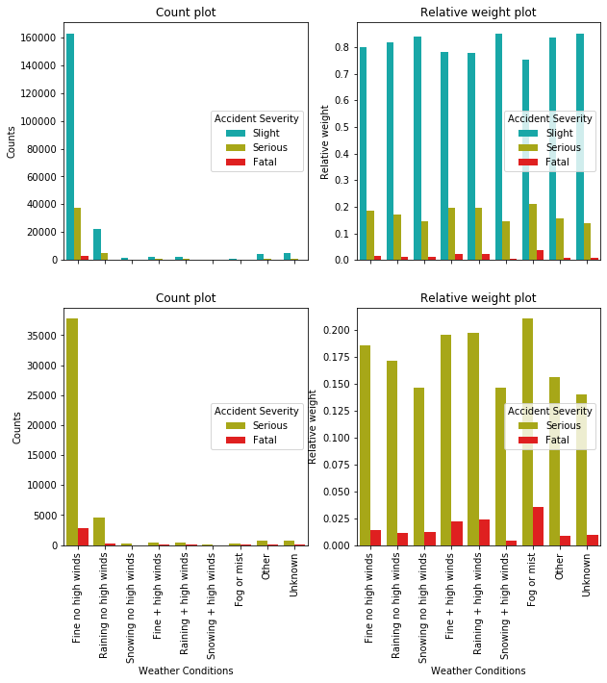
Weather Conditions
The majority of accidents happened for fine weather, followed by rain
Highest relative weights for fog and high wind conditions
Left: Count distribution
Right: Relative Weights (to counts at that particular x-axis value)
In the bottom row, only serious and fatal cases are shown

Slide 13
The models
Classification models were chosen for the prediction
The following models were considered:
- K-Nearest Neighbors;
- Decision Tree;
- Bootstrap Aggregation (Bagging) Classifier;
- Adaptive Boosting (AdaBoost) Classifier;
- Random Forest Classifier.
Hyper-parameter tuning was done using balanced accuracy score: average of recall (i.e. true positives divided by the number of real positives) obtained on each class

Slide 14
option class_weight='balanced' was used: each sample contribution is weighted inversely proportional to its class frequency (i.e. total count of samples in that class). Less populated classes thus will count the same as the most populated ones. This is equivalent to oversampling.
Such option was used for Decision Tree and Random Forest Classifiers, as well as the base estimators of Bagging and AdaBoost Classifiers.
Two additional models using undersampling of the most populated classes were trained:
- Balanced Bagging Classifier;
- Balanced Random Forest Classifier.

Slide 15
option class_weight='balanced' was used: each sample contribution is weighted inversely proportional to its class frequency (i.e. total count of samples in that class). Less populated classes thus will count the same as the most populated ones. This is equivalent to oversampling.
Such option was used for Decision Tree and Random Forest Classifiers, as well as the base estimators of Bagging and AdaBoost Classifiers.
Two additional models using undersampling of the most populated classes were trained:
- Balanced Bagging Classifier;
- Balanced Random Forest Classifier.

Slide 16
Titolo

Slide 17
Titolo

Slide 18
Titolo
Ricorda di menzionare immagini prese da https://www.pexels.com

