Slide 1
MRV+ Comparison (Introduction to AI final project)
By: Antonio Bourizk
Theresa Tamer

Slide 2
What is MRV
The Minimum Remaining Values (MRV) strategy, which heuristically selects variable with fewest candidates to expand, is an existing popular strategy for Graph Coloring Problem. MRV prioritizes unassigned variables dynamically based on the number of available values that they hold, i.e., the candidates in the variables domains. According to its simple heuristics, the less the number of candidates in a variable’s domain, the higher priority it receives as potential variable for search.

Slide 3
Difference between MRV & MRV+
Typically, the MRV strategy iterates through all unassigned variables in a CSP, and compares each of their domain sizes before selecting a variable with the minimum remaining values or candidates as the ‘next variable to be solved’. If there is only one variable with the optimal heuristic value, the variable is selected and labelled, and the search continues. However, if there is a FoS, MRV deals with the situation in two ways:

Slide 4
Algorithm I: variable selection based on order
This algorithm selects a variable based on pre-assigned static order, i.e., the first variable 206 S. Abuluaih et al. found with the desired optimal heuristic value will become the new frontier even if there are other variables holding the same heuristic value

Slide 5
Algorithm II: Random selection
This algorithm selects a variable randomly among a group of variables that hold same optimal heuristic value.
What is common with both approaches is the arbitrary selection of variables that does not effectively help to advance the search.

Slide 6
MRV+’s advantage
MRV+ involves a secondary heuristics strategy that is invoked upon detection of FoS in MRV. New heuristic values are generated to re-evaluate each of the indeterminate MRV choice variables. The secondary heuristics proposed is called Contribution Number (CtN), and it takes advantage of existing information to resolve FoS. Technically, the MRV+ strategy comprises MRV and CtN.

Slide 7
What is CtN(aka Contribution Number)
The CtN heuristics work by identifying the variables that have potentially valid candidates in common with their peers. The more candidates in common a variable has with respect to its peers, the greater is its contribution number. The argument is that by labelling a variable with the highest contribution number, will result in the deduction of most number of candidates from its peers’ domains; thus, solving the problem quickly by hastening fail-first.
By doing so the ‘next variable to be solved’ will not only be the one with minimum remaining value but also the one with the maximum contribution number.

Slide 8
Performance of MRV and MRV+
Tables 1 and 2 list the average number of FoS encountered by MRV and MRV+ for the Sudoku puzzles generated based on the Number of Clues and the Location of Clues categories, respectively. The 5,000 puzzles under each category are organised according to their difficulty levels where each level comprises 1,000 puzzles.

Slide 9
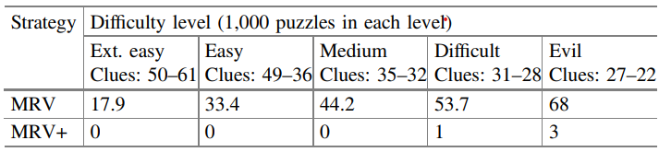
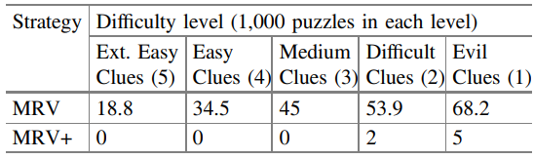
Table I
Average FoS in solving 5,000 Sudoku puzzles generated based on the Number of Clues for the MRV and MRV+ strategies.
Table II
Average FoS in solving 5,000 Sudoku puzzles generated based on the Location of Clues for the MRV and MRV+ strategies.

Slide 10
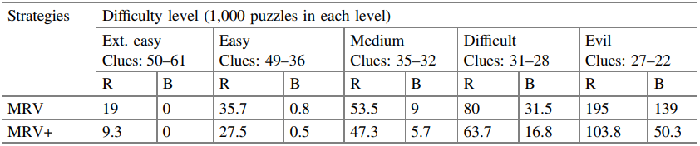
Number of Recursion and Backtracking in solving 5,000 Sudoku puzzles generated based on the Number of Clues for the MRV and MRV+ strategies

Slide 11
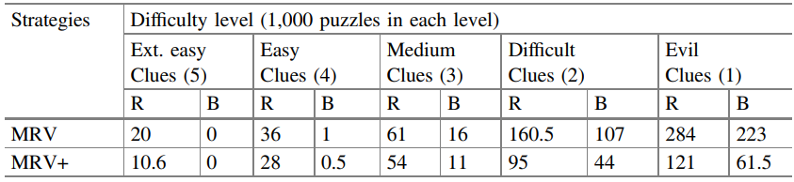
Number of Recursion and Backtracking in solving 5,000 Sudoku puzzles generated based on the Location of Clues for the MRV and MRV+ strategies.

Slide 12
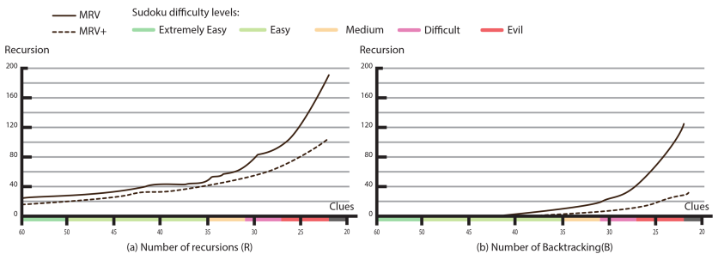
Performance comparison between MRV and MRV+ for solving Sudoku puzzles generated based on the Number of Clues.

Slide 13
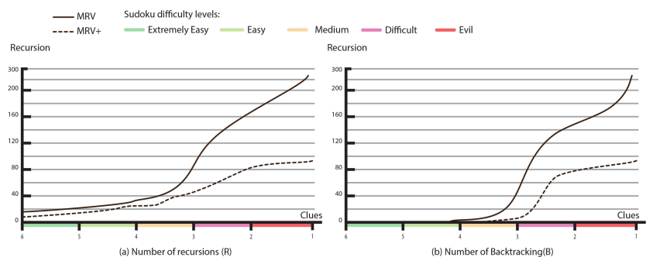
Performance comparison between MRV and MRV+ for solving Sudoku puzzles generated based on the Location of Clues.

Slide 14
Conclusion
The Fog of Search (FoS) situation defines a state of confusion that a search strategy encounters when more than one variable shares the same optimal heuristic value. In the case of MRV, the optimal heuristics is the minimum remaining values, where the common practice to select a variable arbitrarily.
The paper presents a secondary heuristics called Contribution Number (CtN) that enables MRV to make a resolute decision to resolve FoS. The function FogResolver implements the modified MRV+ strategy, which re-evaluates the choice variables that have same minimum remaining values, then selects the maximum contribution number.

