Slide 1
MCPBC
Maximum coverage problem with budget constraints
Author: Emmanuele Antonio

Slide 2
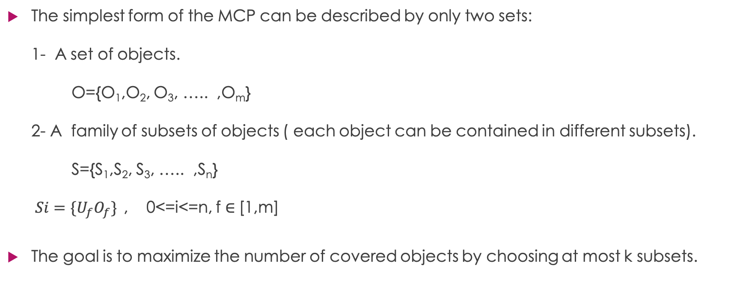

MCPBC
The simplest form of the MCP can be described by only two sets: 1- A set of objects. O={O₁,O₂, O₃, ….. ,O_{m}} 2- A family of subsets of objects ( each object can be contained in different subsets). S={S₁,S₂, S₃, ….. ,S_{n}} $Si=\{U_{f}O_{f}\}$, 0<=i<=n, f $∈$[1,m]
The goal is to maximize the number of covered objects by choosing at most k subsets.
$$∈$$

Slide 3
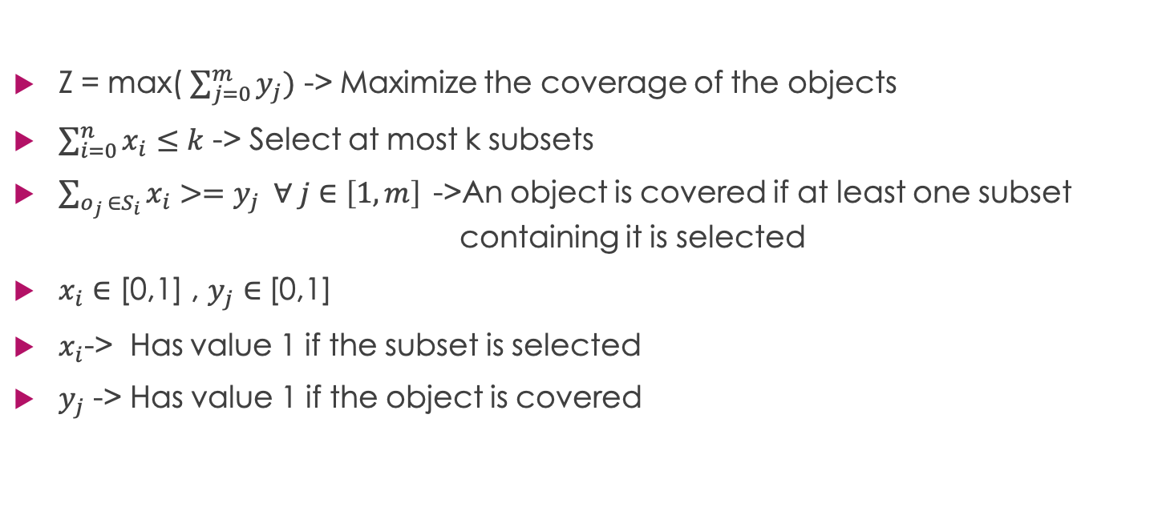
Model
Z = max( $\sum_{j=0}^{m}{y_{j})}$ -> Maximize the coverage of the objects
$\sum_{i=0}^{n}{x_{i}}≤k$ -> Select at most k subsets
$\sum_{o_{j} ∈S_{i}}{x_{i}>=y_{j} ∀ j∈\left[1,m\right]}$->An object is covered if at least one subset containing it is selected
$x_{i}$ $∈$ [0,1] , $y_{j}$ $∈$[0,1]
$x_{i}$-> Has value 1 if the subset is selected
$y_{j}$ -> Has value 1 if the object is covered

Slide 4
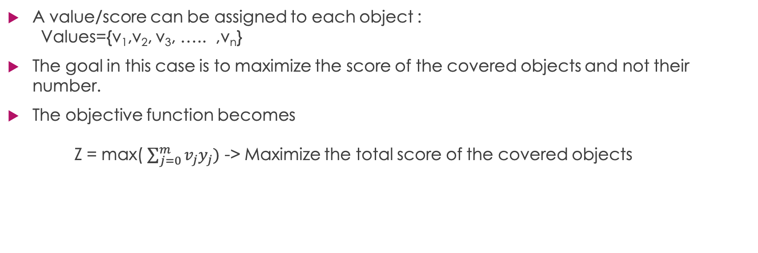
Generalizing the problem
A value/score can be assigned to each object : Values={v₁,v₂, v₃, ….. ,v_{n}}
The goal in this case is to maximize the score of the covered objects and not their number.
The objective function becomes Z = max( $\sum_{j=0}^{m}{v_{j}y_{j})}$ -> Maximize the total score of the covered objects

Slide 5
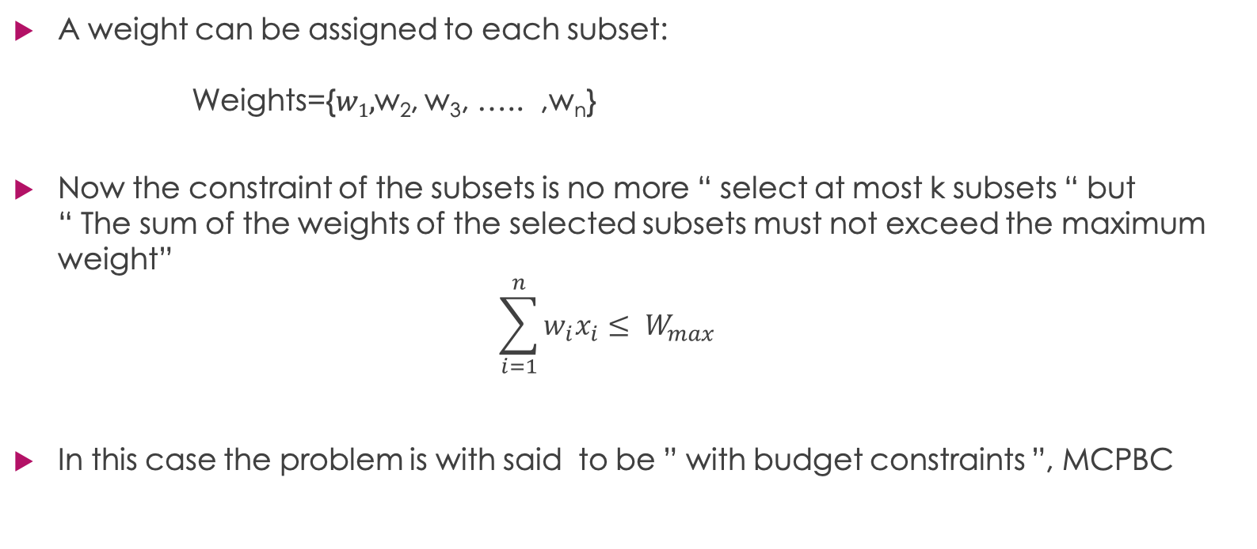
Generalizing the problem
A weight can be assigned to each subset: Weights={$w1,$w₂, w₃, ….. ,w_{n}}
Now the constraint of the subsets is no more “ select at most k subsets “ but “ The sum of the weights of the selected subsets must not exceed the maximum weight” $\sum_{i=1}^{n}{{w_{i}x}_{i}}≤ W_{max}$
In this case the problem is with said to be ” with budget constraints ”, MCPBC

Slide 6
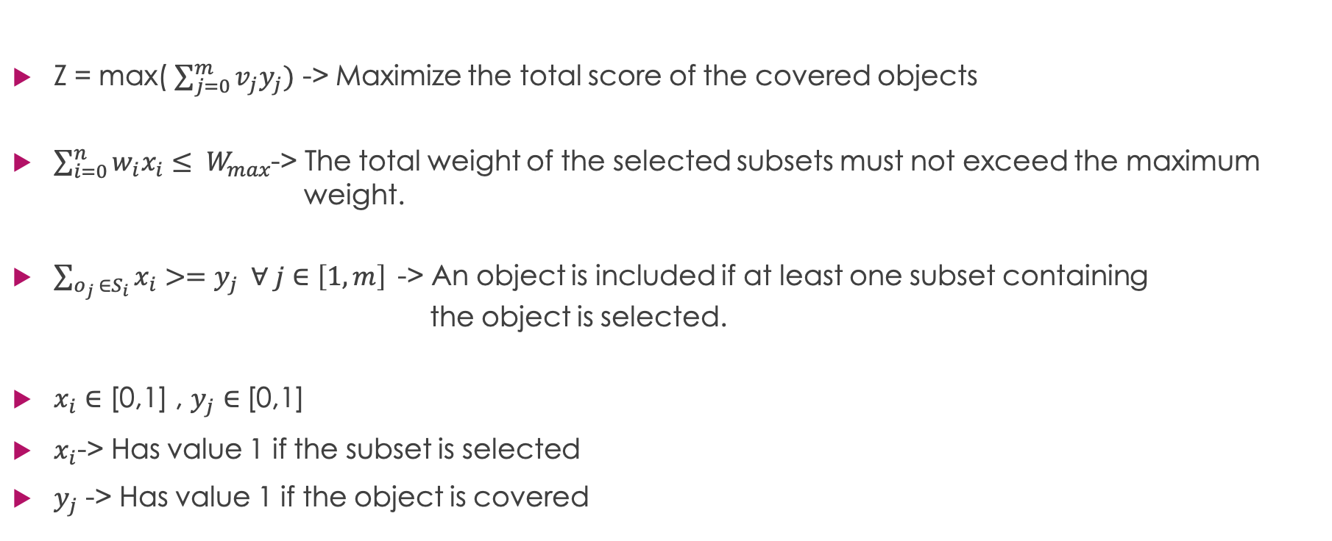
MCPBC-Model
Z = max( $\sum_{j=0}^{m}{v_{j}y_{j})}$ -> Maximize the total score of the covered objects
$\sum_{i=0}^{n}{{w_{i}x}_{i}}≤ W_{max}$-> The total weight of the selected subsets must not exceed the maximum weight.
$\sum_{o_{j} ∈S_{i}}{x_{i}>=y_{j} ∀ j∈\left[1,m\right]}$-> An object is included if at least one subset containing the object is selected.
$x_{i}$ $∈$ [0,1] , $y_{j}$ $∈$[0,1]
$x_{i}$-> Has value 1 if the subset is selected
$y_{j}$ -> Has value 1 if the object is covered

Slide 7
Solution approaches
This problem is an NP-HARD problem.
In this presentation three solving methods are exposed : 1- Gurobi 2- Greedy Algorithm 3- Greedy Algorithm with a Tabu Search

Slide 8
Greedy-algorithm
A first approach can be: Until a subset fills in the remaining capacity : Select the subset with the highest score among the possible choices Add the subset to the solution Update the score and the remaining capacity

Slide 9
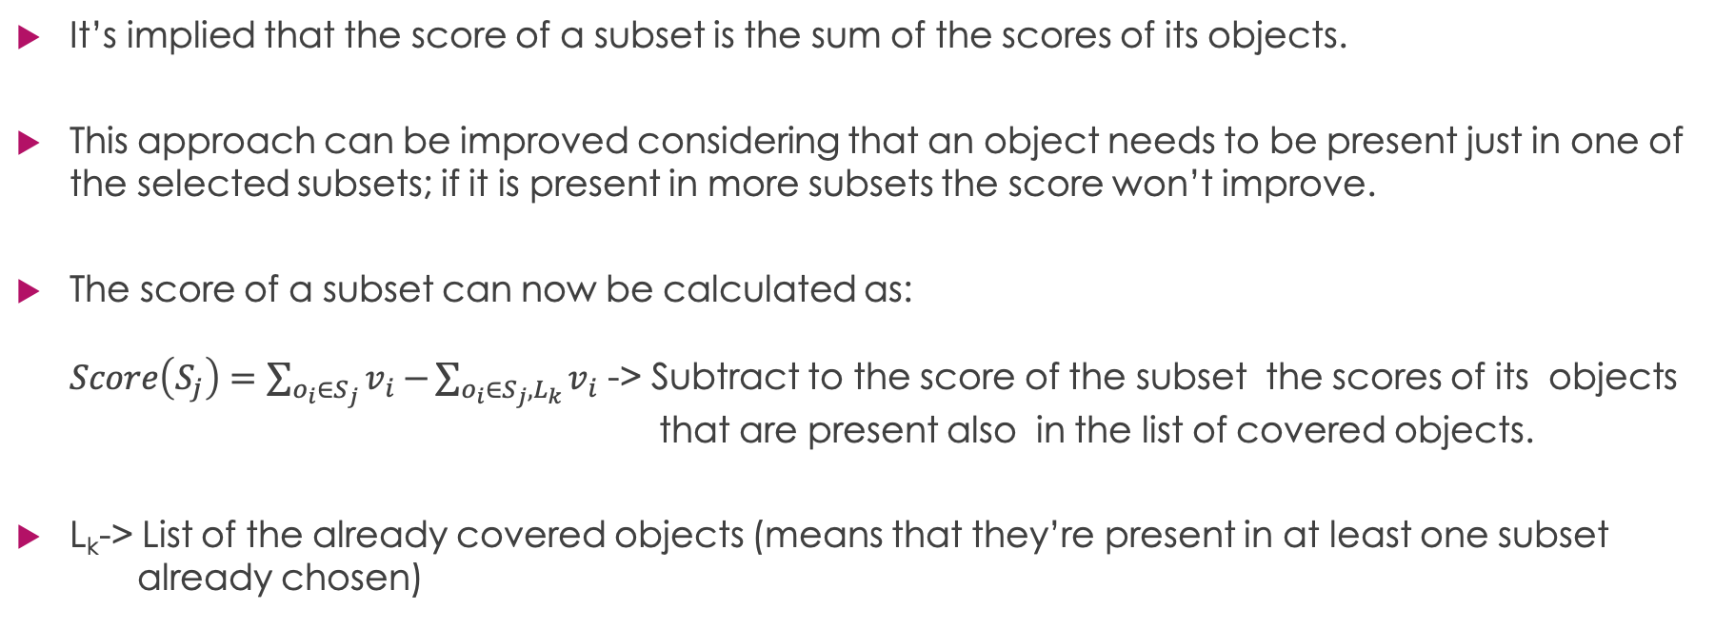
Greedy – A first improvement
It’s implied that the score of a subset is the sum of the scores of its objects.
This approach can be improved considering that an object needs to be present just in one of the selected subsets; if it is present in more subsets the score won’t improve.
The score of a subset can now be calculated as: $Score\left(S_{j}\right)=\sum_{o_{i}∈S_{j}}{v_{i}−}\sum_{o_{i}∈S_{j}, L_{k}}{v_{i}}$ -> Subtract to the score of the subset the scores of its objects that are present also in the list of covered objects.
L_{k}-> List of the already covered objects (means that they’re present in at least one subset already chosen)

Slide 10
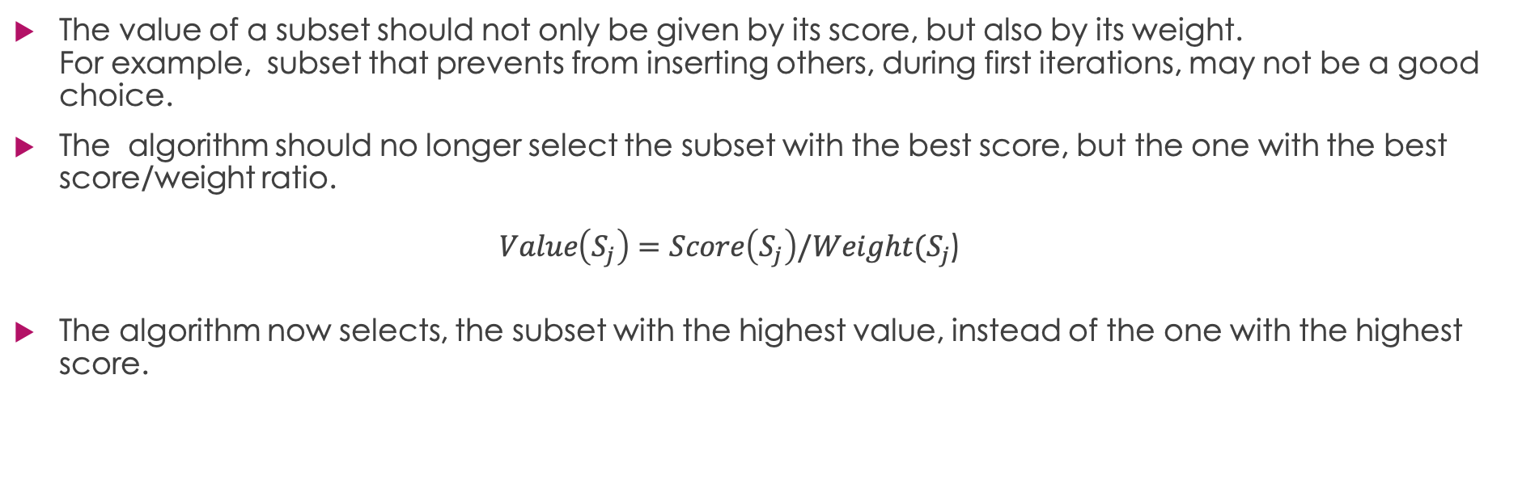
Greedy – A Second improvement
The value of a subset should not only be given by its score, but also by its weight. For example, subset that prevents from inserting others, during first iterations, may not be a good choice.
The algorithm should no longer select the subset with the best score, but the one with the best score/weight ratio. $Value\left(S_{j}\right)=Score\left(S_{j}\right)/Weight(S_{j}$)
The algorithm now selects, the subset with the highest value, instead of the one with the highest score.

Slide 11
Algorithm
remaining_capacity=W_{max}
score=0
L_{k}=[]
remaining_subsets=subsets
loop_value,loop_best_value,best_sub=0,-1,0
while argmin_{sub}(subsetWeights of remaining_subsets)>remaining_capacity:
for sub in remaining_subsets:
if subsetWeights[sub]> remaining_capacity:
remove(remaining_subsets,sub)
else
loop_value=calcValue(objectsInSub[sub],subsetWeights[sub],objectsScore,Lk)
if loop_value>loop_best_value:
loop_best_value=loop_value
best_sub=sub
if loop_best_value==0:
break
remove(remaining_subsets, best_sub)
for obj in objectsInSub[best_sub]:
if not obj in Lk:
append(Lk,obj)
score+=objectsScore[obj]
remaining_capacity-=subsetWeight[sub]

Slide 12
Calc Value function
calcValue(objectsInSub,subsetWeight,objectsScore,Lk):
score=0
for obj in objectsInSub:
if object not in Lk:
score+=objectsScore[obj]
return score/subsetWeight

Slide 13
A greedy example: HASHCODE 2020
The Google HASHCODE 2020 is a special case of the MCPBC and can be solved with a modified version of the previously shown greedy.
There is a set of books, each with its own score ( The set of objects and scores)
Each book is contained in one or more libraries ( Subsets)
Each library can send books to a specific ” scan facility” after a signing up process; the goal is to scan the most valuable books ( each book needs to be scanned just once, it can be scanned twice or more times, but it will be counted as one scan) before a specific deadline.

Slide 14
A greedy example: HASHCODE 2020
The signing up time is different for each library and only one library at a time can sign up to the facility, the signup time is in fact the equivalent of the weight of subsets
The maximum weight is the deadline.
Until now the problem can be classified just as a classic MCPBC; it has however another constraint that, taken into account, makes it more difficult than its classical instance.

Slide 15
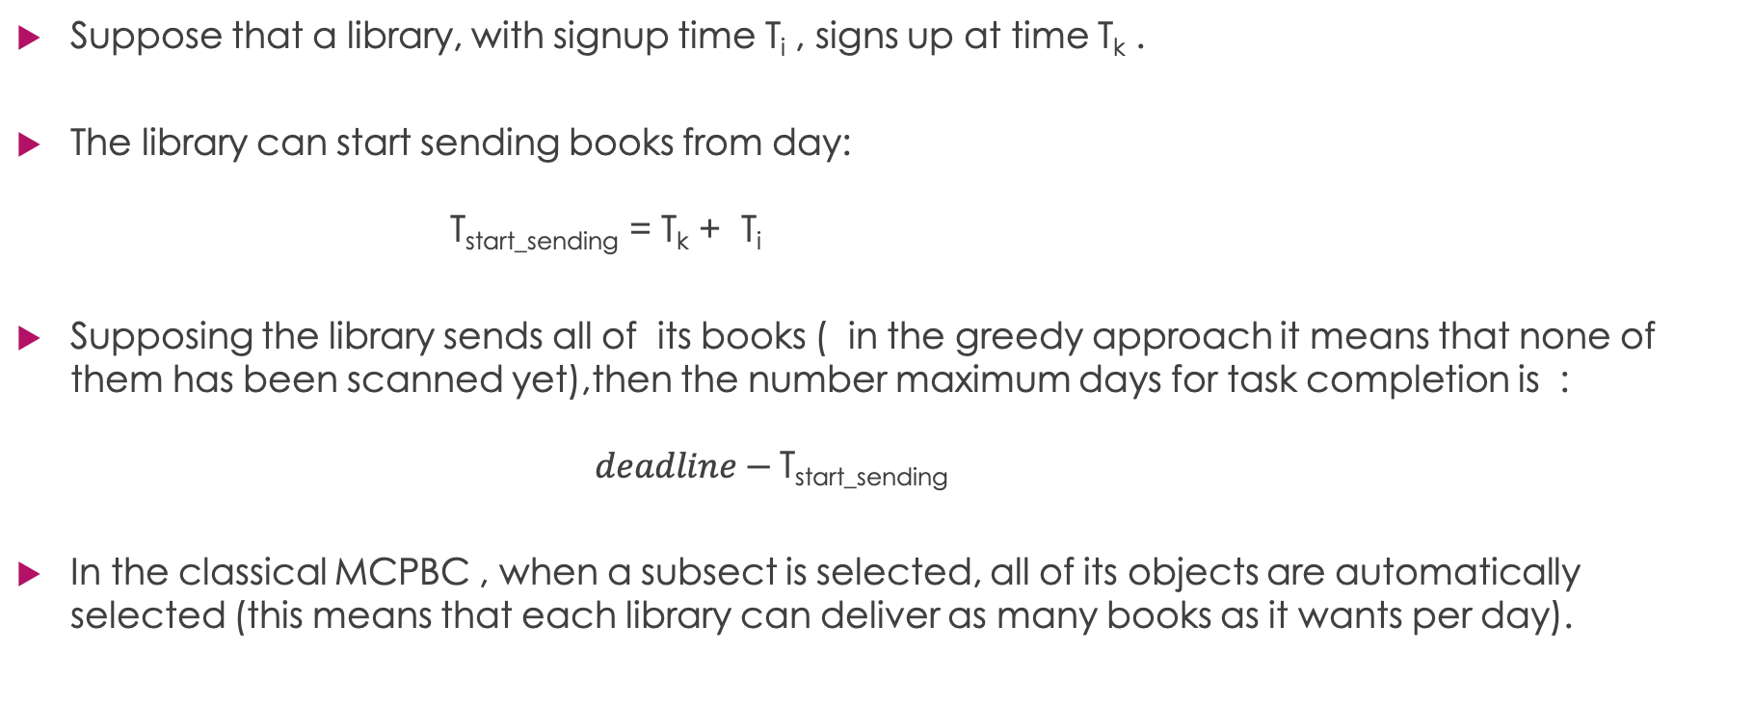
HASHCODE 2020 vs MCPBC
Suppose that a library, with signup time T_{i} , signs up at time T_{k} .
The library can start sending books from day: T_{start_sending} = T_{k} + T_{i}
Supposing the library sends all of its books ( in the greedy approach it means that none of them has been scanned yet),then the number maximum days for task completion is : $deadline−$T_{start_sending}
In the classical MCPBC , when a subsect is selected, all of its objects are automatically selected (this means that each library can deliver as many books as it wants per day).

Slide 16
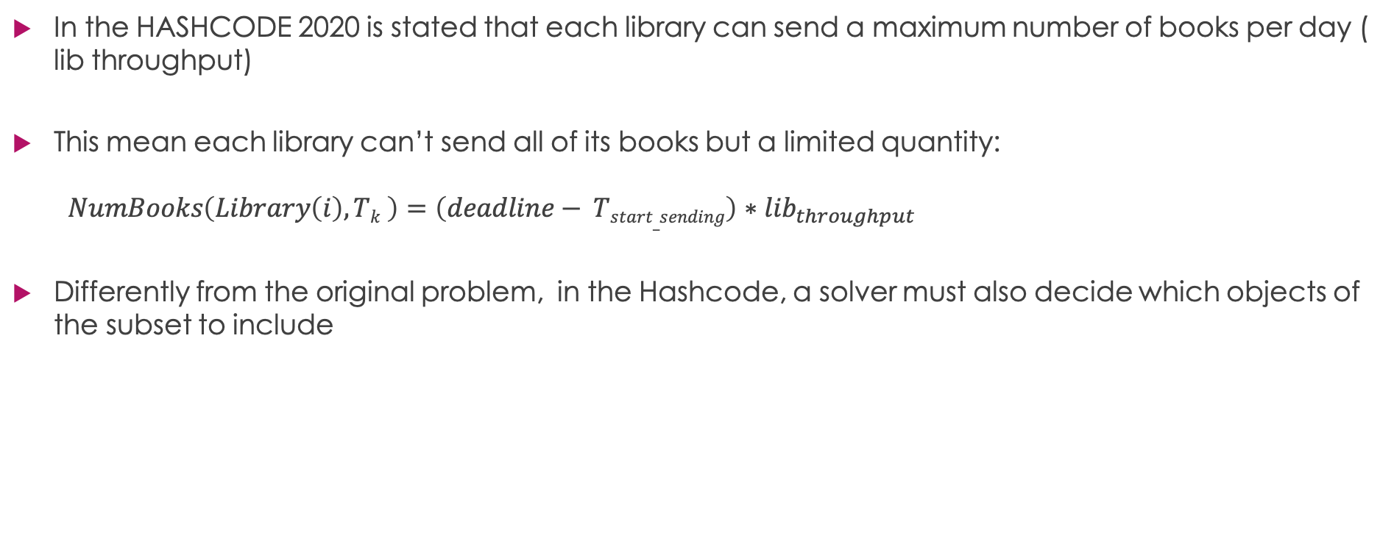
HASHCODE 2020 vs MCPBC
In the HASHCODE 2020 is stated that each library can send a maximum number of books per day ( lib throughput)
This mean each library can’t send all of its books but a limited quantity: $NumBooks\left(Library\left(i\right), Tk \right)=\left(deadline− Tstart_sending\right)∗lib_{throughput}$
Differently from the original problem, in the Hashcode, a solver must also decide which objects of the subset to include

Slide 17
Hashcode 2020:The Greedy modification
The same Greedy used for the MCPBC can be applied because, as previously seen, this Hashcode is a specific case of a more general problem.
However, in order to obtain a better result, the Greedy algorithm needs to take into account also the lib throughput ( not all the books can be delivered in time).
The calcScore function calculates the books that library can deliver if selected for signup process at time T_{k}: NumBooks(Library(i), T_{k} )=(deadline- T_{start_ending} )*lib_throughput
Then it calculates the score selecting NumBooks(Library(i), T_{k} ) books with the highest score, not present in the list L_{k} ( the list represents the books already sended ,or scheduled to be sended, by libraries previously included in the solution).
This score , divided by lib Signup Time ( weight), is returned.

Slide 18
Calc Value HASHCODE
CalcValueHashcode(booksPerLib, libSignupTime, libThrougput,actualTime,bookScores,deadline,Lk):
sort(booksPerLib)
NumBooks=min (len(booksPerLib),(deadline-(actualTime+librarySignupTime)*libraryThrougput)
score=0
books_placed,i=0,0
# supposing the books already ordered by score
while i <NumBooks and books_placed< len(booksPerLib) :
book=booksPerLib[i]
if book not in Lk:
score+=bookScores[book]
books_placed++
i++
return (score/librarySignupTime,NumBooks)

Slide 19
Greedy HASHCODE
remaining_time=deadline
score=0
L_{k}=[]
remaining_libs=libs
loop_value,loop_best_value,best_lib=0,-1,0
while argmin_{sub}(libsSignupTime of remaining_libs)>remaining_time:
for lib in remaining_libs:
if libsSignupTime[lib]>remaining_time
remove(remaining_libs,lib)
else
loop_value,NumBooks=calcScore(booksPerLibrary[lib],signupTime[lib],throughputs[lib],booksScore,deadline,remaining_timeLk)
if loop_value>loop_best_value:
loop_best_value=loop_value
best_lib=lib
if loop_best_value==0:
break
remove(remaining_lib, best_lib)
removed=0
for book in booksPerLib[best_lib]: #also the calculation is different
if not book in Lk:
append(Lk,book)
score+=booksScore[books]
removed++
if removed==MaxBooks:
break
remaining_time-=signupTime[best_lib]

Slide 20
Results
Instance Name | Time (seconds) | Score
a_example | 0 | 21
b_read_on | 0.6756136417388916 | 5813900
c_incunabula | 36.24532437324524 | 5689822
d_though_choices | 521.3948211669922 | 5028465
e_so_many_books | 6.803157567977905 | 5003279
f_lbraries_of_the_world | 1.471337080001831 | 5302835
Total Score
26838322
Compared to the scores obtained during the round, this score is between the 456th and 457th positions. The best team scored: 27203691 .

Slide 21
MCPBC Tabu Search
To further improve the Greedy solution of the MCPBC, a local search can be used
Due to the Greedy approach, which tends to ” saturate “ the capacity, the only possible move is swapping a subset in the solution with another one not in it .
Why a Tabù Search? In the classic MCP problem the maximal value is always achieved with a solution of maximal cardinality. In the budget version this can happen at every cardinality, making easy for a local search to get stuck in a local maximum.
To extend the research space the Tabu Search considers also the infeasable neighborhood i.e. the solutions with total weight greater than W_{max} .

Slide 22
MCPBC Tabu Search
Infeasable Zone = A set of close solutions with the capacity constraint relaxed
Feasable Zone= A set of close solutions with the capacity constraint respected
The basic idea is to do a local search in the Infeasable Zone; even if the neighborhood best solution is infeasable (i.e. capacity constraint not respected) it is taken as current solution.
If the new current solution is better than the best feasable solution, and is feasable, then the best feasable solution is updated.
If the solution is infeasable since many iterations the local search is made in the feasable zone
If the best solution isn’t updated since a specific number of iterations, the algorithm stops.

Slide 23
Infeasable to feasable
It can happen ,after many iterations in the infeasable zone, that the feasable zone is empty. In order to don’t stop the algorithm then the actual infeasable solution is made back feasable by removing the most useless subsets i.e. the ones with the worst objects. Infeas2Feas: while current_weig> W_{max} : to_remove=argmin_{sub} (subs scores for sub in solution) remove(solution,subset) remove objects and update the score current_weig -= subsetWeights[to_remove]

Slide 24
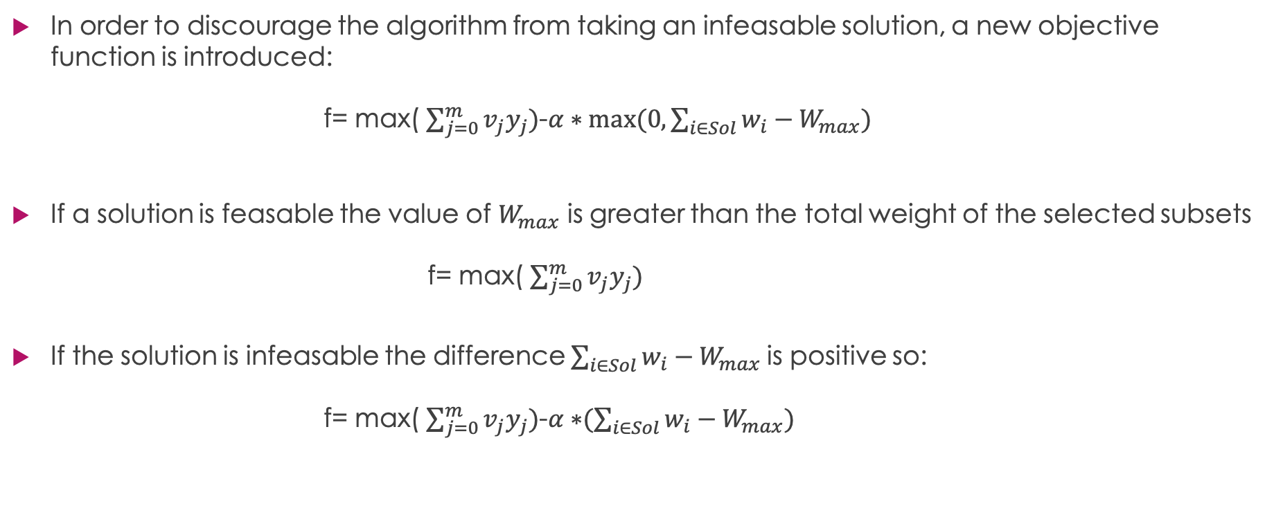
Infeasability penality
In order to discourage the algorithm from taking an infeasable solution, a new objective function is introduced: f= max( $\sum_{j=0}^{m}{v_{j}y_{j})}$-$α∗max⁡(0,\sum_{i∈Sol}{w_{i}−W_{max}) }$
If a solution is feasable the value of $W_{max}$ is greater than the total weight of the selected subsets f= max( $\sum_{j=0}^{m}{v_{j}y_{j})}$
If the solution is infeasable the difference $\sum_{i∈Sol}{w_{i}−W_{max} }$is positive so: f= max( $\sum_{j=0}^{m}{v_{j}y_{j})}$-$α∗⁡(\sum_{i∈Sol}{w_{i}−W_{max}) }$
Notes:
WHERE SHOULD I EXPLAIN THE TABULIST

Slide 25
Tabu Search
If the current solution is infeasable since less N_{i} consecutive iterations then the algorithm searchs the best swap in the infeasable zone( considers also infeasable solutions) and adds the correspondent subset exiting from the solution in the tabù list, the current solution is updated.
If the current solution is infeasable since N_{i} consecutive iterations the algorithm search the best swap in the feasable zone and adds the correspondent subset exiting from the solution in the tabù list, the current solution is updated.
If the feasable zone is empty, the current solution is made feasable
If the new solution is feasable and has an higher score than the actual best feasable solution the best feasable solution is updated
The algorithm stops after N_{t} iterations without an update

Slide 26
Tabù Search Algorithm
while iters_without_updating<N_{t} :
if iters_infeasable<N_{i} :
entering_sub, exiting_sub=infeasSearch(current_solution)
append(tabu_list, exiting_sub)
current solution,score= update with entering_sub
else if feasable zone of current solution is empty:
current_solution =infeas2Feas(current solution)
else:
entering_sub, exiting_sub=feasSearch(current_solution)
append(tabu_list, exiting_sub)
current solution= update with best swap
if current solution is infeasable:
iters_infeasable++
iters_without_updating++
else:
iters_infeasable=0
if score(current solution )> score(best solution)
best solution=current solution
iters_without_updating=0
else
iters_without_updating++

Slide 27
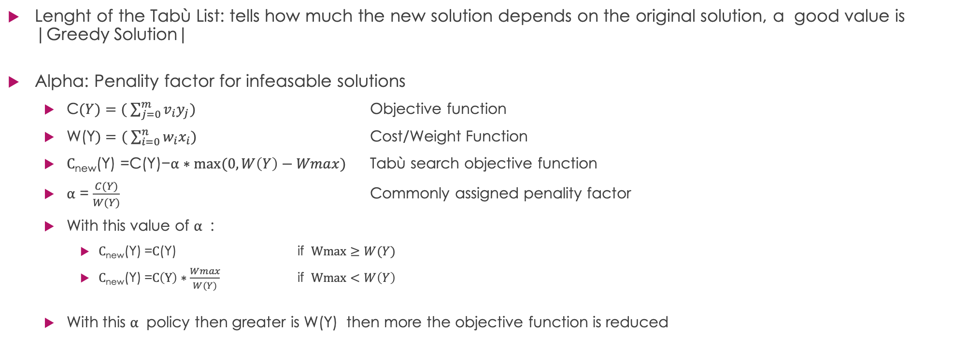
Tabù Search Parameters
Lenght of the Tabù List: tells how much the new solution depends on the original solution, a good value is |Greedy Solution|
Alpha: Penality factor for infeasable solutions
C$(Y)=( \sum_{j=0}^{m}{v_{i}y_{j})}$ Objective function
W(Y$)=( \sum_{i=0}^{n}{w_{i}x_{i})}$ Cost/Weight Function
$\text{C}\text{new}\text{(}\text{Y}\text{) =}\text{C}\text{(}\text{Y}\text{)−}α∗max⁡(0,W\left(Y\right)−Wmax)$ Tabù search objective function
$α$ = $\frac{C(Y)}{W(Y)}$ Commonly assigned penality factor
With this value of $α$ :
$\text{C}\text{new}\text{(}\text{Y}\text{)}$=$\text{C}\text{(}\text{Y}\text{) }$ if $Wmax≥W(Y)$
$\text{C}\text{new}\text{(}\text{Y}\text{)}$=$C\left(Y\right)∗\frac{Wmax}{W(Y)}$ if $Wmax<W\left(Y\right)$
With this $α$ policy then greater is W(Y) then more the objective function is reduced

Slide 28
Tabù Search Parameters
N_{i} : maximum consecutive infeasable iterations
Used value=|Greedy Solution| in order to change at least the entire solution if the neighborhood is composed by only infeasable solutions
N_{t} : maximum consecutive iterations without best feasable solution update
Used Value= 4* |Greedy Solution|, higher values doesn’t give a good solution quality time ratio

Slide 29
Tabù Search Parameters
Instance Name | NUM SUBSET | Num Objects | MAX BUDGET
bcm_1100_1000_3000 | 1100 | 1000 | 3000
bcm_1100_1000_2000 | 1100 | 1000 | 2000
bcm_1400_1500_3000 | 1400 | 1500 | 3000
bcm_1400_1500_2000 | 1400 | 1500 | 2000
bcm_1500_1600_3000 | 1500 | 1600 | 3000
bcm_1500_1600_2000 | 1500 | 1600 | 2000
Test Machine: MacBook Pro (13-inch, 2018)(8 gb ram, i5 quad core),Catalina 10.15.7

Slide 30
Results
Instance Name | Greedy Score | Greedy Time (seconds) | Tabù Search Score | Tabù Search Time (seconds)
bcm_1100_1000_3000 | 136702 | 0.11843609809875488 | 142588 | 33.630189180374146
bcm_1100_1000_2000 | 120386 | 0.16067290306091309 | 125456 | 57.141313791275024
bcm_1400_1500_3000 | 200025 | 0.13712453842163086 | 205753 | 77.35387396812439
bcm_1400_1500_2000 | 179457 | 0.33812618255615234 | 184034 | 126.20470404624939
bcm_1500_1600_3000 | 216631 | 0.25161004066467285 | 222913 | 103.30870199203491
bcm_1500_1600_2000 | 191521 | 0.40669894218444824 | 195067 | 131.63687205314636

Slide 31
Gurobi Results
What if we solve the problem using Gurobi, giving the Tabù Search time as Time Limit?
Instance Name | Gurobi Score | Gurobi Time (seconds)
bcm_1100_1000_3000 | 143105 | 33.630189180374146
bcm_1100_1000_2000 | 125315 | 57.141313791275024
bcm_1400_1500_3000 | 211088 | 77.35387396812439
bcm_1400_1500_2000 | 182515 | 126.20470404624939
bcm_1500_1600_3000 | 219982 | 103.30870199203491
bcm_1500_1600_2000 | 192141 | 131.63687205314636

Slide 32
Conclusions
Why Gurobi performs so well in relation to the Tabù Search?
This is due to the fact that Gurobi uses a multithread approach and the implementation of the tabù search.
Also notice that the cases where it performs better are “ the simplest”
This confrontation makes evident that the future improvement of the heuristic solver must be a multithread inspection of the neighborhood.
The Greedy solution gives however the best solution quality over time ratio

Slide 33
Bibliography and source code
Bibliography:
https://en.wikipedia.org/wiki/Maximum_coverage_problem#:~:text=The%20maximum%20coverage%20problem%20is,widely%20taught%20in%20approximation%20algorithms.&text=of%20these%20sets%20such%20that,selected%20sets%20has%20maximal%20size
The Maximum Coverage Problem, Investigating Approximation Algorithms for Variants of the Maximum Coverage Problem
Author: Ymro Nils Hoogendoorn
Supervisor: ir. drs. R. Kerkkamp
Second Assessor: dr. W. van den Heuvel
Source code:
https://github.com/AntonioEmmanuele/HashCode-2020-Qualification
https://github.com/AntonioEmmanuele/MCPBC-Solver

