Slide 1

Modeling Internal Migration in Italy: Strategies to Reduce Campania’s Outmigration
Antonio Gargiulo | Control of Complex Networks and Systems
University of Naples Federico II, 19 May 2025

Slide 2
Outline
Introduction & Motivation
Data and Methods
Open-loop Analysis
Control Strategies
Conclusions

Slide 3

Introduction and Motivations
Context Since the post World War II economic boom, Italy has experienced significant internal migration, from the Mezzogiorno to its industrialized north [1], [2].
Goals
Provide a mathematical model to simulate interregional flows across all twenty italian regions represented as nodes of a graph.
Introduce region-specific mobility coefficients and calibrating against ISTAT data.
Predict the effects of economic incentives and targeted inflows as control inputs.
[1] R. Basile, A. Girardi, M. Mantuano, and G. Russo, Interregional migration of human capital and unemployment dynamics: Evidence from Italian provinces, German Economic Review.
[2] ”Dati ISTAT”, 2024. [Online]. Available http://dati.istat.it/

Slide 4
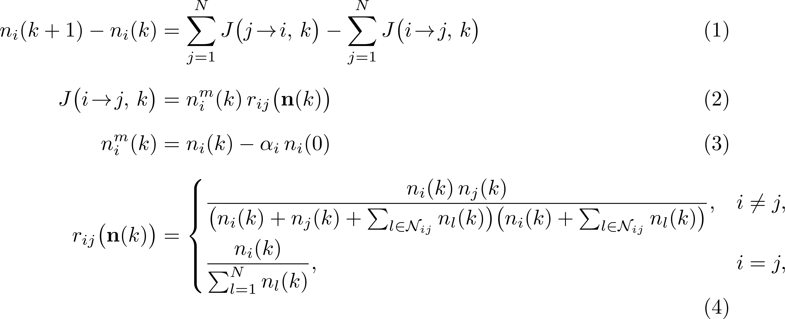
Data and Methods: migration model (1/2)
The following migration model predicts the migration flows for all the twenty italian regions represented as nodes of a network:
Continuity equation [1]
Migration Flux
Mobile Population
Migration Rate [2]
[1] P. De Lellis, M. Ruiz Marín, and M. Porfiri, “Modeling Human Migration Under Environmental Change: A Case Study of the Effect of Sea Level Rise in Bangladesh”
[2] F. Simini, M. C. González, A. Maritan, and A.-L. Barabási, “A universal model for mobility and migration patterns,”
Notes:
Continuity equation: the assumptions are: (1) birth and deat rates balance and (2) there is no net demographic exchange with areas outside the peninsula. Migration rate: this model reflects the fact
that an individual will select its migration destination on the basis of better life opportunities, while
seek ing to remain close to the origin. Therefore, the summation at the denominator in Eq. (2.4)
accounts for intervening opportunities since an individual seek ing to migrate or commute from
region 𝑖 to region 𝑗 will first encounter all of the potential “opportunities” located in regions that
lie closer to 𝑖 than 𝑗 itself.

Slide 5
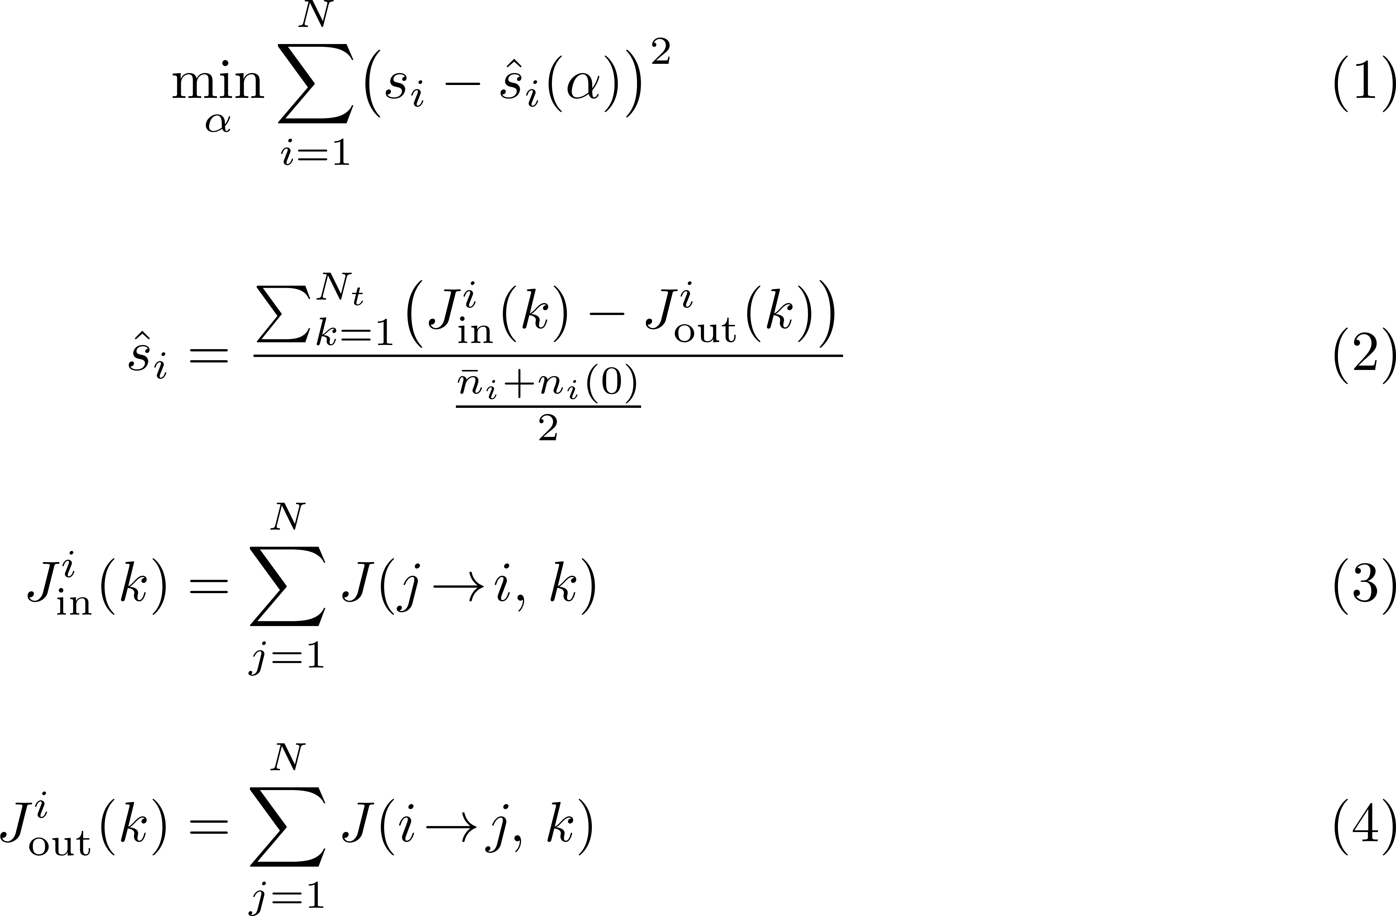

Data and Methods: model calibration (2/2)
A nonlinear least-square optimization determines the coefficients $α_{1},.., α_{N}$ that best reproduce the observed net internal migration balances $s_{i}$ [1].
[1] ”Dati ISTAT”, 2024. [Online]. Available http://dati.istat.it/
Notes:
The calibration of the migration model aims to find the set of values 𝛼1, . . . , 𝛼𝑁, where each
𝛼𝑖 represents the fraction of inhabitants from region 𝑖 who attempt to migrate. Note that the time scale of the migration process is not important, as the net internal migration
balance converges to zero at steady state. Therefore, calibrating the model using net migration
data is appropriate, assuming the model predictions align with the time scale over which the data
were collected.

Slide 6
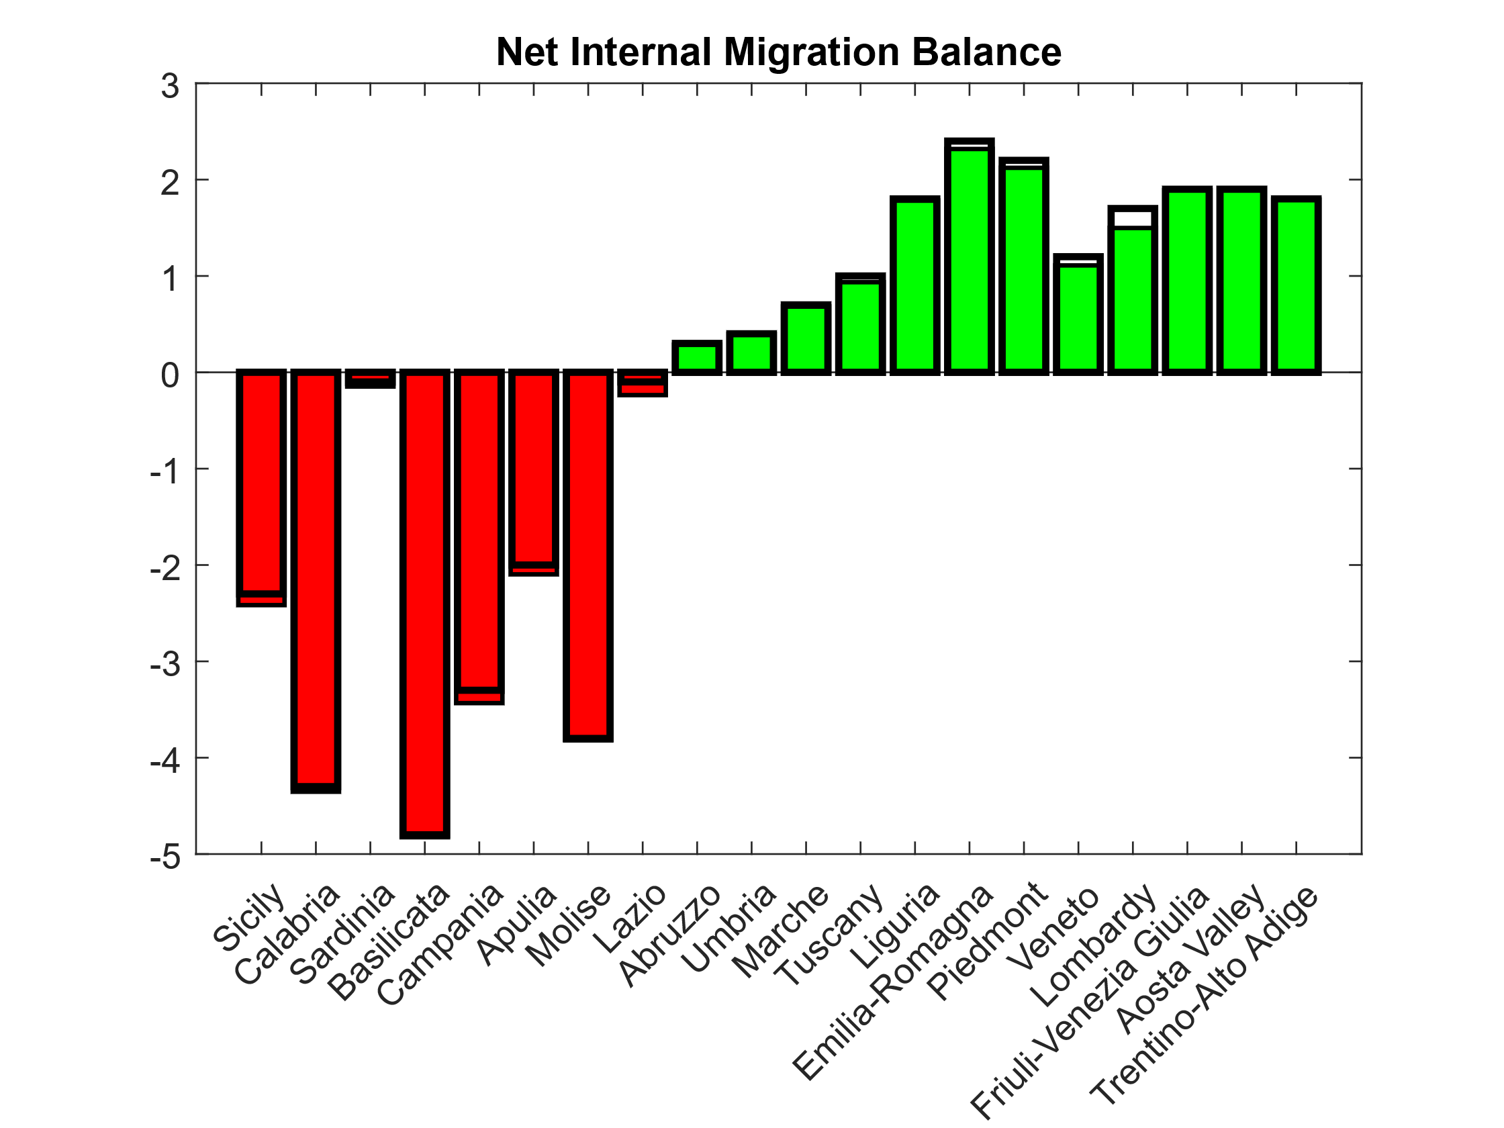
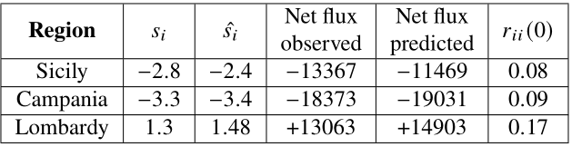
Open-loop Analysis (1/2)
The model predictions are in good agreement with the observed ISTAT data.

Slide 7
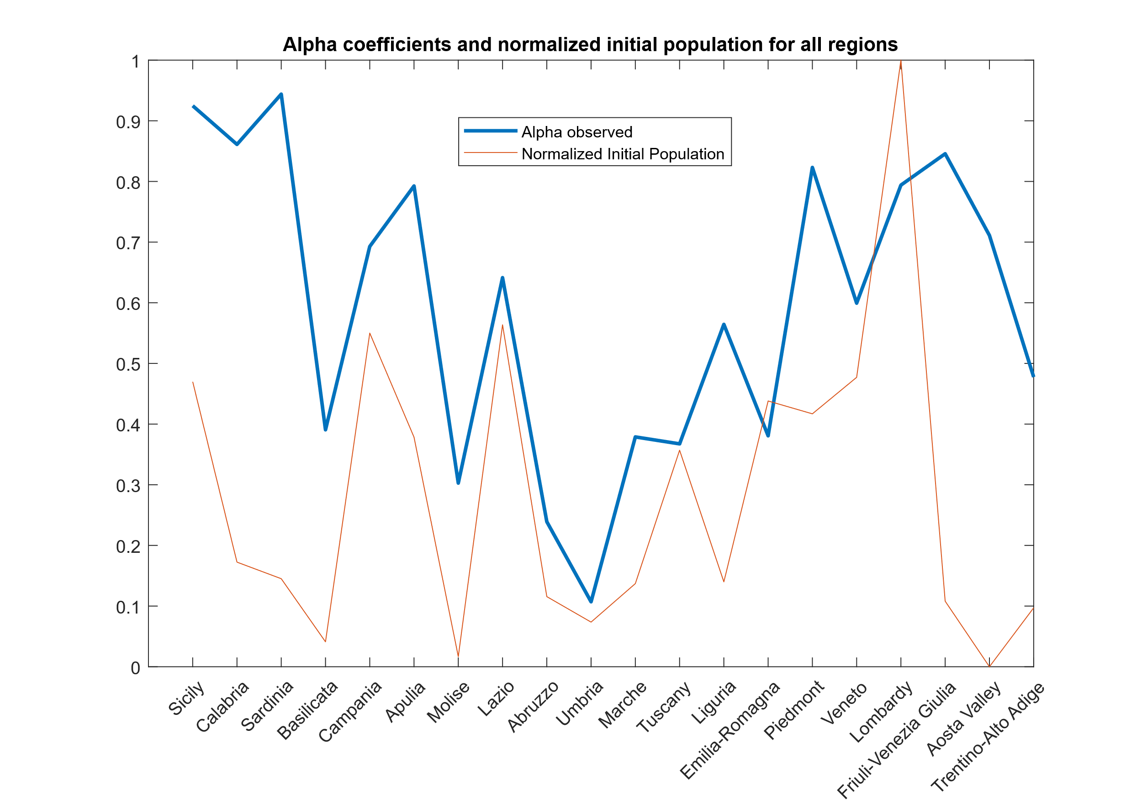
Open-loop Analysis (2/2)
Bigger regions keep more people.
Extra friction in specific small regions.
Notes:
Bigger regions “keep” more people. Whenever 𝑛𝑖(0) is larger, 𝛼𝑖 goes up, meaning a
smaller share of the population is considered “mobile.” This matches the idea that big cities
and dense areas offer more jobs, services, transport link s and social network s—so fewer
people feel the need (or have the chance) to leave.
• Extra friction in certain small regions. Some places (e.g. Sicily) get a surprisingly high
𝛼𝑖 despite their smaller size. That’ s because the basic radiation model would otherwise
over-predict how many people leave. To correct this, 𝛼𝑖 absorbs local hurdles like e ferry costs
and travel times, housing shortages, strong family or community ties, or even under-reported
moves. Overall, 𝛼𝑖 acts as a simple, region-by-region “friction” factor that improves the pure radiation
predictions—built only on populations and distances—to fit the real migration data.

Slide 8
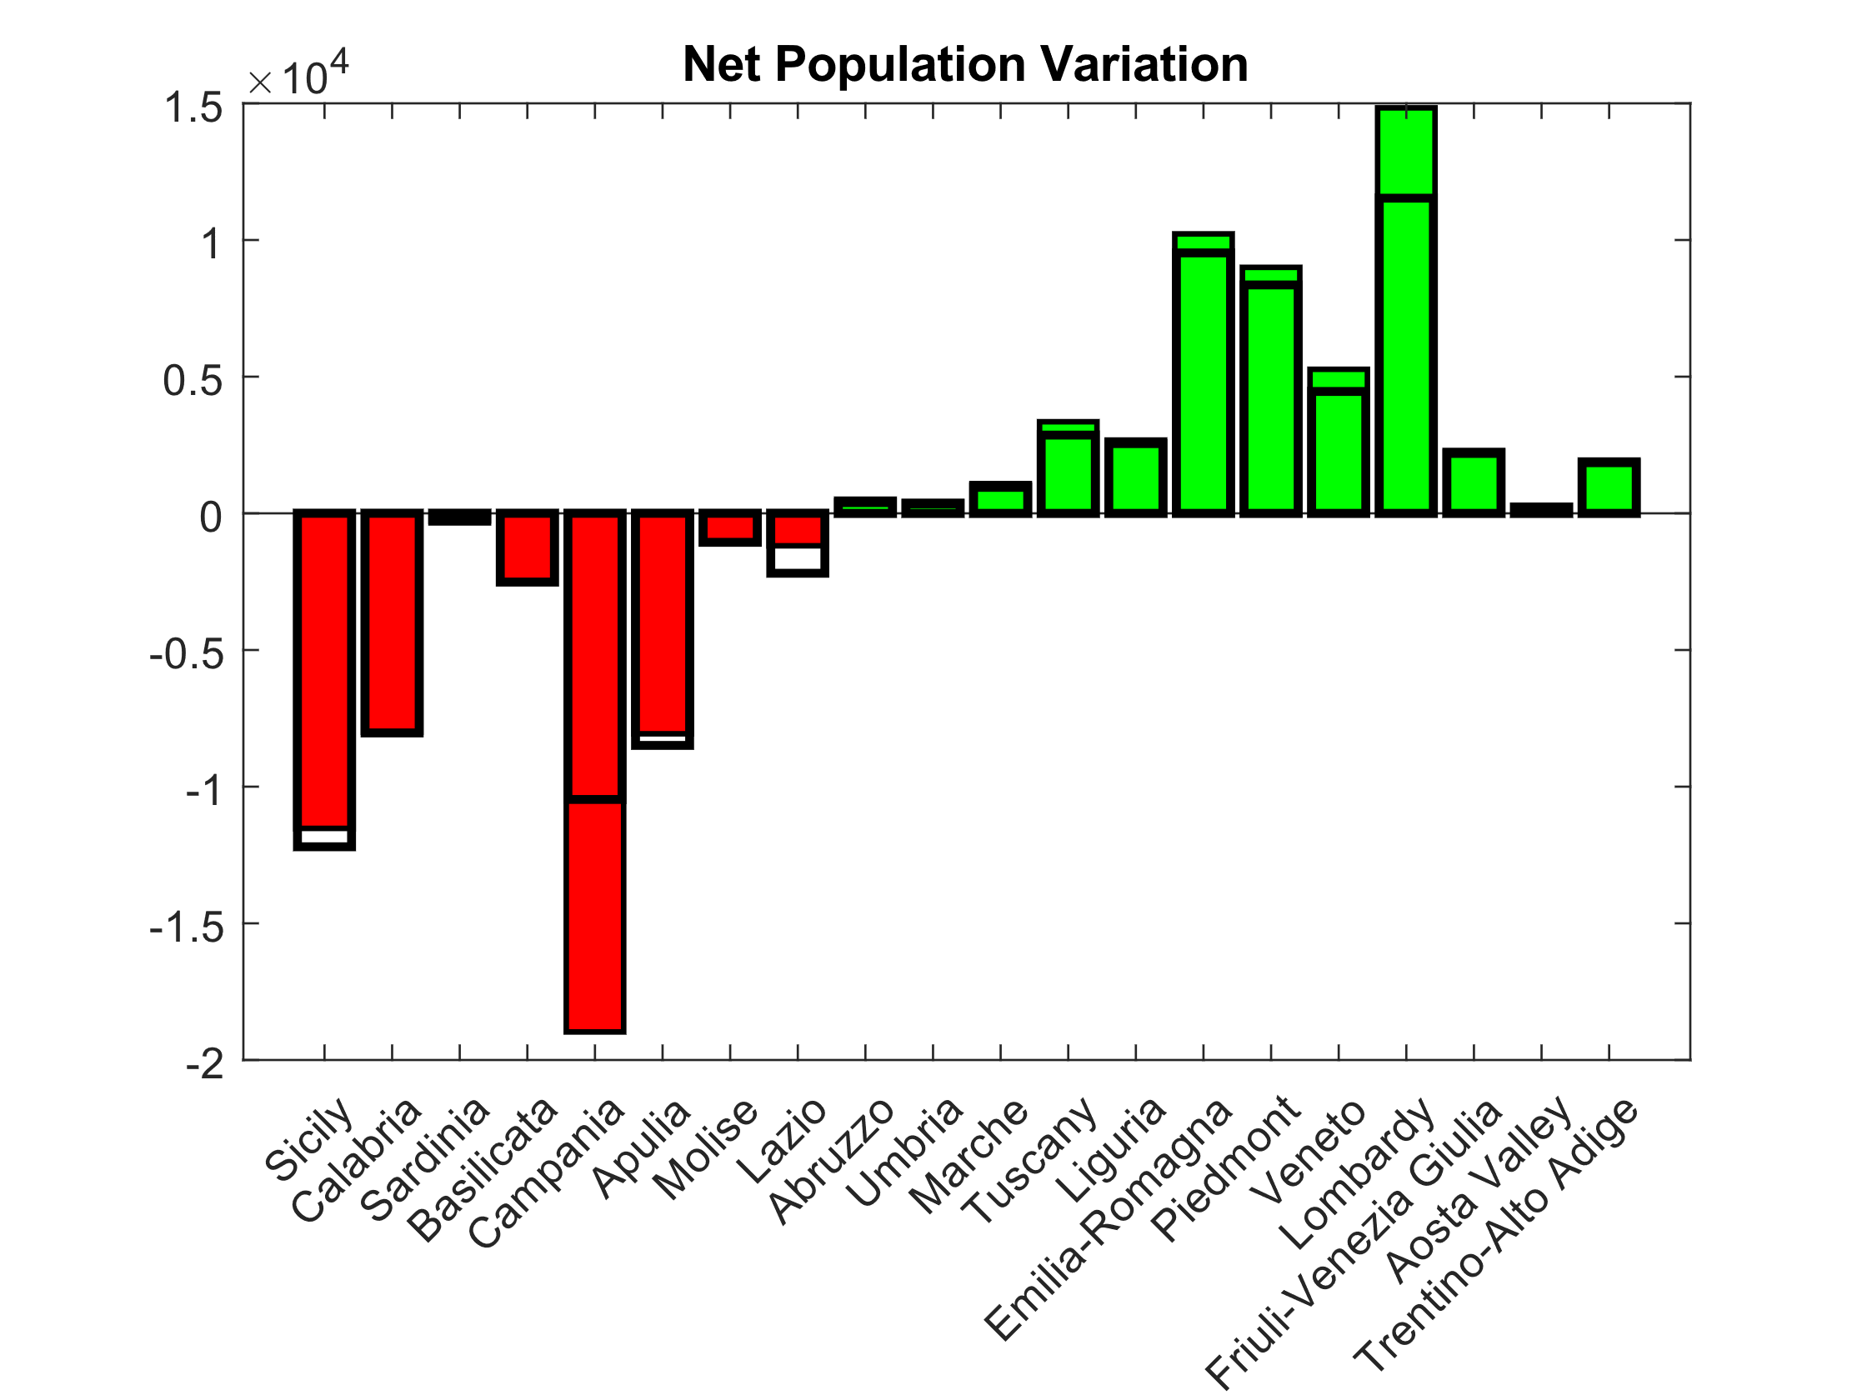
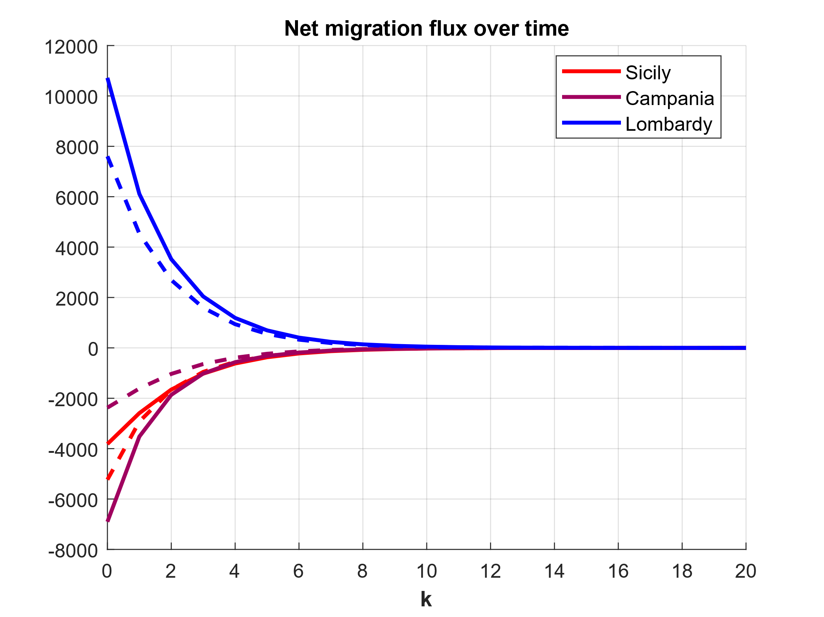

Control Strategies: economic incentives
Control goal: prescribe a net internal migration balance of reference and then find the optimized $α_{i}$
A decline in regional mobility is observed.
Notes:
- If Campania reduces its outmigration, then the model will predict more people migrating from the other southern regions.

Slide 9
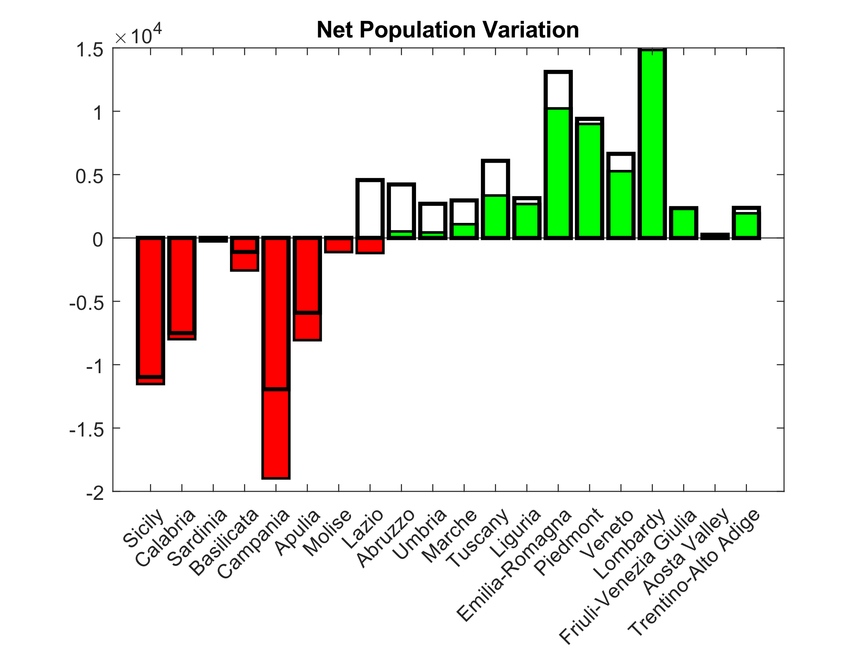
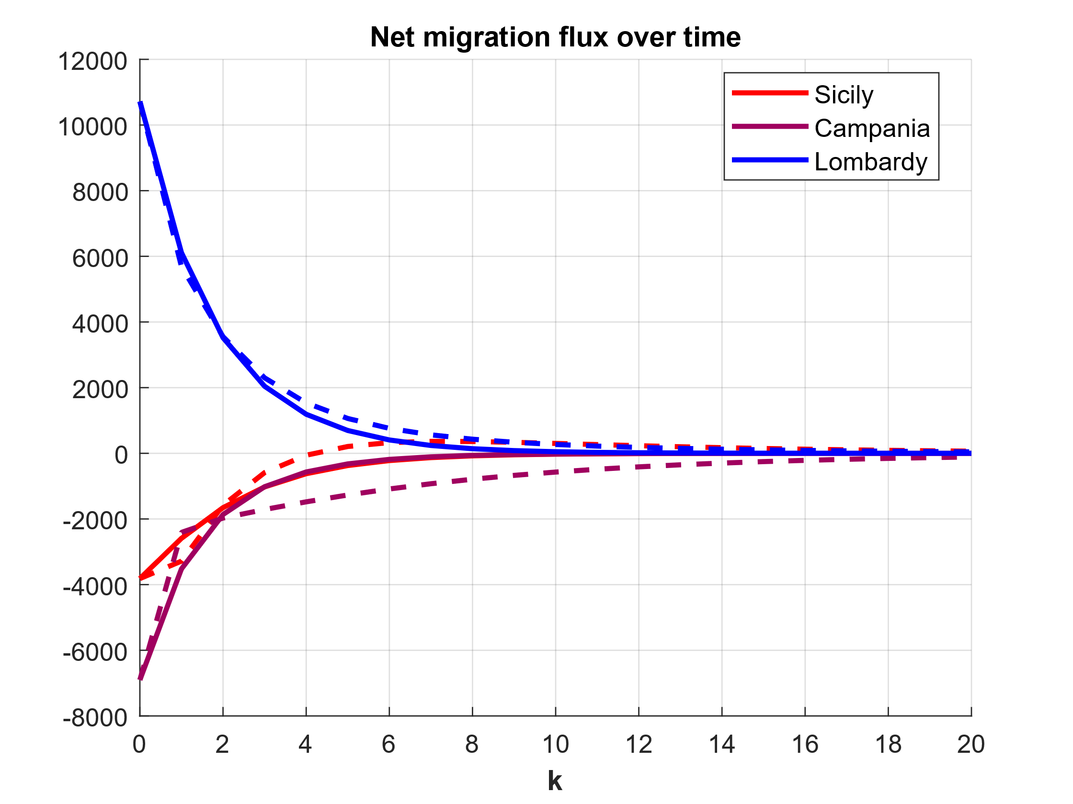
Control Strategies: extra migration flows
Control goal: compute the target steady-state population from the net internal migration balance of reference.
Pinning control increases mobility across Italian regions.
Notes:
- The pinning control simulates the effects of a migrants injections that is also beneficial for outher southern regions, whose net internal migration balance becomes less negative ( the opposite of the situation with the tuning of alpha coefficients)

Slide 10
Conclusion
Summary:
A nonlinear model for the Italy’s internal migration by combining the parameter-free radiation model with region-specific mobility coefficients has been introduced and calibrated against ISTAT data.
An open-loop analysis shows the goodness of the model predictions.
Both economic incentives and extra-migration actions are modelled as control strategies.
Considerations
Local economic incentives reduce the overall mobility, convincing people to stay in their region.
International migration increases all the region’s population.

Slide 11

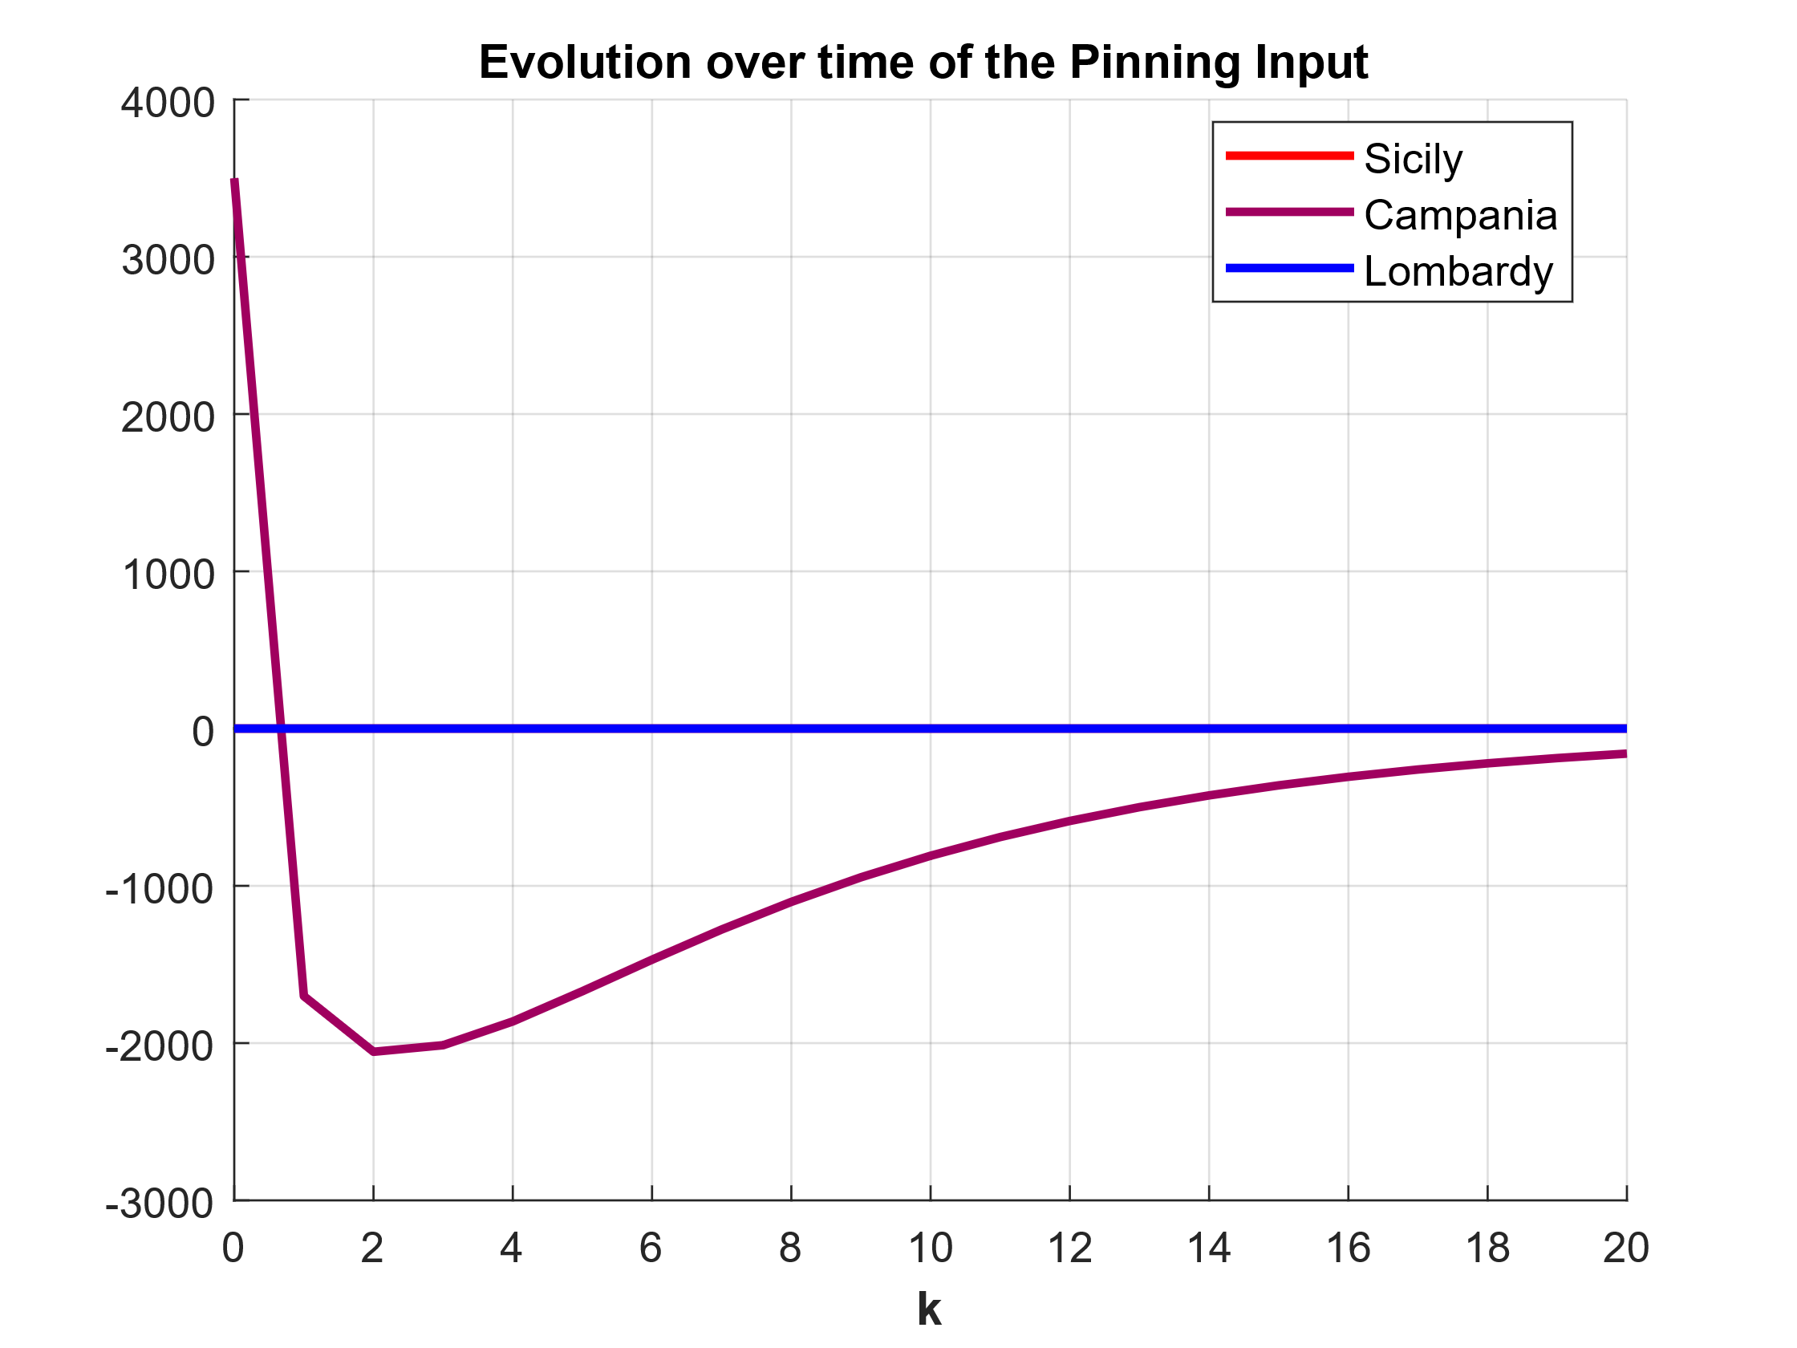
Backup slides
The pinning control considers a reference on the steady-state Campania population:

