Slide 1


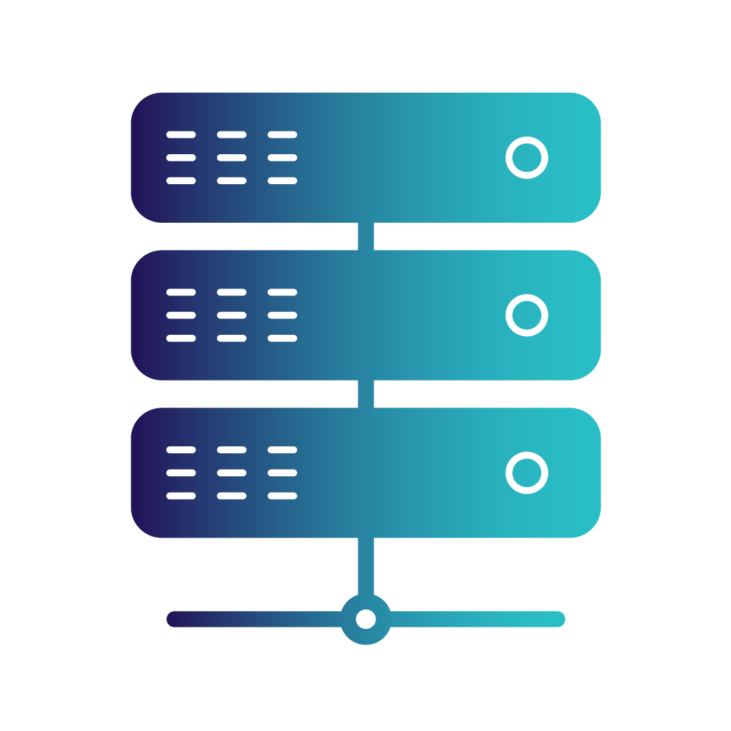
server1
Client
http://localhost
proxy reverse

Slide 2
server1
Client
http://localhost
proxy reverse

Slide 3

http://localhost
proxy reverse
http://nginx-laravel:8083
Web Server
http://laravel1:9000
PHP – Laravel

Slide 4


http://server1:8081
HTML Server
http://server1:8081
HTML Server
Client
http://localhost
proxy reverse
http://server2:8082
CSS Server
http://games1:9001
Java – Spring Boot
http://server2:8082
CSS Server

