Slide 1
How to use the IEEE Corporate Presentation template
This template is designed to be used as a Microsoft PowerPoint template only. Modifications of the IEEE Master Brand and IEEE tagline on the template is prohibited.
Note: Downloading your file and saving in a different format may cause technical issues. For example, uploading a PowerPoint file to Google Drive, converting to Google Slides, and exporting back to PowerPoint may create issues.
The IEEE Corporate Presentation is available for download in the following formats on the IEEE Brand Experience site:
Microsoft PowerPoint template
Google Slides template
Questions pertaining to this template can be submitted at: www.ieee.org/exd

Slide 2
Real-Time Training-Free Multimodal Identity Verification using Biometrical Score Fusion
Antonio Labinjan, Nikola Tanković
Faculty of Informatics, Juraj Dobrila University, Pula

Slide 3
The Problem
Unimodal Biometrics Can Fail in the Real World
Face recognition
Sensitive to illumination changes
Degrades under pose variation
Fails on motion blur & occlusion
Voice recognition
Degrades under ambient noise
Struggles with reverberant rooms
Vulnerable to cross-speaker confusion
Results in elevated false rejection and false acceptance rates in deployment

Slide 4
Motivation
The Gap in Existing Multimodal Fusion
Paired
Dataset
Joint
Training
Fused
Model
Deep multimodal fusion needs synchronized, paired datasets
Joint training adds computational overhead and overfitting risk
Prevents independent upgrades of face / voice sub-models

Slide 5
Real-Time Training-Free Multimodal Identity Verification using Biometrical Score Fusion
Contributions
Real-time multimodal framework fusing face and voice biometrics
Unified Qdrant retrieval backend for heterogeneous embeddings
Training-free fusion - no joint optimization or paired data required
Temporal decision layer: agreement, missing-stream, and conflict states

Slide 6
SYSTEM DESIGN
Camera Node
Microphone Node
CLIP ViT-B/32
512-D face embedding
VoiceNet CNN
128-D speaker embedding
Unified Vector DB (Qdrant)
cosine search · shared identity metadata
Temporal Stream Aligner
peak match (Cᵥ, Cₐ) per identity, before state logic
State Logic Engine → Identity Verification Output
05

Slide 7
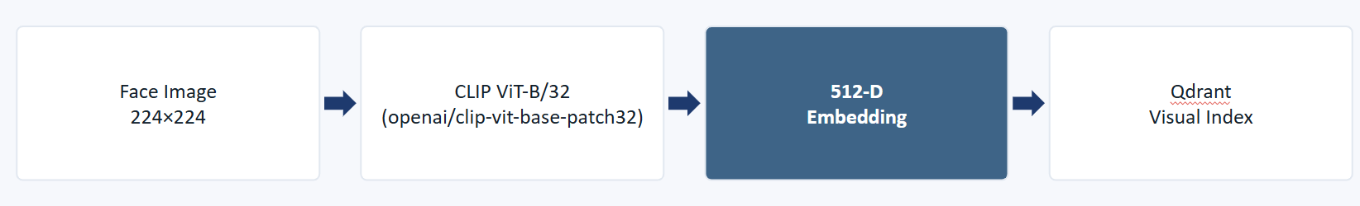
Visual pipeline
Face recognition algorithm
Builds on prior zero-shot work (Labinjan et al.) - encoder unchanged
Robust to domain shifts: pose, illumination and blur variation
Migrated retrieval backend from FAISS to Qdrant for unified infrastructure

Slide 8
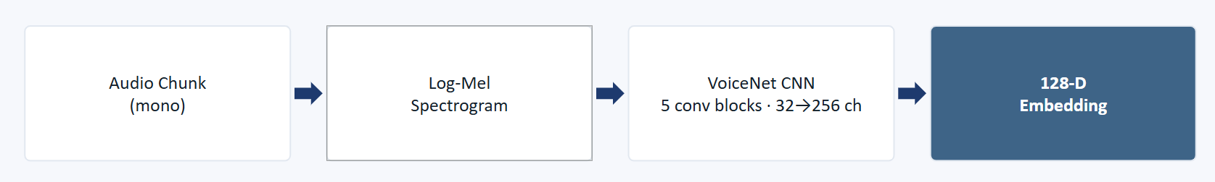
Audio pipeline
Voice recognition algorithm
Trained closed-set on VoxCeleb: Conv2d + BatchNorm + MaxPool x5
The “truncation trick”: Softmax head used only for training, then discarded
Remaining backbone reused as zero-shot open-set speaker embedding extractor

Slide 9
Infrastructure
Qdrant unification
Two Separate FAISS Indexes | One Unified Qdrant Backend
Two vector indexes to maintain | Centralized vector storage and retrieval
Duplicated identity metadata | Shared identity and metadata schema
Manual sync across storage layers | Modality-specific similarity retained
Separate persistence mechanisms | One deployment configuration
Clarification: Qdrant unifies infrastructure and identity metadata - not the vector spaces themselves. Face (512-D) and voice (128-D) embeddings remain separate.

Slide 10
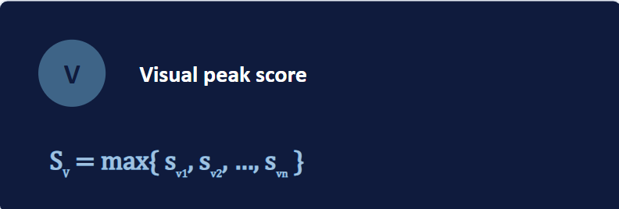
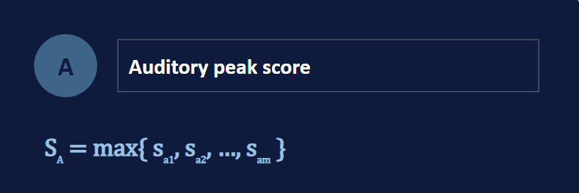
Methodology
Score alignment and normalization
Camera and microphone streams arrive asynchronously at different rates - strict frame-level alignment is infeasible. Instead, the system takes the peak similarity score per modality within an evaluation window.
Eq. (1)–(2): both pathways share Qdrant cosine-similarity retrieval, so Sᵥ and Sₐ are compatible and can be thresholded before fusion.

Slide 11
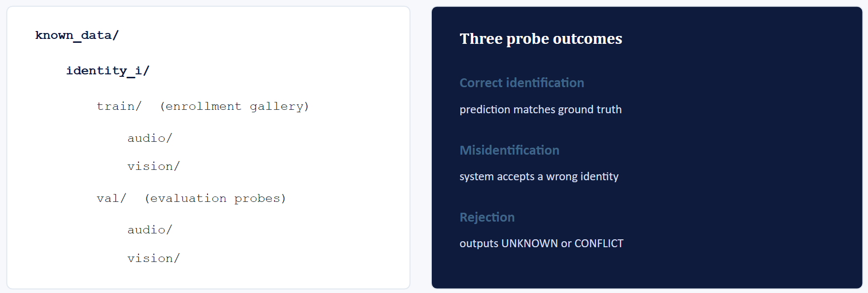
Experimental setup
Dataset & evaluation protocol

Slide 12
Methodology
Evaluation metrics
Accuracy | Misidentification Rate | Rejection Rate (unknown)
n_correct/n_total | n_misidentified/n_total | n_rejected/n_total
Together, the three quantities describe complementary failure behavior across the unimodal and fused configurations.

Slide 13
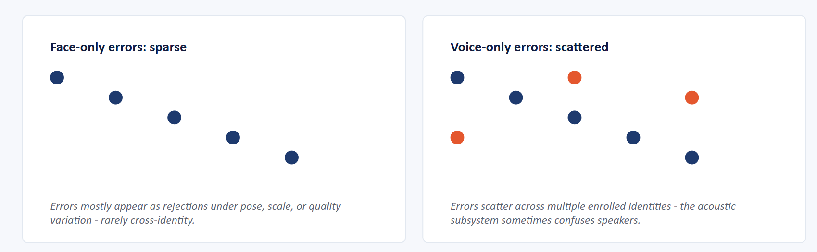
Analysis
Complementary error patterns
Non-overlapping failure modes: when audio misidentifies, vision usually gives the correct match or UNKNOWN - so the CONFLICT state catches the contradiction.

Slide 14
Conclusion & future work
Contributions
What We Did
✓ Training-free multimodal fusion - no paired audio-visual data, no fusion network to train
✓ Unified Qdrant retrieval backend - merges 512-D CLIP (face) and 128-D VoiceNet (voice) embeddings under one identity-aware infrastructure, without forcing them into a shared latent space
✓ Deterministic state-based fusion layer - explicit CONFIRMED / VISION_ONLY / AUDIO_ONLY / CONFLICT logic for agreement, missing streams, and cross-modal conflicts
✓ Misidentification rate cut from 9.00% → 0.00% by rejecting under cross-modal contradiction - a deliberate, risk-averse security trade-off (accuracy 83% → 75%, rejection 7% → 25%)
Future Steps
Edge-device deployment
Latency and resource profiling
Live cross-modal synchronization

