Slide 1
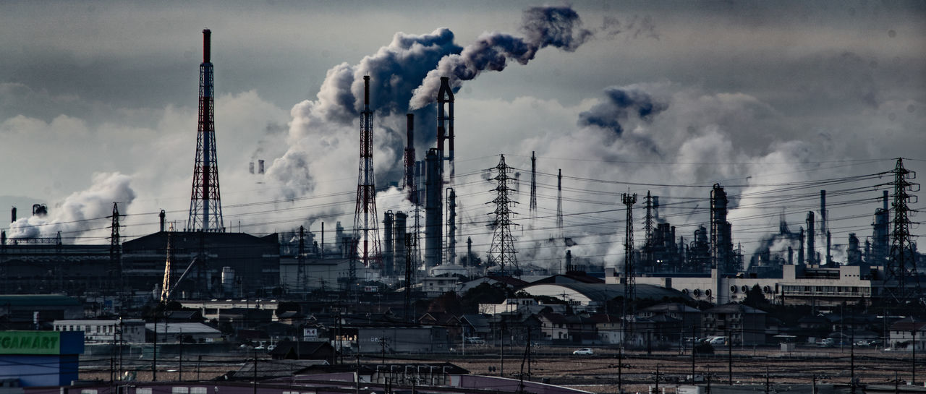

Influence of local CO2 emissions on local temperature
Antonio Jesús Leal Martín
Bootcamp Data Science
-The Bridge-

Slide 2
Hypothesis
Context:
    Average global temperature has increased 0.8ºC during last century¹
    CO2 emissions seem to be one of the main causes of this change
The objective of this study is to corroborate or refute the following hypothesis:
Temperature increases more in countries with more CO2 emissions
¹Data from GISS (Goddard Institute for Space Studies)

Slide 3
Data
Temperature data:
    Content: Average temperatures of 243 countries from 1744 to 2013
    Dataset shape: (577462, 4)
    Incomplete data: DataFrame contains 64.563 NaN values
    Source: Kaggle
    Cleaning:
          Keep data only from 1910 to 2013

Slide 4
Data
CO2 emission data:
    Content: Yearly CO2 emissions of 264 countries from 1960 to 2016
    Dataset shape: (264, 66)
    Incomplete data: DataFrame contains 3.390 NaN values
    Source: The World Bank Data
    Cleaning:
          Removed data of countries with NaN values
          Dropped data from 2013 to 2016

Slide 5
Data
CO2 data
264 countries
Common countries
Temperature data
243 countries
Columns = Countries
CO2 data
123 countries
Temperature data
123 countries
Rows = Dates

Slide 6
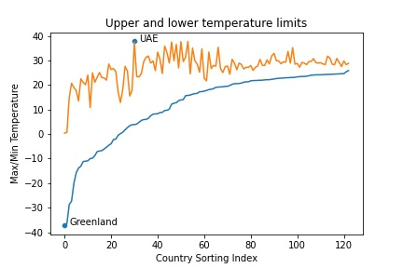
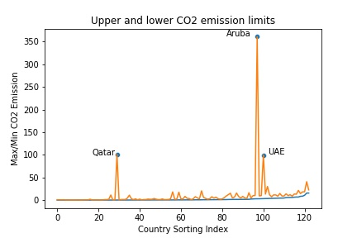
Data: Outliers
Are there outliers in our data?
Minimum/maximum analysis

Slide 7
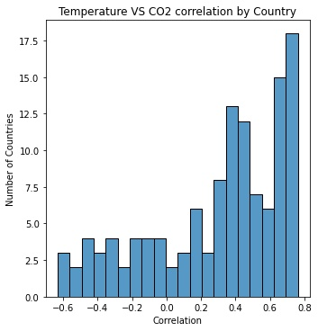
Analysis
How is the correlation between CO2 emission and Temperature?
8 countries with correlation < -0.45
43 countries with correlation > 0.5
Best correlation Worst correlation
Mauritius | 0,76
Pakistan | 0,76
Dominica | 0,75
Malaysia | 0,74
Grenada | 0,74
Mauritius | 0,76 |  | Cameroon | 0,01
Pakistan | 0,76 |  | Uganda | -0,02
Dominica | 0,75 |  | Tanzania | 0,06
Malaysia | 0,74 |  | Peru | -0,06
Grenada | 0,74 |  | Uruguay | -0,06

Slide 8
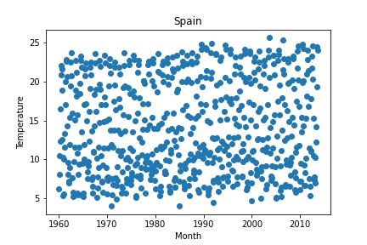
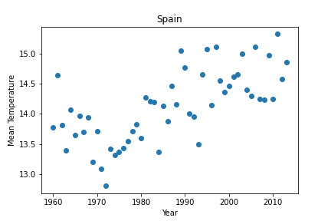
Analysis
Does the temperature follow any tendency?
Mean by year

Slide 9
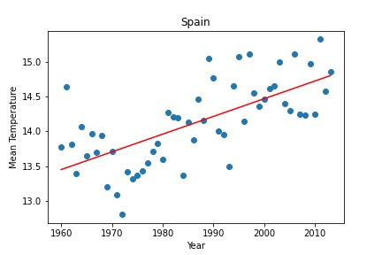
Analysis
Does the temperature follow any tendency?
Linear regression
Regression line slope give us information about the temperature increasing rate
Higher slopes Lower slopes
Mauritius | 0,76
Pakistan | 0,76
Dominica | 0,75
Malaysia | 0,74
Grenada | 0,74
Greenland | 0,037 |  | Bolivia | 0,005
Denmark | 0,037 |  | Peru | 0,008
Canada | 0,036 |  | Chile | 0,008
Afghanistan | 0,034 |  | Argentina | 0,008
UAE | 0,033 |  | Palau | 0,008

Slide 10
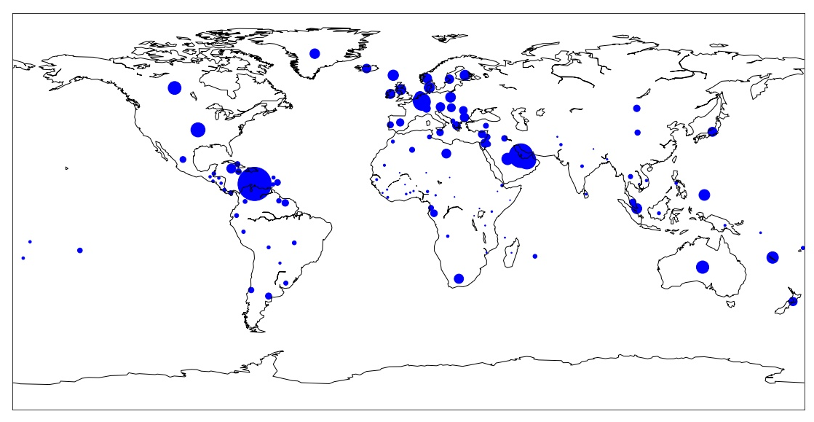
Analysis
How do we relate the temperature data with CO2 emission data?
CO2 average emission (1960-2013)

Slide 11
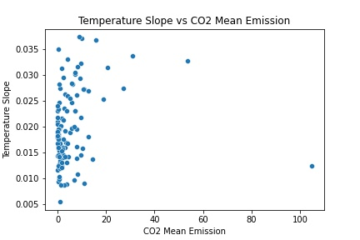
Analysis
How do we relate the temperature data with CO2 emission data?

Slide 12
Analysis
How do we relate the temperature data with CO2 emission data?
A wide range of temperature slopes
can be found for a similar CO2 mean
emission

Slide 13
Analysis
How do we relate the temperature data with CO2 emission data?
A wide range of temperature slopes
can be found for a similar CO2 mean
emission
Aruba average CO2 emission is significantly bigger than the rest of countries, but its temperature slope is in low range
Aruba

Slide 14
Analysis
How do we relate the temperature data with CO2 emission data?
A wide range of temperature slopes
can be found for a similar CO2 mean
emission
Afghanistan
Aruba average CO2 emission is significantly bigger than the rest of countries, but its temperature slope is in low range
Afghanistan, with the fourth highest temperature slope, has one of the lowest CO2 average emissions

Slide 15
Results
Conclusion
From this analysis, we can conclude that the proposed hypotesis is false. This does not mean that CO2 emissions do not affect the temperature increase, only shows that there is no direct relationship between local temperature and local emissions
Scope
For future steps of this study, the following items would be interesting:
      Analize temperature and CO2 emissions taking into account the country and its neighbours
      Consider the location of each country and search for correlations between temperature, emissions, and coordinates (longitude and latitude).
      Try to predict future temperatures based on known data.

Slide 16
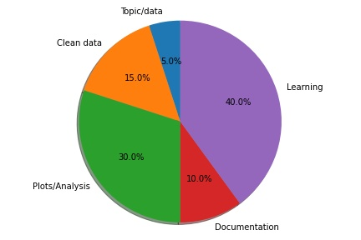
Time check

