Slide 1
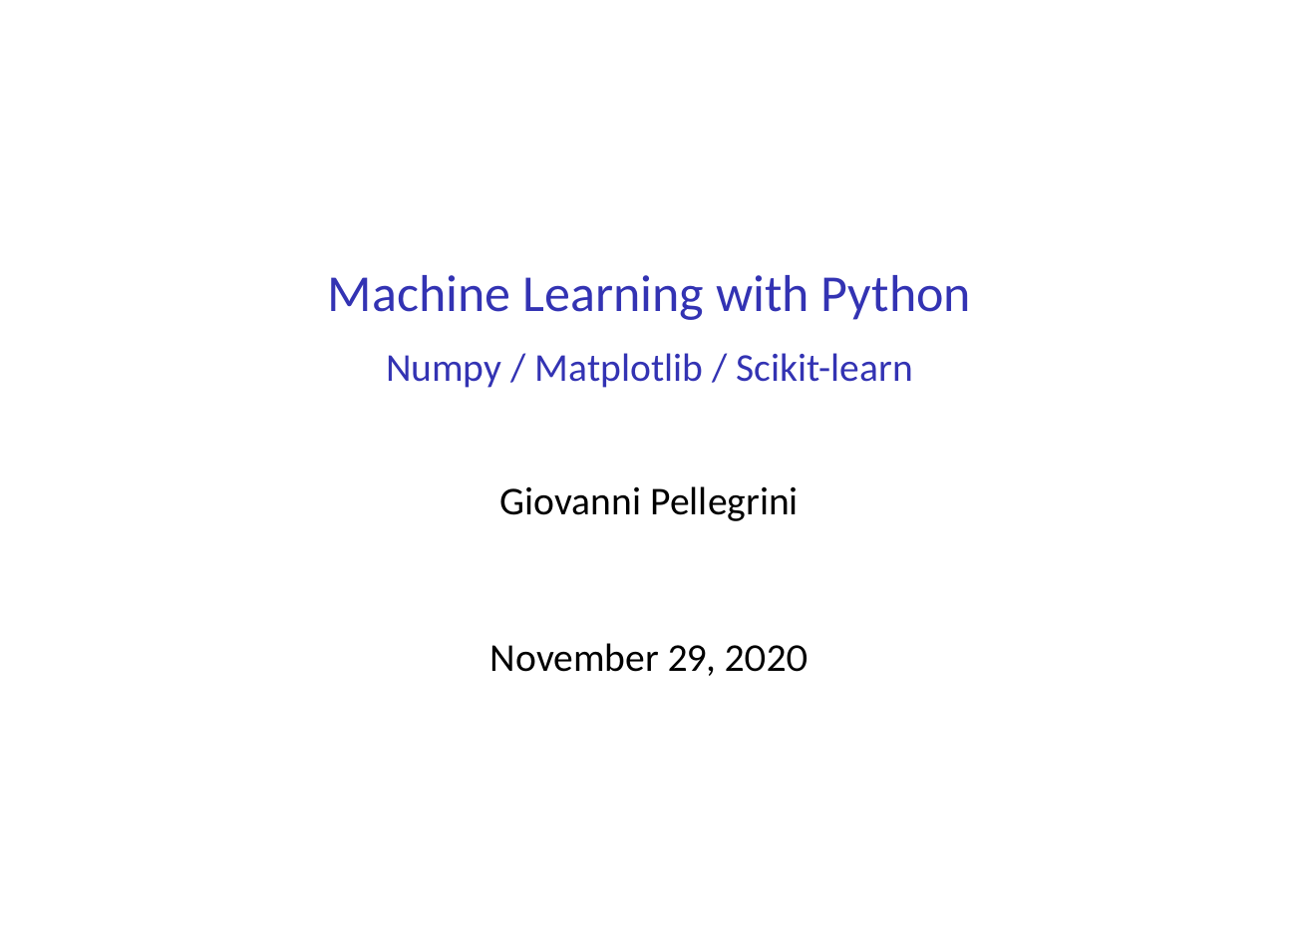
Antonio Longa
November 22,2021

Slide 2
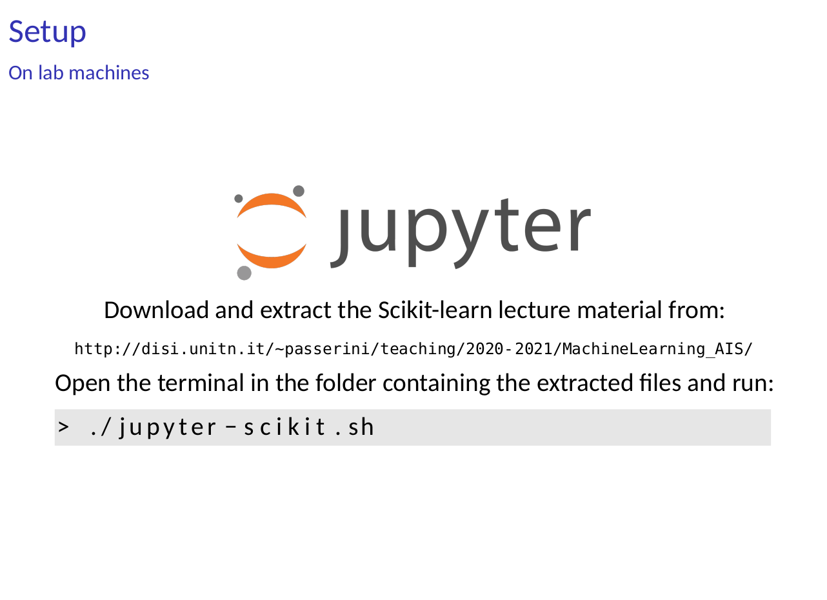
https://disi.unitn.it/~passerini/teaching/2021-2022/MachineLearning_AIS/index.html

Slide 3
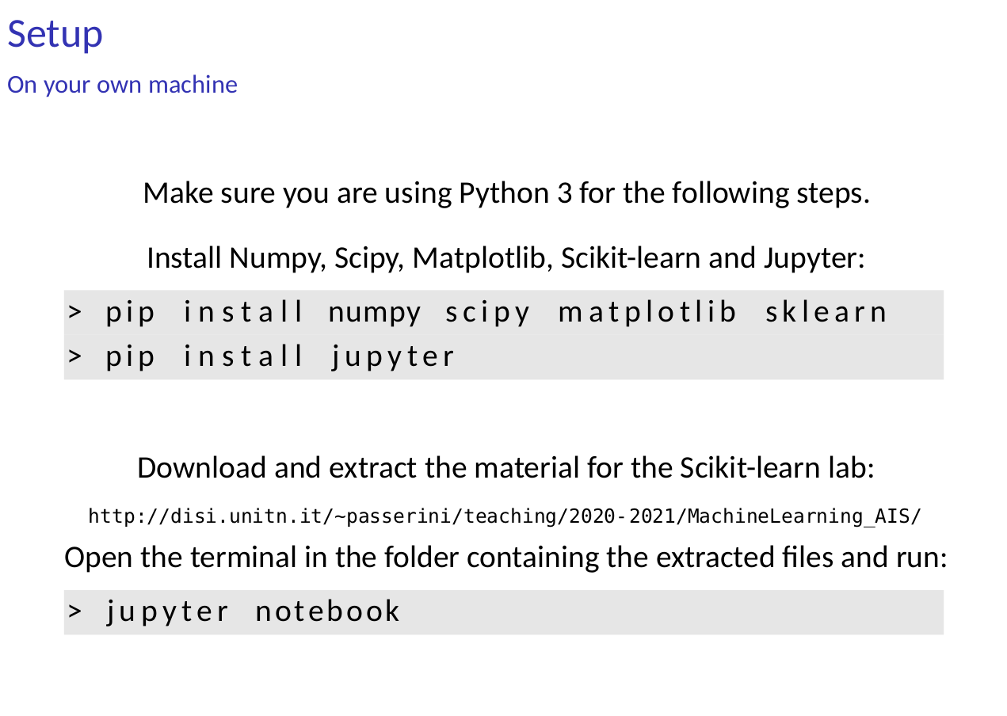
> pip install numpy scipy matplotlib sklearn pandas
> pip install jupyter
https://disi.unitn.it/~passerini/teaching/2021-2022/MachineLearning_AIS/index.html

Slide 4
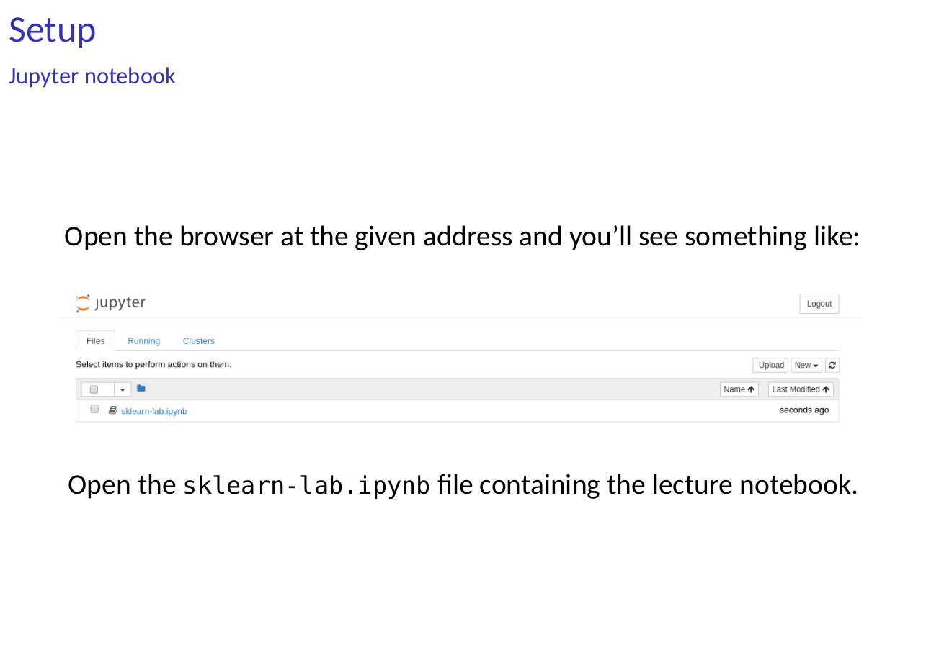

Slide 5
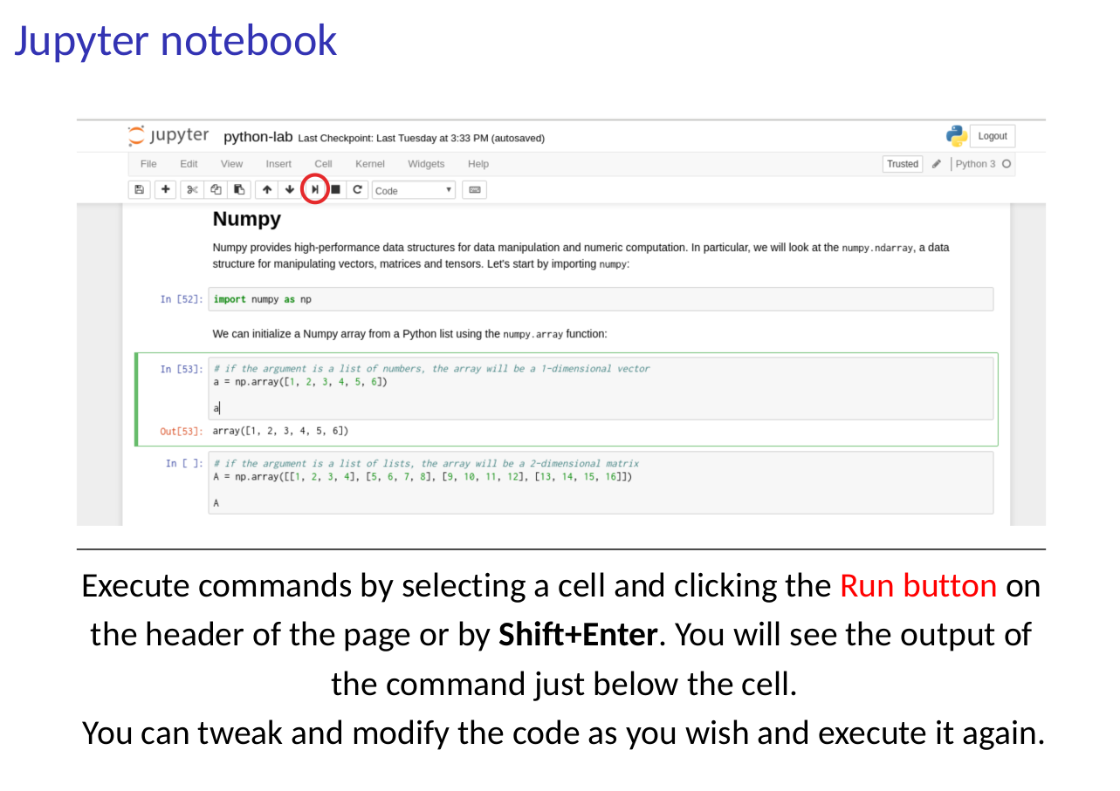

Slide 6
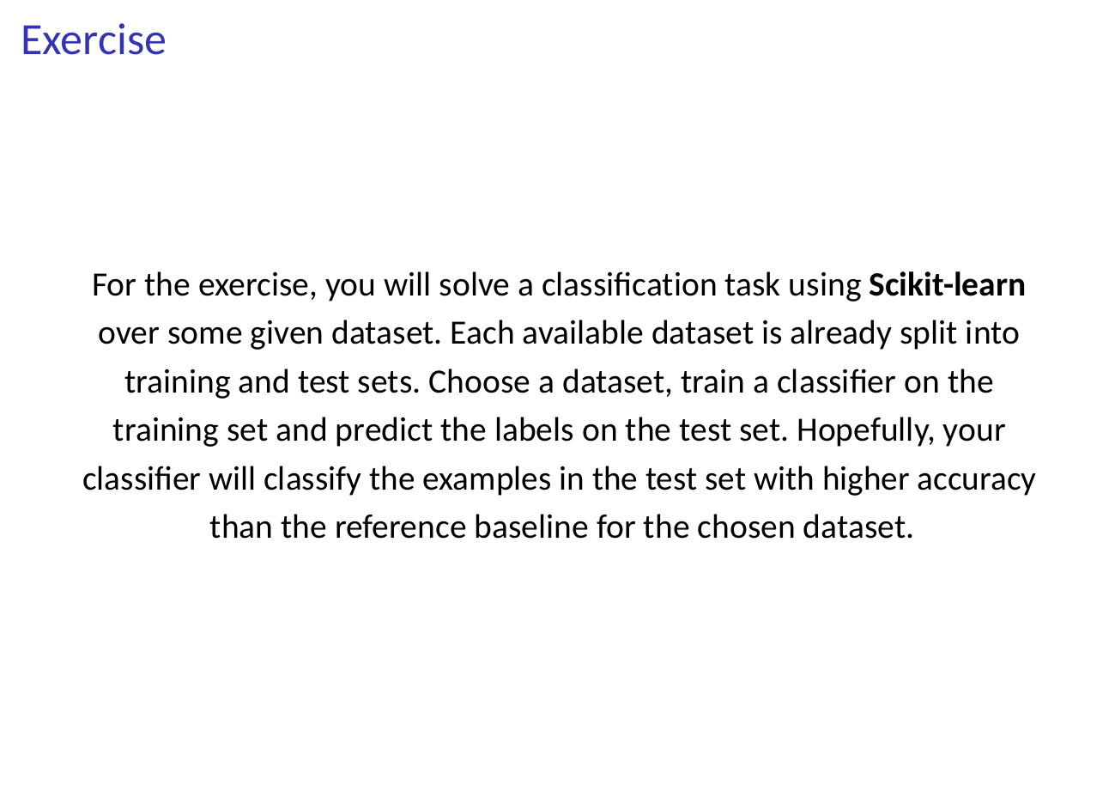

Slide 7
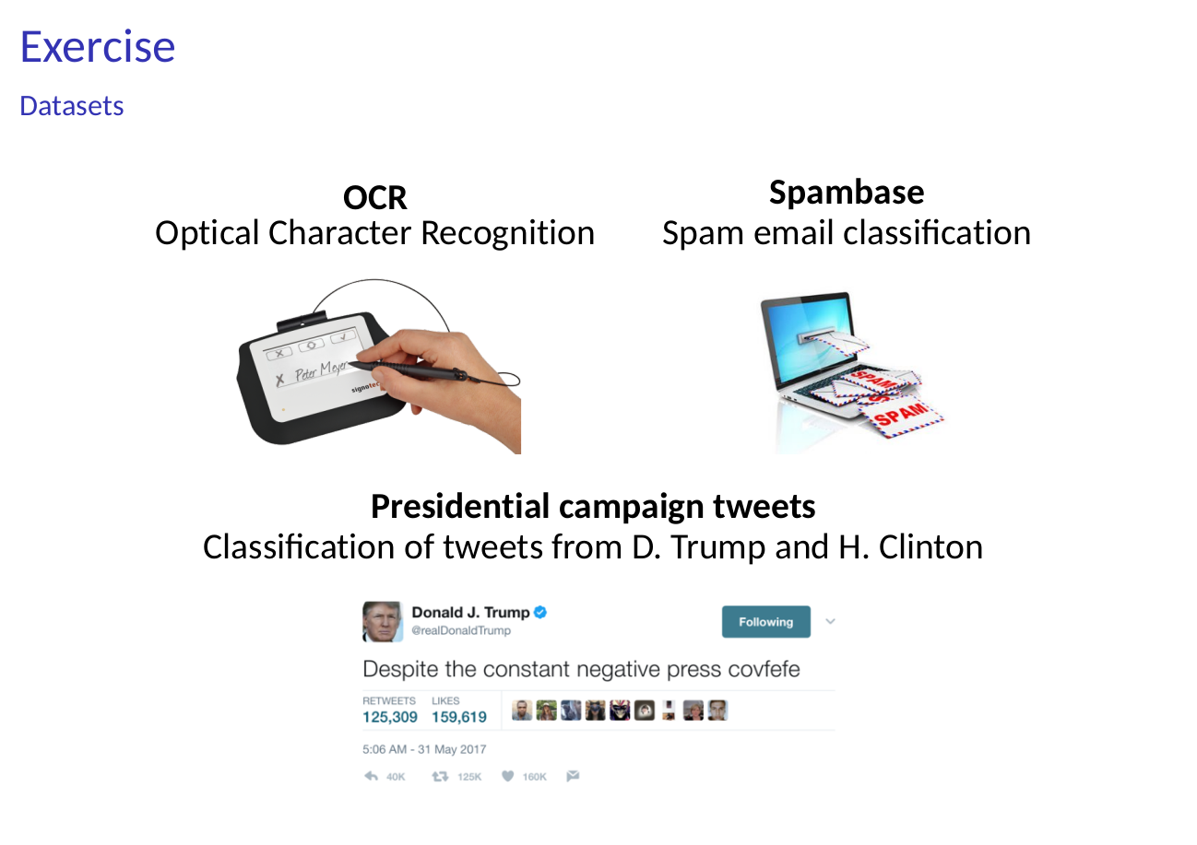

Slide 8
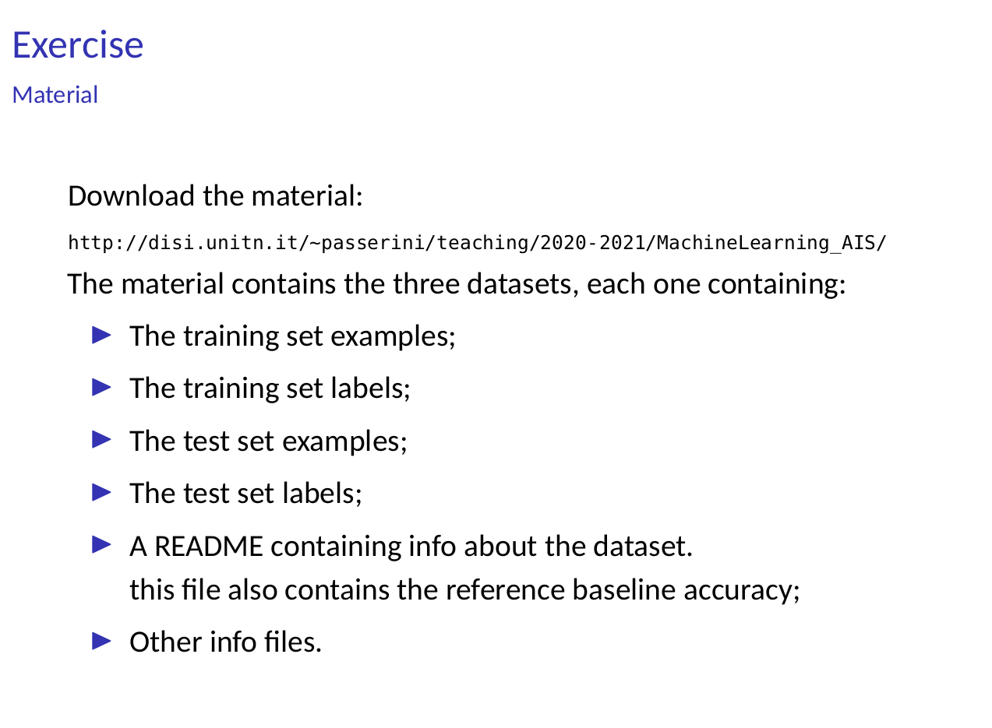
https://disi.unitn.it/~passerini/teaching/2021-2022/MachineLearning_AIS/index.html

Slide 9
