Slide 1

4th Meeting

Slide 2
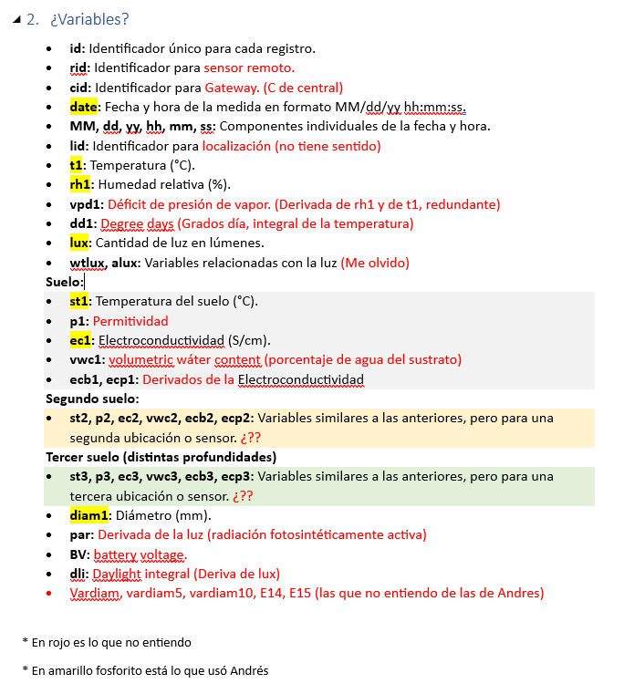
About the parameters selection:
Let’s review Paula’s Thesis:
Can we select our parameters based on correlations?

Slide 3
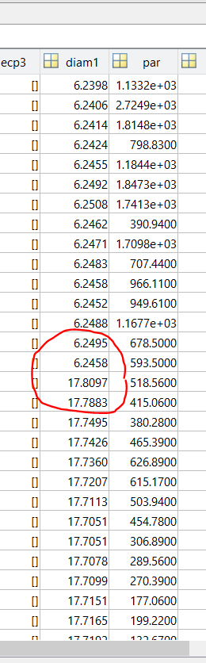
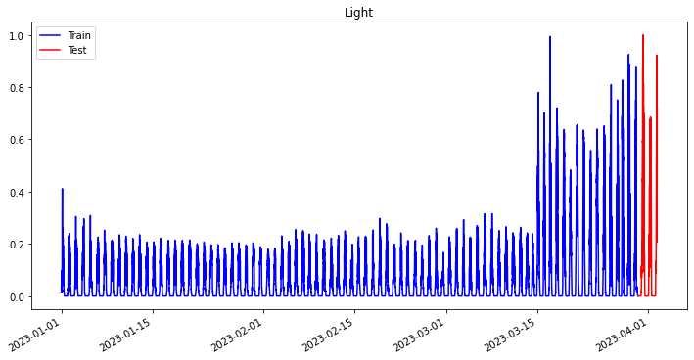
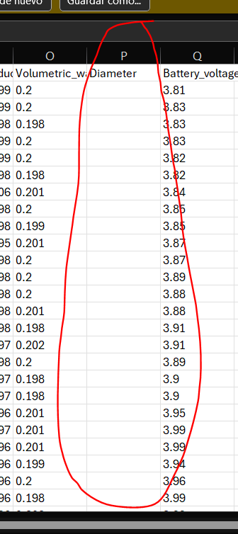



Datasets issues:
Sand_1 Sand_2 Clay_1 Clay_2

Slide 4

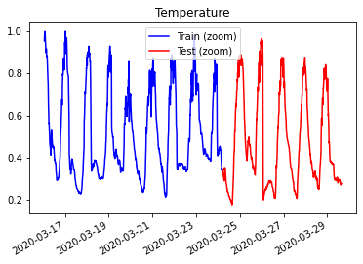

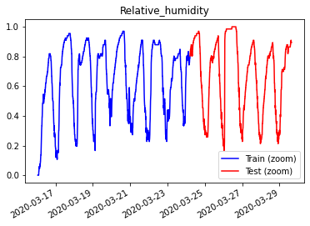

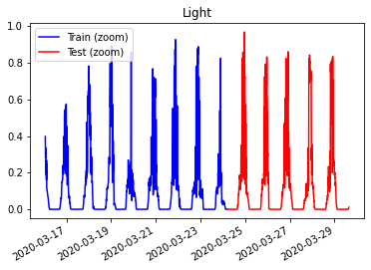
Datasets issues: We are only using Clay_2 dataset:

Slide 5

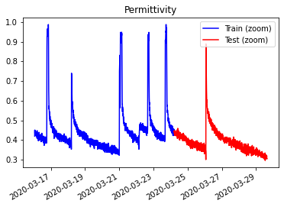

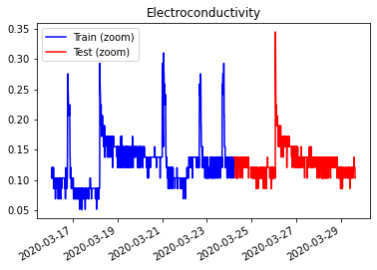

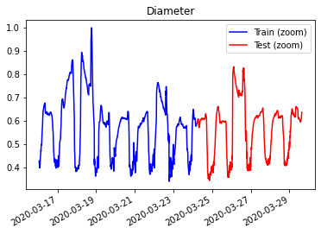
Datasets issues: We are only using Clay_2 dataset:
🤔

Slide 6
Some updates:
Validation data doesn’t change
About date indexation (irregular time series) -> Kashif Rasul : “train a model that predicts the next time of arrival”
Tried different batches, lags sequence
Latex documentation started

Slide 7
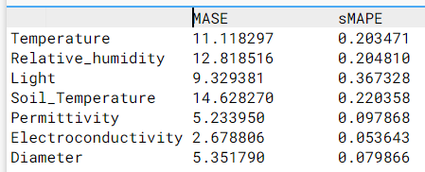
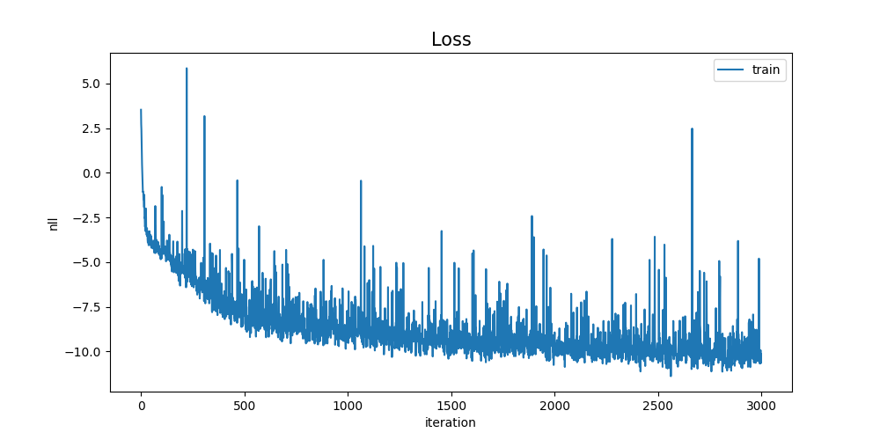
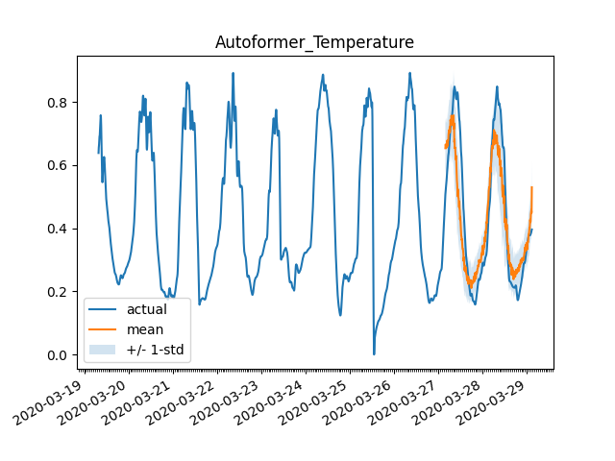
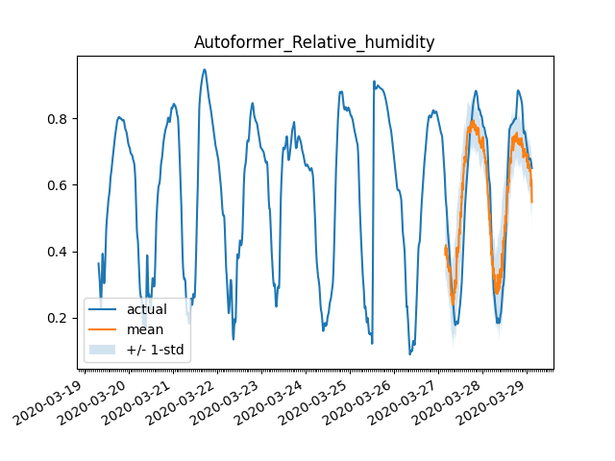
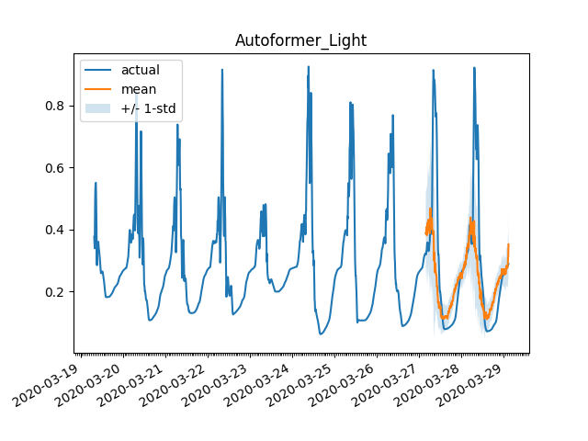
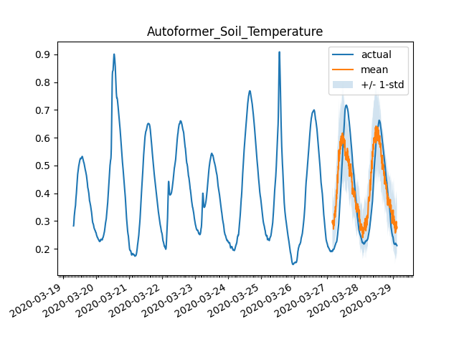
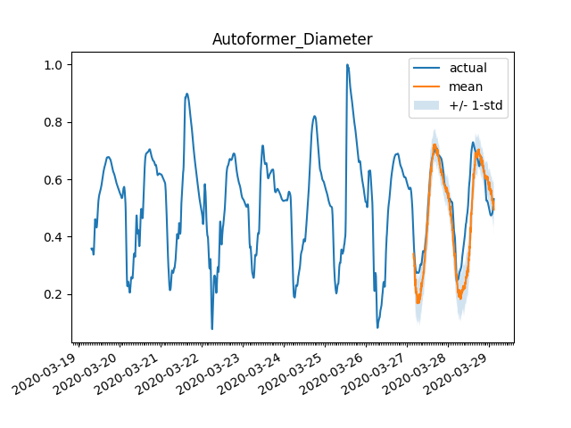
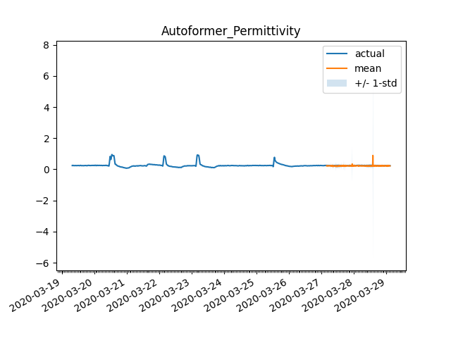
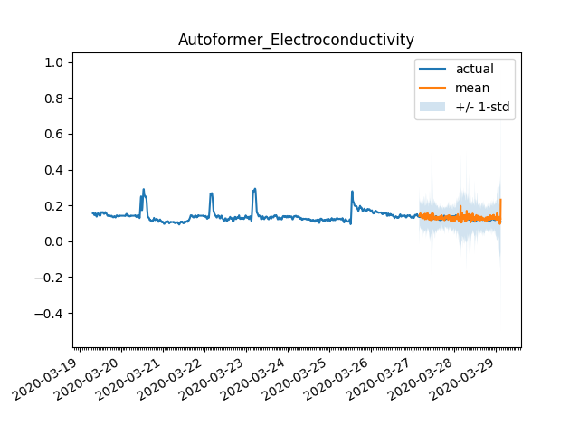
Best results so far: (eliminating trend)

Slide 8
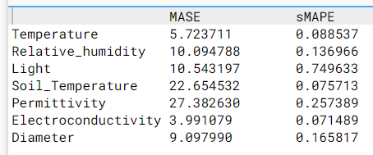
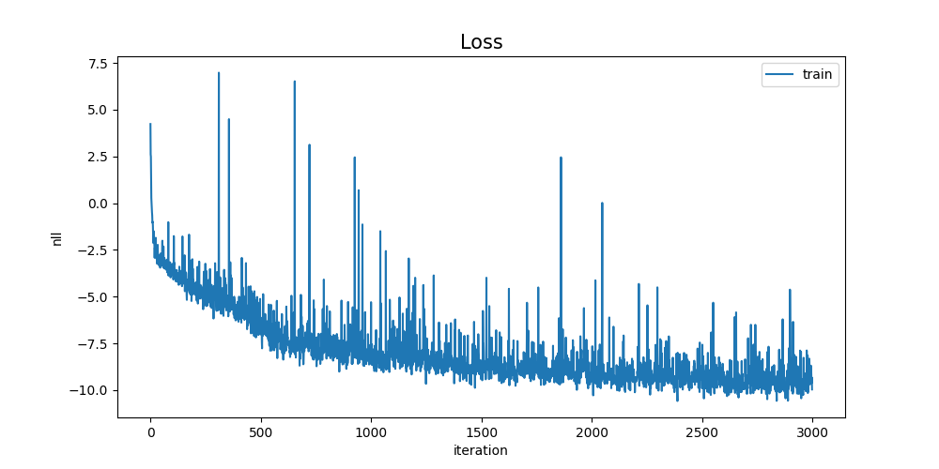
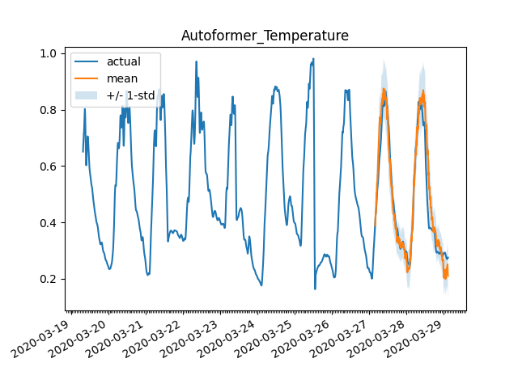
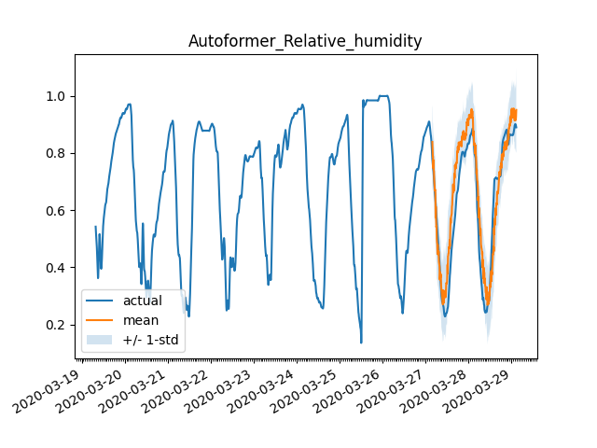
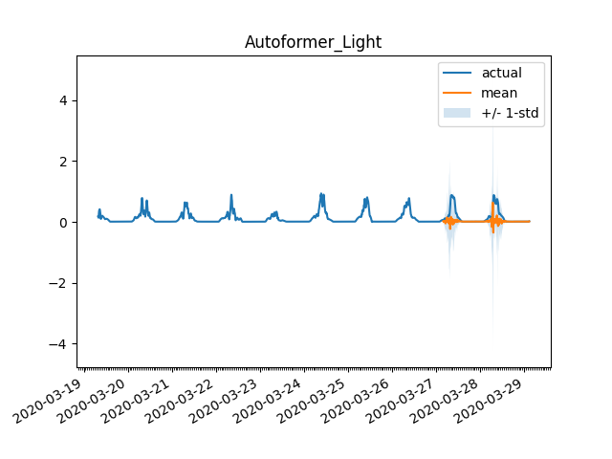
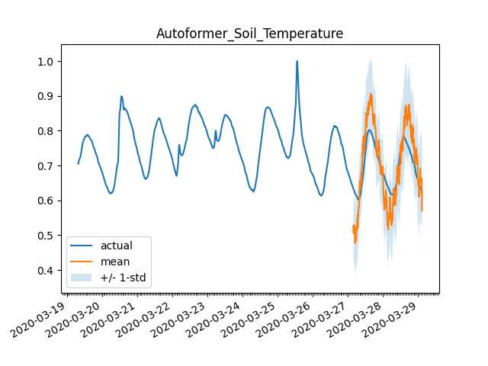
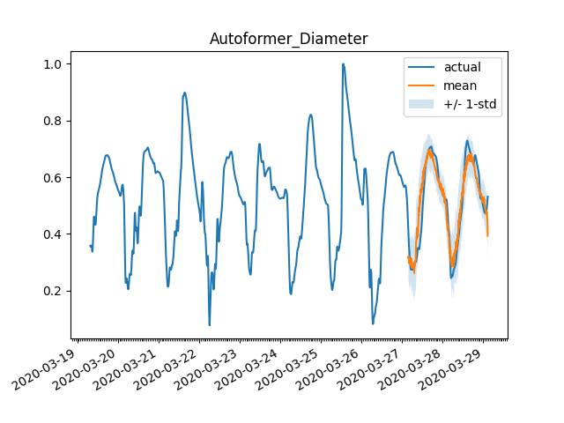
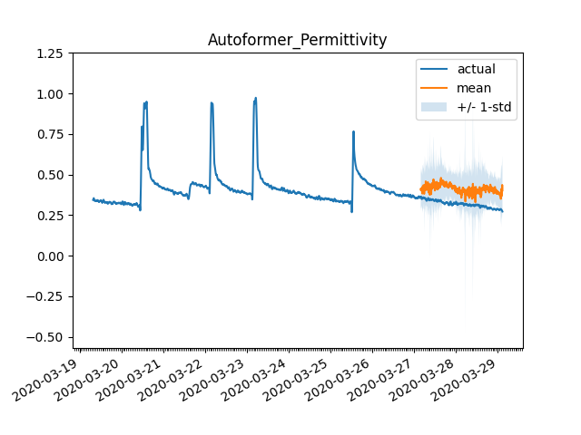
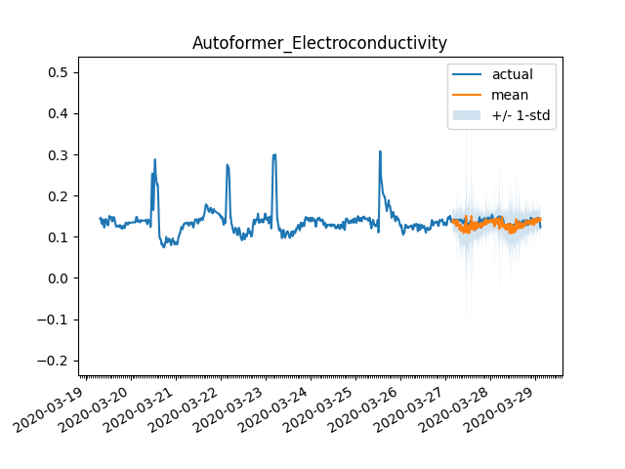
Best results so far: (without eliminating trend)

Slide 9
Experimental design: Hiperparameters
Transformers, Autoformers, Informers.
Context length
Batch size, num_epochs
With trend or without trend.
Lags sequence
transformer params:
dropout=0.1,
encoder_layers=4,
decoder_layers=4,
d_model=32,
Much more -> link

Slide 10
Questions and suggestions:
Which performance index should we use? Papers: MSE and MAE, Andrés: MSE and R2, Current: MASE and sMASE.

