Slide 1
OC ATARI
Supervisor: Hector Kohler
By: Antonio Al Makdissi
1

Slide 2
RENDER Modes
Render mode = human:
displays the game in front of you using pygame window, while limiting the fps to 60 to avoid super-fast movement
Render mode = rgb_array:
does not display it, just stores it as a 3d array.

Slide 3
Observation Modes
"Vision" Mode: Observe the game environment using visual data, typically captured as pixels or screenshots.
"Raw" Mode: Observe the environment using raw data, often by reading specific RAM addresses of the emulator
"Revised" Mode: Adapt environment processing to a specific game, with custom modifications to game state variables.
"Both" Mode: Simultaneously use "Vision" and "Revised" modes to interact with the environment using visual and modified data.

Slide 4
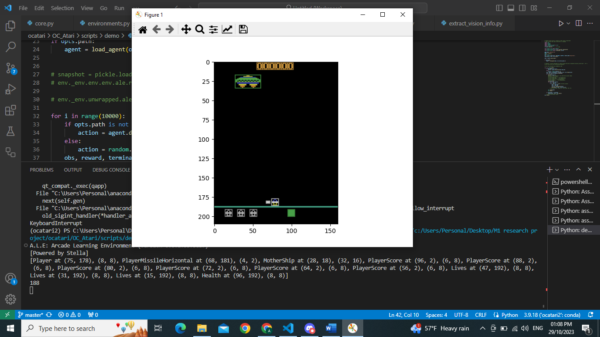
VISION MODE
In "vision" mode, the environment is observed using vision-based sensors, typically capturing the visual information (e.g., pixels, screenshots) of the game screen.
array size increases with each new object that appears on the screen
This mode is suitable for tasks that require analyzing and making decisions based on the visual output of the game.

Slide 5
VISION MODE
a. Detecting the Player Character:
Utilizes the find_mc_objects function for object detection.
Identifies the player character using the color corresponding to the player.
Criteria, like the player's y-coordinate > 170 and x-coordinate > 4, define player character detection.
b. Player Missiles Detection:
Looks for colors associated with player missiles.
Distinguishes between horizontal and vertical player missiles based on color.
c. Enemy Ship Detection:
Analyzes colors associated with enemy ships.
Checks the position and size of detected enemy ships.
Different enemy ship colors correspond to different enemy ship types.
d. Enemy Missile Detection:
Searches for colors linked to enemy missiles.
Categorizes enemy missiles based on color and position.
e. Mother Ship Identification:
Analyzes colors associated with mother ships.
Considers the position and size of detected mother ships.
Different colors represent various mother ship types.
f. HUD Element Detection (Optional):
Searches for colors of HUD elements like player's score, lives, and health indicators.
ALL Detected elements are categorized and added as objects.

Slide 6
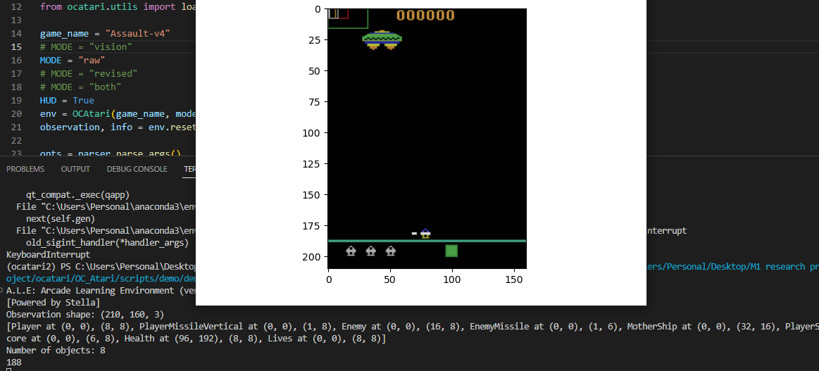
RAW MODE
In "raw" mode, the environment is observed using raw data, such as reading the values of specific RAM addresses of the emulator.
This mode is suitable for tasks that do not require visual information and instead rely on specific game state variables stored in RAM.

Slide 7
RAW MODE
a. Calculating Player's Score:
Combines values from different RAM addresses.
Multiplies values at RAM addresses 0, 1, and 2 by specific factors.
Sums them up to calculate the player's score.
b. Extracting Player's Horizontal Position:
Retrieves the player's horizontal (X) position from RAM address 16.
c. Player's Missile Information:
X position of the player's missile is extracted from RAM address 39.
Y position of the player's missile is obtained from RAM address 67.
These values represent the position of the player's missile on the screen.
Similar procedures are applied to other elements.
d. Player's Sprite and Lives:
Extracts information about the player's sprite from RAM address 30.
Retrieves the number of lives remaining from RAM address 101.

Slide 8
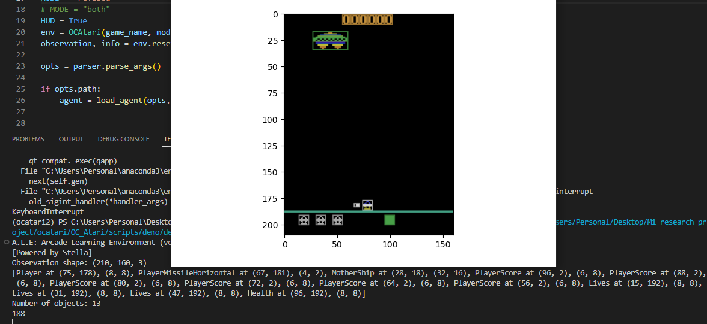
REVISED MODE
In "revised" mode, the environment processing is adapted to a specific mode that includes some modifications. This mode is tailored to a particular game environment, and the modifications are likely to be specific to that game.
The detect_objects_revised function is used to detect and process objects based on the modified game state variables.
This mode is suitable for games where the default "vision" and "raw" modes do not provide the necessary information, and custom processing is required.

Slide 9
REVISED MODE
a. Player Object Detection:
Detects the player's position based on RAM state information.
Calculates the player's x-coordinate (x) using specific formulas.
Adjusts for screen wrapping, if necessary.
Appends a Player object to the objects list with the detected position.
b. Player Missile Detection:
Determines the missile's position (x, y) and dimensions (w, h) using RAM state information and specific formulas.
Appends a PlayerMissileVertical object to the objects list if a missile is detected.
c. Player's Horizontal Missile Detection:
Monitors and updates the horizontal missile's position (horizontal_pos) based on the player's actions.
Appends it to the objects list if detected.
d. Mother Ship Detection:
Detects the mother ship's position based on RAM state information.
Adjusts for screen wrapping, if necessary.
Changes the color if specified by RAM state.
Appends a MotherShip object to the objects list.
e. Enemy Object Detection:
Detects up to three enemy objects.
Calculates the position, size, and color of each enemy based on RAM state information.
Appends Enemy objects to the objects list for each detected enemy.
Handles cases where two enemies appear as a single object.
f. Enemy Missile Detection:
Detects enemy missile's position, size, and color based on RAM state information.
Appends the missile to the objects list if detected (one missile per enemy?).
g. HUD Element Detection (if hud=True):
Detects and appends HUD elements, including score, lives, and health, to the objects list based on RAM state information.

Slide 10
BOTH MODE
In "both" mode, both "vision" and "revised" modes are available simultaneously. This means that the environment can be observed and interacted with using both visual information and modified game state variables.
Separate functions, detect_objects_vision and detect_objects_revised, are used to detect and process objects based on visual and modified game state data, respectively.
The _step_test method is used to interact with the environment and allows you to choose whether to use visual or modified game state information for interaction.
This mode is useful when you want to experiment with agents that utilize both visual and revised game state information.
The primary use case for the "both" mode is when you require access to both types of information, likely for debugging, analysis, or specific research purposes. You might want to observe visual information and access game state variables simultaneously to gain insights into how the game environment works or to facilitate specific types of analysis.

Slide 11
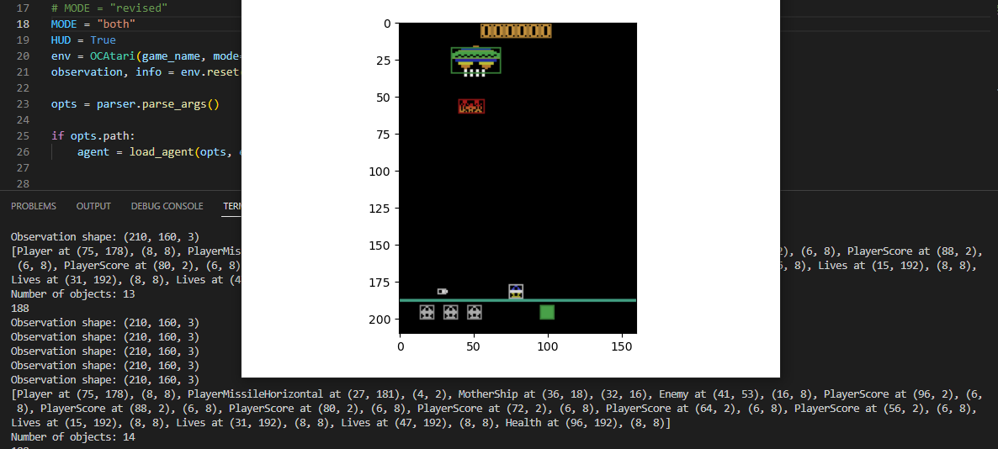
BOTH MODE
As we can see here “both” mode uses a combination of vision and revised.
Taking objects from both, following about the same process.
The _step_test method is used to interact with the environment and allows you to choose whether to use visual or modified game state information for interaction.

