Slide 1


By: Fawzy Ghazawy & Antonio Makedsi
DELIVERY WEB APPLICATION
Supervisor: Dr. Zaher Merhi
Committee Member: Dr. Milia Habib
Senior Project
School of Engineering: Department of Computer & Communication Engineering

Slide 2
Outline:
Introduction
Problem Statement
Similar Systems
System Design
Implementation
Future Work
Demonstration
Conclusion

Slide 3
Introduction:
Delivery companies have spread by the growth of customers needs.
They are the linking relationship between one side customer and other half client.
Drivers takes all the orders to whenever the customers desire.
Managers monitor the progress of tasks

Slide 4
Outline:
Introduction
Problem Statement
Similar Systems
System Design
Implementation
Future Work
Demonstration
Conclusion

Slide 5
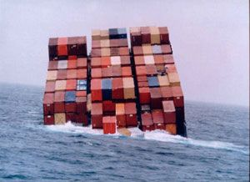


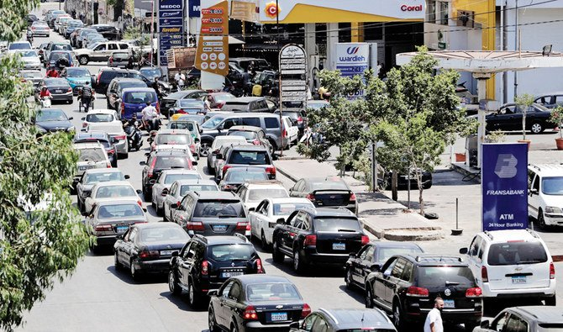

Problem Statement:
Problems in loss of cargo either through piracy or corruption.
Absence of trust between customer and company due to lack of communication.
Economic crisis affecting the transportation and telecommunication sector.

Slide 6
Will the resolution of these problems lead to the success and growth of delivery companies?
Well Yes

Slide 7
Objectives:
Save time and money ordering online
Organize work using an advanced database and easy software
Track system with number of orders status

Slide 8
Outline:
Introduction
Problem Statement
Similar Systems
System Design
Implementation
Future Work
Demonstration
Conclusion

Slide 9
Similar Systems:
Smartech
Ogero
Terranet
Lebanese company in the IT field found in 2007
Fixed infrastructure operator in Lebanon broadcasting and troubleshooting internet services
Lebanese internet provider company found in 1999

