Slide 1
DELIVERY WEB APPLICATION
1

Slide 2
DELIVERY WEB APPLICATION
Stage 01
Stage 02
Introduction
Problem statement
Stage 03
Stage 04
Similar systems
System Design
WEB
Stage 05
Stage 06
Implementation
Conclusion
Stage 07
Stage 08
Future work
Demonstration
2

Slide 3
DELIVERY WEB APPLICATION
Stage 01
Stage 02
Stage 03
Stage 04
Introduction
Problem statement
Similar systems
System Design
3

Slide 4
DELIVERY WEB APPLICATION
Introduction:
Delivery companies have spread by the growth of customers needs.
They are the linking relationship between one side customer and other half client.
Drivers takes all the orders to whenever the customers desire.
Managers monitor the progress of tasks
4

Slide 5
DELIVERY WEB APPLICATION
Stage 01
Stage 02
Stage 03
Stage 04
Introduction
Problem statement
Similar systems
System Design
5

Slide 6
DELIVERY WEB APPLICATION
Problem statement:
Clients
Absence of trust between customer and company due to lack of communication.
Companies
Problems in loss of cargo either through piracy or corruption.
Economic crisis affecting the transportation and telecommunication sector.
6

Slide 7
Inadequate visibility and communication: The logistics and transportation industry faces challenges related to limited visibility and ineffective communication, leading to delivery delays and lower customer satisfaction.
Increased costs: The industry struggles with rising costs due to manual processes and inefficient resource allocation, impacting profitability for logistics providers.
Intense competition and security threats: The market is highly competitive, and security threats pose risks to logistics providers, requiring measures to ensure the safety of shipments and maintain a competitive edge.

Slide 8
DELIVERY WEB APPLICATION
Will the resolution of these problems lead to the success and growth of delivery companies?
Well Yes
7

Slide 9
DELIVERY WEB APPLICATION
Stage 01
Stage 02
Stage 03
Stage 04
Introduction
Problem statement
Similar systems
System Design
8

Slide 10



DELIVERY WEB APPLICATION
Similar systems:
Aramex
Aramex is a global logistics and transportation company based in Dubai, founded in 1982
Companies
Wakilni
Wakilni is a delivery company in the Middle East founded in 2015
GoShare
GoShare is a rapidly growing logistics and transportation company based in San Diego, California, founded in 2014
9

Slide 11
DELIVERY WEB APPLICATION
Similar systems:
Company | Advantages | Disadvantages
Aramex | Efficient global logistics solutions Diverse service offerings | Higher cost Service inconsistencies Limited coverage in certain regions
Wakilni | Reliable last-mile delivery Enhanced convenience | Limited geographic coverage Lack of real-time tracking
GoShare | On-demand delivery Flexible vehicle options | Limited availability Potential pricing variability
10

Slide 12
DELIVERY WEB APPLICATION
Stage 01
Stage 02
Stage 03
Stage 04
Introduction
Problem statement
Similar systems
System Design
11

Slide 13
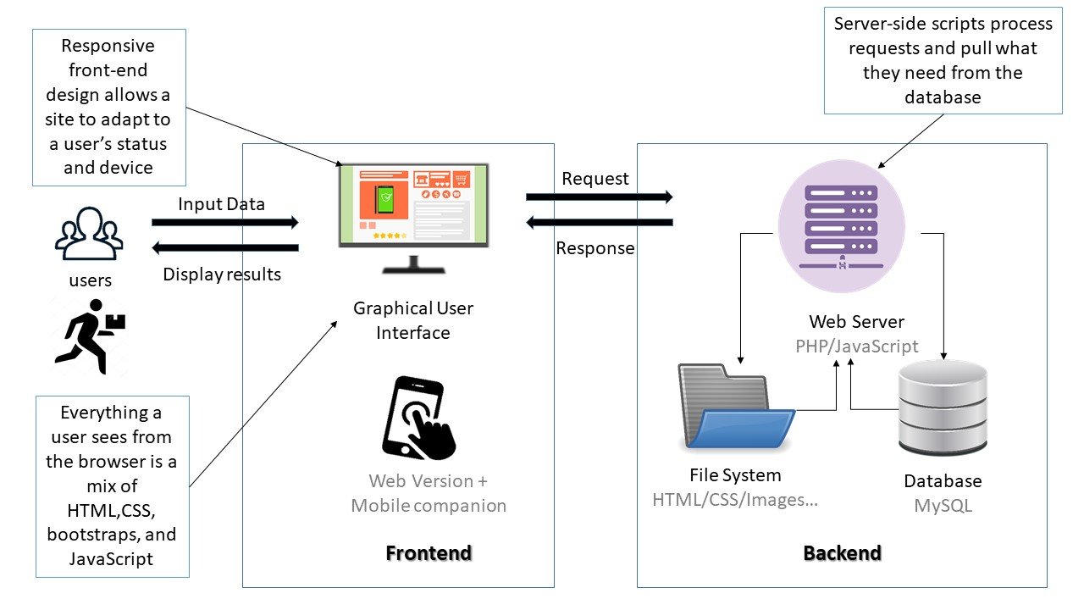
DELIVERY WEB APPLICATION
System architecture:
12

Slide 14
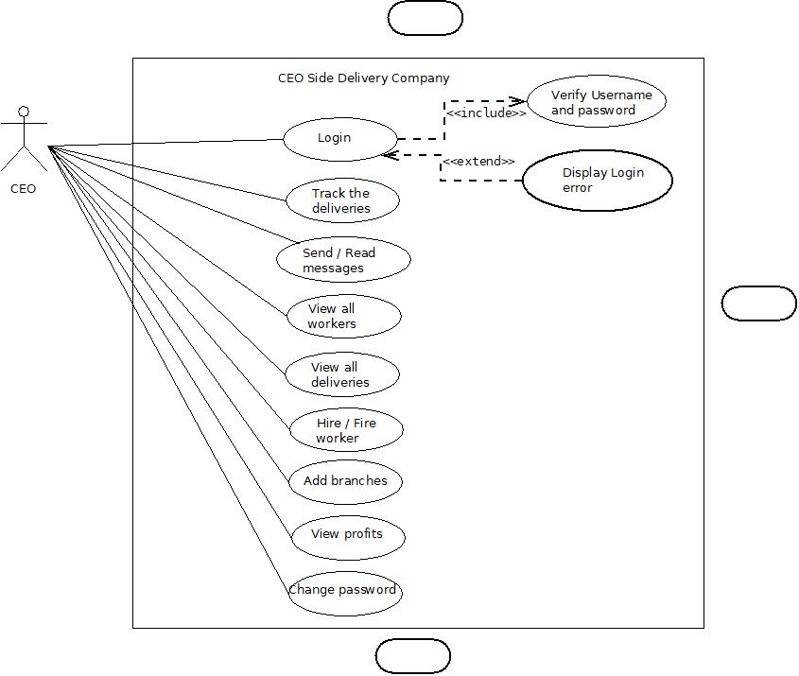
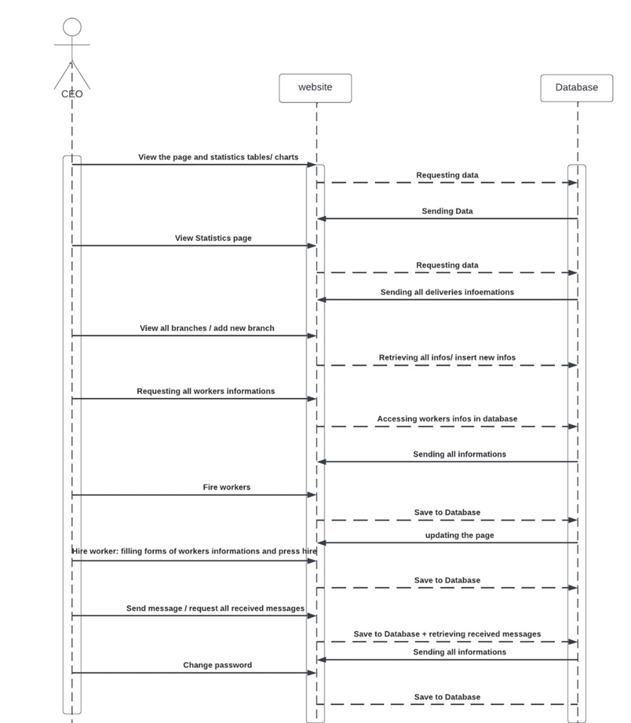
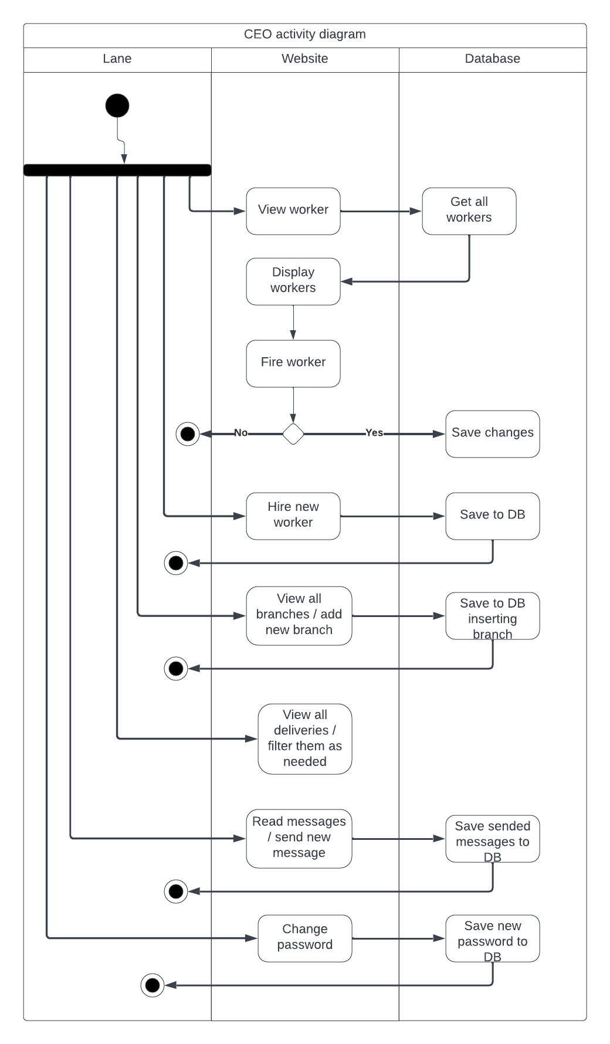
DELIVERY WEB APPLICATION
CEO Diagrams:
13

Slide 15
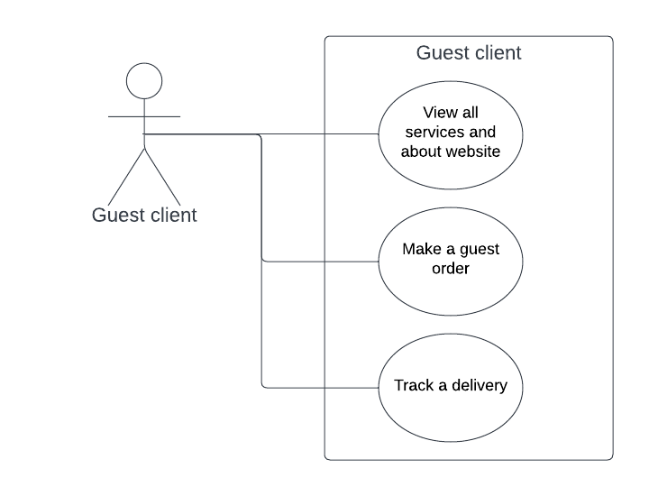
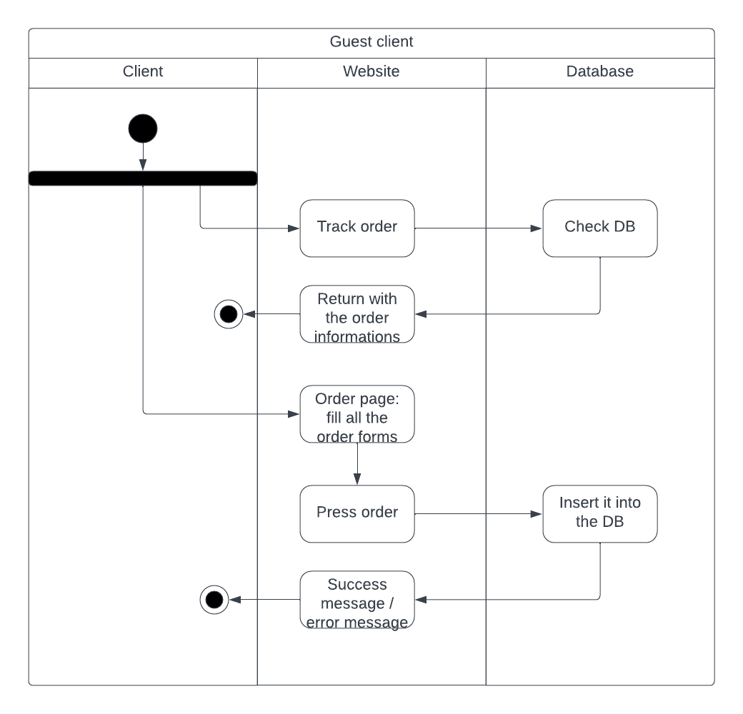
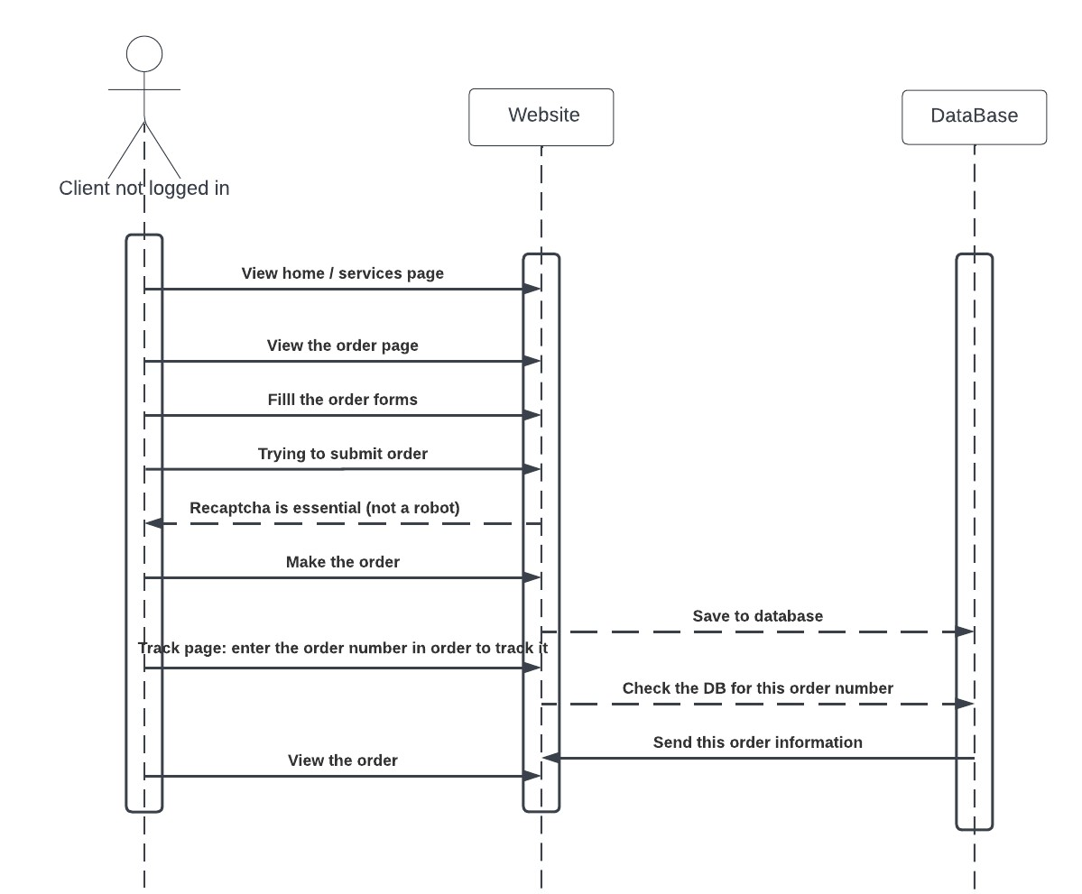
DELIVERY WEB APPLICATION
Guest user diagrams:

Slide 16
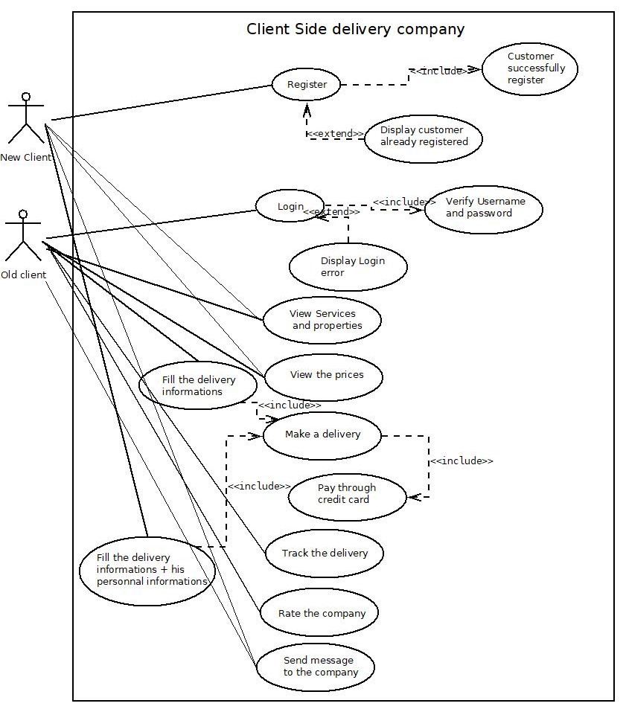
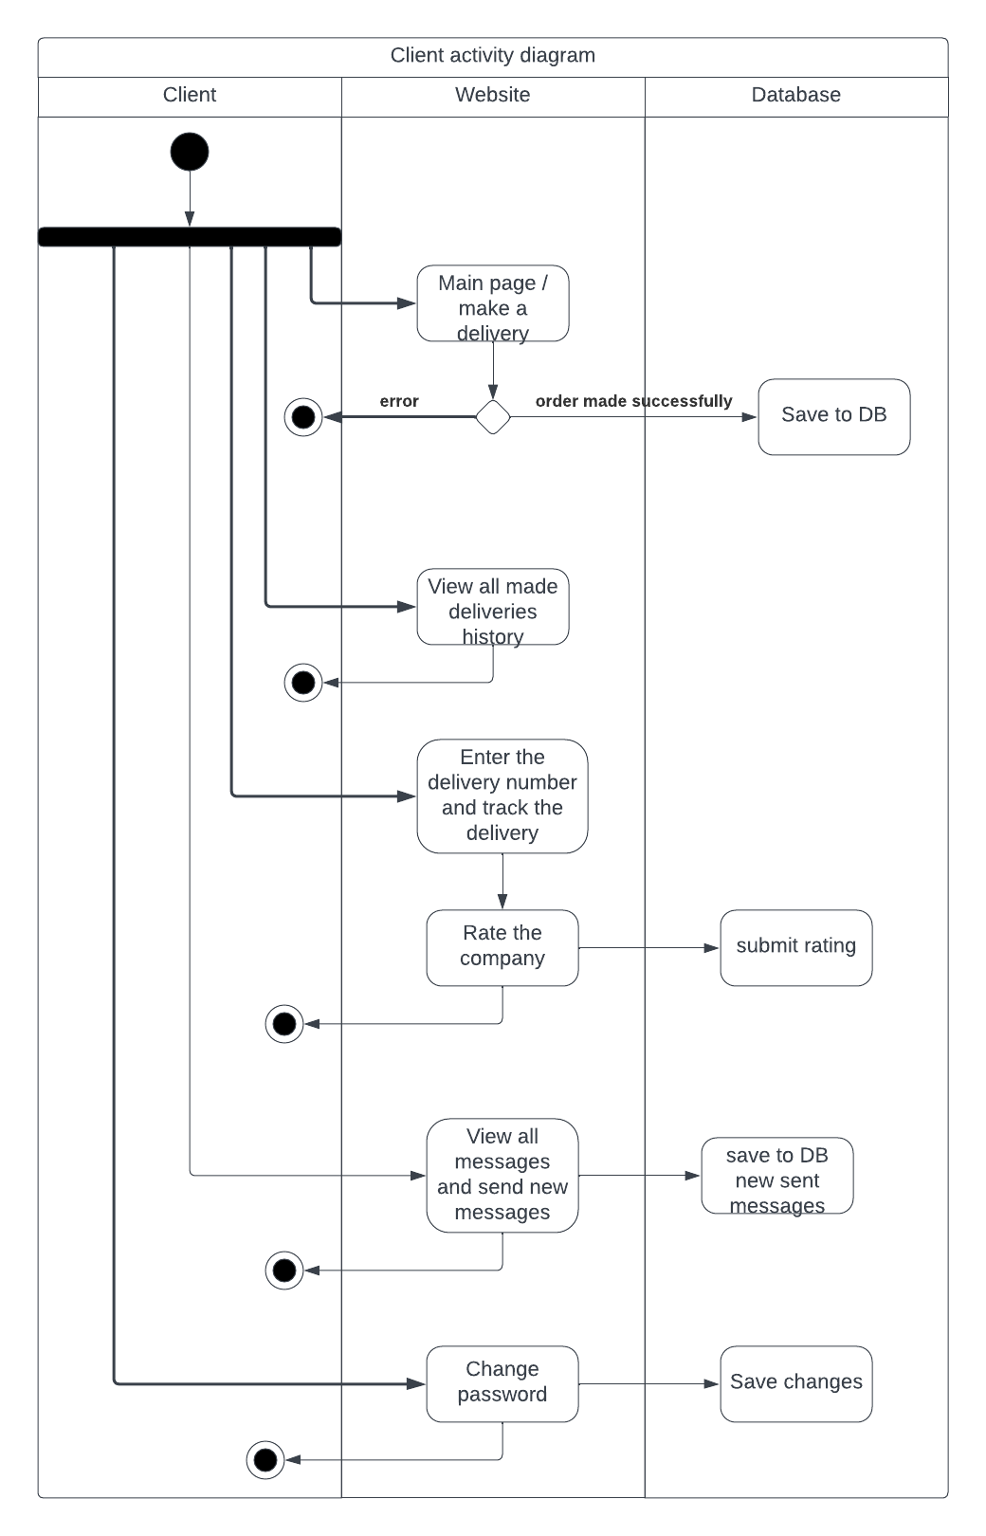
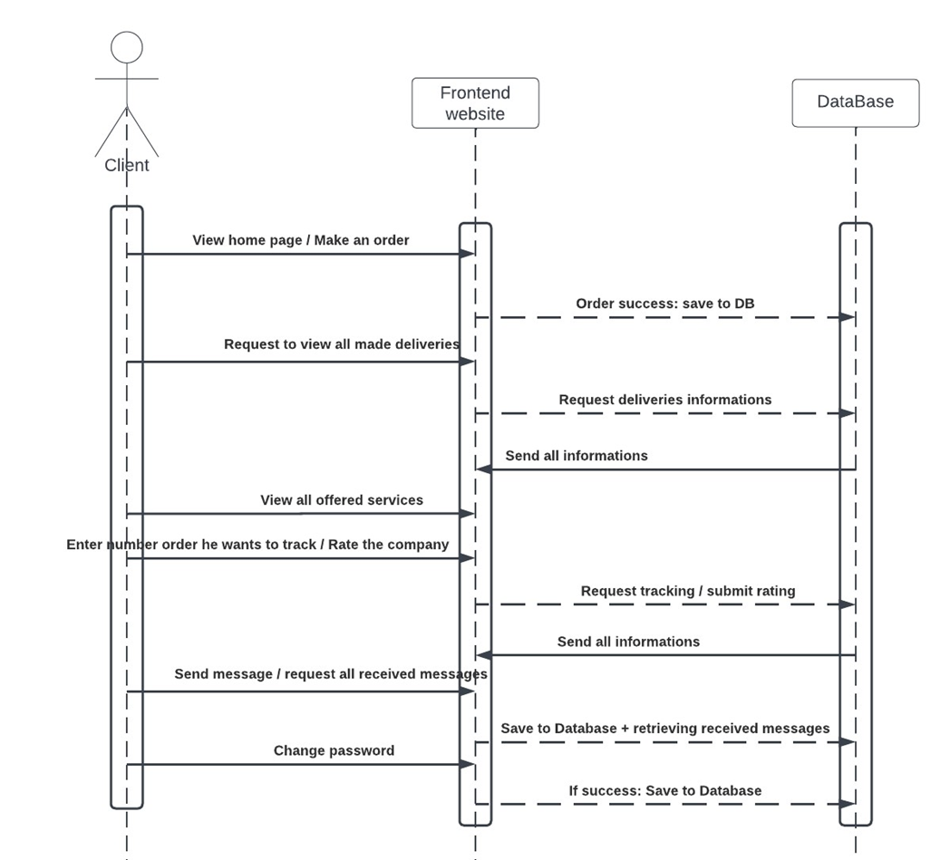
DELIVERY WEB APPLICATION
Registered Client diagrams:

Slide 17
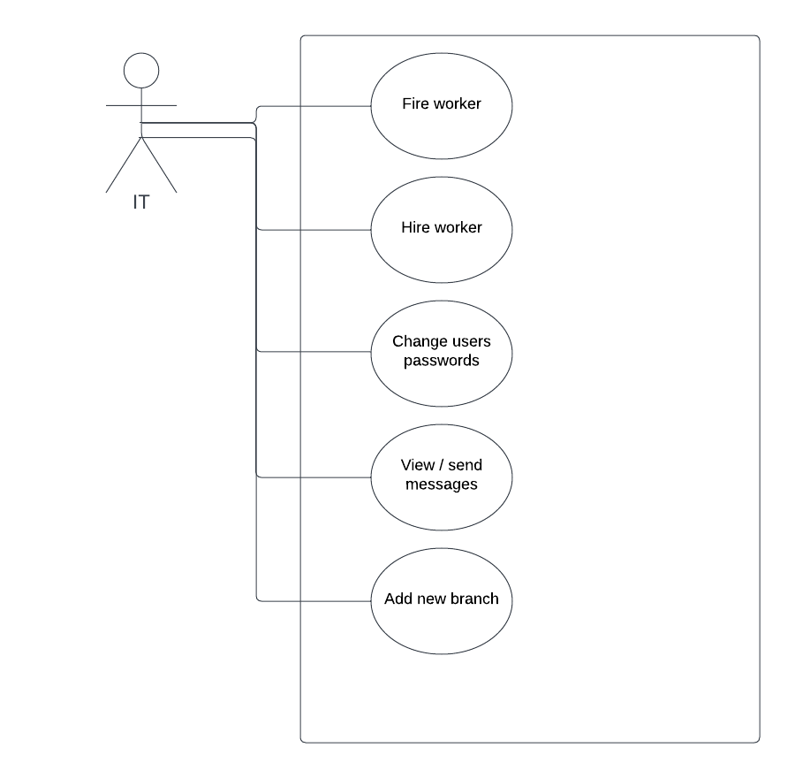
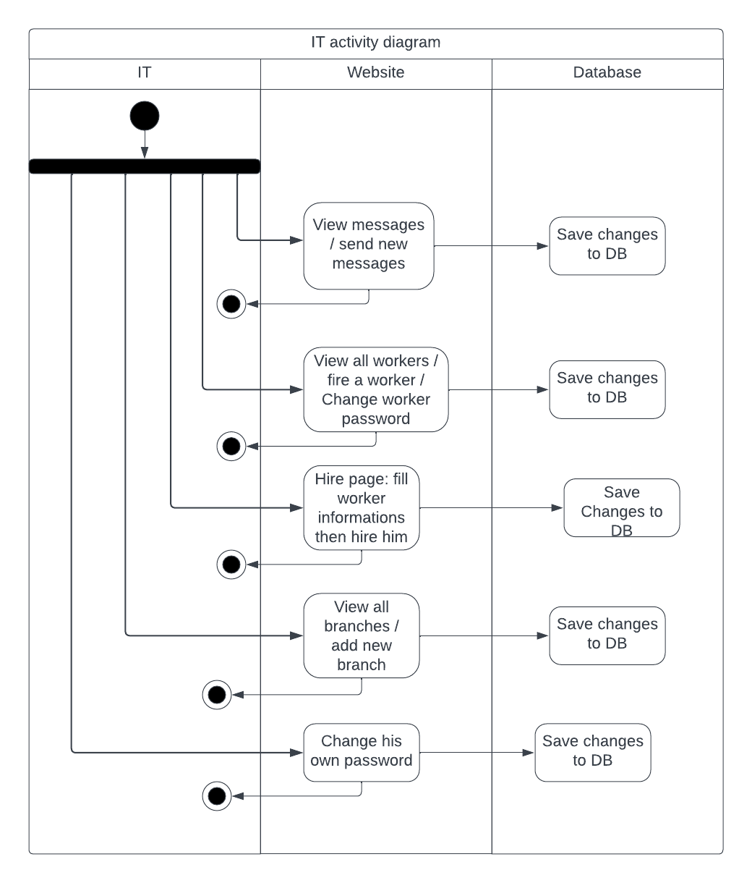
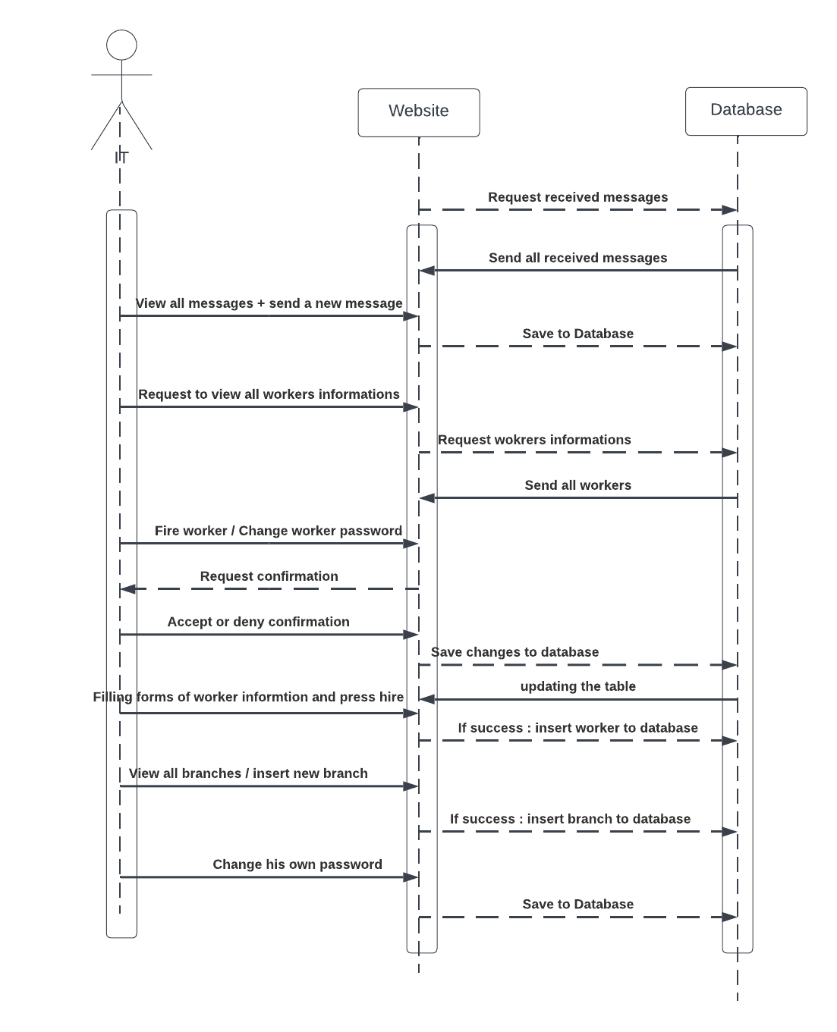
DELIVERY WEB APPLICATION
IT diagrams:

Slide 18
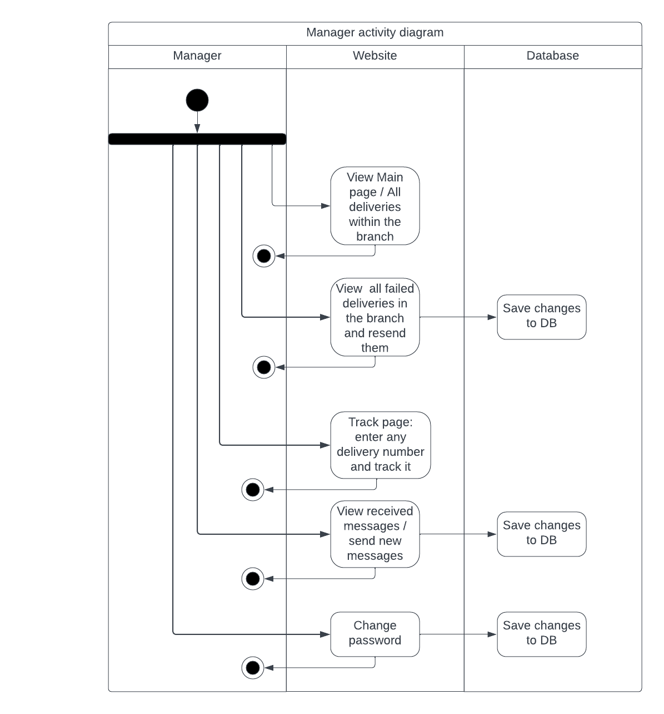
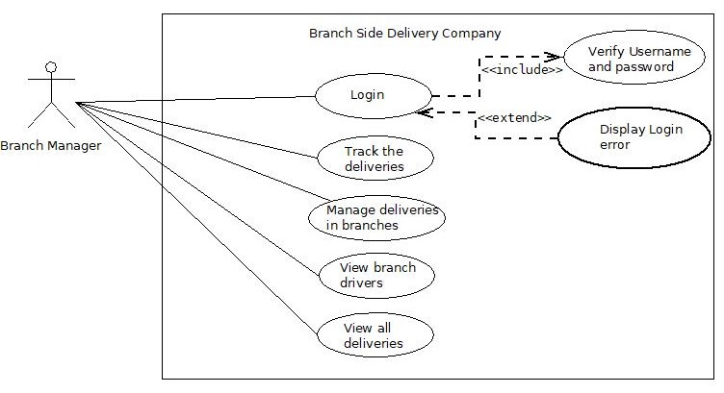
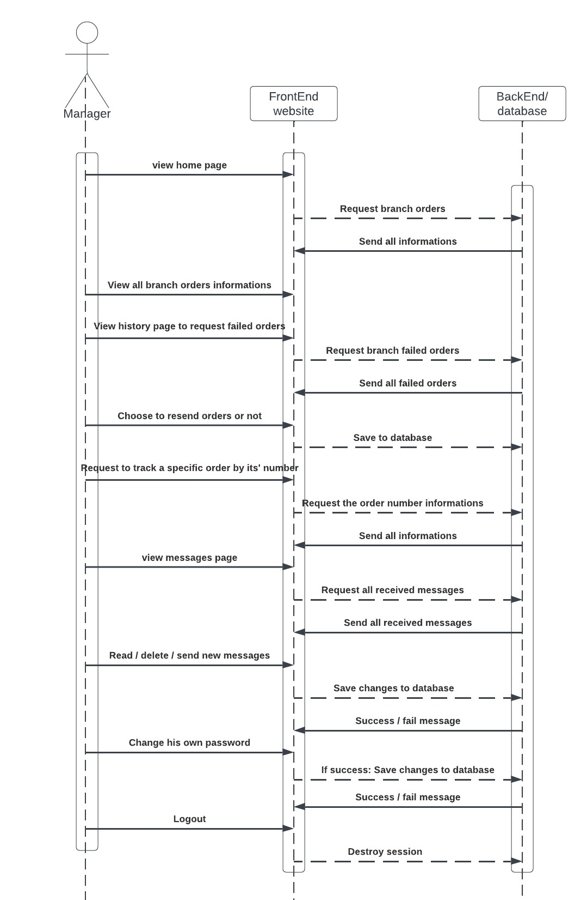
DELIVERY WEB APPLICATION
Branch Manager Diagrams:

Slide 19
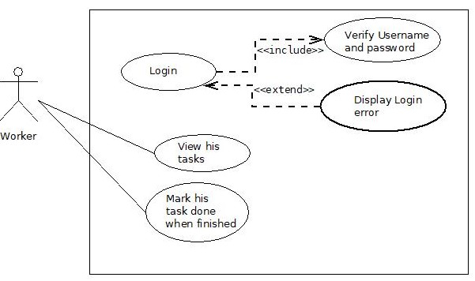
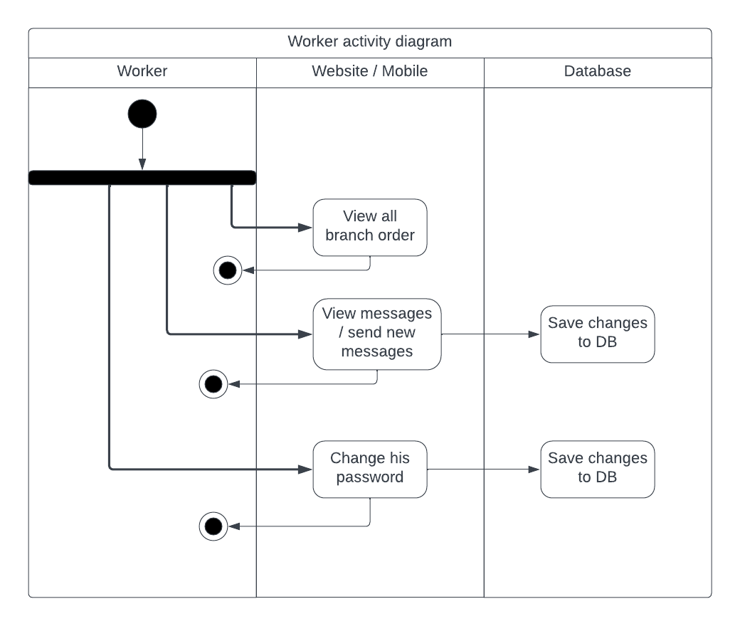
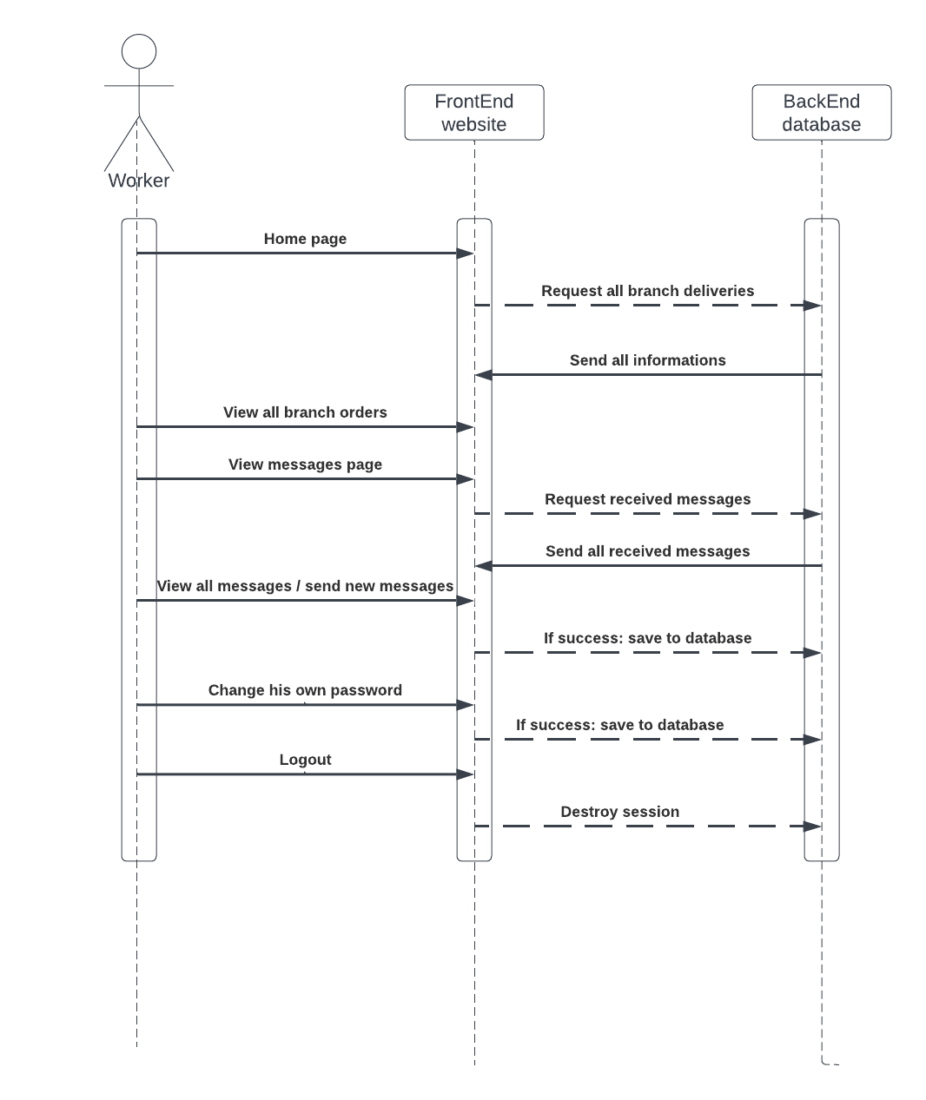
DELIVERY WEB APPLICATION
Worker Diagrams:

Slide 20
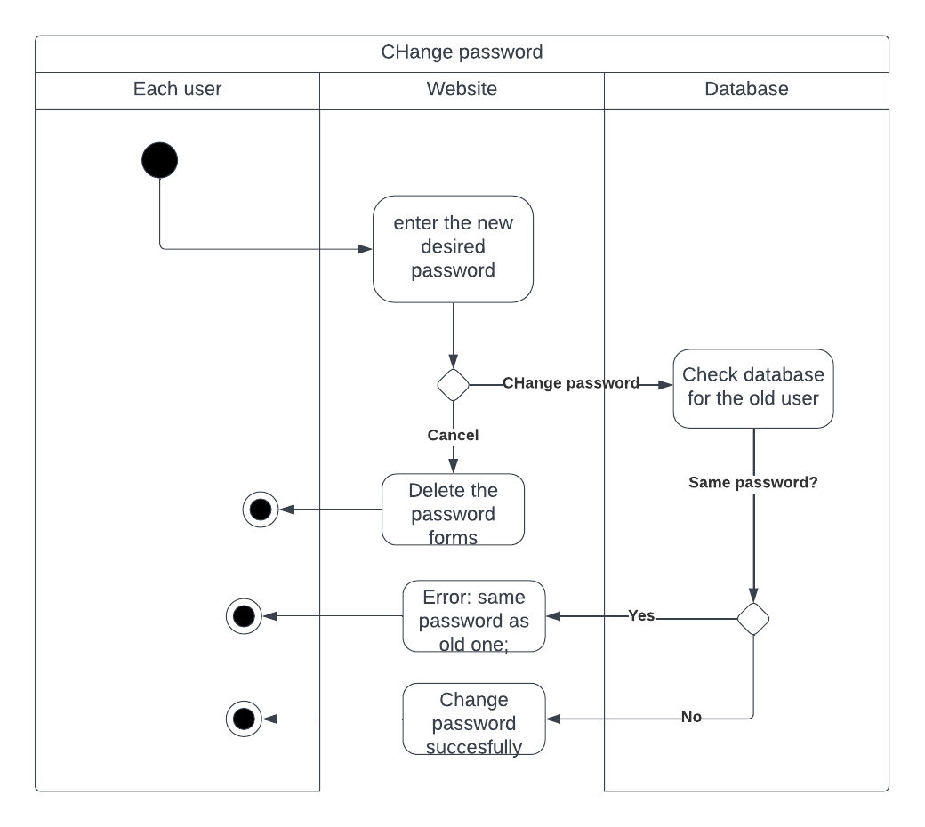
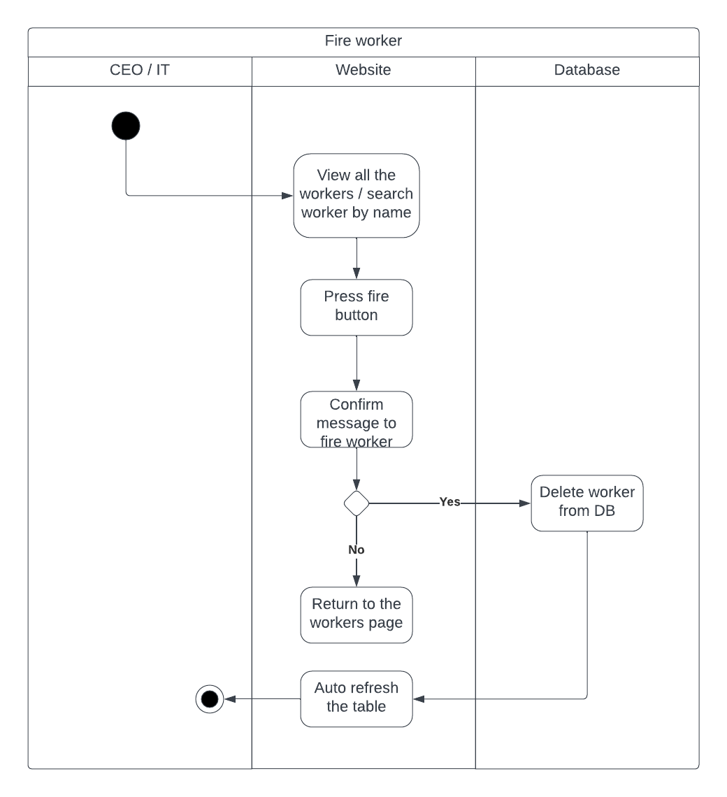
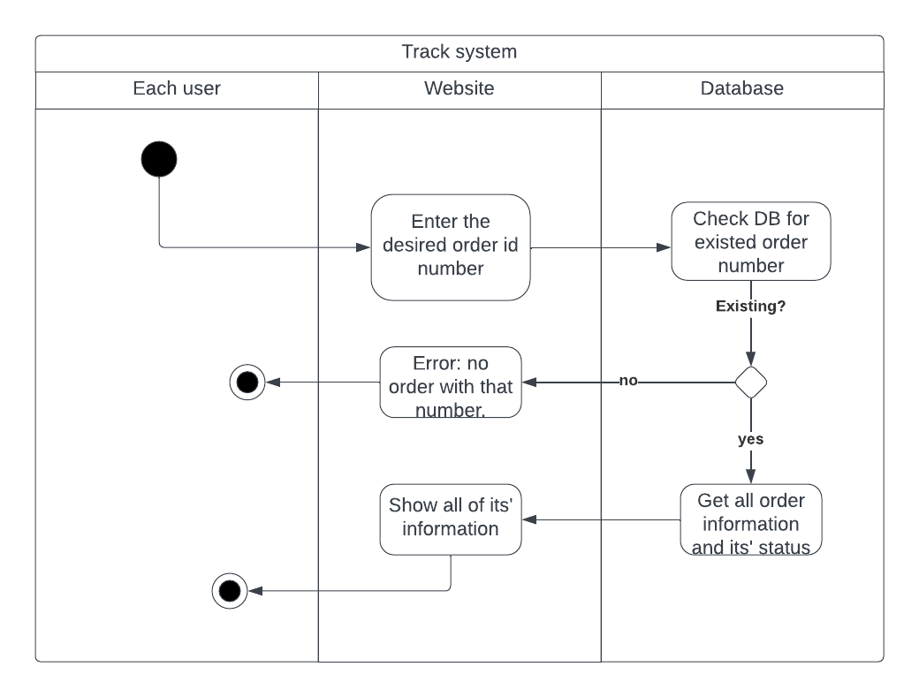
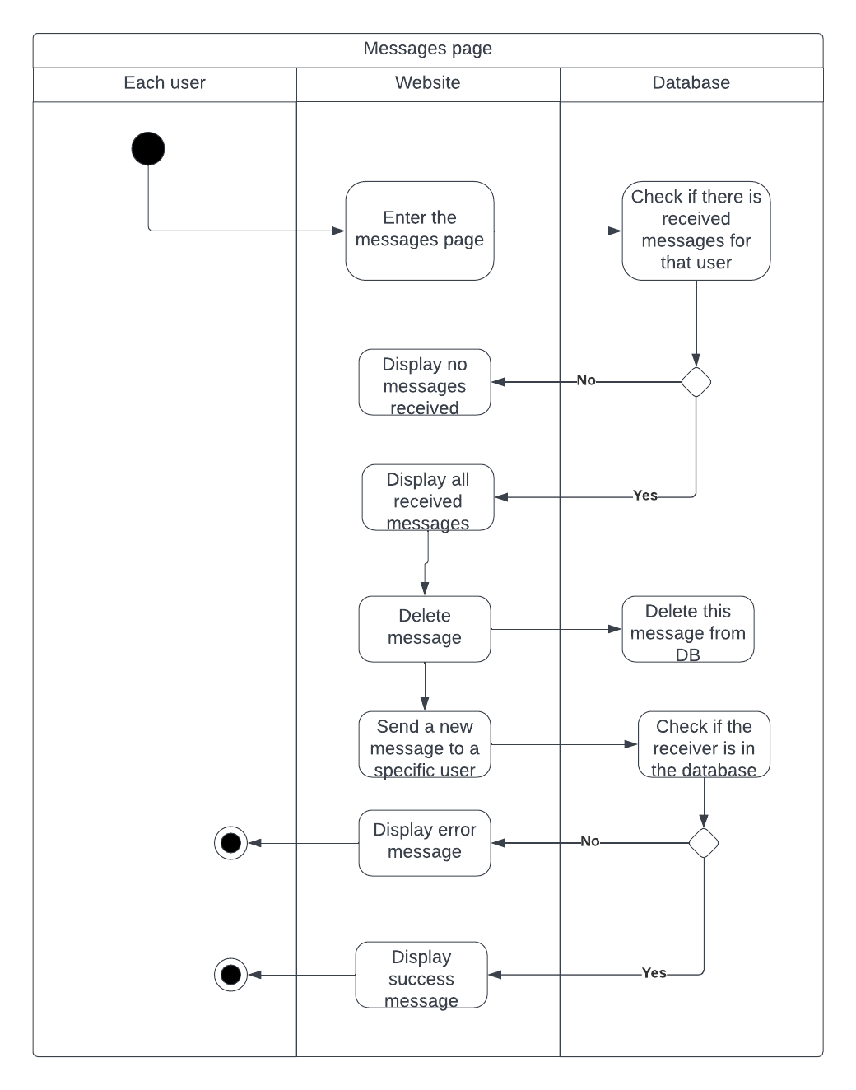
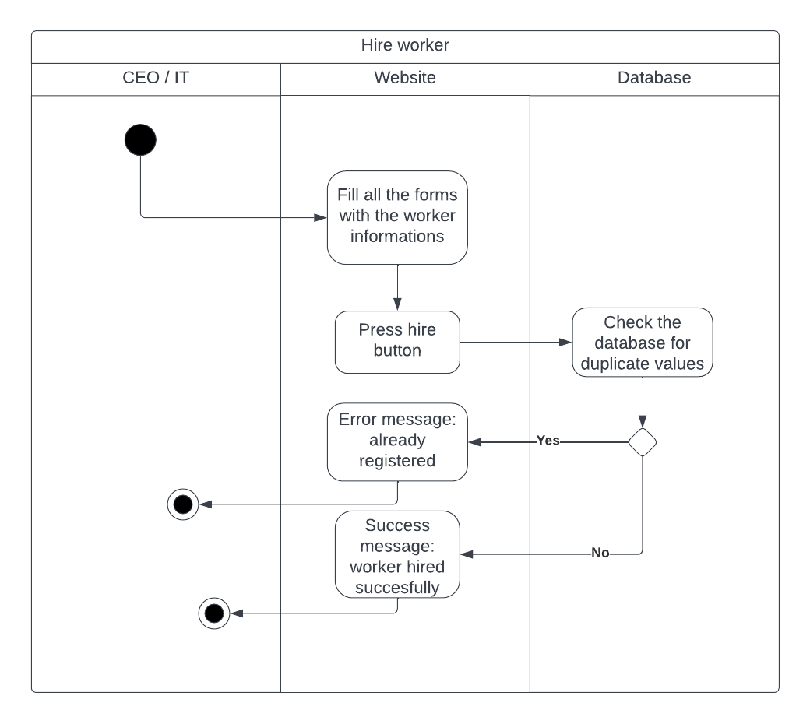
DELIVERY WEB APPLICATION
Common Pages Diagrams:

Slide 21
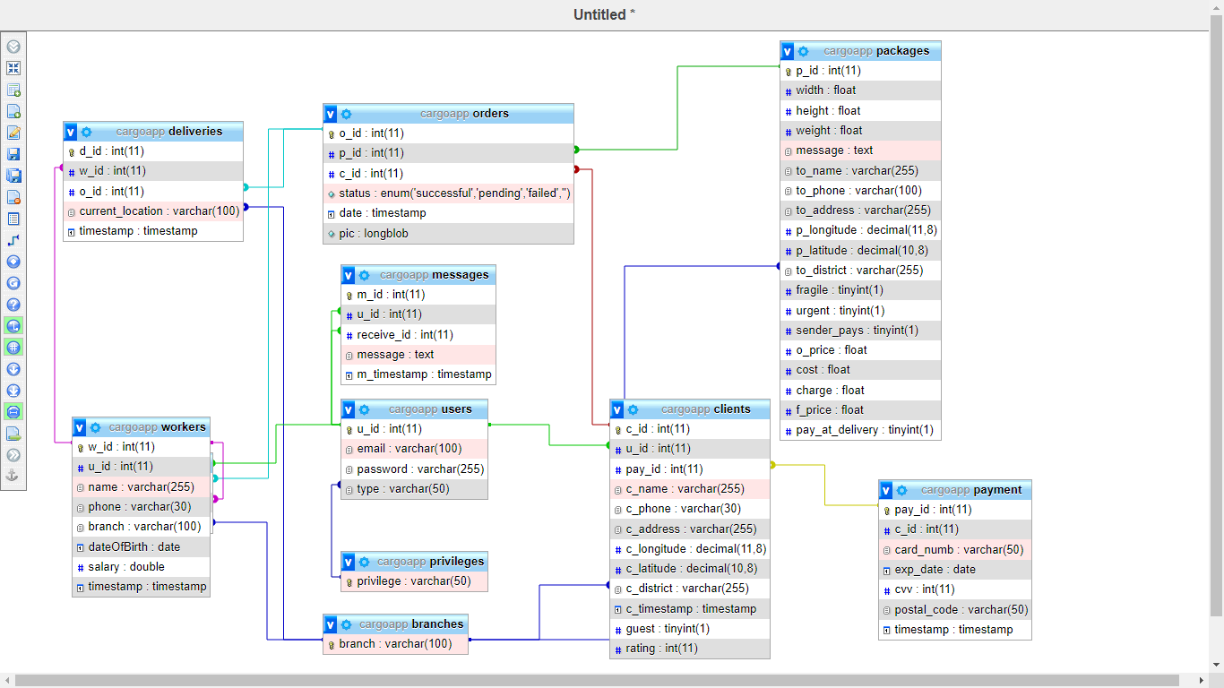
DELIVERY WEB APPLICATION
Class diagram:
14

Slide 22
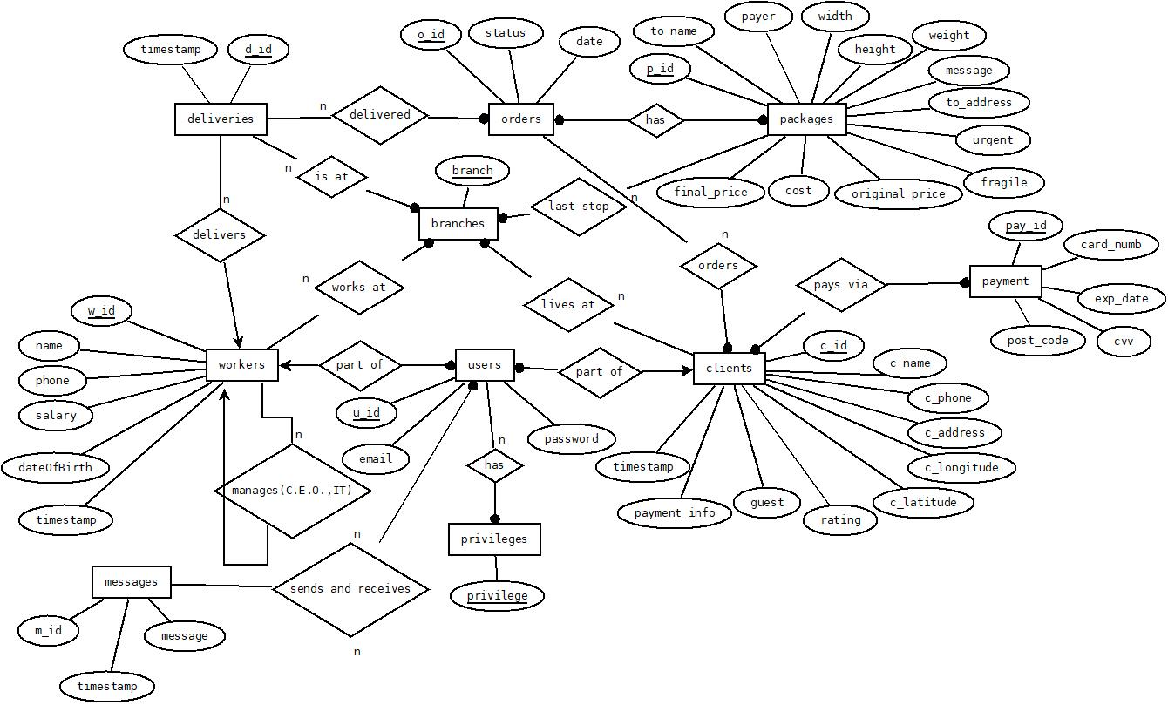
DELIVERY WEB APPLICATION
ER diagram:
15

Slide 23
DELIVERY WEB APPLICATION
Stage 05
Stage 06
Stage 07
Stage 08
Implementation
Conclusion
Future Work
Demonstration
16

Slide 24








DELIVERY WEB APPLICATION Implementation:
HTML5
01
02
XML
Css
03
04
Java Script
Xampp
05
Java
06
MySQL DB
PHP
08
07
17

Slide 25
DELIVERY WEB APPLICATION FEATURES:
IT
Workers informations
Branches
Hire
Messages
Password
He can view all workers and fire a worker
View all branches + add a new branch
Hire a new worker
He can receive or send messages to company users
He can change his password and other workers passwords
18

Slide 26
DELIVERY WEB APPLICATION FEATURES:
CEO
Statistics
Branches and workers
History
Messages
Password
He can view charts or tables for latest statistics
He can either hire or fire a worker and add a new branch
View all made orders + filtering them
He can receive or send messages to company users
He can change his own password
19

Slide 27
DELIVERY WEB APPLICATION FEATURES:
Client
Guest order
Track
View all his deliveries
Messages
Password
A guest mode delivery order is available
The client can track his deliveries
He can access all his deliveries informations
He can receive or send messages to company users
He can change his own password
20

Slide 28
DELIVERY WEB APPLICATION FEATURES:
Branch Manager
Deliveries informations
Fail
Track
Messages
Password
View all branch deliveries (urgent ones at top)
View all failed orders and resend them
Track an order
He can receive or send messages to company users
He can change his own password
21

Slide 29
DELIVERY WEB APPLICATION FEATURES:
Workers
Deliveries informations
Mobile app
Delivers
Messages
Password
View all branch deliveries (urgent ones at top)
He has an easy to use mobile app to facilitate his daily job
Delivers the orders to another location
He can receive or send messages to company users
He can change his own password
22

Slide 30
DELIVERY WEB APPLICATION
Stage 05
Stage 06
Stage 07
Stage 08
Implementation
Conclusion
Future work
Demonstration
23

Slide 31
DELIVERY WEB APPLICATION
Conclusion:
Addressed challenges: Overcame transparency, efficiency, communication, security, competition, and demand issues.
Innovative solution: Developed advanced cargo tracking app with real-time tracking, automation, communication, security, and data insights.
Overcame obstacles: Achieved success through collaboration, task management, and persistence.
Industry impact: Optimized operations, reduced costs, increased revenue, improved satisfaction, and informed decision-making potential.
24

Slide 32
DELIVERY WEB APPLICATION
Stage 05
Stage 06
Stage 07
Stage 08
Implementation
Conclusion
Future work
Demonstration
25

Slide 33
DELIVERY WEB APPLICATION
Future work:
Strengthen cybersecurity: Implement ISO 28000 and ISO 31000 standards for enhanced information security.
Improve tracking: Integrate GPS tracking for real-time monitoring and accurate location tracking.
Streamline pricing: Enhance pricing system with bundles and dynamic adjustments for flexibility.
Enhance accessibility: Add dark mode and translation capabilities for improved usability.
26

Slide 34
DELIVERY WEB APPLICATION
Stage 05
Stage 06
Stage 07
Stage 08
Implementation
Conclusion
Future work
Demonstrarion
27

Slide 35
DELIVERY WEB APPLICATION
Let’s head to the demo
28

