Slide 1


SQLite
Presentation and Discussion
By Jannick Gruschka and Antonio Pirani

Slide 2
Content Overview
Why SQLite?
Principles
History and Examples
Pros & Cons
Demo

Slide 3

Why SQLite?
01 – Open Source
Often used in:
Mobile applications
Web development
Embedded systems
Desktop applications
02 – Lightweight
03 - Relational
04 - Embedded

Slide 4


RDBMS & Schema
SQLite is a relational database management system. It is an in-memory open-source library, that stores data in a row-based table structure which connects related data elements.
01
Relational Database
CREATE TABLE sqlite_schema(
type text,
name text,
tbl_name text,
rootpage integer,
sql text
);
Every SQLite database contains a single "schema table" that stores the schema for that database. The schema for a database is a description of all of the other tables, indexes, triggers, and views that are contained within the database.
02
Schema Table

Slide 5
SQLite Principles
Serverless
Transactional
Cross-Platform
Tested
Reliable
Lightweight

Slide 6
Principles of SQLite – Serverless & Cross-Platform
The database engine runs within the same process, thread, and address space as the application. There is no message passing or network activity.
Any program that is able to access the disk is able to use an SQLite database. => no configuration
Cross platform, since all machines use the same file format

Slide 7



CAP Theorem
All copies have the same value
01
Consistency
A
C I D
Reads and Writes always succeed
01
Availability
System properties are mantained
01
Partition Tolerance

Slide 8
Principles of SQLite – Transactional (ACID)
A transactional database is one in which all changes and queries appear to be Atomic, Consistent, Isolated, and Durable.
All changes to data are performed together, either all succeed, or all fail ➔ “All or nothing”
Data is in a consistent state at the beginning and end of a transaction
Atomic
Consistent
(Type Affinity – Weak typing of columns)
Ensures concurrent transactions do not interfere, but appear to be executing in isolation
Ensures changes made to data persist, even after system failure
Isolated
Durable

Slide 9
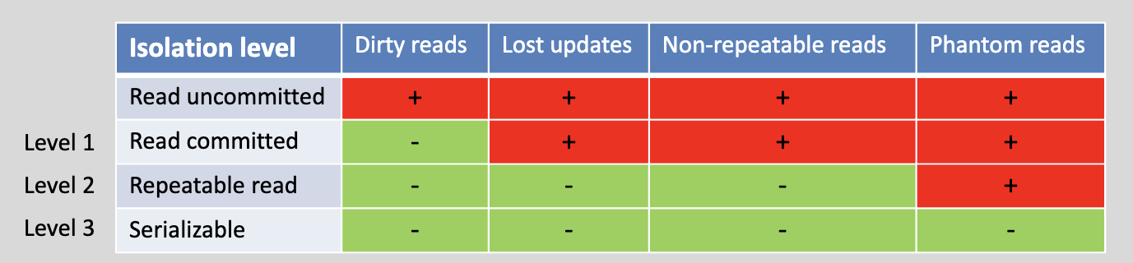
Transaction Processing 1/3
SQLite implements serializable transactions that are ACID.
All changes within a single transaction in SQLite either occur completely or not at all
Serializable schedule: A schedule S of a number of transactions is serializable if it is equivalent to some serial schedule of the same transactions.
Taken from DBS2_7_TxnProc_ConcurControl.pdf
How does it work?

Slide 10
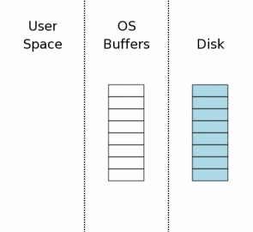
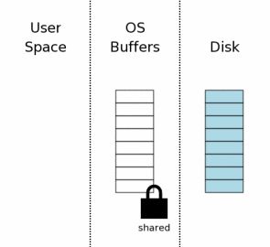
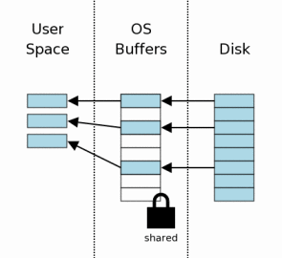
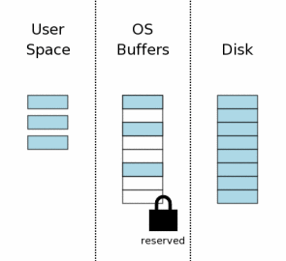
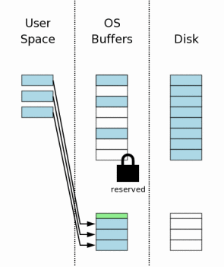
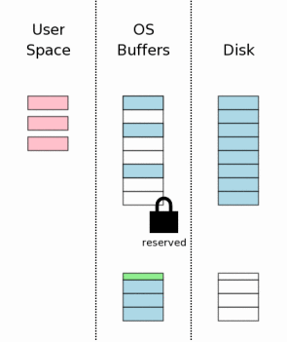
Transaction Processing 2/3
Legenda:
Original data
Empty space
Changed data
RbJ header
The database connection has just been opened and no information has been read yet, so the user space is empty.
The first step toward reading from the database file is obtaining a shared lock on the database file
After the shared lock is acquired, we can begin reading information from the database file.
Before making changes to the database, SQLite first obtains a "reserved" lock on the database file, allowing only one process to write at a time.
Prior to making any changes SQLite creates a separate rollback journal file and writes into the rollback journal the original content of the database pages that are to be altered.
Now the pages can be modified in user memory. Each database connection has its own private copy of user space

Slide 11
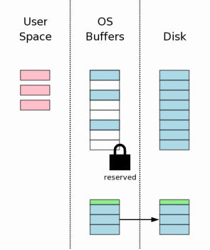
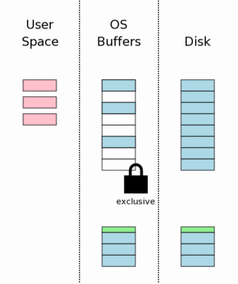
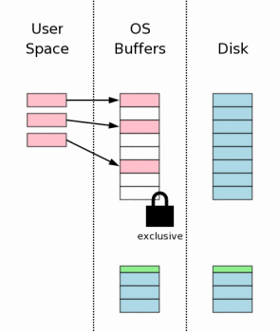
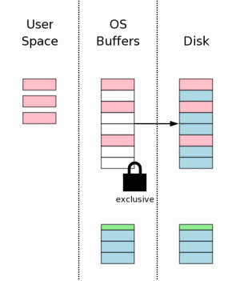
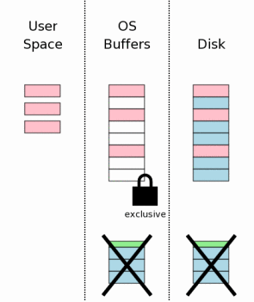
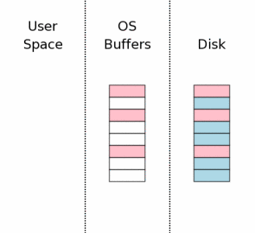
Transaction Processing 3/3
Legenda:
Original data
Empty space
Changed data
RbJ header
The next step is to flush the content of the rollback journal file to non-volatile storage. It’s necessary to avoid power loss problems
We must obtain an exclusive lock on the database file. First SQLite obtains a "pending" lock, which then becomes an exclusive lock.
We know that no other processes are reading from the database file and it is safe to write changes into the database file now.
Another flush must occur to make sure that all the database changes are written into non-volatile storage
After the database changes are all safely on the mass storage device, the rollback journal file is deleted. This is the instant where the transaction commits.
The last step in the commit process is to release the exclusive lock so that other processes can once again start accessing the database file.

Slide 12

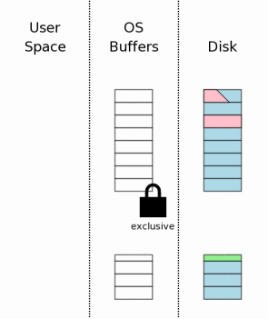
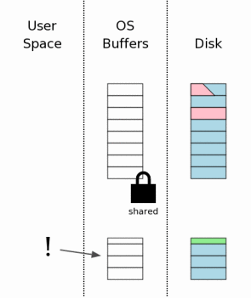
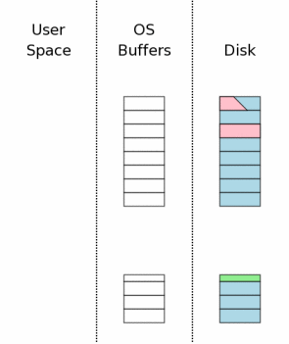
Recovery 1/2
A hot journal means that the database file is in an inconsistent state and needs to be repaired (by rollback) prior to being used.
Suppose the power loss occurred while the database changes were being written to disk. The rollback journal is complete and intact on disk when the power is restored.
As soon as a SQL process tries to access a db file, it notices that there is a rollback journal file present. SQLite then checks to see if the rollback journal is a "hot journal”.
The first step toward dealing with a hot journal is to obtain an exclusive lock on the database file. This prevents two or more processes from trying to rollback the same hot journal at the same time.

Slide 13
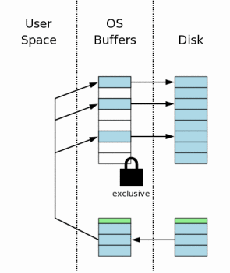
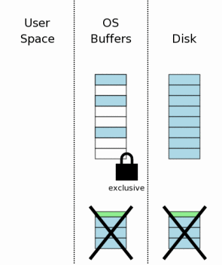

Recovery 2/2
Once a process obtains an exclusive lock, it is permitted to write to the database file. It then proceeds to read the original content of pages out of the rollback journal and write that content back to where it came from in the database file.
After all information in the rollback journal has been played back into the database file, the hot rollback journal can be deleted.
The final recovery step is to reduce the exclusive lock back to a shared lock. Once this happens, the database is back in the state that it would have been if the aborted transaction had never started.

Slide 14
Security
Untrusted SQL Inputs
Set the SQLITE_DBCONFIG_DEFENSIVE flag to prevents ordinary SQL statements from deliberately corrupting the database file;
Reduce the limits that SQLite imposes on inputs. This can help prevent DDOS attacks and other kinds of mischief that can occur as a result of unusually large inputs;
Set a timer in a separate thread and invoke sqlite3_interrupt() when the timer goes off to prevent the SQL statement from running forever;
Control memory usage.
Untrusted SQLite Database Files
If the application does not use triggers or views, consider disabling the unused capabilities with sqlite3_db_config();
Run PRAGMA integrity_check on the database as the first SQL statement after opening the database files and prior to running any other SQL statement.
Database Encryption
done by using the official SQLite Encryption Extension (SEE) or opting for 3rd party options, like SQLChipher.
With SQLite there are two main ways of appling security: using precautions and encrypting the entire database.
with RC4 and AES 128 & 256 encryption algorithms

Slide 15


Testing
TCL Test
TH3 Test
Test
Logic Test
Fuzz Test
151 K
92038 K
And more: I/O, Dynamic Analysis (Assert and Valgrind)
Lines of Code

Slide 16
Performance
in seconds, in a single use platform
5
For most common operations
SQLite is 2x times faster than MySQL
and 10 – 20x faster than PostgreSQL
SQLite
0
1000 INSERT
MySQL
12
PostgreSQL
0
100 SIMPLE SELECT
100 SELECT WITH CONDITION

Slide 17
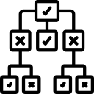


SQLite Database Key Features
01
B-Tree
The main method of indexing used
SQLite uses dynamic memory allocation to obtain memory for storing various objects and to build a memory cache of the database file and to hold the results of queries.
02
DMA
Dynamic Memory Allocation
The complete state of an SQLite database is contained in a single file on disk called the "main database file".
During a transaction, SQLite stores additional information in a second file called the "rollback journal” or WAL file.
03
Format
To store the state of the DB and save changes

Slide 18
Optimization
SQLite uses a query planner to determine the most efficient way to execute a query, using query trees.
SQLite uses a variety of techniques to optimize clauses between tables (WHERE, JOIN, etc…)
Query Planner
Techniques
SQLite supports indexing on columns in a table, which allows for much faster data retrieval.
SQLite caches frequently accessed data in memory to improve performance
Indexing
Caching
SQLite is designed to optimize queries by using the most efficient algorithm for a given task
Compilation
SQLite compiles queries into a bytecode format that can be executed by the virtual machine
Algorithms
Note: Prior to version 3.8.0, SQLite always used the "Nearest Neighbour" or "NN" heuristic when searching for the best query plan. With the new update SQLite uses a cost-based optimization approach to optimize queries. Nevertheless, in some cases, the heuristic approach is still used.

Slide 19
Serverless
SQLite
Server
Runs on your local disk, any process on it can comm. to
Communication to server via intermediary process
Library
Language
VS
Library that imp. Database engine => subset of SQL
Language to manage & manipulate rel. databases
Small & Fast
Big & Slow
Typical use case is a small or embedded project
Typical use case is a big / enterprise application
SQL

Slide 20
Use Cases
Embedded devices and IoT
Data transfer format
Websites
Phones, televisions, cameras, thermostats, automobiles, airplanes, remote sensors, drones, medical devices
Used as a container for transferring content from one system to another.
The database engine for most low to medium traffic websites (less than 100k hits/day)
Application File Format
Server-side database
Data analysis
An underlying storage engine for an application-specific database server
Used as version control systems, financial analysis tools, media cataloging and editing suites
Raw data can be imported from CSV files and used to generate summary reports

Slide 21




History of SQLite
SQLite 1.0 is released
First Big Tech
Test and Coverage
In August D. Richard Hipp announces a new DB engine to manage military missiles
Motorola decides to start implementing SQLite in its new phone models
SQLite releases have 100% branch test coverage
2000
2001
2002
2005
2009
2010
SQLite gets updated to V.2
O'Reilly Award
More companies
B-Tree implementation replaces the previous GNU storage manager
Hipp wins Google’s Open Source Award for best integrator
Facebook, Apple, Google and many more of todays big companies are using SQLite

Slide 22



Famous Examples
Microsoft
Microsoft uses SQLite as a core component of Windows 10 and 11
SQLite
Google uses SQLite in their Android cell-phone operating system, and in the Chrome Web Browser.
Google
Apple uses SQLite in many of the native applications running on Mac OS-X desktops and servers and on iOS devices.
Apple
And more: Facebook (osquery), Mozilla, Php, Python

Slide 23

Specific Example with osquery
Osquery exposes an operating system as a high-performance relational database. This design allows you to write SQL-based queries efficiently and easily to explore operating systems. With osquery, SQL tables represent the current state of operating system attributes, such as:
running processes
loaded kernel modules
open network connections
For example, this query returns all of the processes which are currently executing
SELECT name, path, pid FROM processes WHERE on_disk = 0;
This query finds all processes that are listening on network ports:
SELECT DISTINCT process.name, listening.port, listening.address, process.pid FROM processes AS process JOIN listening_ports AS listening ON process.pid = listening.pid;

Slide 24
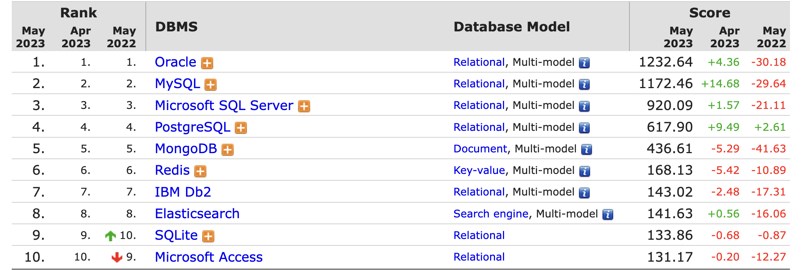
Ranking
Multi model includes: Document, Graph, RDF, Spatial, Search engine and Time Series

Slide 25
Pros and Cons
PROS
CONS
Supported by most programming languages
Single Model, No Concurrency
Easy to Use
No concept of user accounts,
relies on the file system for
all database permissions
Embeddable
Surclassed by other DBMS

Slide 26

Demo

Slide 27
Sources
https://sqlite.org/index.html
https://corecursive.com/066-sqlite-with-richard-hipp/ Richard Hipp Interview
https://www.sqlitetutorial.net/sqlite-vs-other-sql-databases/
https://www.geeksforgeeks.org/difference-between-sql-and-sqlite/
https://db-engines.com/en/ranking
https://www.zetetic.net/sqlcipher/
https://github.com/osquery/osquery
https://github.com/AntonioPirani/SQLiteProject Project Repository

