Slide 1
AI & ChatGPT
Antonio Prgomet
Delta AI & Negotiations
https://www.linkedin.com/in/antonioprgomet/

Slide 2

Agenda
Context, Information Age and AI.
ChatGPT.

Slide 3
Information Age and AI

Slide 4
Information Age
We live in a society where information technology (IT) with the purpose of handling data and information is central.
Examples: Transactions, internet, communication, sales, (un)social media, … .

Slide 5
Computers
What if computers could advance from “merely following instructions” to actually solve problems that in general requires “intelligence”?
Fill in password
Correct password
Welcome to the site
Wrong password
Please try again

Slide 6
Artificial Intelligence
AI is the capability of computers and robots to do things / solve problems that normally requires ”intelligence”.
Examples: Conversations, predictions, classifications.
Example “Emotion Classifier”: Is my friend happy, neutral or sad?
We will now dive deeper into ChatGPT.

Slide 7
ChatGPT

Slide 8
ChatGPT – General Information
ChatGPT is a language model that we can have a conversation with.
The model was trained on an enormous data set containing data from the internet (books, articles, social media, …).
From the data the model has learned what is probable sequences of words.
When we “prompt” ChatGPT it estimates probabilities for the next word.
A: How are you today? B: ______________
Summary: ChatGPT is a stochastic parrot that is very useful.
Good | 55%
Great | 15%
Bad | 10%
… | …

Slide 9
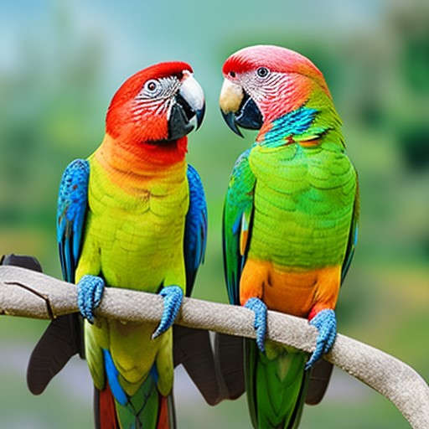
Let’s see what it says!
What is AI?
Image generated by Chatsonic.

Slide 10
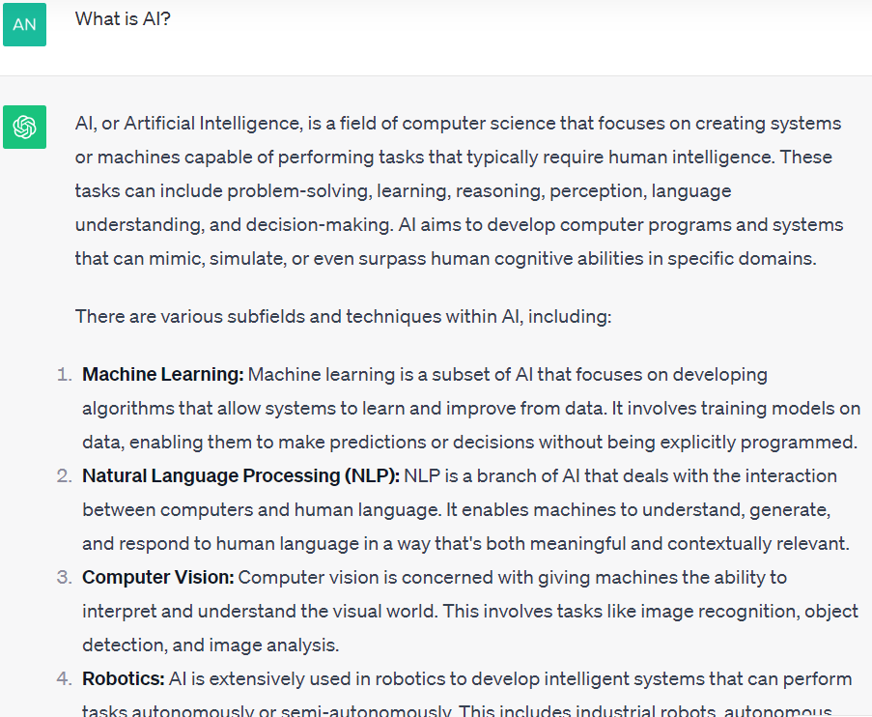

Slide 11
ChatGPT – General Information
Can ChatGPT “think”? No! It has simply learned probable patterns based on text available on the internet and produced by humans.
Can ChatGPT give “wrong answers”? Yes! It gives probable answers based on the data it has been trained on.
Can we classify if text has been produced by ChatGPT? No.
Is ChatGPT useful? Yes!
The model has been “tuned” to protect against inappropriate content (violence, racism, political preferences).
Morgan Stanley (revenue 50 billion) have fine tuned ChatGPT on internal data → Employees can ask company specific questions to it.
Notes:
Can we classify if text has been produced by ChatGPT? No.
https://help.openai.com/en/articles/8313351-how-can-educators-respond-to-students-presenting-ai-generated-content-as-their-own

Slide 12
“Prompt Engineering” – How do we ask good questions?
In most cases you can ask/discuss what you wish without too much thinking.
For better answers/conversations there is some things you can think about. This is what “Prompt Engineering” is about.
Best Practices: https://help.openai.com/en/articles/6654000-best-practices-for-prompt-engineering-with-openai-api

Slide 13
Prompt Engineering
Be specific, descriptive and as detailed as possible about the desired context, outcome, length, format, style, … .
Less Effective: Write a poem about ChatGPT.
Better: Write a short inspiring poem about ChatGPT that focuses on its benefits for using it in school for learning.

Slide 14
ChatGPT – Applications
Create / Improve text. PowerPoints, mails, speeches, marketing campaigns, job ads.
Answer factual questions. How many days are there in a year?
Problem solving. I run this code and get this error. Why?
Brainstorming. How can I find new revenue streams for my company?
Discussion partner. Decision processes.

Slide 15
Shared Links
I had a conversation with ChatGPT and now I want to save it.
Use Shared Links.

Slide 16
Risks & Guiding Principles
ChatGPT collects data. Examples include questions you ask, IP address.
20 march 2023 there was a data breach. Conversations, name, email, … was visible in some cases. Probably low impact but it shows that IT CAN HAPPEN.
Your conversations can be used for training.
“ChatGPT Enterprise” is more secure and you have more control of the data.
When and how shall we use ChatGPT in our company?
Risk of people not verifying information presented as “facts”.
Source criticism is not a trivial activity.
Should we have company/team wide rules and guiding principles?

Slide 17
Learn more about ChatGPT?
If you want to understand ChatGPT in detail, read for instance: https://writings.stephenwolfram.com/2023/02/what-is-chatgpt-doing-and-why-does-it-work/

Slide 18
AI & ChatGPT
Antonio Prgomet
Delta AI & Negotiations
https://www.linkedin.com/in/antonioprgomet/

