Slide 1

Introduction to R Programming
Antonio Prgomet
https://www.linkedin.com/in/antonioprgomet/

Slide 2
Course Setup
In this course I will use RStudio as my integrated development enviroment (IDE). Run your R code as your prefer.
Installing R & RStudio is a standard procedure, if you need guidance check the internet.
First we will go through slides to get an overview of R and then we will look at R code.

Slide 3
Course Content
What is R?
RStudio
hello, world
Packages
Variable Assignment
Styleguide
Data Types
Data Structures (Vectors, Arrays, Matrices, Factors, Lists, Dataframes)
Operators (Arithmetic, Relational, Logical)
Conditional Logic
Built in Functions
User defined Functions
Looping
Benchmarking – Example with storing values
Loading Excel Data
Plotting
Some Statistics
Linear Regression
Tidyverse
Tibble
Dplyr
Ggplot2
Code session in R

Slide 4
What is R?
R is a programming language for statistical computing and graphics.
The name “R” is due to being a successor of the S programming language and it is also the shared first letter of the founders; Ross Ihaka and Robert Gentleman.
Website of R: https://www.r-project.org/

Slide 5
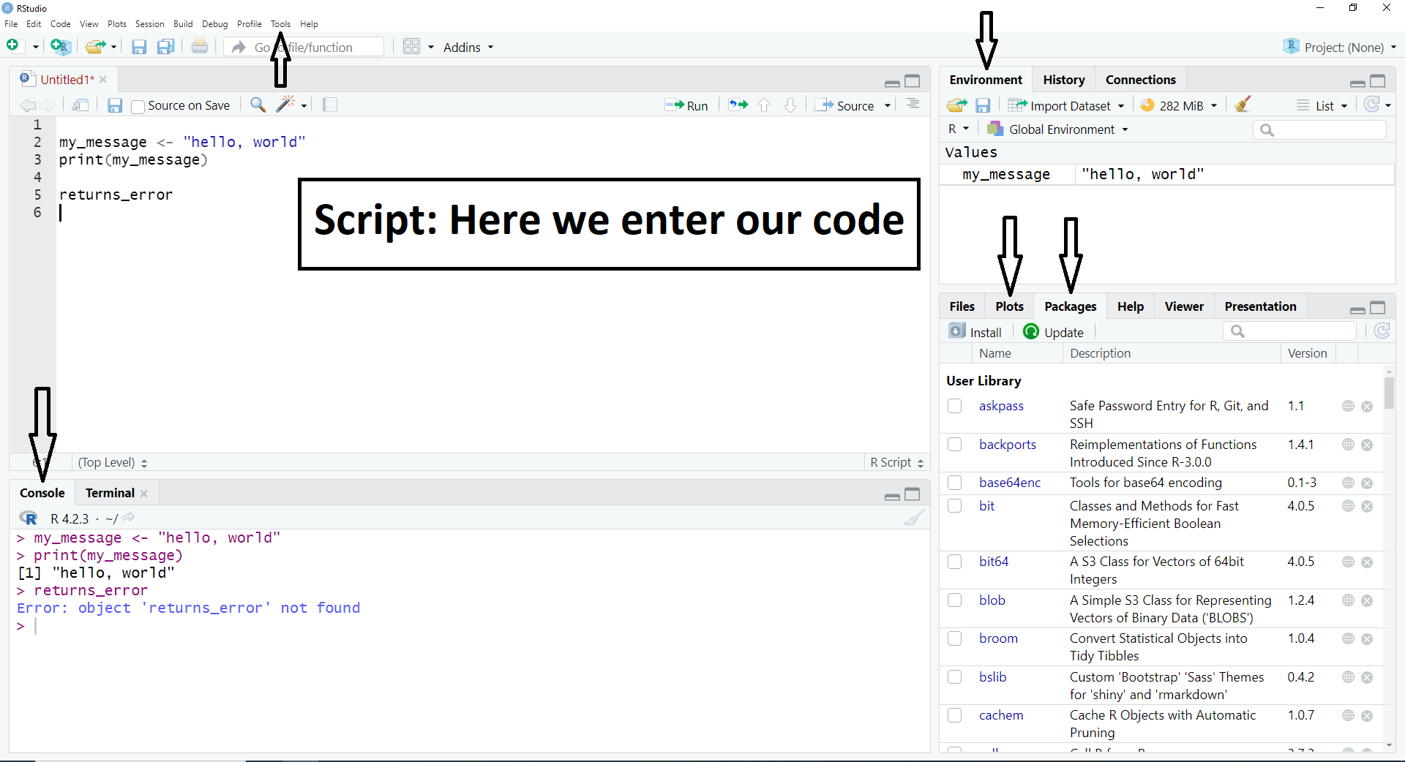

Slide 6
RStudio
RStudio is an integrated development enviroment (IDE) for R. It has several nice features, some examples are:
You can create your scripts in the IDE.
In the ”Console” you can see the results of executed code and command history.
In the ”Enviroment” you can see information about variables and datasets currently stored in the working enviroment during your R session.
In ”Packages” you can install packages through a graphical user interface if you prefer that.
In ”Plots” you can see plots that you have created.
Check out Tools > Keyboard Shortcuts Help to see for instance:
How to execute code.
Comment code

Slide 7
hello, world
print("hello, world")

Slide 8
Packages
R can be extended through packages and that is one of the reason why R is as famous as it is.
Example: Installing and Loading Tidyverse.
install.packages("tidyverse") # Install Package
library("tidyverse") # Load package
# Show which packages are currently loaded
search()
At “CRAN Task Views” you can see which packages on CRAN are relevant for specific topics: https://cran.r-project.org/web/views/

Slide 9
Variable Assignment
# Standard approach to assign a variable
var1 <- "Leftward Assignment"
# Rightward assignment is possible
"Rightward Assignment" -> var2
# Equal sign works but does not follow the styleguide
var3 = 5
# Print out all the variables in workspace
ls()

Slide 10
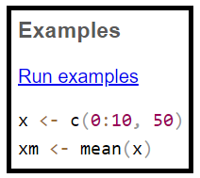
Styleguide
A styleguide provides consistency making it easier to read code but also writing it since the need for taking decisions, such as how to name variables, decrease.
There is no official R style manual, but by looking at how source code and/or documentation in R is written, we could work out an “implicit guide”. For instance, running the following code: ?mean to display the documentation for the mean function we see the following example:
When assigning variables use ”<-” even though ”=” works aswell.
We will use the ”The tidyverse style guide”: https://style.tidyverse.org/index.html
Notes:
https://cran.r-project.org/web/packages/rockchalk/vignettes/Rstyle.pdf

Slide 11
Styleguide – Some Takeaways (1/2)
Use <- (not =) for assignment.
If you load packages by the library() command, load them all at the very beginning of the file.
Generally, variable names should be nouns and function names should be verbs. Strive for names that are concise and meaningful (this is not easy!).
Variable and function names should use only lowercase letters, numbers, and underscores (_) . Use underscores (“snake case”) to separate words within a name.

Slide 12
Styleguide – Some Takeaways (2/2)
Break up files by chunks using the following commented line type:
# Plot data ---------------------------
In code, use comments to explain the “why” not the “what” or “how”.
In data analysis code, use comments to write important findings and analysis decisions. If you need comments to explain what your code is doing, consider rewriting your code to be clearer.
styler allows you to interactively restyle selected text, files, or entire projects. It includes an RStudio add-in making it easy to re-style existing code so that it conforms to the tidyverse styleguide. https://styler.r-lib.org/
Recommended to read the guide as soon as possible: https://style.tidyverse.org/index.html

Slide 13
Data Types
R has six basic (‘atomic’) vector types:
Logical
Integer
Real
Complex
String (or character)
Raw.
Single numbers, such as 4.2, and strings such as “four point two” are still vectors of length 1.
Notes:
https://cran.r-project.org/doc/manuals/r-release/R-lang.html#:~:text=R%20has%20six%20basic%20('atomic,(or%20character)%20and%20raw.

Slide 14
Data Structures
The six basic data structures in R are:
Vectors: One dimensional collection of elements of the same data type (homogenous).
Arrays: Multidimensional and homogenous.
Matrices: A two dimensional array.
Factors: Used for storing categorical data.
Lists: One dimensional and heterogenous (elements can be of different data types and you can store for instance vectors, matrices and so on in it).
DataFrames: Two dimensional and used to store tabular data. Columns can be of different data types.

Slide 15
Operators
Some operator types in R:
Arithmetic operators - Ex: Addition (+), Subtraction (-), Multiplication (*).
Relational operators - Ex: < .
Logical operators - Ex: & (AND), | (OR).

Slide 16
Conditional Logic
# Example code to check whether a number
# is considered "low", "medium" or "high"
x <- 15
if (x < 10) {
print("low")
} else if (10 <= x && x <= 20) {
print("medium")
} else {
print("high")
}
The difference between ”&” and ”&&” is explained here: https://stackoverflow.com/questions/6558921/difference-between-boolean-operators-and-and-between-and-in-r

Slide 17
Built in Functions
R has several built in functions, some examples include: sum, max, min, mean.
Example 1:
sum(c(1, 2, 3)) # Returns 6
Example 2:
my_string <- "ProGramming is GREAT FuN"
toupper(my_string) # Returns: "PROGRAMMING IS GREAT FUN"

Slide 18
User Defined Functions
# A user defined function with mutliple outputs
rectangle_info <- function(length, width = 4) {
area <- length * width
perimeter <- 2 * (length + width)
result <- list("Area" = area, "Perimeter" = perimeter)
result
}
rectangle_info(2, 2) # Calling by position
rectangle_info(5) # Using the default value for width
rectangle_info(width = 2, length = 1) # Calling by keyword and changed order of arguments

Slide 19
Looping
# For loop
languages <- list("R", "Python", "Matlab", "SAS", "C", "C++", "C#", "Java")
for (language in languages) {
print(language)
}
# While loop
i <- 0
while (i < 4) {
print(i)
i <- i + 1
}

Slide 20
Benchmarking – Example With Storing Values
# Approach 1: Appending an empty vector
time1 <- system.time({
my_results <- c()
for (i in 1:100000) {
result <- i^2
my_results <- c(my_results, result)
}
})
# Approach 2: Replacing elements in a pre allocated vector
time2 <- system.time({
my_storage <- integer(100000)
for (i in 1:100000) {
result <- i^2
my_storage[i] <- result
}
})

Slide 21
Loading Excel Data
install.packages("readxl")
library("readxl")
my_data <- read_excel("your_file_path")

Slide 22
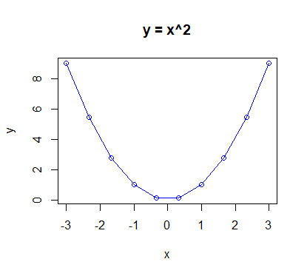
Plotting
x <- seq(-3, 3, length.out = 10)
y <- x^2
plot(x, y, type = "o", col = "blue", main = "y = x^2")

Slide 23
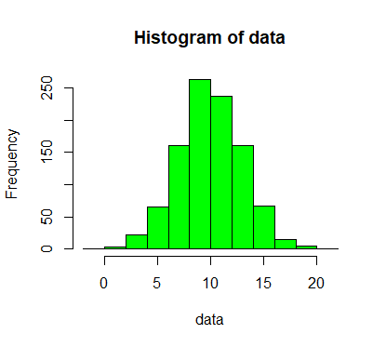
Some Statistics
# Simulate normal distributed data
data <- rnorm(1000, mean = 10, sd = 3)
hist(data, col = "green", border = "black")
# Creating a confidence interval with built in functions
ci_builtin <- t.test(data, conf.level = 0.95)
ci_builtin$conf.int

Slide 24
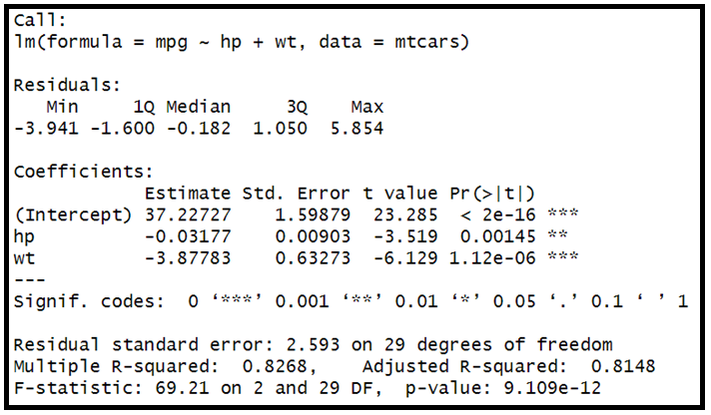
Linear Regression
# Example on Linear Regression
lin_reg <- lm(mpg ~ hp + wt, data = mtcars)
summary(lin_reg)

Slide 25
Tidyverse
Tidyverse is a group of packages designed for Data Science and is highly popular.
Tidyverse can be considered a “dialect” of the R language.
Some core Tidyverse packages are:
tibble (a development of the dataframe).
dplyr (data manipulation).
ggplot2 (creating graphics).
tidyr (functionality to get tidy data). Will not be covered in this course.
https://www.tidyverse.org/

Slide 26
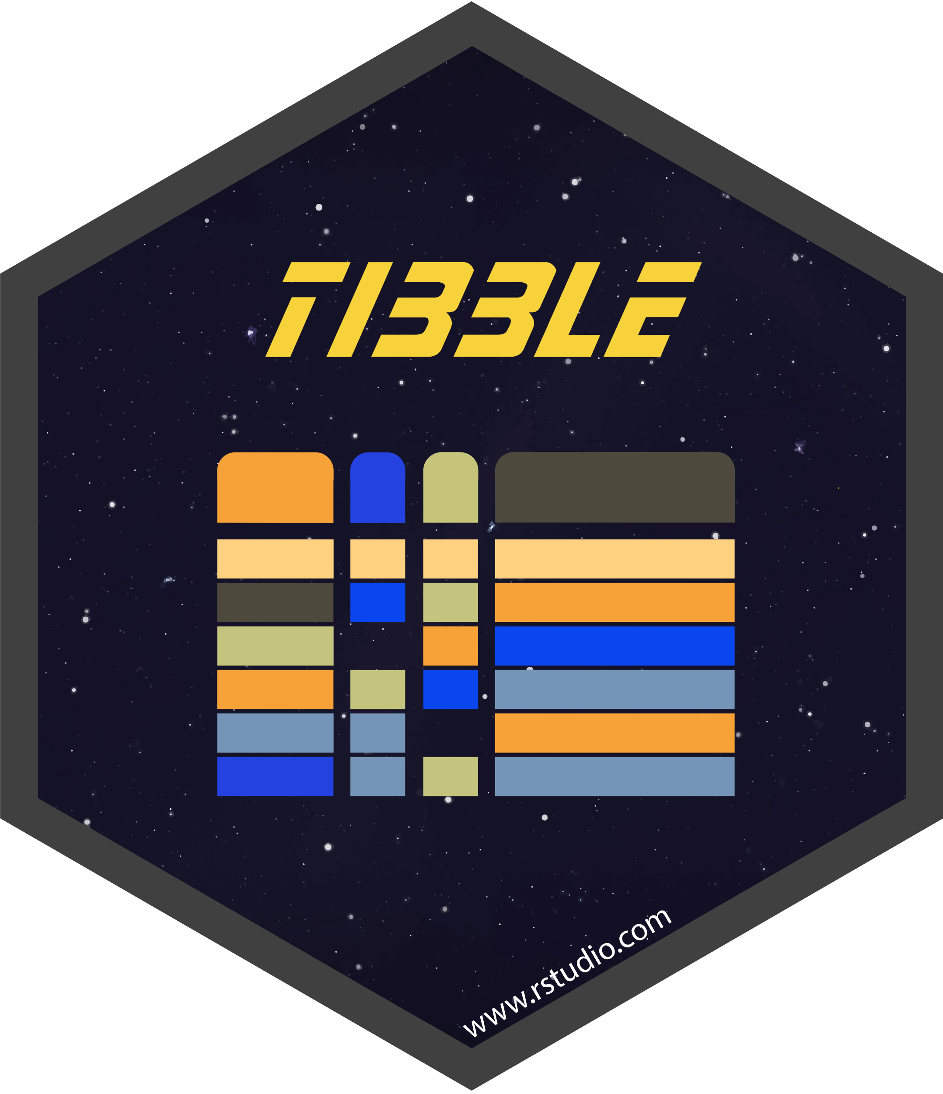
Tibble
Tibbles are data frames but they tweak some older behaviours.
Example: If you try to access a column that does not exist in a dataframe, you only get the value NULL. If you do the same in a tibble, you get NULL and a warning message.
Tibbles are one of the unifying features of the tidyverse.
You can transform a dataframe to a tibble by the function: as_tibble(name_of_df)
Turning a tibble back to a dataframe can be done by as.data.frame(name_of_tibble)
To learn more, check out: https://tibble.tidyverse.org/ or run the code vignette("tibble") in R.

Slide 27

dplyr - Background
dplyr provides a consistent set of verbs with which you handle dataframes or tibbles in an intuitive and user-friendly way.
Use case for dplyr: transforming a dataset so that you can do the particular analysis/visualization that you want.

Slide 28
dplyr – Single Table Verbs
dplyr provides functions for different basic verbs of data manipulation. We can group the verbs in three groups depending on if they work with rows, columns or group of rows. Some examples:
1. Rows:
- filter() chooses rows based on column values.
- arrange() changes the order of the rows.
2. Columns:
- select() changes whether or not a column is included.
- rename() changes the name of columns.
- mutate() changes the values of columns and creates new columns.
3. Groups of rows:
- summarise() collapses a group into a single row.

Slide 29
dplyr – Example 1 (Single Table Verb)
# Choose rows based on specific column values
starwars %>% filter(skin_color == "light", eye_color == "brown")
# Extracting the same data without using dplyr
starwars[starwars$skin_color == "light" & starwars$eye_color == "brown", ]

Slide 30
dplyr – Pipe Operator
The pipe operator denoted by %>% is used to chain multiple operations together. The output from one function is the input to the next. The pipe operator is read as ”then”.
Allows us to write a sequence of operations without having to do intermediate steps.
# Approach with intermediate variables
a1 <- group_by(starwars, species, sex)
a2 <- select(a1, height, mass)
a3 <- summarise(a2,
height = mean(height, na.rm = TRUE),
mass = mean(mass, na.rm = TRUE)
)
# Elegant approach with pipe operator
starwars %>%
group_by(species, sex) %>%
select(height, mass) %>%
summarise(
height = mean(height, na.rm = TRUE),
mass = mean(mass, na.rm = TRUE)
)

Slide 31
dplyr – Two Table Verbs
In reality we often work with multiple tables. One common thing to do is to combine columns from multiple tables into one. In dplyr, there are three families of verbs that work with two tables at a time:
Mutating joins, which add new variables to one table from matching rows in another. - Inner join, left join, and full join
Filtering joins, which filter observations from one table based on whether or not they match an observation in the other table. - semi join and anti join
Set operations, which combine the observations in the data sets as if they were set elements. - Union, intersection and setdiff

Slide 32
dplyr – Example 2 (Two Table Verb)
# left_join(x, y) includes all observations in x, regardless of whether they match or not (mutating join)
df1 %>% left_join(df2, by = "x")
# semi_join(x, y) keeps all observations in x that have a match in y (filtering join)
df3 %>% semi_join(df4, by = "x")
# intersect(x, y) return only observations in both x and y (set operation)
intersect(df5, df6)

Slide 33
dplyr – Learn More
Home page of dplyr: https://dplyr.tidyverse.org/
To learn more about one-table verbs, check for example: https://dplyr.tidyverse.org/articles/dplyr.html
To learn more about two-table verbs, check for example: https://dplyr.tidyverse.org/articles/two-table.html

Slide 34
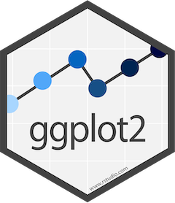
ggplot2 - Background
ggplot2 is a data visualization package that is based on ”The Grammar of Graphics” (Leland Wilkinson).
The grammar of graphics is based on the insight that you can uniquely describe any plot as a combination of a dataset, a geom, a set of mappings, a stat, a position adjustment, a coordinate system, and a faceting scheme.
To make a plot, we need a data layer, a geometric layer and an aesthetic layer. The rest is not required and often has sensible defaults.

Slide 35
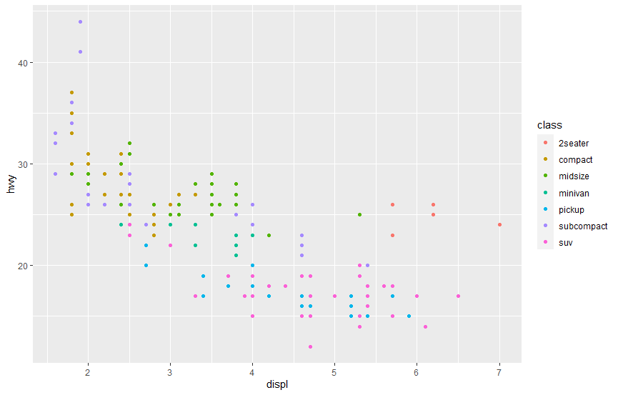
ggplot2 - Example
# Creating a simple scatterplot
ggplot(data = mpg) +
geom_point(mapping = aes(x = displ, y = hwy))

Slide 36
ggplot2 – Learn More
Home page of ggplot2: https://ggplot2.tidyverse.org/
To learn more, check for example: https://r4ds.had.co.nz/data-visualisation.html

Slide 37
Introduction to R Programming
Antonio Prgomet
https://www.linkedin.com/in/antonioprgomet/

