Slide 1

Comprehensive Meta Platforms Advertising Campaign Analysis Report
In-Depth Campaign Performance Evaluation
Prepared By :
Dr. Antonio Rawad Nassar
January 2024

Slide 2

Executive Summary
Overview of Meta Platforms' advertising strategy analysis.
Detailed comparison of budget allocations, ad format impacts, and the resulting sales and revenue across Facebook and Instagram.
Objective: To derive actionable insights that guide future advertising efforts and budget planning.

Slide 3
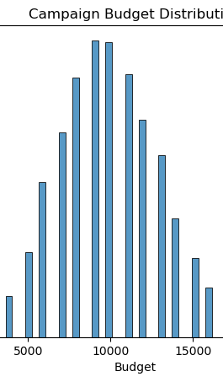
Budget Analysis and Campaign Duration
Insight into budget trends: Majority centered around USD 10,000, indicating standard campaign investment levels.
Duration insights: Wide variation; however, a median duration suggests a preference for moderate-term campaign strategies.

Slide 4
Innovative Campaign Planning
Introduction of Zero-Duration Campaigns: Indicative of proactive and strategic planning for upcoming market opportunities.

Slide 5
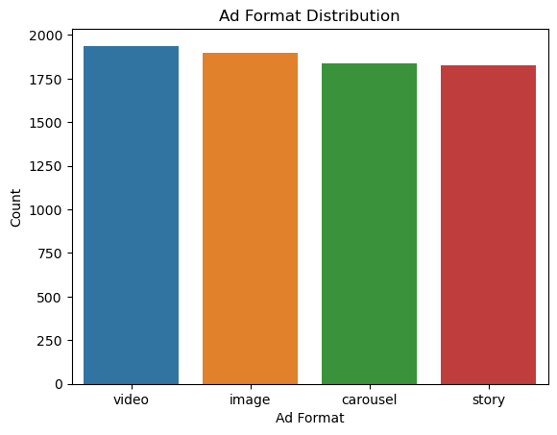
Ad Format Distribution and Performance
Analysis of ad format choices: Even distribution across Video, Image, Carousel, and Story formats.
Performance highlights: Story and Image formats exhibit a superior impact on sales performance, suggesting high audience engagement.

Slide 6
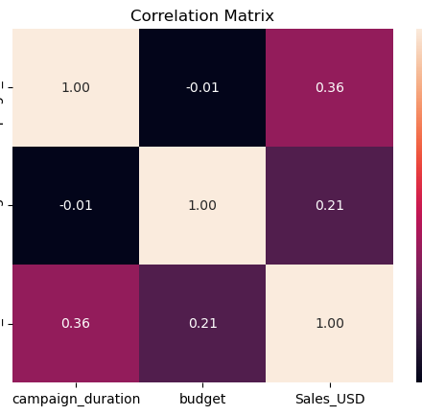
Correlational Insights
Statistical correlations: Moderate positive link between campaign duration and sales success; weaker yet positive correlation with budget size.
Budget and sales: A detailed look at how budget variations influence sales performance across different ad formats.

Slide 7
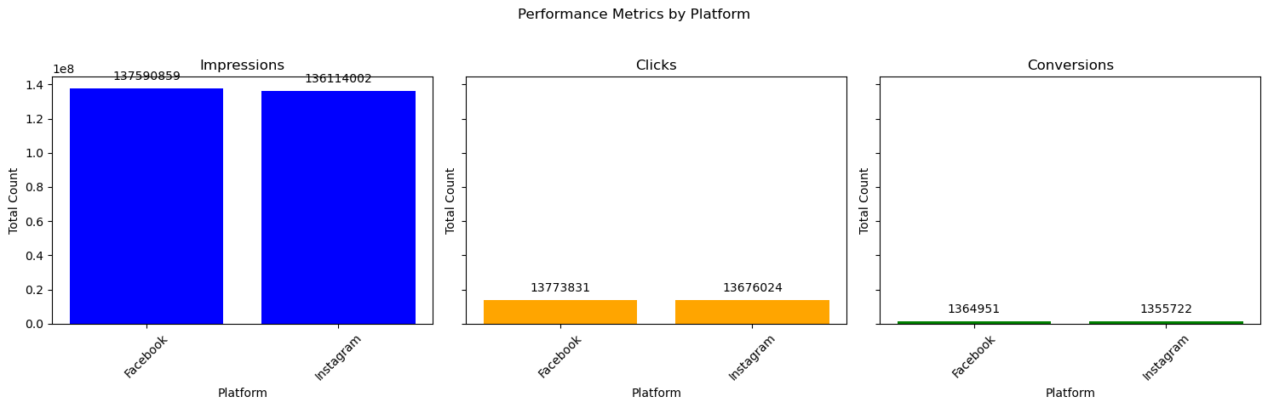
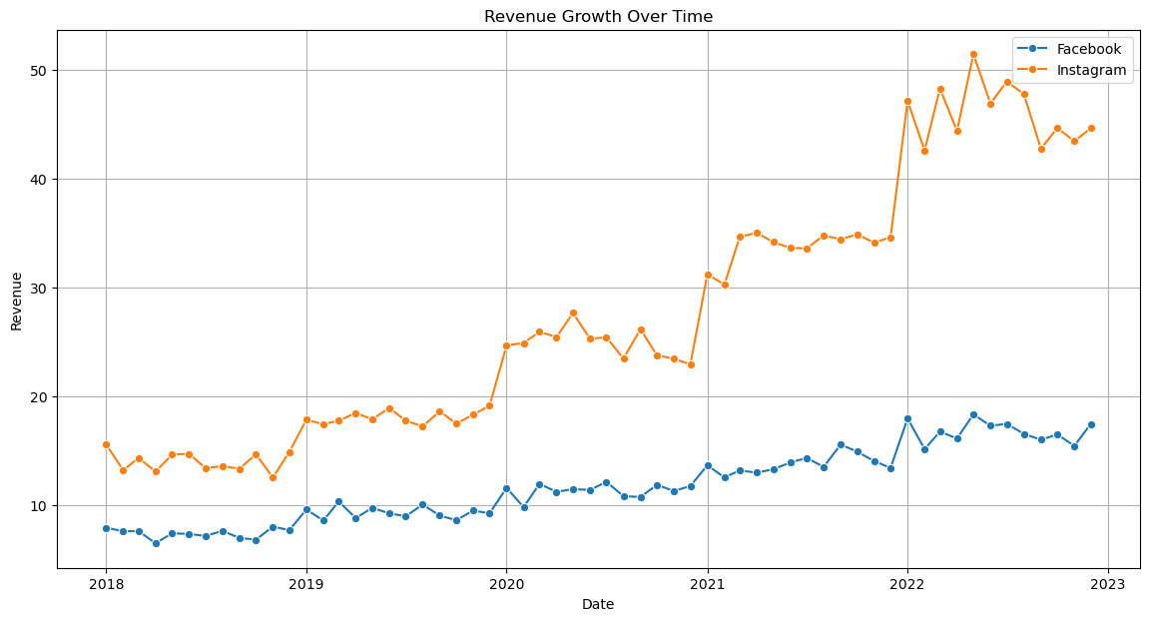
Platform-Specific Performance
Comparative revenue trends: Facebook's steady growth contrasted with Instagram's significant surge, especially after 2020.
Efficiency in action: Instagram's superior ability to convert impressions into actionable responses.

Slide 8
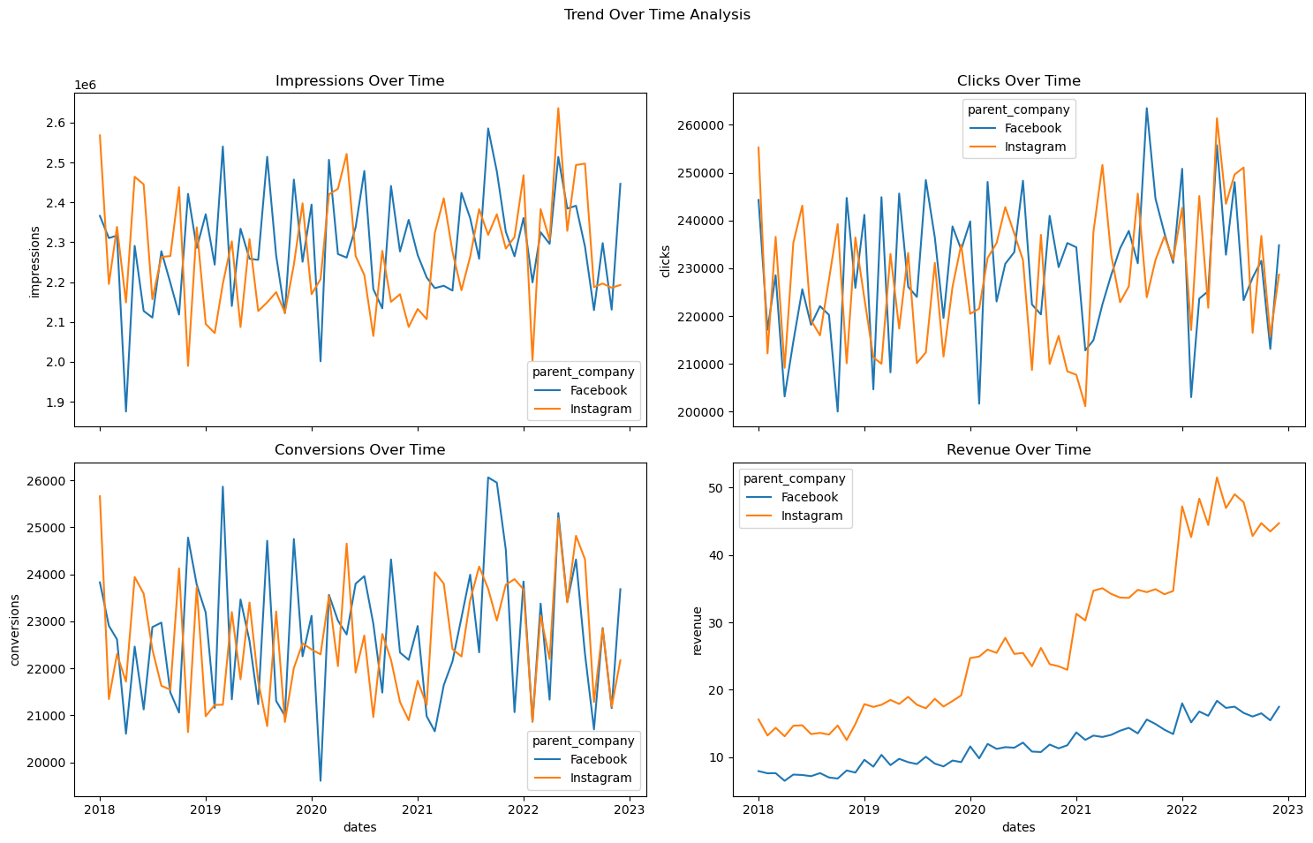
Sales Dynamics and Conversion Analysis
Year 2022 focus: Instagram's enhanced conversion efficacy relative to Facebook’s performance
Actionable data: Leveraging conversion rates to inform future platform-specific marketing strategies.

Slide 9
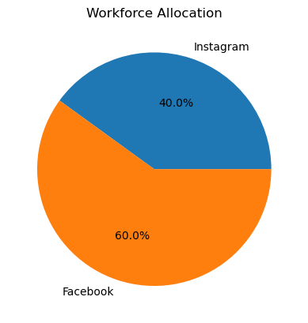
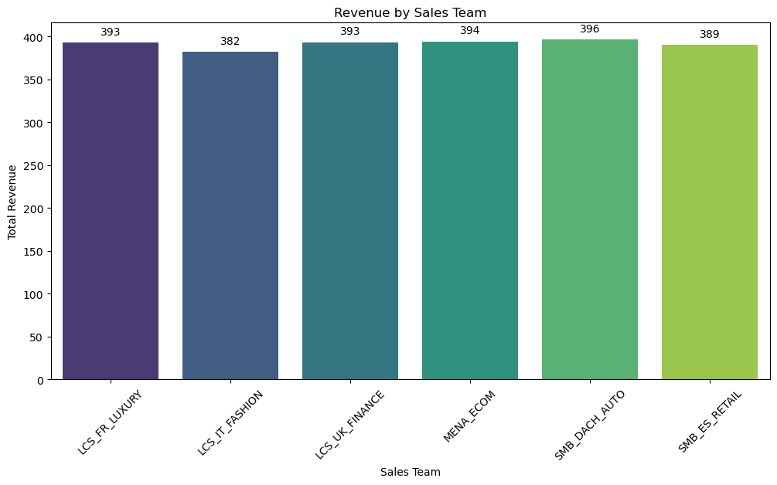
Workforce Dynamics and Efficiency
Current workforce allocation: Predominant focus on Facebook with emerging opportunities for Instagram.
Sales team spotlight: Exceptional revenue generation by the SMB_DACH_AUTO team sets a benchmark for strategic efficiency.

Slide 10
strategic Recommendations

Slide 11
A. Optimize Ad Formats & Campaign Budgeting
Optimize Ad Formats:
Prioritize Story and Image ad formats for higher sales effectiveness. Continuously adapt strategies to leverage most effective formats
Campaign Budgeting:
Integration of anticipated campaigns in financial forecasting to enhance strategic planning accuracy.

Slide 12
B. Investment Strategy and Platform Utilization
Replication of Success: Investigating and adopting the strategies used by the SMB_DACH_AUTO team across other sales teams.
Dual Platform Utilization: A strategy to leverage the unique strengths of both Facebook and Instagram to maximize overall reach and impact.

Slide 13
C. Sales Team Strategy and Workforce Realignment
Reallocation of Investment: A shift towards Instagram in response to its robust growth and potential for higher ROI.
Workforce Reallocation: Adjusting the resource distribution to support Instagram's growing influence and potential for market penetration.

Slide 14

Strategic Implications and Future Direction

Slide 15
a. Strategic Implications and Agile Planning
Agile Campaign Planning: The importance of Zero-Duration Campaigns as a marker for flexible and responsive marketing strategies.
Budget Allocation Strategy: Analysis of budget spending reveals the need for a strategic balance between budget size, campaign timing, and quality.

Slide 16
Ad Format Optimization and Platform-Specific Approaches
The nuanced differences in performance across ad formats highlight the importance of selecting the right format for the target audience and campaign objectives. Businesses should continually analyze ad format performance, adapting their strategies to leverage the most effective formats
Dynamic allocation of resources in response to the shifting landscape in social media marketing. Growing emphasis on Instagram while maintaining presence on Facebook.

Slide 17
Long-Term Strategic Implications
Beyond Tactics: Understanding how the insights from the analysis have broader implications for long-term strategic planning and market positioning.
Adapting to Market Dynamics: The necessity for businesses to be agile, informed, and customer-focused to succeed in the evolving digital advertising space.

Slide 18
Conclusion: Towards Sustainable Growth
Embrace Change: The pace of digital advertising is rapid. We must quickly adapt our strategies to what's working now. Success hinges on selecting effective ad formats and deploying them on the right platforms.
Invest Wisely: It's not just about the amount we invest in our campaigns—it's about optimizing timing and placement. Strategic budget use is key to maximizing our return on investment.
Anticipate the Future: Trends like Zero-Duration Campaigns signal the need for forward-thinking. We must anticipate our customers' future needs and begin engaging them now.
Data-Driven Decisions: Our path forward involves a vigilant focus on data. Understanding and acting on our analytics will lead to more impactful ads, smarter spending, and a competitive edge.

Slide 19
Considerations and Limitations
Data Scope and Completeness: Our analysis is based on the available dataset. Any missing data or unrecorded metrics could provide additional insights if included.
Market Dynamics: External market factors, such as economic shifts, competitor actions, or changes in consumer behavior, can influence campaign performance but were outside the scope of our analysis.
Analytical Methods: The conclusions drawn are based on the methods used in this analysis. Different analytical techniques or models might yield different insights.
Temporal Constraints: The data reflects past and current trends. Future market conditions could alter the effectiveness of the recommended strategies.
Assumptions: Certain assumptions were necessary for analysis. Where assumptions have been made, real-world conditions may differ, impacting the results.

Slide 20

Final Note:
While our analysis provides a comprehensive look at Meta Platforms' advertising campaigns, these considerations should be kept in mind when interpreting and applying the findings."

Slide 21

Questions & Discussion
Open for stakeholder queries and discussions.

Slide 22

Thank you
Prepared by :
Antonio Rawad Nassar
In appreciation for the opportunity to present the Meta project at the Master School Graduation, January 2024.
January 2024

