Slide 1
Data Aggregation Task Antonio Rosolia

Slide 2
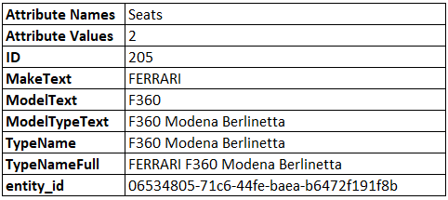
Key Facts Input file (supplier_car.json)
8 Columns
Attribute Names contained more classes such as Seats, FuelType, DriveType,…
Attribute Values contained corresponding values
example row:

Slide 3
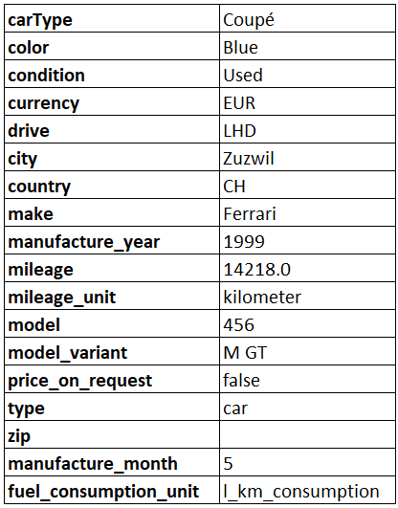
Key facts of Target Data → Goal
18 rows
some information is missing from supplier data, such as drive, price_on_request, type
format of values are different (make)

Slide 4
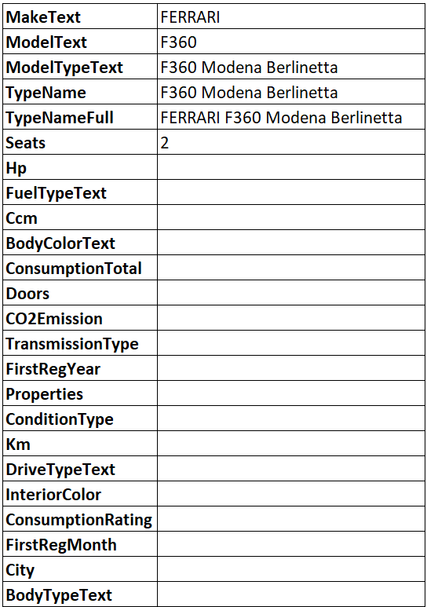
Pre-processing Attribute names and values
each unique Attribute Name will be set as new column

Slide 5
Pre-processing Goals
input data same granularity as target data
→ same amount of rows as target data
keep as much information as possible

Slide 6
Pre-processing Renaming and deleting Rows
renaming rows :
MakeText → make
ModelText → model
TypeName → model_variant
FirstRegYear → manufacture_year
City → city
ConsumptionTotalText → fuel_consumption_unit
FirstRegMonth → manufacture_month
BodyColorText → color
Km → mileage
BodyTypeText → carType
deleting rows :
ModelTypeText
HP
FuelTypeText
Ccm
Doors
CO2Emission
TransmissionType
DriveTypeText
InteriorColor
ConsumptionRating

Slide 7
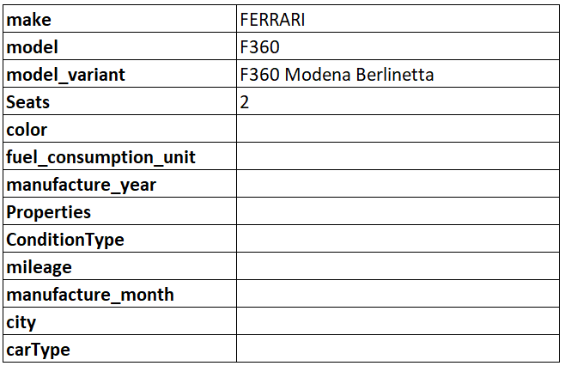
Pre-processing Renaming and Deleting Rows

Slide 8
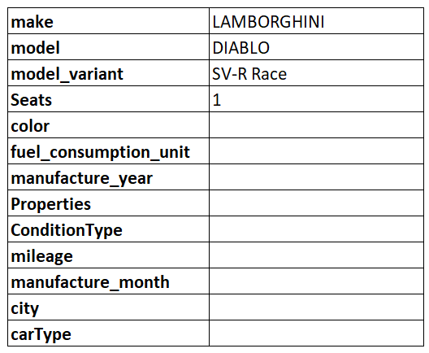
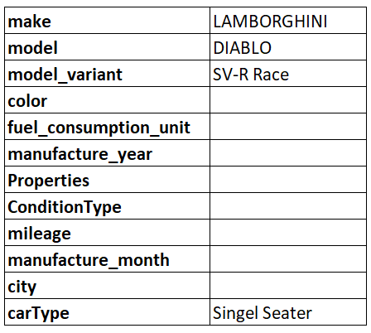
Pre-processing Seats
if only one seat, set carType to Single seater
delete seats

Slide 9
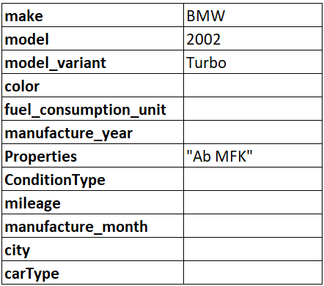
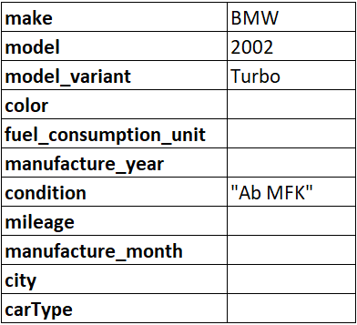
Pre-processing Properties and conditionType
Properties and ConditionType contain the same information
→ merged and rename

Slide 10
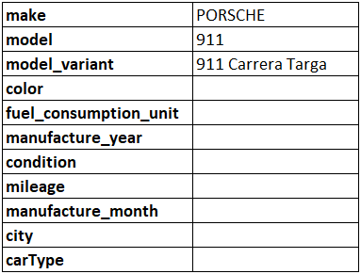
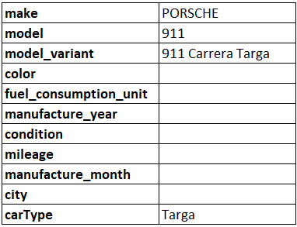
Pre-processing carType
If model_variant contains (case insensitive) something similar to:
coupé → carType Coupé will be set
limousine → carType Saloon will be set
targa → carType Targa will be set
roadster/spyder/spider/convertible/cabriolet → Convertible / Roadster will be set

Slide 11
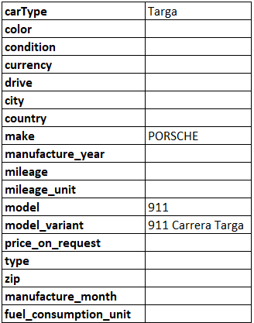
Pre-processing Adjust to target data
If column is missing from target data it will be added
DataFrame will be rearranged according to target data

Slide 12
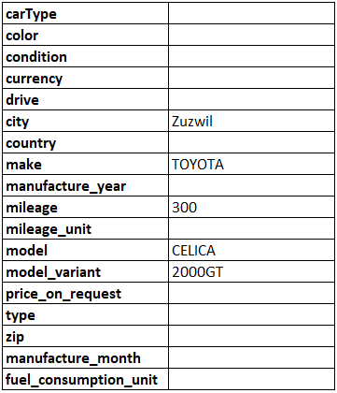
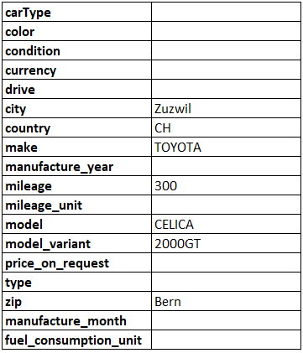
Pre-processing city, country and zip
if city is given country code and area will be looked up:
country code will be set for country column
area will be set for zip

Slide 13
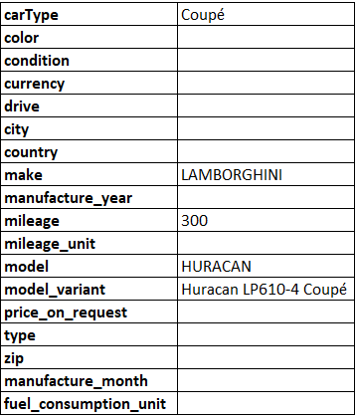
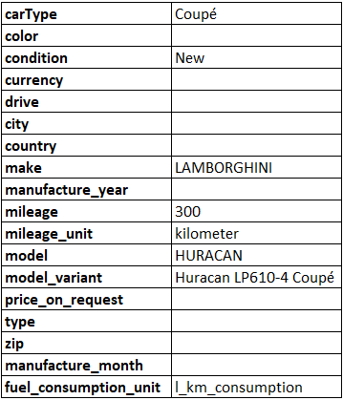
Pre-processing mileage_unit and fuel_consumption_unit
if mileage is greater than 0
→ fuel_consumption_unit will be set to l_km_consumption
→ mileage_unit will be set to kilometer
if mileage is smaller than 1000 (threshold can be modified)
→ condition will be set to New
→ else to used

Slide 14
Normalisation carType
if in carType (case insensitive):
Cabriolet → Convertible / Roadster
Limousine → Saloon
SUV / Geländewagen → SUV
Kombi → Station Wagon
Wohnkabine → Other
Sattelschlepper → Other
Kleinwagen → Other
Kompaktvan → Other
Pick-up → Other

Slide 15
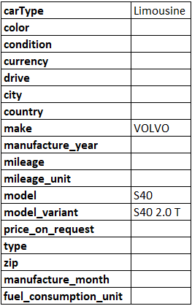
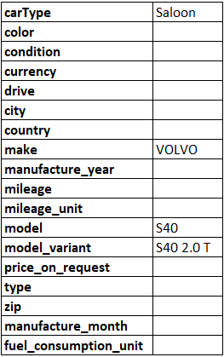
Normalisation carType
potential addition:
set type that occurs most often for same make, model and model_variant
→ error-prone, since there are different types for the same for the same make, model and model_variant

Slide 16
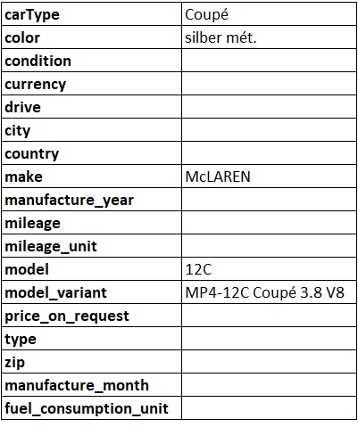
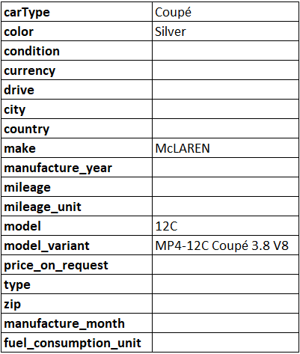
Normalisation color
translate colours and set it with the format of target data

Slide 17
Normalisation condition
If condition contains "AB MFK", it will be replaced with Used with guarantee
Neu will be replaced with New
Occasion, Vorführmodell, Rennwagen, Tuning, Oldtimer or Direkt-/Parallelimport it will be replaced with Used
potential addition:
set condition to Used if condition contains no value

Slide 18
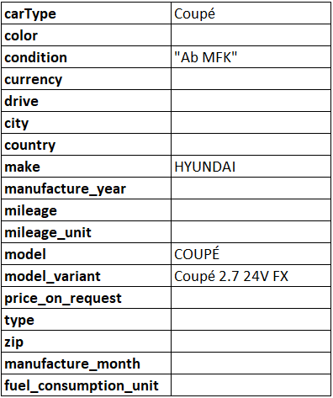
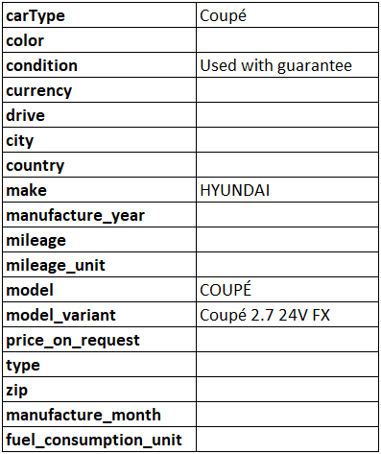
Normalisation condition

Slide 19
Normalisation currency
potential addition:
set currency to corresponding country
set currency to CHF if it has no value

Slide 20
Normalisation drive
potential addition:
set drive to RHD (right hand drive) if country is known for RHD
set drive to RHD if it has no value

Slide 21
Normalisation city
checked if there are same cities written differently
→ city ok

Slide 22
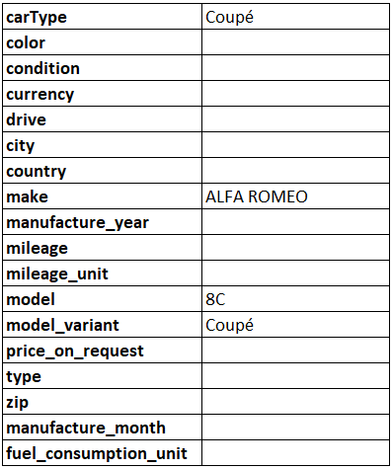
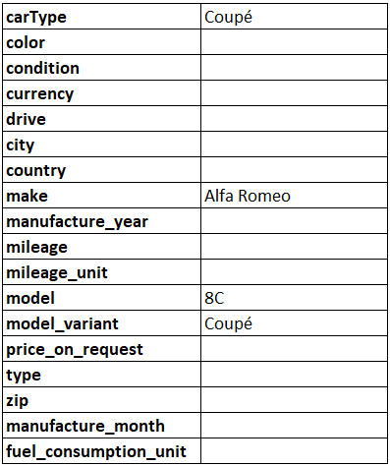
Normalisation make
normalize input data, for example FORD (USA) → FORD
compare make from input data with make from target data
if euqal, replace with the format of target data
if make not found in target data it will be formated as title (BUGATTI → Bugatti)

Slide 23
Normalisation manufacture_year AND manufacture_month
checked if year in correct format → ok

Slide 24
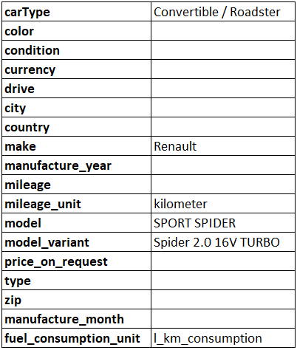

Normalisation model AND model_variant
Compare model from input data with modle from target data
if euqal, replace with the format of target data
if make not found in target data it will be formated as title, if it is longer than 3 character and has no number in it (RACE AMG SL → Race AMG SL)

Slide 25
Normalisation price_on_request
no data
default value can be set

Slide 26
Normalisation type
no data if row is car or not
potential addition:
set to car if it has more than two seats
set to car if it has doors
set to car if it is a carType
if make is not Harley-Davidson set to car
→ may lead to errors

Slide 27
Summary
integration
input data attached to target data
lots of missing data
→ can be improved through clients expertise (see potential addition)
each pipeline step can be seen in output.xlsx

