Slide 1

Distributed Streaming Ensemble Methods in Renoir
Zhiqiang Shi (252205)
Antonio Sulfaro (259954)
October 21, 2026
Advisor: Prof. Alessandro Margara
Co-advisors: Prof. Gianpaolo Saverio Cugola,
Luca De Martini, Dario d’Abate, Federico Giannini
Master’s Degree in Computer Science and Engineering
Academic Year 2025–2026
Notes:
Hello everyone. I'm Zhiqiang Shi. Today, I'll present our thesis on distributed streaming ensemble methods in Renoir. I'll first introduce the background, then explain our implementation, and at the end show the results.

Slide 2
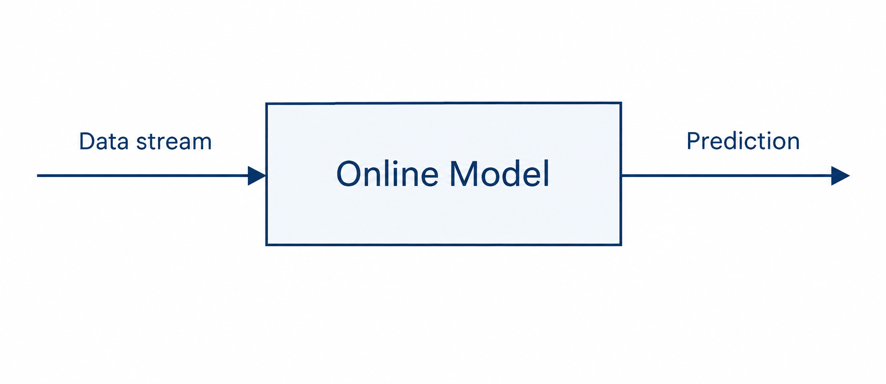
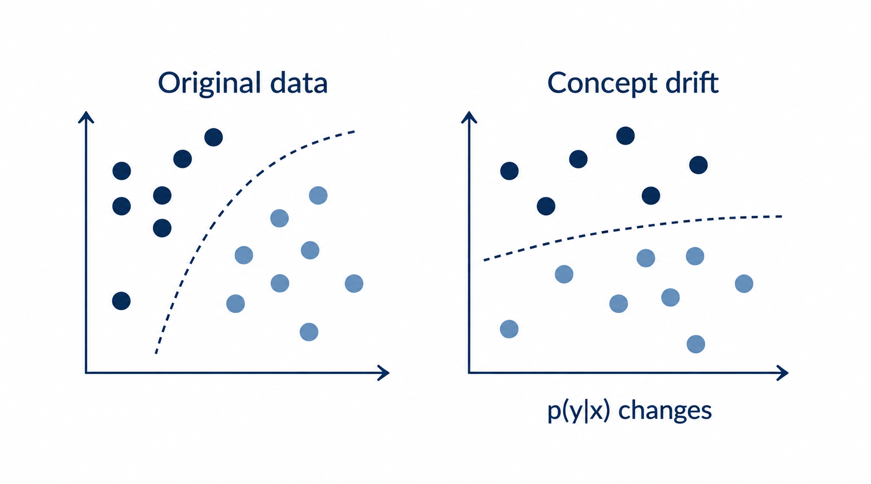
Background: Streaming Machine Learning
Learn continuously from a data stream
  Predictions available at any time
  Limited time and memory
  Single-pass updates
Challenge: concept drift
  The data distribution can change
Data + label
Notes:
Today’s focus is streaming machine learning.
In traditional machine learning, we train on a fixed dataset. But nowadays, many applications generate data continuously at high speed, so we need models that can learn from a data stream.
[click 1]
The key idea of streaming machine learning is to learn continuously from a data stream, with predictions available at any time, using limited time and memory.
[click 2]
To evaluate how well the model perform, we use prequential evaluation.
We assume that each example comes with a label: we predict first, then use the label to check the prediction and update the model.
Each example is used only once and then discarded.
[click 3]
The data stream brings Another challenge, concept drift. The data distribution can change over time, so the model needs to adapt to these changes.

Slide 3
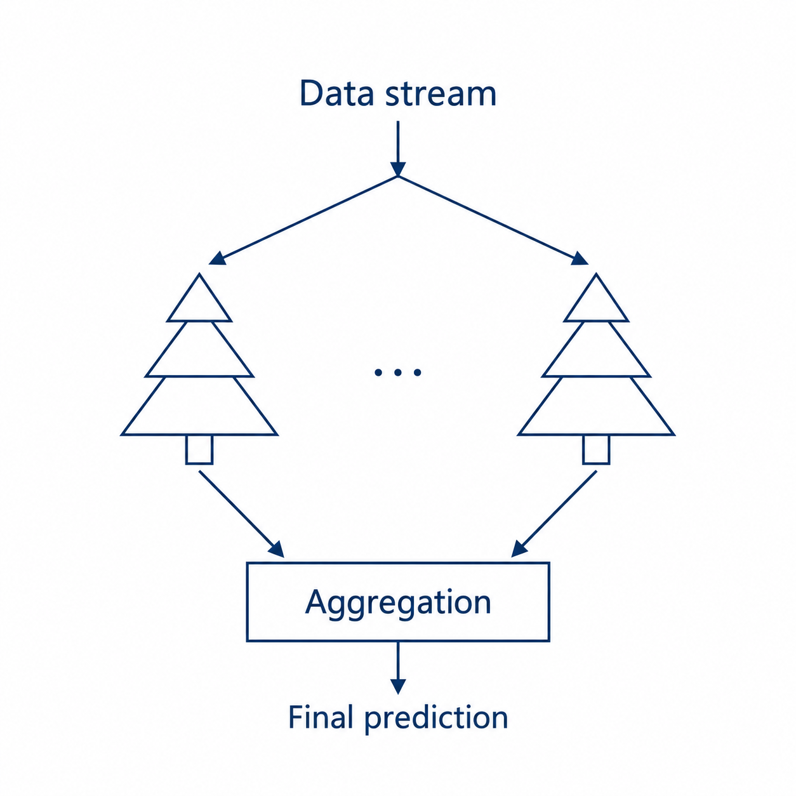
Background: Ensemble Methods
Based on Hoeffding trees
  Streaming Random Patches (SRP)
  Adaptive Random Forest (ARF)
Based on Mondrian trees
  Aggregated Mondrian Forest (AMF)
Key features
  Diversity
  Aggregation
Seed = x
Seed = z
Notes:
Our thesis centers on ensemble methods. An ensemble combines predictions from several models. In our case, those models are decision trees.
click 1
Our framework supports three methods. Streaming Random Patches and Adaptive Random Forest both use Hoeffding trees and were implemented by Antonio. I focused on Aggregated Mondrian Forest, or AMF, which uses Mondrian trees.
click 2
One key feature is diversity. Here, the different seeds help the trees develop different structures, so they are less likely to make the same mistakes.
click 3
The other is aggregation. Since we are working on a classification problem, in AMF, we average the class probabilities predicted by each tree and choose the class with the highest average.

Slide 4
Background: Our Goal
Unified Module
ARF
SRP
AMF
Support multiple streaming
ensemble methods.
Ensemble methods
Distributed processing
Stream
Scale across cores and machines.
Improved performance
Increase throughput while preserving
predictive accuracy.
Notes:
Our work has three goals.
[click 1]
First, a unified module to support multiple streaming ensemble methods. We want Adaptive Random Forest, Streaming Random Patches, and Aggregated Mondrian Forest to use a common pipeline.
[click 2]
Second, distributed processing to scale across cores and machines. This allows us to process the data stream in parallel using multiple workers.
[click 3]
Third, improved performance to increase throughput while preserving predictive accuracy.

Slide 5
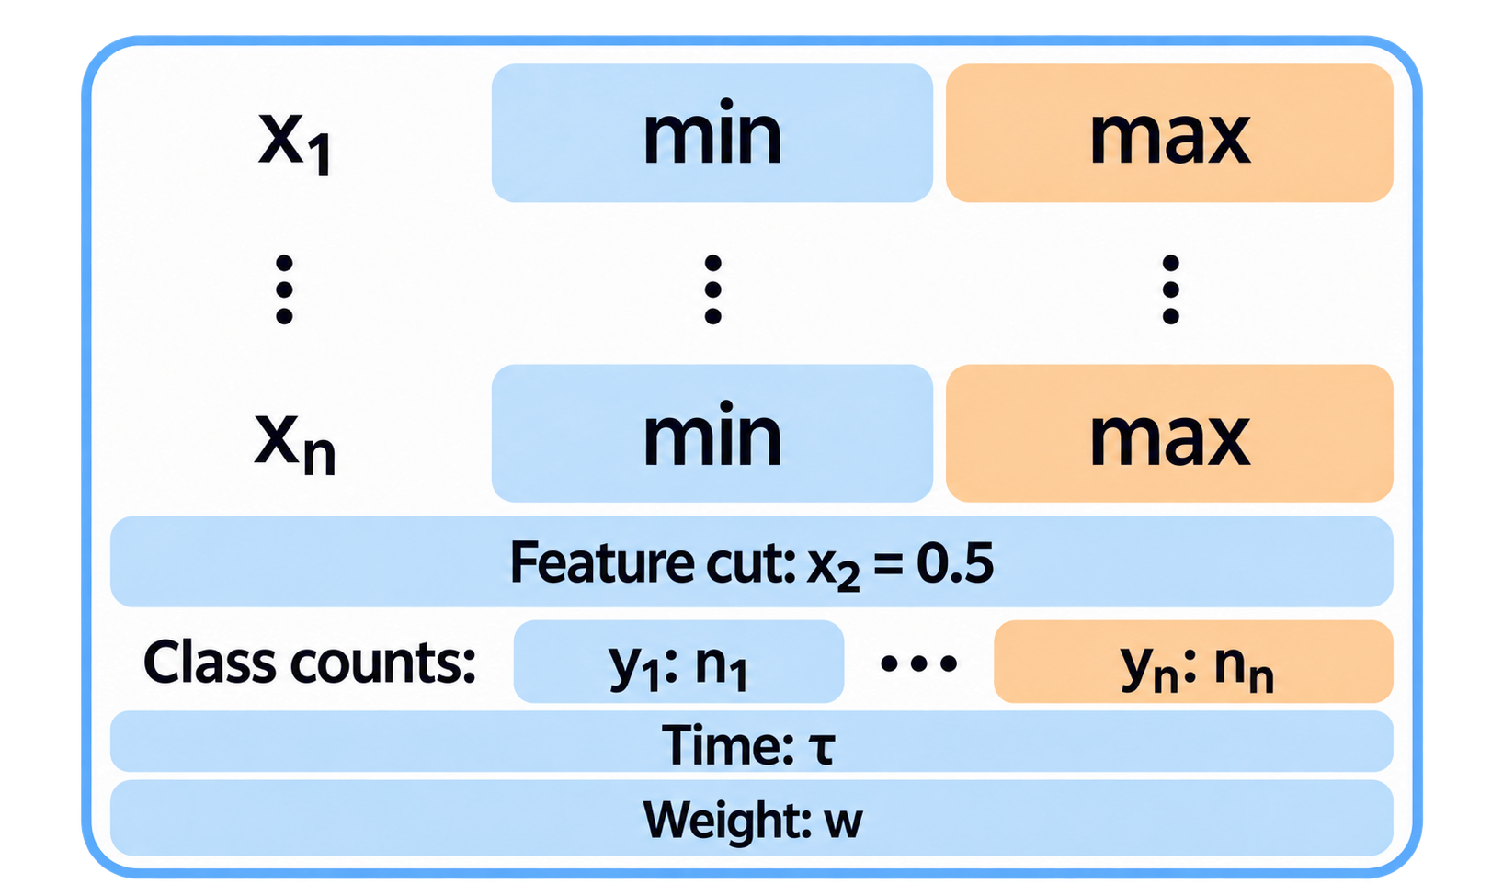
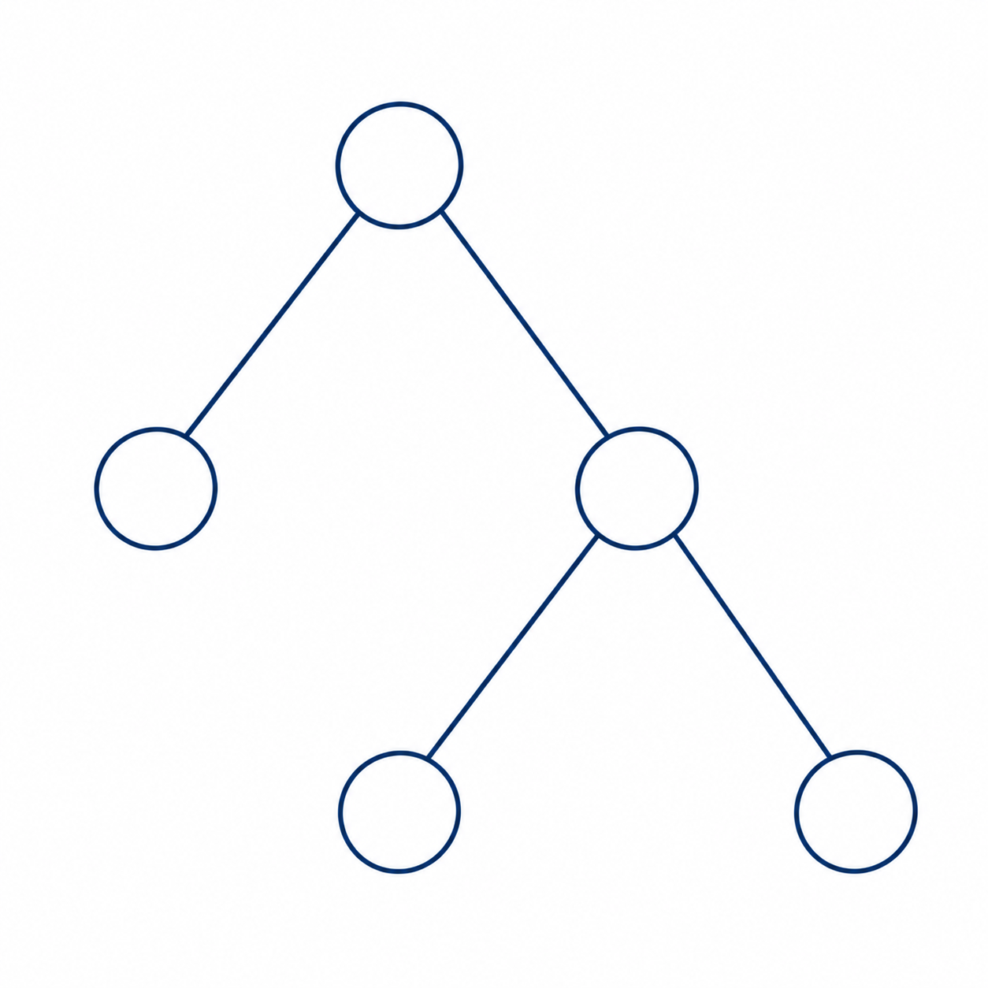
Background: Mondrian Tree Prediction
Top-down: reach a leaf
  Follow feature cuts
  Get initial class probabilities
Bottom-up: aggregate to the root
  Context Tree Weighting
  Root output = one tree’s prediction
Data
Prediction
Notes:
To understand AMF, let’s look at how a single Mondrian tree makes a prediction.
[click 1]
Here, you can see what each node stores.
Each node stores a range for each feature, from x 1 to x n. We use feature cuts to guide the routing.
Each node also stores a counter for each class y, a creation time, and weights that reflect past predictive performance.
[click 2]
First, let’s follow the top-down process
We follow feature cuts to reach the leaf. Here, the class counts give us the initial class probabilities.
[click 3]
Then, let’s follow the bottom-up process. We combine each node’s own prediction with the prediction coming from below. This is called Context Tree Weighting.
The root output is one tree’s prediction.

Slide 6
Background: Mondrian Tree Learning
Top-down: update and extend
  Update statistics and local weights
  Introduce a split if needed
Bottom-up: update sub-weights
  Recompute subtree weights
Data + label
new 4
old 1
old 1
new 5
old 2
old 3
old 2
old 3
Update
Notes:
For learning, we use both the data and the label.
[click 1]
First, let’s follow the top-down process, from the root to a leaf.
We update statistics and local weights for all nodes in the path, using log-loss. A lower probability for the true class means a larger penalty.
We also introduce a split if needed.
The chance of a split depends on how far x falls outside the node’s feature ranges. A larger distance means a higher chance of splitting.
We choose the feature cut randomly, with larger distances giving higher selection probabilities.
[click 2]
Here, you can see the two new nodes.
When a split occurs, we add a new parent, new 4, stores the feature cut, and a new leaf, new 5, for the new example.
[click 3]
Then, let’s follow the bottom-up process.
We recompute subtree weights up to the root.

Slide 7
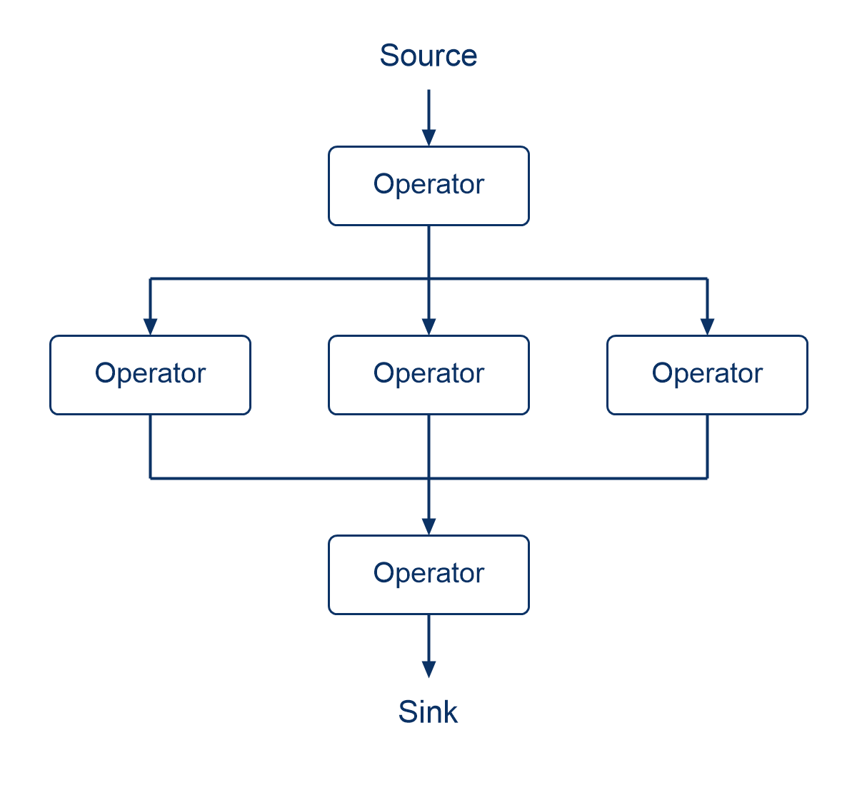
Background: Renoir
Rust-based framework
Dataflow programming model
  Operators connected by streams
Parallel execution
  Across cores and machines
Notes:
To run these trees in parallel, we use Renoir as our framework.
click 1
It is a Rust-based framework.
click 2
Renoir uses a dataflow programming model. Here, data flows from a source, through several operator instances, to a sink.
click 3
Renoir supports parallel execution across cores and machines.
Multiple operator instances can work in parallel, and Renoir handles scheduling and communication.

Slide 8
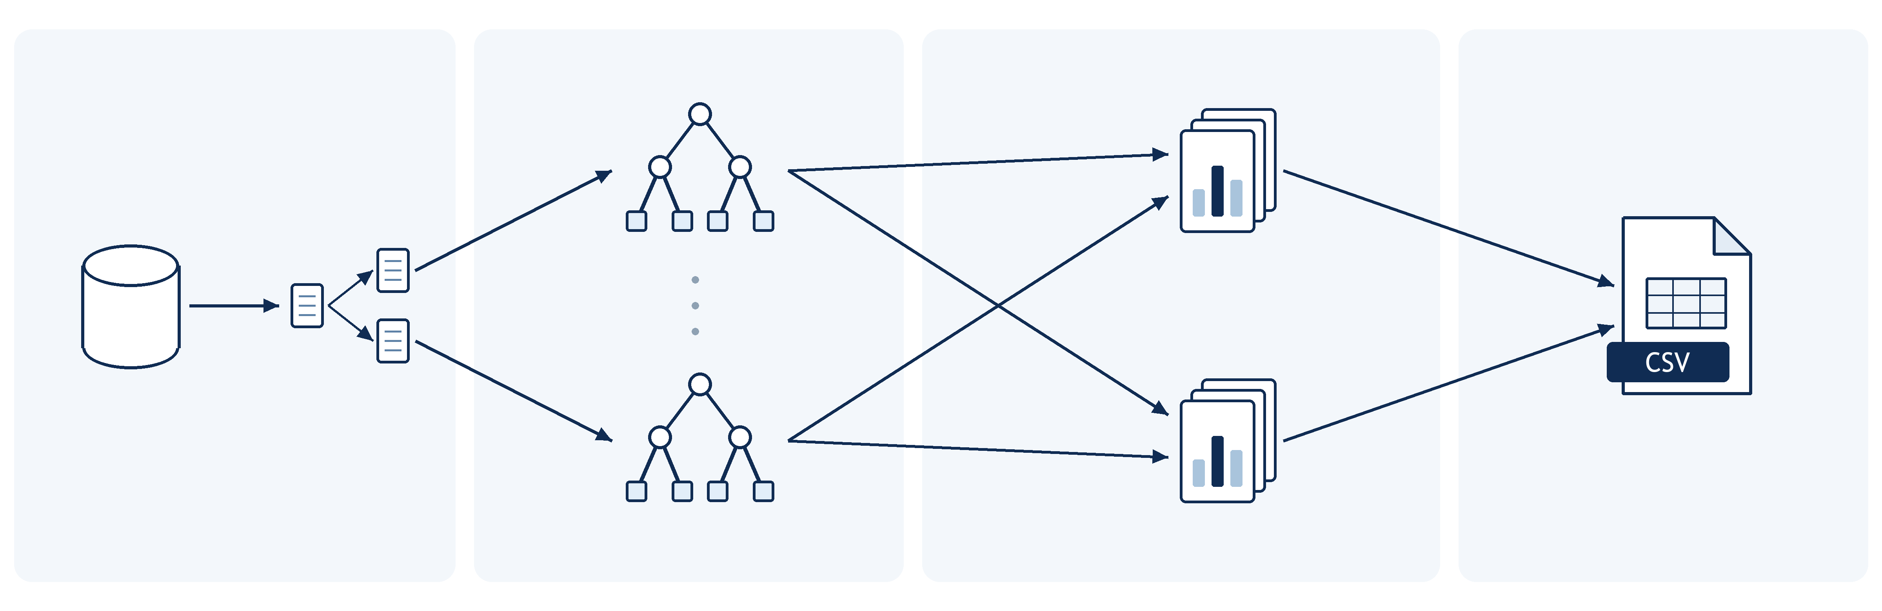
Renoir Pipeline
Result
Data
Prediction
Data
Data
Prediction
stream_iter()
flat_map()
rich_map()
key: tree_id
rich_map_transient()
key: instance_id
write_csv()
Notes:
This diagram shows how the ensemble fits into a Renoir pipeline.
click 1
In the first stage, the stream_iter operator turns the dataset into a stream. The flat_map operator makes one copy of each example for every tree.
click 2
We group these copies by tree ID, and the rich_map operator maintains each tree's state.
Multiple trees can run in parallel
click 3
Once all trees have contributed, rich_map_transient combines their predictions and discards the stored state for that example.
Multitree aggregator can run in parallel
click 4
At the end, write_csv writes the results to a CSV file.
We use these results for evaluation.

Slide 9
Experimental Setup
HARDWARE
FRAMEWORKS
AMD Ryzen 9 9950X
16 cores, 32 threads
64 GB RAM
ARF, SRP: MOA, Renoir
AMF: Onelearn, River, Renoir
DATASETS
METRICS
7 real-world (3k–5M instances)
6 synthetic (1M instances)
7–40k original features
Accuracy
Speedup
Scalability
Notes:
To evaluate the system, we used a machine with sixteen physical cores, thirty-two logical threads, and sixty-four gigabytes of RAM.
For ARF and SRP, the reference is MOA. For AMF, we compared the River and Onelearn implementations. Onelearn was faster, so we chose it as our baseline.
We tested thirteen datasets: seven real-world and six synthetic, with different sizes and feature counts.
We measure accuracy, speedup, and scalability.

Slide 10
Accuracy: AMF
Absolute difference
  Gap <1 pp on 10/13 datasets
  Max: 3.66 pp
  Min: 0.00 pp
Notes:
For accuracy:
Both implementations use ten trees, and we average accuracy over ten runs with different seeds.
If you look at the chart, they show Renoir’s accuracy minus Onelearn’s, in percentage points.
The gap is less than 1 percentage point on 10 of 13 datasets
These differences may come from different random number generators and floating-point precision.

Slide 11
Single-thread Speedup: AMF
Max speedup: 18.24×
Min speedup: 0.87×
Notes:
For speedup:
Both implementations use ten trees and one thread
as you can see the chart shows Renoir’s throughput divided by Onelearn’s throughput.
Renoir is faster on most datasets, reaching eighteen point two four times the throughput of Onelearn.
Now, look at the lower chart. It orders the datasets by their original feature count. Gains tend to be smaller as feature counts rise.
Even though Onelearn is optimized for single-thread execution, Renoir still outperforms it on most datasets.

Slide 12
Scalability: AMF
RBF(m): scales to 17.66×
Spam Corpus: plateaus near 3×
Why below ideal scaling?
  20 trees: limited tree-level parallelism
  SMT: 32 logical threads share 16 physical cores
  Amdahl’s law: serial work limits speedup
  High dimensionality
Notes:
For scalability:
We use twenty trees and increase the thread count from one to thirty-two. Here, the baseline is Renoir's own single-thread throughput.
You can see the difference of two dataset
RBF(m) continues to scale, reaching a speedup of seventeen point six six.
Spam Corpus reaches only two point nine two.
So adding workers does not bring the same benefit for every dataset.
click 1
Several factors limit scaling.
Twenty trees provide only twenty independent tree tasks.
Also, thirty-two logical threads share sixteen physical cores.
Some work remains sequential, limiting speedup under Amdahl's law.
And high-dimensional datasets require more memory bandwidth.

Slide 13
Distributed Execution
Max efficiency: 103.43%
Min efficiency: 72.17%
Notes:
We also tested distributed execution to see how communication overhead affects performance.
For distributed exeuction We used twenty trees across two logical nodes, each with sixteen threads.
Local execution also uses thirty-two threads. Here, efficiency means the percentage of local throughput retained in distributed execution.
Most datasets retain around ninety percent or more.
click 3
Now, look at the lower chart, where datasets are ordered by their original feature count.
The feature calculations take longer with more features, allowing computation to overlap with communication, and this hide the communication overhead

Slide 14
Effect of Ensemble Size
• Accuracy gains depend on the dataset
covtypeNorm: +0.80 pp at 80 trees
RBF(f): +7.40 pp at 80 trees
• More trees reduce throughput
80 trees retain only 16–18%
of the 10-tree throughput.
• 15 trees retain >90% of baseline
throughput on both datasets
Notes:
The remaining question is the effect of ensemble size. We tested ten to eighty trees on two datasets to explore the balance between accuracy and throughput.
click 1
With eighty trees, accuracy improves by zero point eight zero percentage points on covtypeNorm and seven point four zero points on RBF(f), compared with ten trees.
click 2
Now, let’s look at the throughput cost.
The second chart shows throughput relative to ten trees. Reading the two charts together helps us see what we gain in accuracy and what we give up in speed.
click 3
In these experiments, fifteen trees offer a useful compromise: both datasets retain over ninety percent of baseline throughput while achieving better accuracy on our current hardware setup.

Slide 15
Future Work
Stored in each node
Explore memory optimization
Min₁
Max₁
Node
Min₂
Max₂
⋮
⋮
Investigate ways to reduce
AMF’s memory usage.
Minₙ
Maxₙ
Current
Future?
Explore intra-tree parallelism
Each tree uses one worker at a time.
Can multiple workers process
a single tree?
1 core
Multiple cores
Notes:
The results also suggest two directions for future work.
click 1
The first is memory usage. Every node stores a minimum and maximum value for each feature. As trees grow, this adds up, especially with high-dimensional data. We'd like to explore ways to reduce that cost.
click 2
The second is parallelism within a tree. Currently, each tree is processed by one worker at a time, so small forests limit parallelism. We'd like to find ways to allow multiple worker process on same tree

Slide 16
Conclusion
Unified module implemented
ARF
SRP
AMF
ARF, SRP and AMF integrated
within a unified framework.
Ensemble methods
Parallel and distributed execution
Stream
Local: Up to 17.66× speedup at 32 threads.
Distributed: ~90% throughput retained on most datasets.
Faster AMF, comparable accuracy
Up to 18.24× Onelearn’s single-thread throughput.
Accuracy gap <1 pp on 10/13 datasets.
Notes:
To end, let's return to our three goals.
click 1
We brought Adaptive Random Forest, Streaming Random Patches, and Aggregated Mondrian Forest together in a unified Renoir framework.
click 2
AMF benefits from parallel execution, reaching up to seventeen point six six times its single-thread throughput. Distributed execution retains around ninety percent of local throughput on most datasets.
click 3
On one thread, our AMF reaches up to eighteen point two four times Onelearn's throughput, with accuracy gaps below one percentage point on ten of thirteen datasets.

Slide 17
Thank you for your attention
Notes:
Thank you for your attention.

