Slide 1



Machine learning pipeline for flaky tests classification
FlakyPipeline
Students:
Afeltra Angelo
Rastelli Francesco
Trovato Antonio
Teacher:
Prof. Palomba Fabio
Tutor:
Dott.ssa Pontillo Valeria
Project for the software engineering for artificial intelligence course

Slide 2
What are 'Flaky Tests'?
Flaky tests are non-deterministic tests which pass and fail when run on the exact same version of a codebase.

Slide 3
What is our goal?
Currently, existing techniques for detecting faulty tests are based on test execution: if we can see two different results (pass and fail) of the same test on the same version of the code base, then surely that test is faulty.
Our goal is to use machine learning to be able to determine whether a test is flaky, without having to run it several times.

Slide 4
What steps will be taken?
Data Understanding
FlakyPipeline
Data
Pre-Processing
Model
Training & Validate
Verification
Model
Explainability

Slide 5
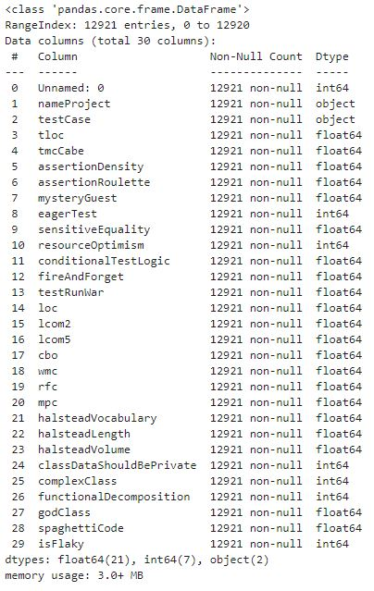
Data Understanding
Our work, as a data-driven approach to solving a problem, begins with an understanding of the data made available by Alshammari et al.
The data consists of a series of test metrics and each sample is labelled 0 (noFlaky) or 1 (isFlaky).
Within the dataset there are no null values, however, we have a strong imbalance as there are 629/1291 flasky tests

Slide 6
Data Pre-Processing And Model T&V
Before starting the pre-processing of the data, the following steps were performed:
- Removal of setup and teardown tests
- Removal of column containing row indices
- Spit the dataset into train-set and test-set
- Identification of a classifier to be used

Slide 7
Data Pre-Processing And Model T&V
Identification of a classifier to be used:
We decided to identify which classifier to use between SVM, KNN and RandomForest directly on the original data, in order to understand which were the best feature engineering techniques to adopt to improve model performance.

Slide 8
Data Pre-Processing And Model T&V
Identification of a classifier to be used with nested cross-validation (10x3)
Winner is: Random Forest {criterion=entropy,n estimators=150}
Model | Accuracy | Precision | Recall | F1
SVM | 0.95 | 0.77 | 0.09 | 0.16
KNN | 0.97 | 0.72 | 0.54 | 0.62
RandomForest | 0.97 | 0.81 | 0.56 | 0.65

Slide 9
Data Pre-Processing And Model T&V
Data Cleaning
Removal of redundant data
Removing the nameProject column
TestCase column removal
Feature Scaling
Feature Construction
Random Forest Performances
ACC | 0.97 -> 0.97
PRE | 0.81 -> 0.81
REC | 0.56 -> 0.56
F1 | 0.65 -> 0.65
Feature Selection
Data Balancing

Slide 10
Data Pre-Processing And Model T&V
Norm Min-Max
Data Cleaning
Random Forest Performances
ACC | 0.97 -> 0.97
PRE | 0.81 -> 0.81
REC | 0.56 -> 0.57
F1 | 0.65 -> 0.66
Feature Scaling
Feature Construction
Standardization
Feature Selection
Random Forest Performances
ACC | 0.97 -> 0.97
PRE | 0.81 -> 0.80
REC | 0.56 -> 0.57
F1 | 0.65 -> 0.66
Data Balancing

Slide 11
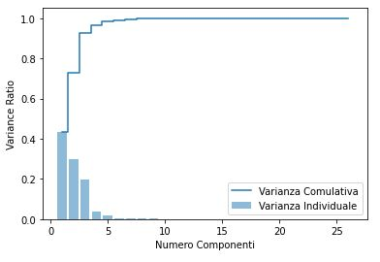
Data Pre-Processing And Model T&V
PCA
Data Cleaning
Feature Scaling
(Norm Min-Max)
Feature Construction
5 components: 98% Cumulative variance
Feature Selection
Random Forest Performances
ACC | 0.97 -> 0.96
PRE | 0.81 -> 0.72
REC | 0.57 -> 0.47
F1 | 0.66 -> 0.57
Data Balancing

Slide 12
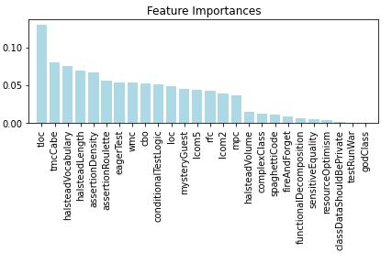
Data Pre-Processing And Model T&V
Random Forest
Data Cleaning
Feature Scaling
(Norm Min-Max)
Feature Construction
Feature Selection
Random Forest Performances
ACC | 0.97 -> 0.96
PRE | 0.81 -> 0.79
REC | 0.57 -> 0.59
F1 | 0.66 -> 0.68
Data Balancing

Slide 13
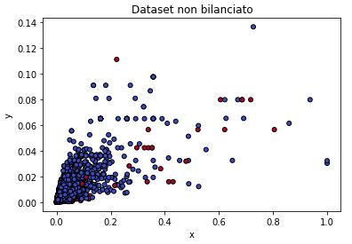
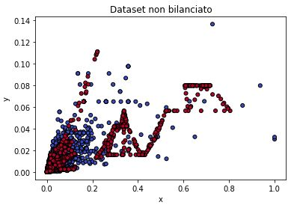
Data Pre-Processing And Model T&V
SMOTE
Data Cleaning
Feature Scaling
(Norm Min-Max)
Feature Construction
Random Forest Performances
ACC | 0.97 -> 0.96
PRE | 0.79 -> 0.62
REC | 0.59 -> 0.71
F1 | 0.68 -> 0.66
Feature Selection
Data Balancing

Slide 14
Advanced Methods
Metrics | Random Forest | Ensamble (RF,SVM,KNN) | MLP
ACC | 0.96 | 0.95 | 0.84
PRE | 0.62 | 0.60 | 0.21
REC | 0.71 | 0.60 | 0.79
F1 | 0.66 | 0.60 | 0.39
this is interesting!!

Slide 15
Verification
We created metamorphic tests to evaluate the goodness of the created pipeline
Test Case: Feature Permutation
Input | Dataset
Mutation | column permutation
Metamorphic Relation | The same performans as the model trained on the unmodified dataset
Test Case: redundant row addition
Input | Dataset
Mutation | Adding redundant rows
Metamorphic Relation | The same performans as the model trained on the unmodified dataset
Test Case: random label editing
Input | Dataset
Mutation | Random label editing
Metamorphic Relation | Relation: Lower performance than the model trained on the original dataset
Test Case: random row deletion
Input | Dataset
Mutation | Random row delation
Metamorphic Relation | Performance less than or equal to the model trained on the original dataset

Slide 16
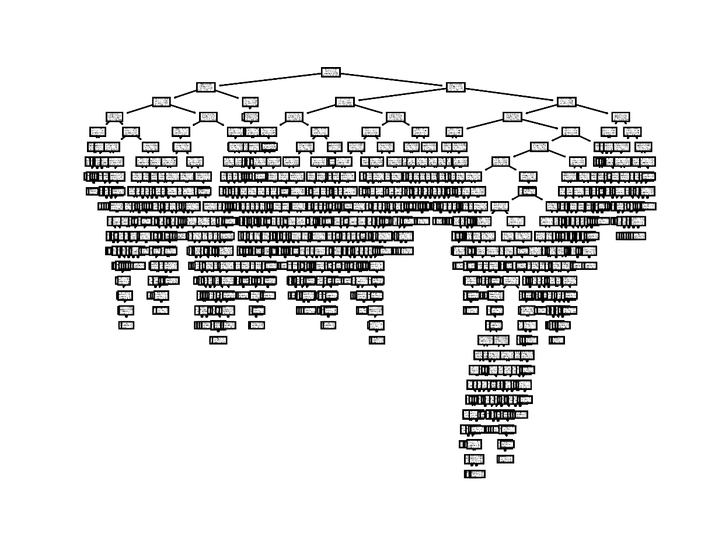
Model Explainability
The global surrogate is the decision tree with r^2 = 0.60
Data
RF
Prediction
DT

Slide 17

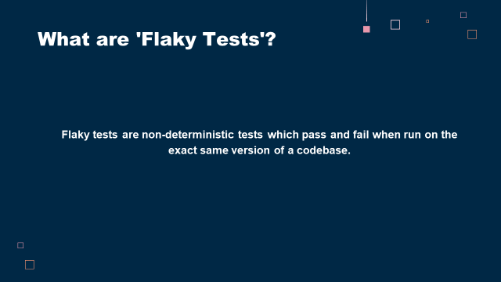
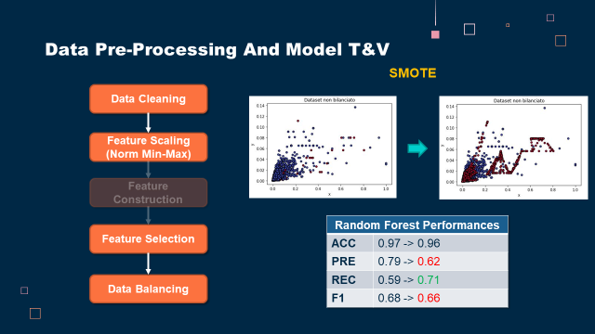
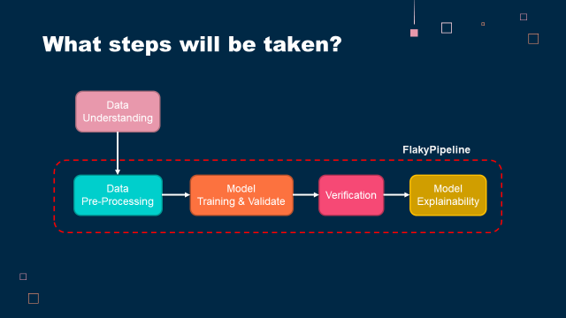
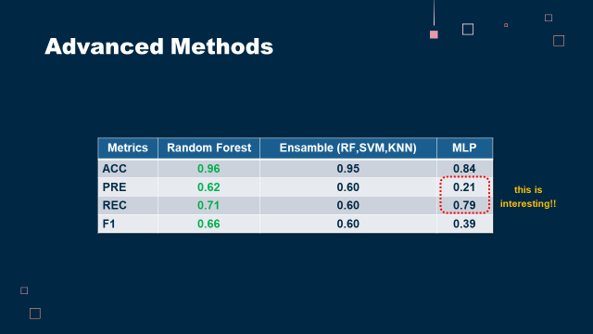
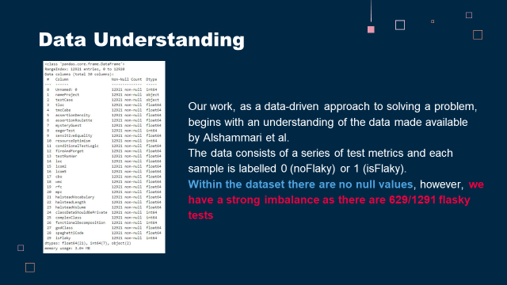
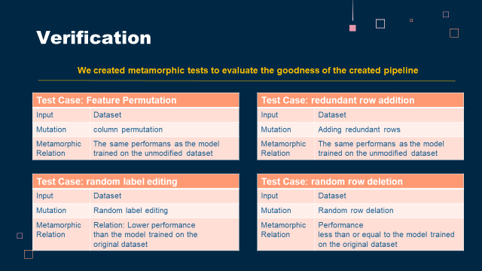
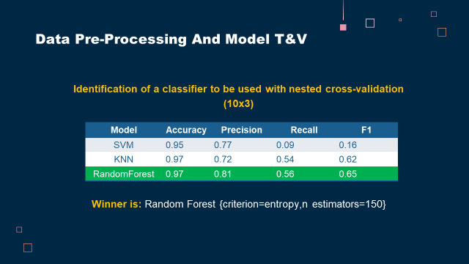
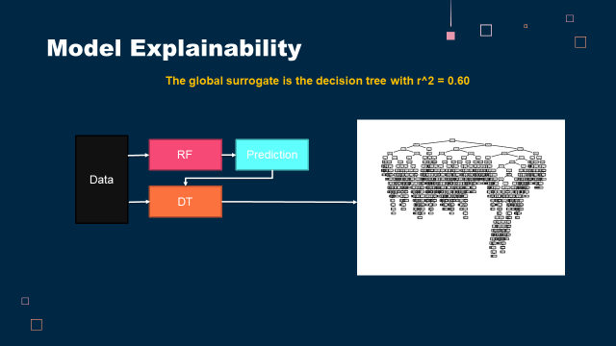
FlakyPipeline
Thank you for your kind attention!
Questions?
Thank you for your kind attention!
Students:
Afeltra Angelo
Rastelli Francesco
Trovato Antonio
Teacher:
Prof. Palomba Fabio
Tutor:
Dott.ssa Pontillo Valeria
SE4AI

