Slide 1
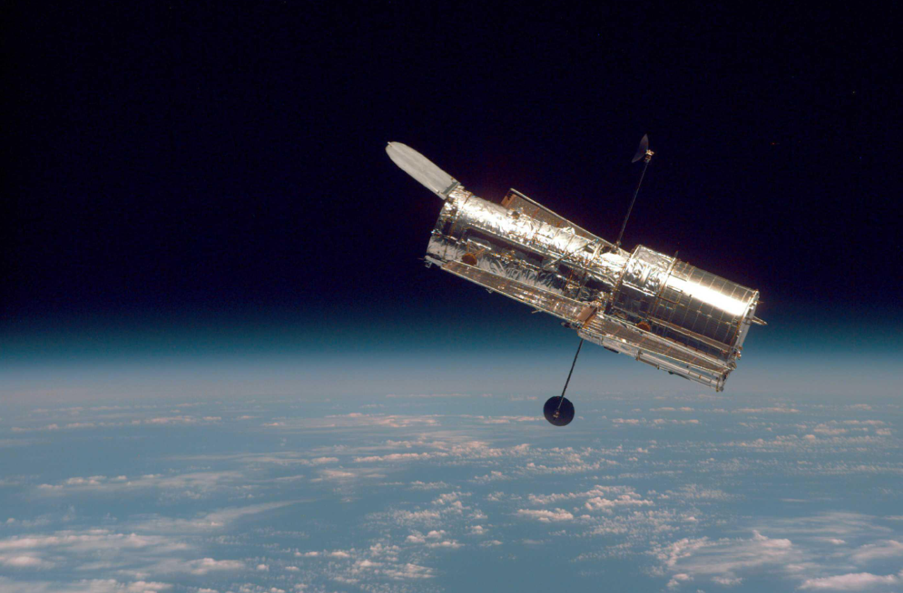
Orbital maneuvering simulation
November 25th, 2025
Antonio Hernández-Rodicio Mateos
NASA – Hubble Against Earth Horizon

Slide 2
Contents
Introduction
State representation
Orbital dynamics
Hohmann transfers
Problem parametrization

Slide 3
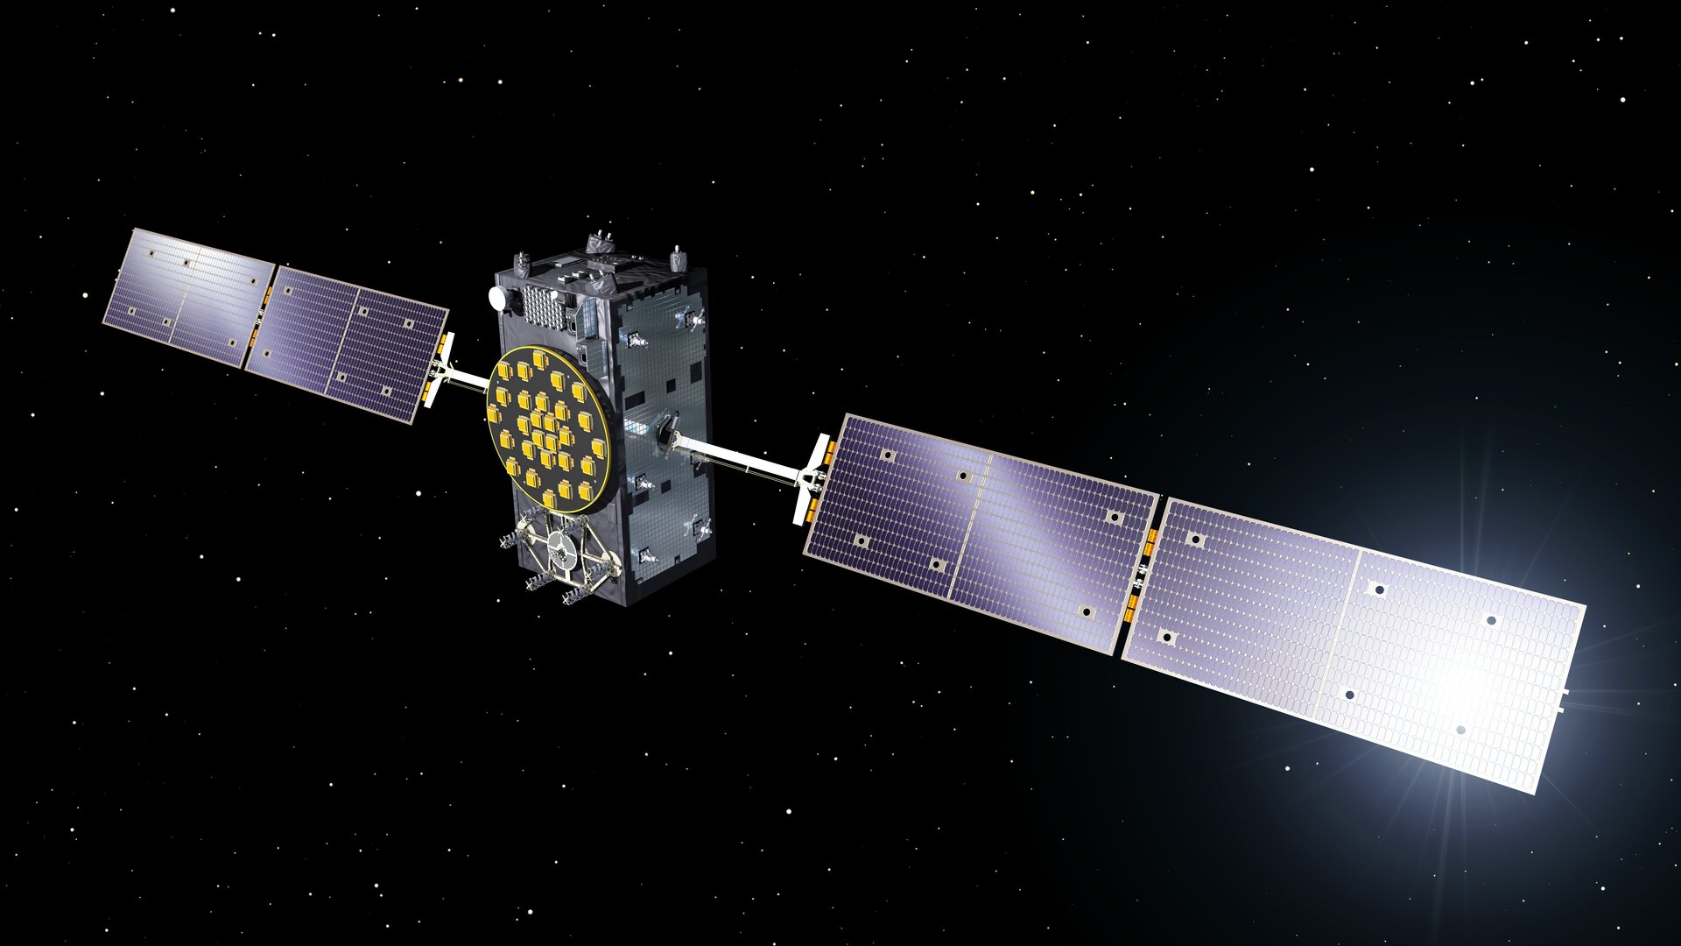
Introduction
  The goals of the sessions are:
    Understand orbital dynamics as a non-linear system of differential equation
    Simulate orbital dynamics by numerical integration
    Simulate an orbit raising operation using impulsive maneuvers
  To achieve that, the steps we’ll follow are:
    Review applicable theory
    Parametrize our initial and final orbits
    Simulate the initial orbit
    Simulate the orbit raising maneuver assuming impulsive burns
    Simulate the orbit raising maneuver considering non-instantaneous burns (future work)
Galileo Satellite

Slide 4
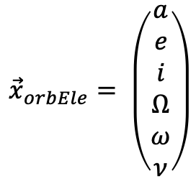
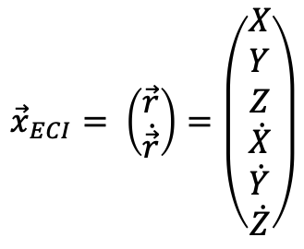
State representation
  Two state representations are needed to simulate the orbital raising maneuver:
    Earth-Centered Inertial (ECI) frame: Cartesian Inertial (assumed static and with no external forces) frame, centered around Earth’s CoM, with the X axis pointing towards a fixed direction (vernal equinox), the Z axis pointing towards the North, and the Y axis completing the right-hand rule
    Keplerian orbital elements: 6 figures that fully describe a particular instant in a specific orbit
    Note that neither of the two representations consider Earth’s rotation. For that, a time reference that links the current instant to the angular rotation of the Earth is needed.
  Both representations are implemented by a state vector:
$${\vec{x}}_{ECI}= \left(\begin{aligned}\vec{r} \\ \dot{\vec{r}}\end{aligned}\right)=\left(\begin{aligned}X \\ Y \\ Z \\ \dot{X} \\ \dot{Y} \\ \dot{Z}\end{aligned}\right)$$
$${\vec{x}}_{orbEle}= \left(\begin{aligned}a \\ e \\ i \\ Ω \\ ω \\ ν\end{aligned}\right)$$

Slide 5
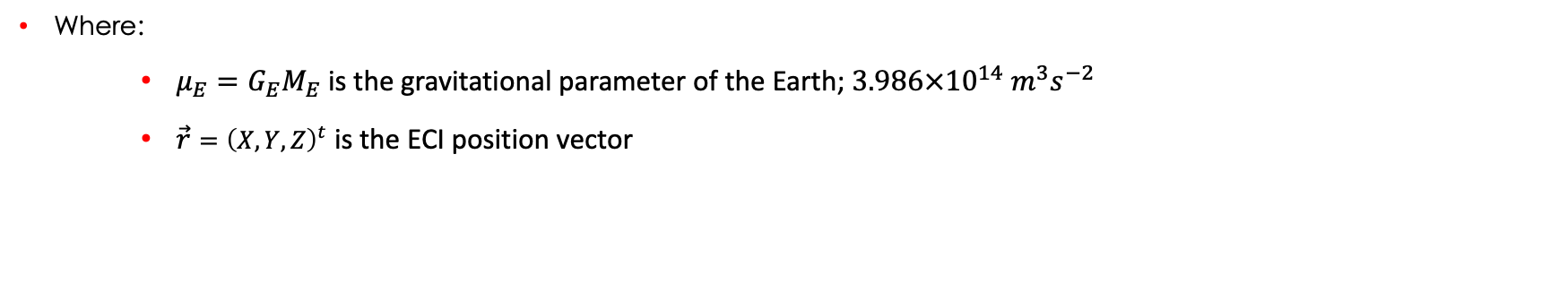
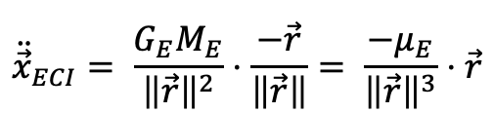
Orbital dynamics
  Assuming:
    Two body problem approximation (only Earth and spacecraft considered)
    No atmospheric drag
    No other external perturbations
  The equations of motion of the vehicle can be reduced to the effect of the gravitational force:
$${\ddot{\vec{x}}}_{ECI}= \frac{G_{E}M_{E}}{{\left\|\vec{r}\right\|}^{2}}⋅\frac{−\vec{r}}{\left\|\vec{r}\right\|}= \frac{−μ_{E}}{{\left\|\vec{r}\right\|}^{3}}⋅\vec{r}$$
  Where:
    $μ_{E}=G_{E}M_{E}$ is the gravitational parameter of the Earth; $3.986×{10}^{14} m^{3}s^{−2}$
    $\vec{r}={\left(X, Y, Z\right)}^{t}$ is the ECI position vector

Slide 6
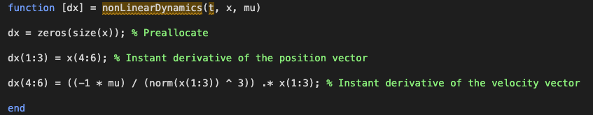
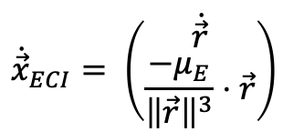
Orbital dynamics II
  So, the non-linear equations of motion can be expressed as:
$${\dot{\vec{x}}}_{ECI}= \left(\begin{aligned}\dot{\vec{r}} \\ \frac{−μ_{E}}{{\left\|\vec{r}\right\|}^{3}}⋅\vec{r}\end{aligned}\right)$$
  Or, as a Matlab function:
The time input is needed to integrate later
Note the element-wise multiplication

Slide 7
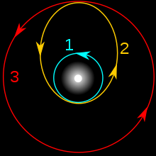
Hohmann transfers
  A simple technique for achieving a target orbit is performing Hohmann transfers, for example from a lower orbit to a higher orbit:
  From the initial orbit, the velocity is increased in the perigee so that the new apogee is at the altitude of the desired orbit. This maneuver places the satellite in the transfer orbit
  Once the satellite has reached the apogee of the transfer orbit, the velocity is increased again to circularize and reach the target orbit
  The opposite process can be followed to go from a higher to a lower orbit, with the maneuvers substracting velocity from the orbiter
  For our calculations, we assume impulsive maneuvers, meaning that the increment in velocity is instantaneous and applied in the optimal moment.

Slide 8
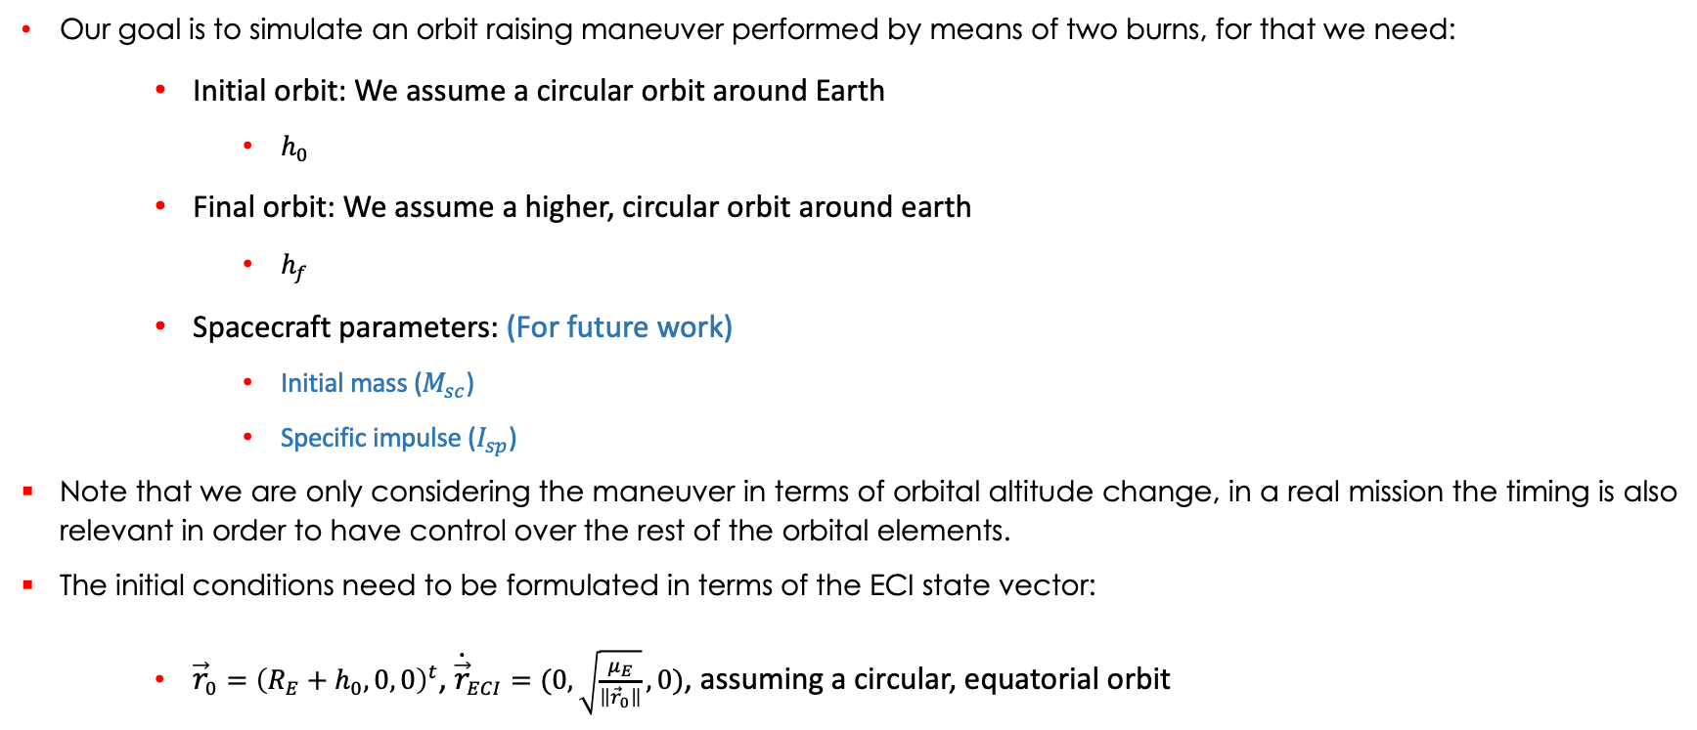
Problem parametrization
  Our goal is to simulate an orbit raising maneuver performed by means of two burns, for that we need:
    Initial orbit: We assume a circular orbit around Earth
      $h_{0}$
    Final orbit: We assume a higher, circular orbit around earth
      $h_{f}$
    Spacecraft parameters: (For future work)
      Initial mass ($M_{sc}$)
      Specific impulse ($I_{sp}$)
  Note that we are only considering the maneuver in terms of orbital altitude change, in a real mission the timing is also relevant in order to have control over the rest of the orbital elements.
  The initial conditions need to be formulated in terms of the ECI state vector:
    ${\vec{r}}_{0}={\left(R_{E}+h_{0}, 0, 0\right)}^{t}$, ${\dot{\vec{r}}}_{ECI}=(0, \sqrt{\frac{μ_{E}}{\left\|{\vec{r}}_{0}\right\|}}, 0)$, assuming a circular, equatorial orbit

Slide 9
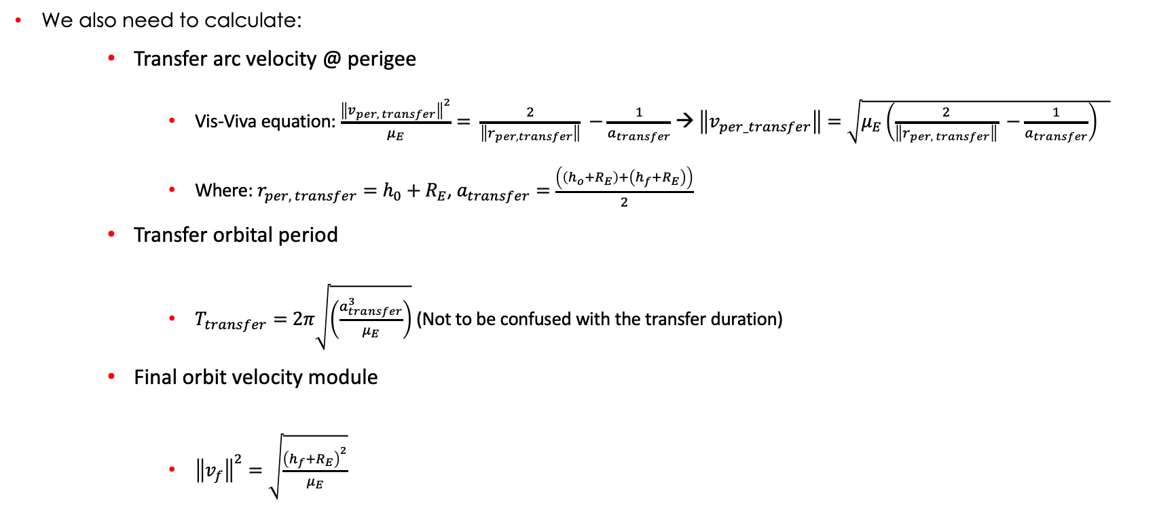
Problem parametrization
  We also need to calculate:
    Transfer arc velocity @ perigee
      Vis-Viva equation: $\frac{{\left\|v_{per, transfer}\right\|}^{2}}{μ_{E}}= \frac{2}{\left\|r_{per, transfer}\right\|} −\frac{1}{a_{transfer}}$ → $\left\|v_{per_transfer}\right\|=\sqrt{μ_{E}\left(\frac{2}{\left\|r_{per, transfer}\right\|} −\frac{1}{a_{transfer}}\right) }$
      Where: $r_{per, transfer}=h_{0}+R_{E}$, $a_{transfer}=\frac{\left(\left(h_{o}+R_{E}\right)+\left(h_{f}+R_{E}\right)\right)}{2}$
    Transfer orbital period
      $T_{transfer}=2π\sqrt{\left(\frac{a_{transfer}^{3}}{μ_{E}}\right)}$ (Not to be confused with the transfer duration)
    Final orbit velocity module
      ${\left\|v_{f}\right\|}^{2}=\sqrt{\frac{{\left(h_{f}+R_{E}\right)}^{2}}{μ_{E}}}$

Slide 10
Steps
  Simulate equatorial, circular orbit
  Simulate inclined, circular orbit
  Perform orbit raising maneuver

Slide 11

Thank you!
Any questions?

