Slide 1
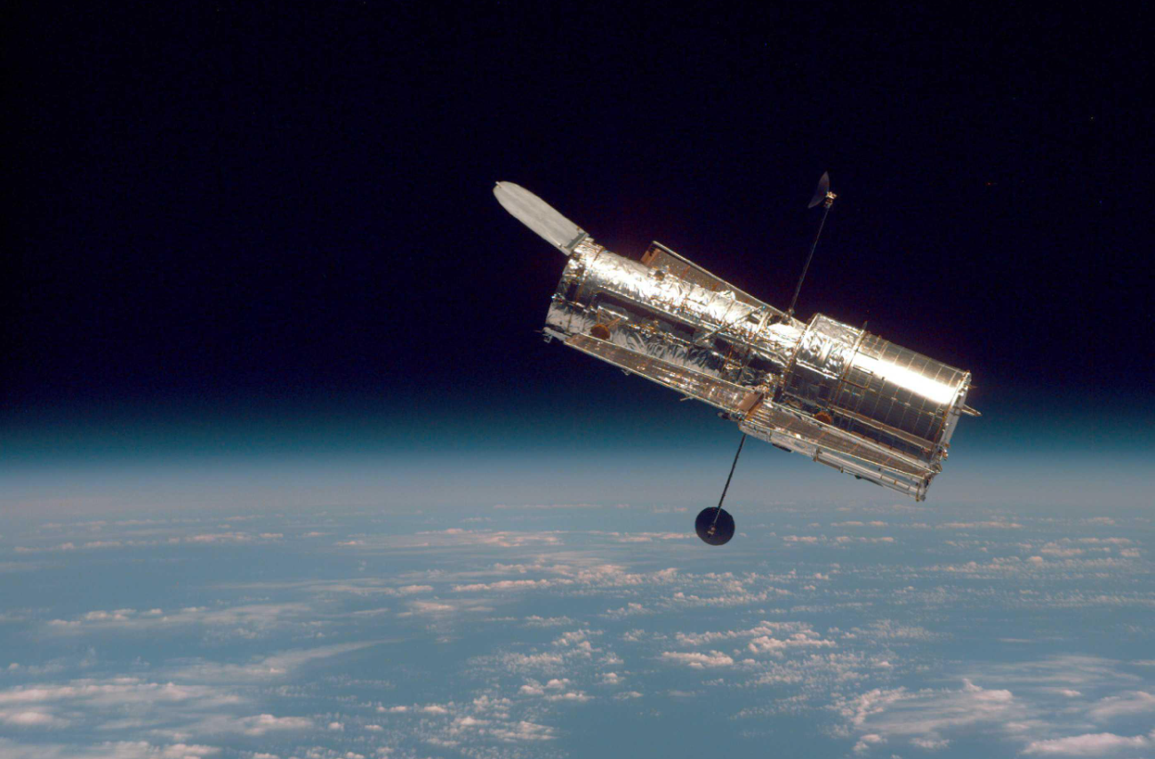
Reaction Wheel simulation
November 26th, 2025
Antonio Hernández-Rodicio Mateos
NASA – Hubble Against Earth Horizon

Slide 2
Contents
Introduction
Dynamics of the problem
Dynamics Simulink model
Main Simulink model
Adding external disturbances
PID control
PID controller Simulink implementation
PID tuning

Slide 3
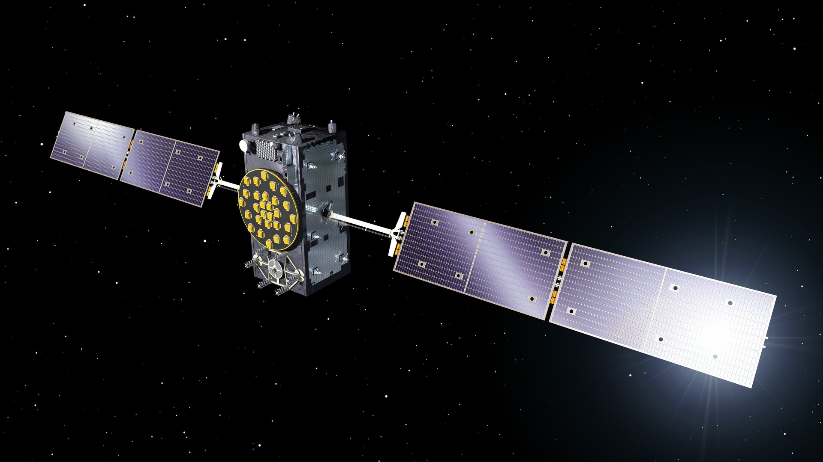
Introduction
  The goals of the sessions are:
    Understand 1-DoF rotational dynamics as a non-linear system of differential equation
    Set up a Simulink-based environment to simulate the rotational dynamics
    Generate a control input to modify the evolution of our dynamics
  To achieve that, the steps we’ll follow are:
    Review applicable theory
    Build a Simulink model of the dynamics
    Linearize the system and generate a controller
    Visualize results
Galileo Satellite

Slide 4

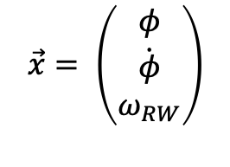
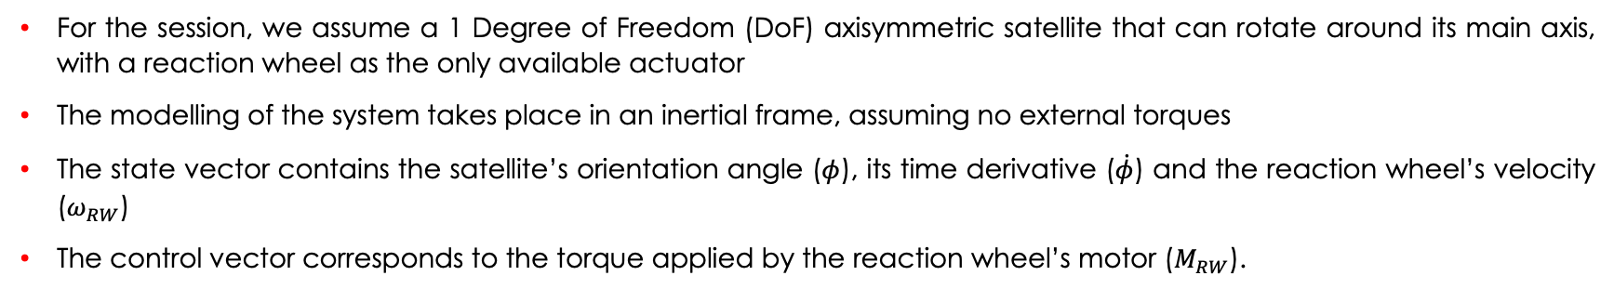
1-DoF rotational dynamics
  For the session, we assume a 1 Degree of Freedom (DoF) axisymmetric satellite that can rotate around its main axis, with a reaction wheel as the only available actuator
  The modelling of the system takes place in an inertial frame, assuming no external torques
  The state vector contains the satellite’s orientation angle ($φ$), its time derivative ($\dot{φ}$) and the reaction wheel’s velocity ($ω_{RW}$)
  The control vector corresponds to the torque applied by the reaction wheel’s motor ($M_{RW}$).
$$\vec{x}= \left(\begin{aligned}φ \\ \dot{\begin{aligned}φ \\ ω_{RW}\end{aligned}}\end{aligned}\right)$$
$$\vec{u}=\left(M_{RW}\right)$$
  The dynamics of the problem are modelled from conservation of angular momentum (Assuming no external torques):
$L_{S}=L_{S0}+L_{RW}=J_{S0}\dot{φ}+J_{RW}ω_{RW}$ → $\frac{∂L_{s}}{∂t}=J_{S0}\ddot{φ}+J_{RW}{\dot{ω}}_{RW}=0$ → $\ddot{φ}=\frac{1}{J_{S0}}\left(−J_{RW}{\dot{ω}}_{RW}\right)=\frac{1}{J_{RW}}\left(−J_{RW}\frac{M_{RW}}{J_{RW}}\right)=−\frac{M_{RW}}{J_{S0}}$

Slide 5
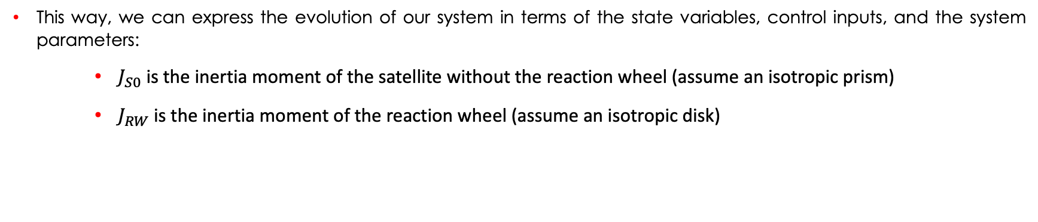
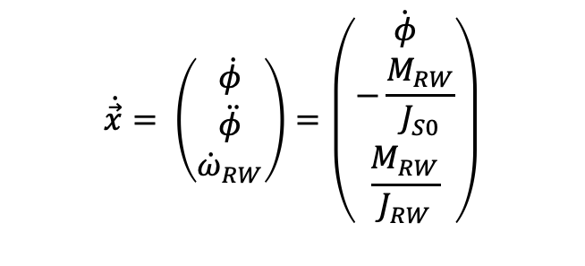
1-DoF rotational dynamics II
  So, we can formulate our system as:
$$\dot{\vec{x}}= \left(\begin{aligned}\dot{φ} \\ \ddot{φ} \\ {\dot{ω}}_{RW}\end{aligned}\right)=\left(\dot{\begin{aligned}φ \\ −\frac{M_{RW}}{J_{S0}} \\ \frac{M_{RW}}{J_{RW}}\end{aligned}}\right)$$
  This way, we can express the evolution of our system in terms of the state variables, control inputs, and the system parameters:
    $J_{S0}$ is the inertia moment of the satellite without the reaction wheel (assume an isotropic prism)
    $J_{RW}$ is the inertia moment of the reaction wheel (assume an isotropic disk)

Slide 6
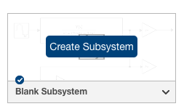
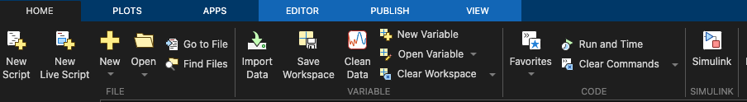
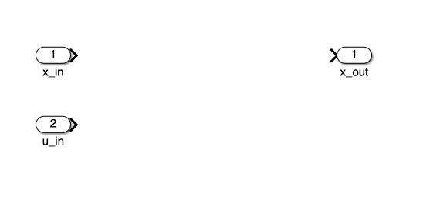
Dynamics block creation
  First, launch Simulink and create a blank subsystem:
  Then, add two inputs and one output:
    x_in for the state vector
    u_in for the control input
    x_out for the state vector output
  Save the file before proceeding to next steps

Slide 7
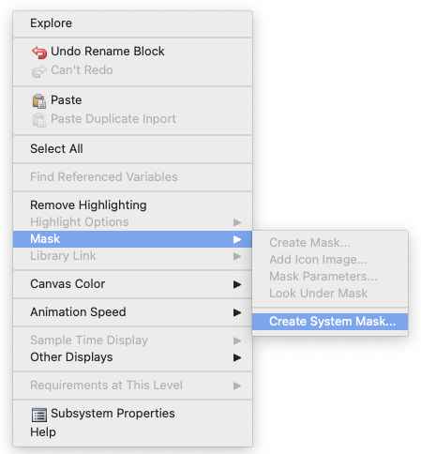
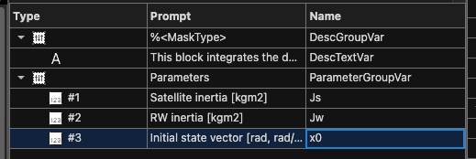


Dynamics block creation II
  Create a system mask for the dynamics block (This is used to parametrize the block for constant values)
  Create three ”edit” instances to allocate the parameter inputs
  Set the parameter’s prompts and variable names:
    Satellite inertia → Js
    Reaction wheel inertia → Jw
    Initial state vector → x0
  Save the mask

Slide 8
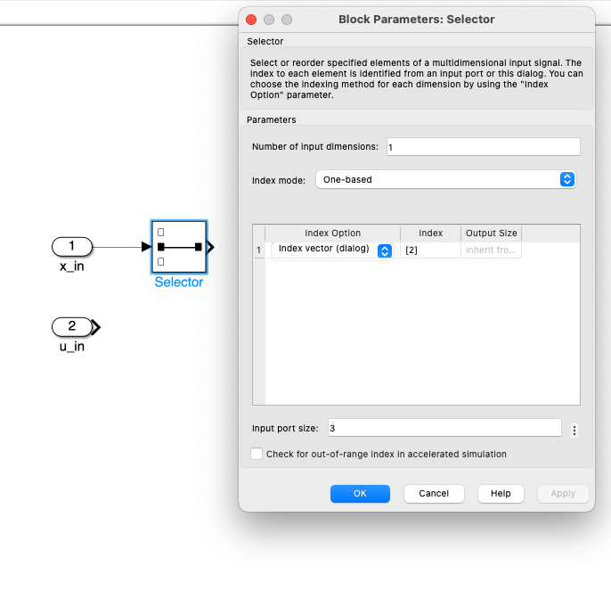
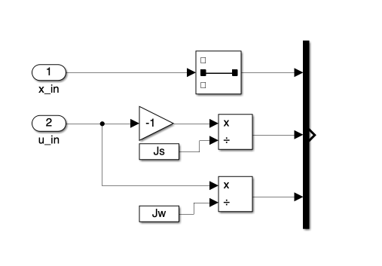
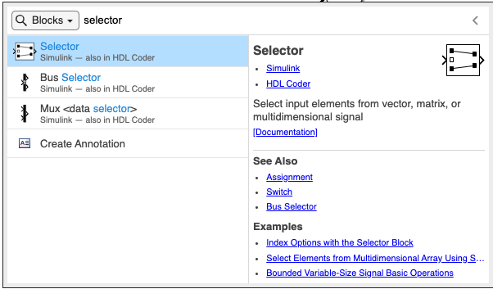
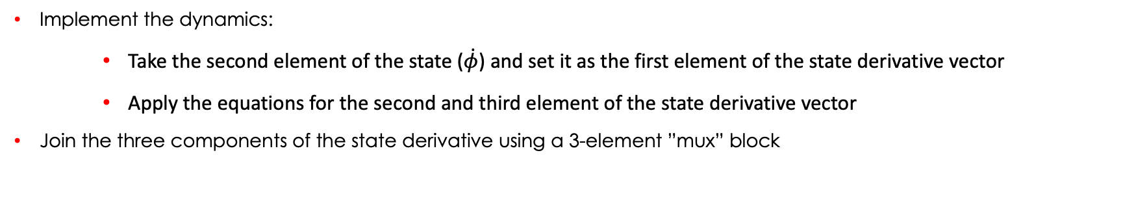
Dynamics block creation III
  Implement the dynamics:
    Take the second element of the state ($\dot{φ}$) and set it as the first element of the state derivative vector
    Apply the equations for the second and third element of the state derivative vector
  Join the three components of the state derivative using a 3-element ”mux” block

Slide 9
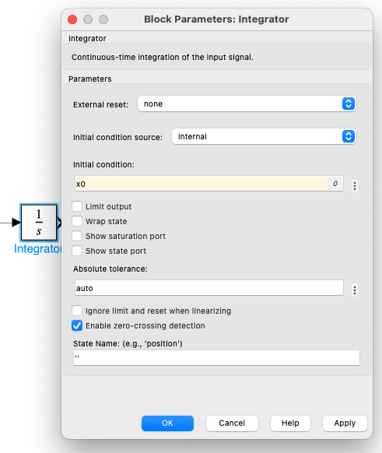
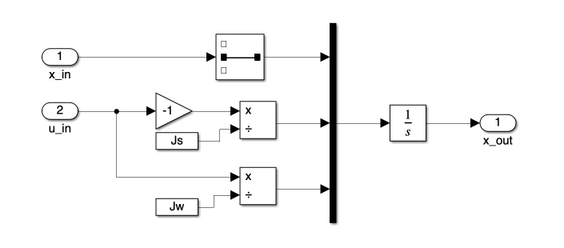
Dynamics block creation IV
  Add an integrator, applying the initial state by referencing the variable that was listed in the mask (x0)

Slide 10
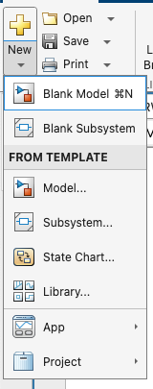
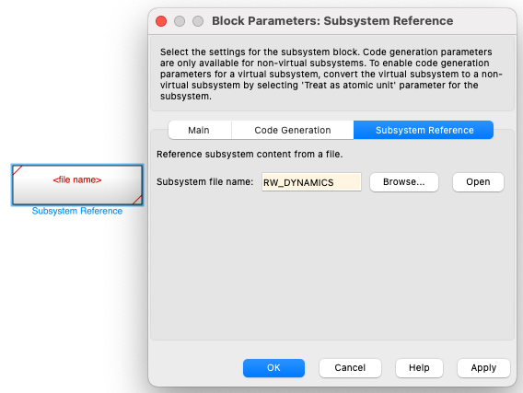
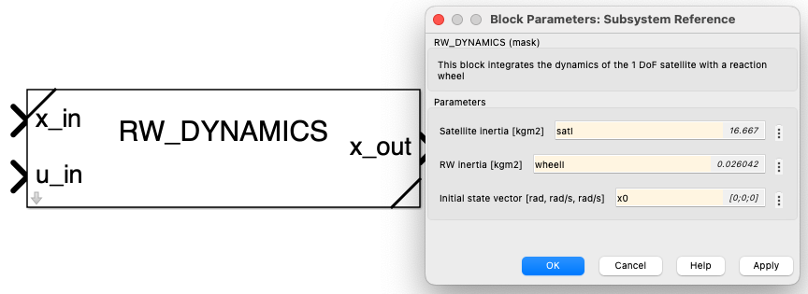

Main model creation I
  The dynamics block is a parametrized subsystem, so it can’t run by itself. For that, we need:
    A script to load the parameters into Matlab’s base workspace
    A Simulink model that references the dynamics subsystem
  Once the subsystem reference is added, configure its mask by double clicking on it (load first the variables through the input script)

Slide 11
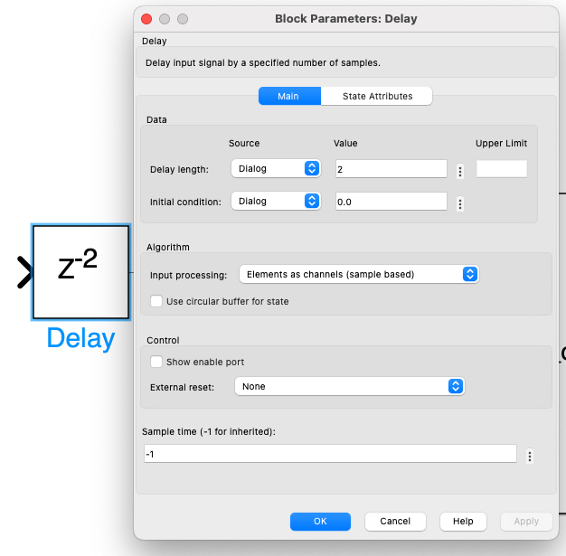
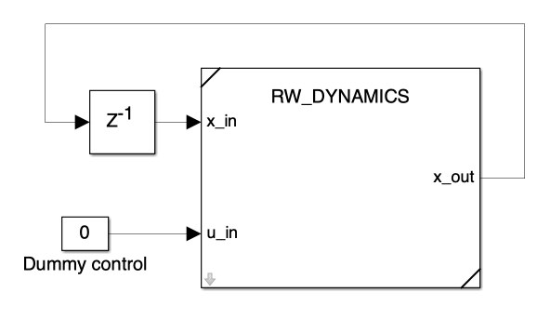
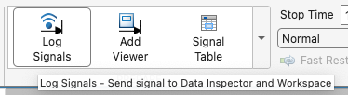
Main model creation II
  Add a 1 step delay block after the output of the dynamics before feeding the integrated state back to the dynamics input (specify initial conditions too), to avoid an algebraic loop
  Add a dummy constant control input
  Extract the state and the control input. Convert the states into degrees (for visualization), demux the vector into its three components and pass them to a scope
  Name the state components signals and log them (see next slide)

Slide 12
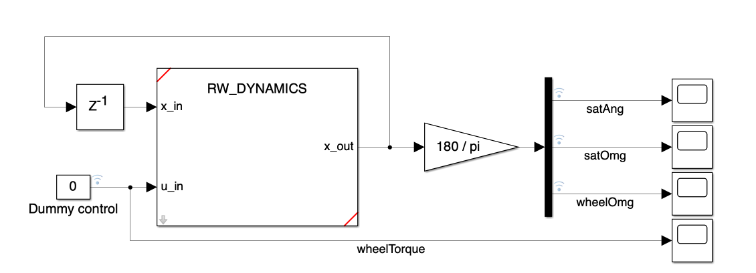
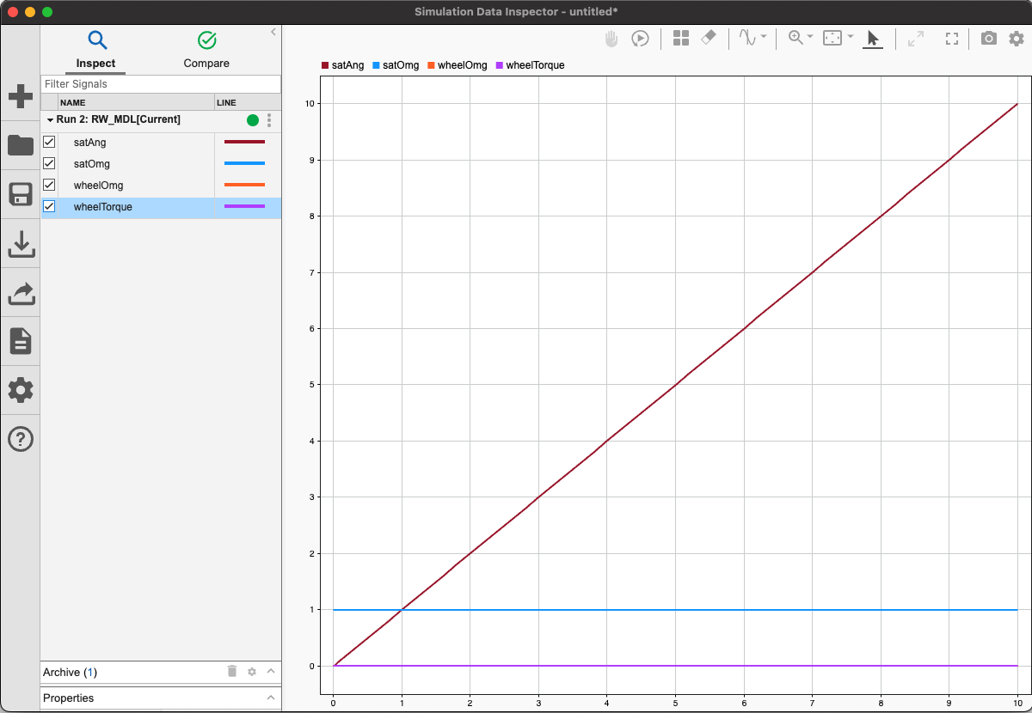

Main model creation III
  Run a 10 second simulation and open the data inspector
  Play with the initial conditions and the dummy control input to see how the state evolution changes
  The ouputs can also be visualized using the scopes (name the blocks if used, in order to identify the signals)

Slide 13
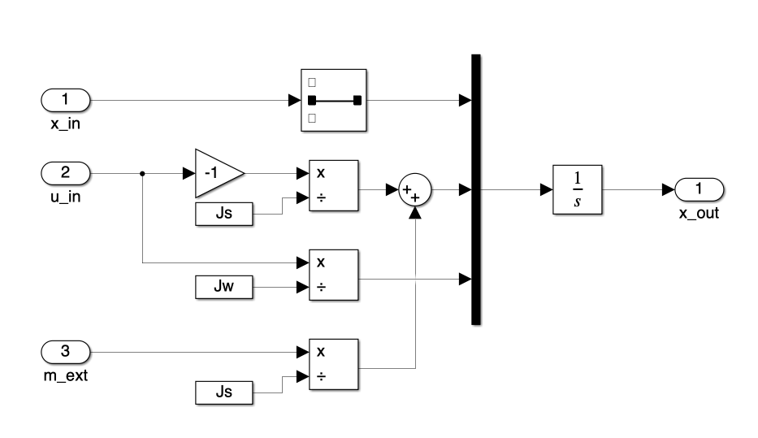
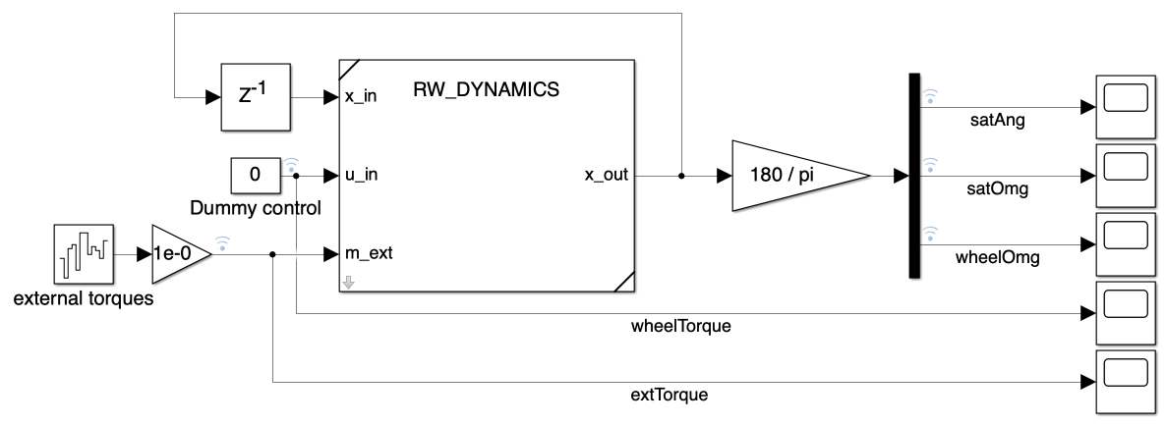
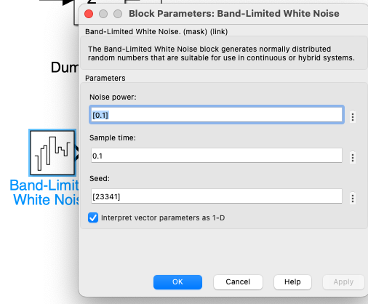
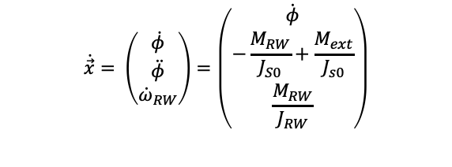
External disturbances
  If we add external torque disturbances ($M_{ext}$), the updated dynamics are:
$$\dot{\vec{x}}= \left(\begin{aligned}\dot{φ} \\ \ddot{φ} \\ {\dot{ω}}_{RW}\end{aligned}\right)=\left(\dot{\begin{aligned}φ \\ −\frac{M_{RW}}{J_{S0}}+\frac{M_{ext}}{J_{s0}} \\ \frac{M_{RW}}{J_{RW}}\end{aligned}}\right)$$
  Add a new input (m_ext) to the dynamics subsystem and update the dynamics
  Add a band limited white noise source in the main model and scale it down using a gain block (to be tuned), then feed it to the dynamics
  Log the external torque signal

Slide 14
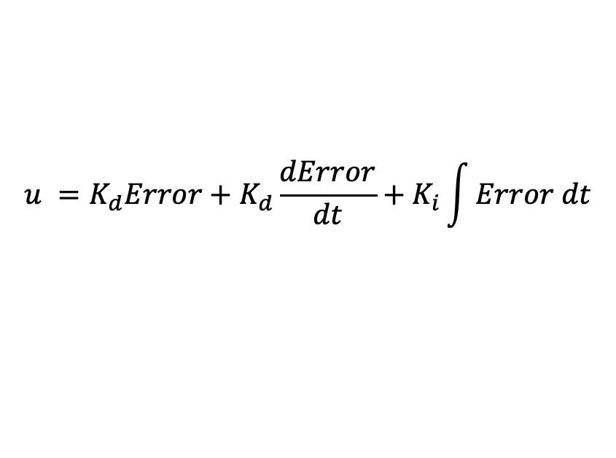
PID control
  A PID (Proportional-Integral-Derivative) controller is a feedback compensator that produces a control output based on:
    Current tracking error
    Time derivative of the tracking error
    Integral of the tracking error
$$u =K_{d}Error+K_{d}\frac{dError}{dt}+K_{i}\int{Error dt}$$

Slide 15
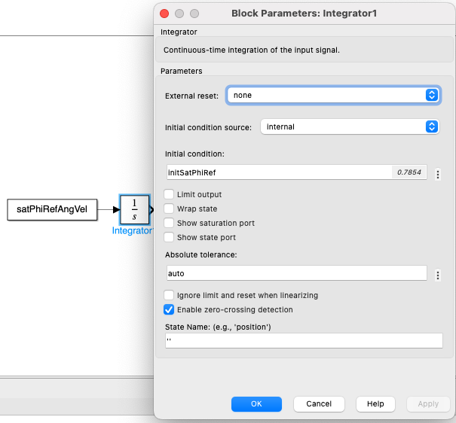
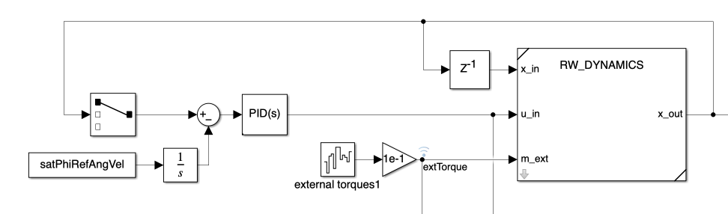
PID controller implementation I
  We need a reference signal for the controller to track
    Assume a GEO Earth Observation satellite that needs to point towards a certain point in the Earth’s equator, the angular reference will change with a rate of (2 * pi) / 24 hours
  Add the initial reference angle and its derivative to the initialization script and run it
  Add a constant block with the time derivative of the reference angle and integrate it, including the initial reference angle
  Subtract the current satellite angle from the reference to obtain the tracking error
  Add a PID controller block that takes the tracking error and that outputs the wheel torque

Slide 16

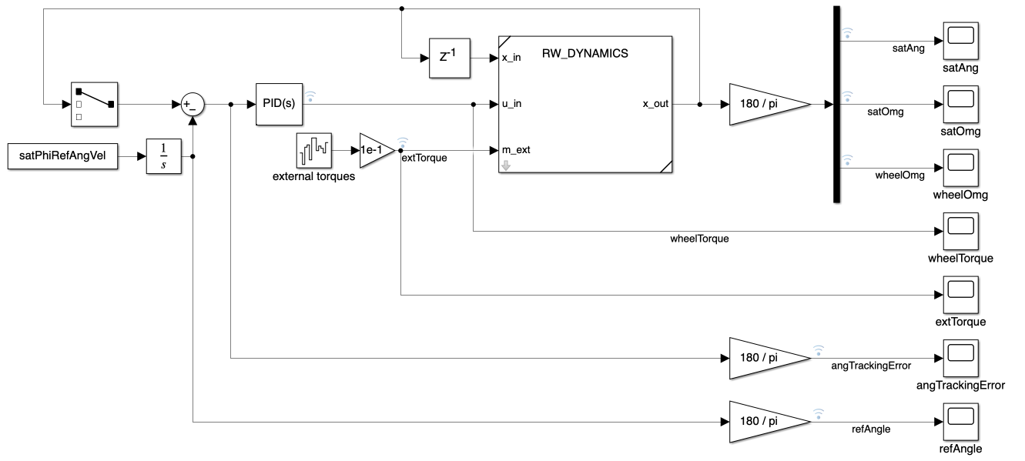
PID controller implementation II
  Log the tracking error and reference angle signals (convert them to degrees before logging for easier visualization)
  Set the simulation time to one day (24 * 3600)

Slide 17
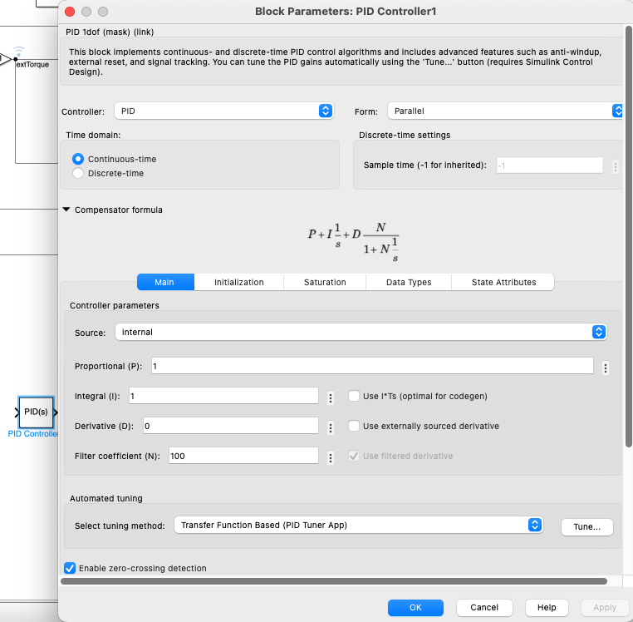
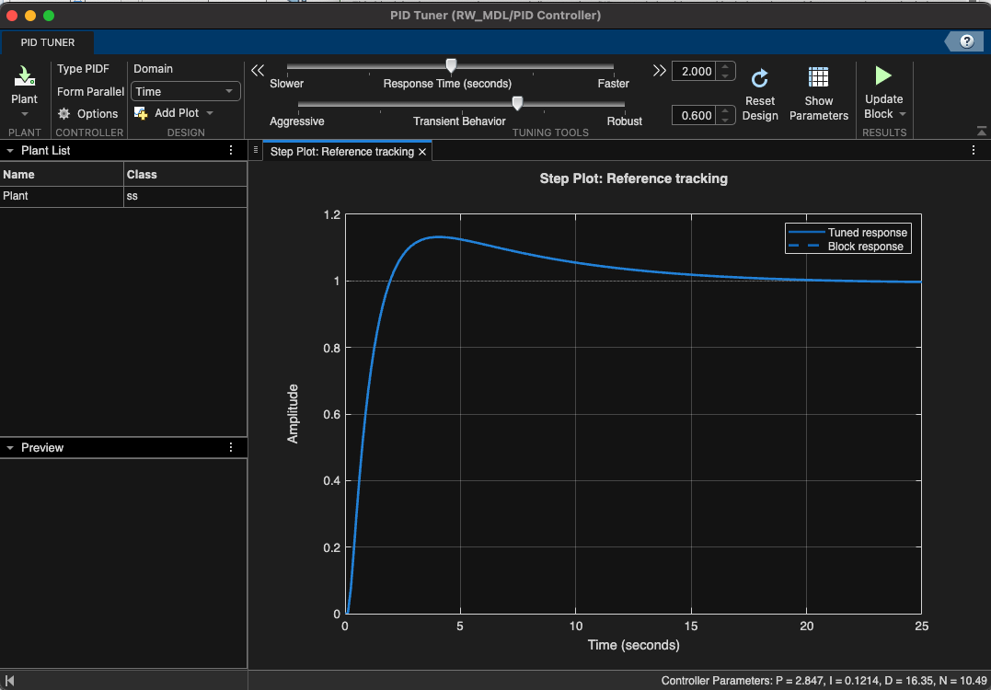
PID controller tuning
  Double-click on the PID block, the gains can be tuned directly in the Controller parameters fields
  We’ll use the automatic tuner provided by Simulink, press on tune
  The PID tuner app opens in a few seconds, there the controller response time and behavior can be graphically adjusted
  Click on Update block to save the settings and run a simulation
  Test different settings to see how the tracking error and control effort change (Hint: Integrate the abs of the wheel torque signal and log it, in order to visualize the total control effort)
  Also test what happens when changing the scaling of the external torque perturbations, to see how the controller is able to compensate for them, and how the control error and control effort change

Slide 18

Thank you!
Any questions?

