Slide 1
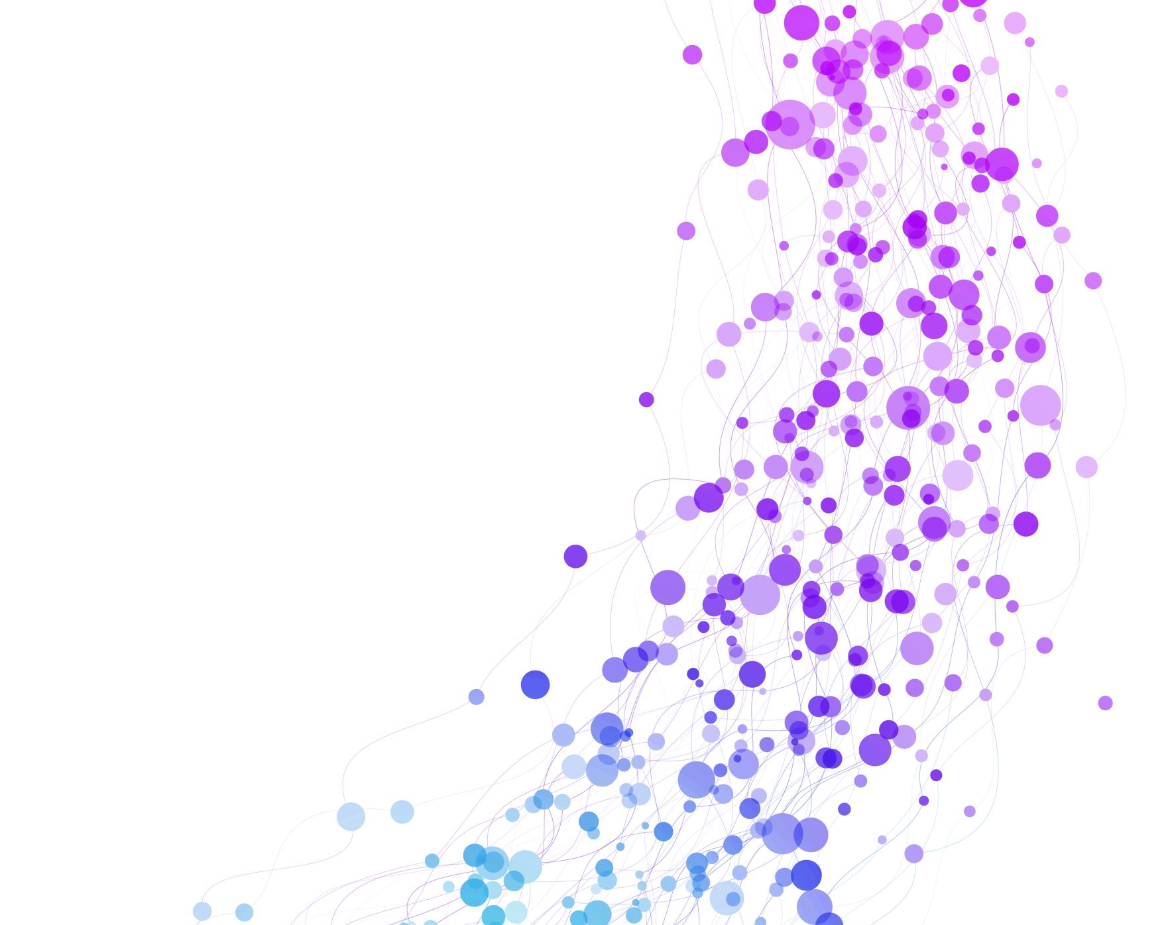
AI platforms Final Project
RAG (Retrieval-Augmented Generation)

Slide 2
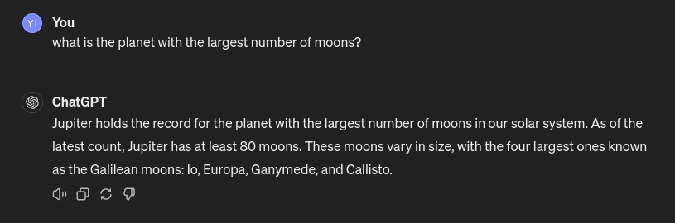
LLMs challenges
If we asked ChatGPT-3 a simple question:

Slide 3
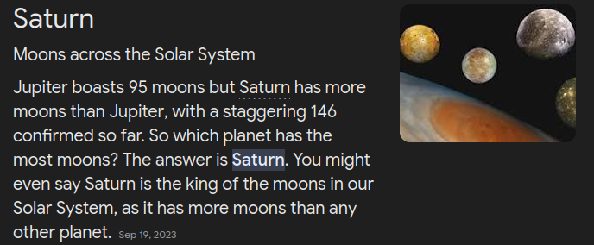
As we can see ChatGPT-3 was very confident with his answer.
This is the data it was fed.
THE ANSWER IS WRONG
The planet with the most number of moons is Saturn

Slide 4

LLMs challenges
From the Example given, we can conclude that we are facing two challenges:
No source
Out of Date
So, we use RAG to solve this problem.
The limitations of traditional LLMs, such as their tendency to provide outdated or unsupported information

Slide 5
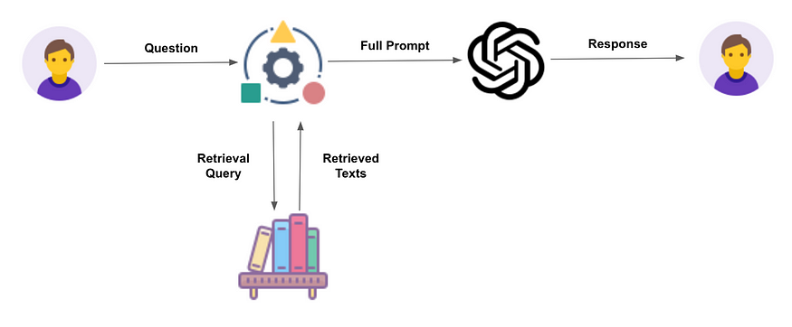
What is RAG?
RAG
Model
Moons?
The Answer according to NASA
The user asks a Question
The model revise the New Data source Before Answering the Question
NASA
5

Slide 6

The Role of Llama 3
Understand Natural Language: Llama 3 has been trained on diverse datasets, which enables it to understand linguistic patterns and semantics deeply.
Text Generation for explanation: It excels at generating text that is not only grammatically correct but also contextually aligned with the input it receives. This makes it ideal for applications like chatbots, or in our case a study assistant.
Translation and Dialogue Generation: Llama 3 can handle complex tasks such as translation between languages and generating dialogues.

Slide 7
RAG combines both retrieval from external sources and generation by the LLM.
This content can be from open or closed sources, such as the internet or specific databases.
that the LLM is instructed to generate responses based on the retrieved information, improving accuracy.
Summarize the benefits of using RAG, including:
increased accuracy and up-to-date of responses.
Ability to provide evidence-based answers.
Reduced likelihood of misinformation or data leakage.
ongoing efforts to improve both retrieval and generation aspects of RAG.

Slide 8
Functionality
We can give the model the needed retrieval source data (TEXT or PDF)
Then we ask the model questions, which it revise the data then give an answer relative to the data given by the user.

Slide 9
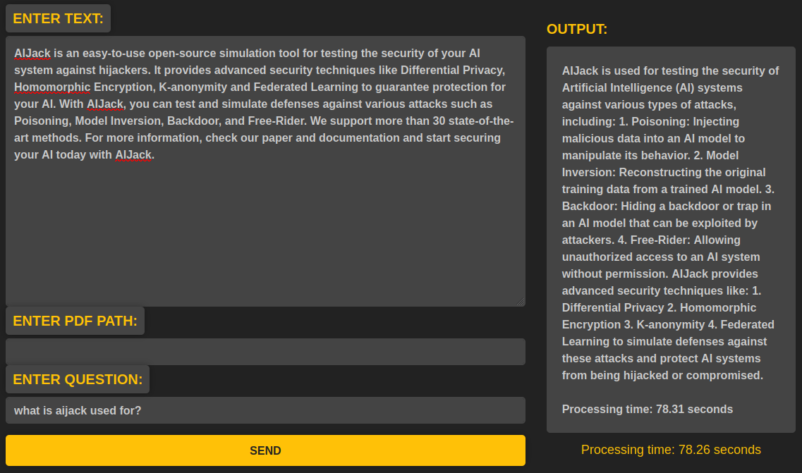
1.a. Here we add our retrieval data as text
4.Output
1.b. or add the path of a PDF file
2.Enter the prompt
3. Hit SEND

Slide 10

conclusion
We resolved the issues introduced with LLMs by:
Giving the model a data it needed so it’s up to date.
Get the data from a verified source hence the material its fed.

Slide 11
Done By:
Name | ID
Hashem Ahmed Abdel hafiz | 20221445676
Hussein Hesham Ibrahim | 20221372791
AbdelRahman Ahmed Fathi | 20221441784
Antonios Gerges Nageh | 20221903971
Youssef Ibrahim Shehata | 2103127
AbdelRahman Tarek Zaki | 20221442265

