Slide 1
Multi User Editor
Γιώργος Βελλής: g.vellis@hotmail.com

Slide 2
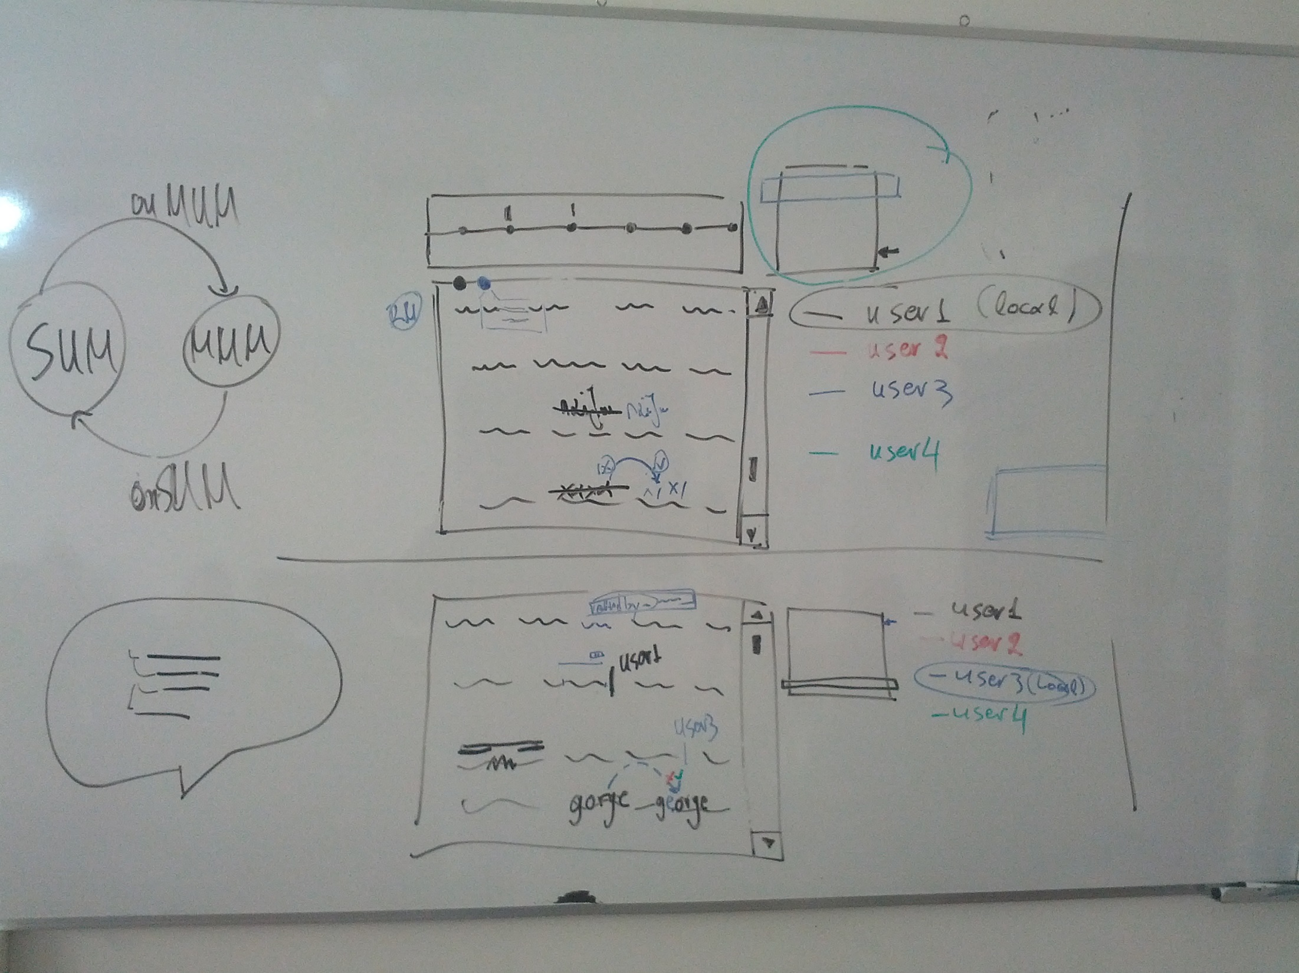
Radar
Change proposal
Comment Balloon
Specific color user caret and name(above caret)
Notes:
Balloon Tip site: https://balloontip.java.net/

