Slide 1
The Pan Cretan Forum as a case study for boundary spanning artifacts
Providakis Antonios
Charalampakos Orestis

Slide 2
Agenda
Theoretical Frames in CSCW
Distributed Cognition
Language/Action Perspective
Virtual Work
Boundaries
Pan-Cretan Forum
Design
Implementation

Slide 3
Theoretical Frames in CSCW
Based on J. Grudin and S. Poltrock, theory, is among others, important for:
Motivation or to justify system’s architectures or development approaches
Serving as a guideline or checklist for researchers or systems developers

Slide 4
Analyzing the system through the lenses of Distributed Cognition
Distributed Cognition
Examines the cognition that takes place in a whole system, human and non-human.
Boundaries are set to include cognitive process wherever it may occur in the system.
Appropriate theory to examine the role of the technologies and the artifacts
Under which circumstances and rules they interact with the human agent.

Slide 5
Language-Action Perspective for singleton communication
Language-Action Perspective
Communication is the main motivation for people to act
Using the language as an activity and not as the media to exchange information, a LAP could support different scenarios in a collaborative work

Slide 6
Virtual work, as a basic theme in our project
According to Bailey, Leonardi and Barley, agents can:
Operate with the digital representation
Operate on a distributed artefact
Operate through the technology to affect real world
Operate within a representation which simulates a real object

Slide 7
Boundaries in virtual work
Participants in virtual work have:
Different role
Unique digital representation
Boundaries distinguish the users
Enforced by the technology
Set by different roles in collaboration
Set by the uniqueness of every user or group

Slide 8
Pan-Cretan Forum
Design

Slide 9
Prototyping an e-collaboration system for the Pan-Cretan Forum
The roles at the collaboration
The Boundaries of the system
Boundary Artifacts
Social Translucence

Slide 10
The roles at the collaboration
Chamber
Supervises and gathers data from the events
Hotelier
Has interests in products and meets with producers to make deals
Producer
Has products and meets with hoteliers to make deals

Slide 11
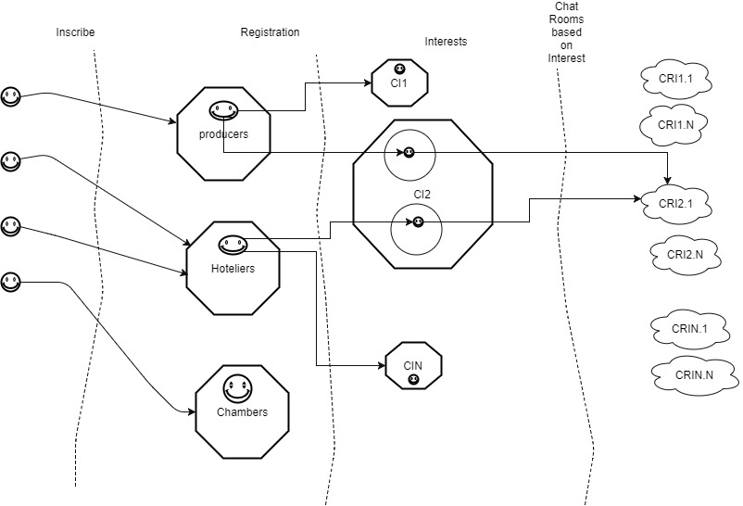
The Boundaries of the system
Inscribed boundary.
Requires a digital account in order to be trespassed
Common interests boundary
Separates the users in groups based on their interests
Meetings boundary
One-to-one meetings between users with same interests and different roles (Producer-Hotelier).
Boundaries-scheme

Slide 12
Boundary Artifacts - Overview
Scheduler
Negotiations Table (chat room)
Forum overview

Slide 13
Boundary Artifacts - Scheduler (1)
Agency
Organize the appointments
Notify about the upcoming appointments
Operation
Users operate on scheduler
Users operate with digital representation of other users
Through scheduler, meetings are arranged

Slide 14
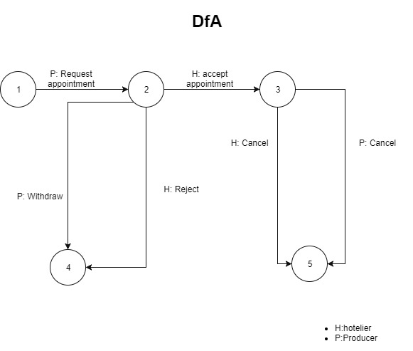
Boundary Artifacts - Scheduler (2)
A DfA diagram can represent the procedure for arranging a meeting
Meeting request by the producer
Accept or Reject by the Hotelier, or withdraw by the Producer
Cancel by both

Slide 15
Boundary Artifacts – Negotiations table
Agency
Meetings take place through chatrooms
Users operate on chatrooms
Deal button
Tagging mechanism
With digital representation
Instant messaging
File sharing

Slide 16
Boundary Artifacts – Forum Overview
Visualization of information
Tag cloud
Community network
Pie Chart

Slide 17
Pan-Cretan Forum
Implementation

Slide 18
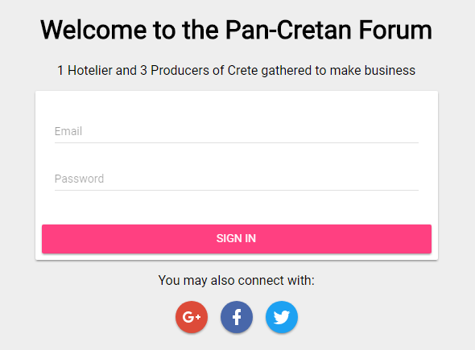
Sign-in
Conventional way
Email
Password
Social sign-in
Google
Facebook
Twitter
Realtime forum community overview

Slide 19
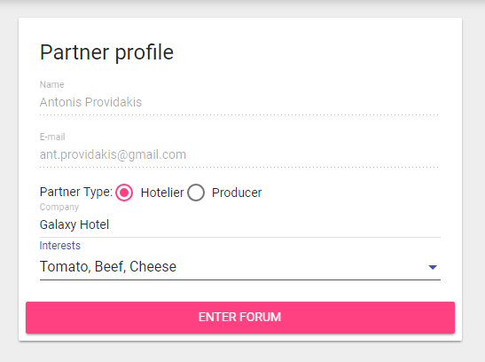
Profile Filling
Role selection
Hotelier
Producer
Representing hotel or producer’s brand name selection
Interests declaration

Slide 20
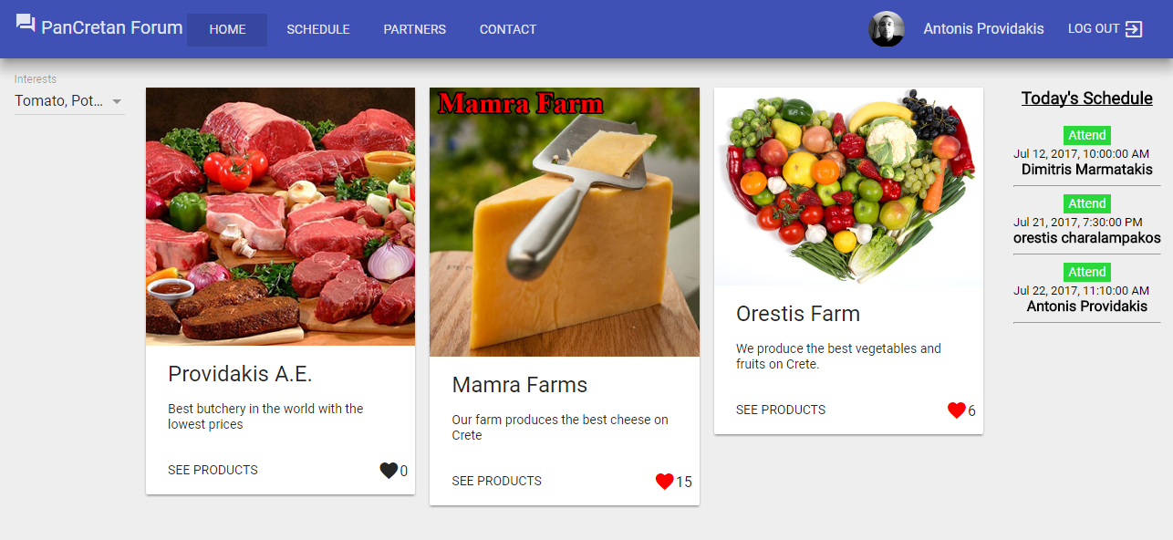
Main Screen – Exhibition Area
Similar view for Hoteliers and Producers
Exhibition tables based on selected interests
Interests filtering
Upcoming meetings

Slide 21
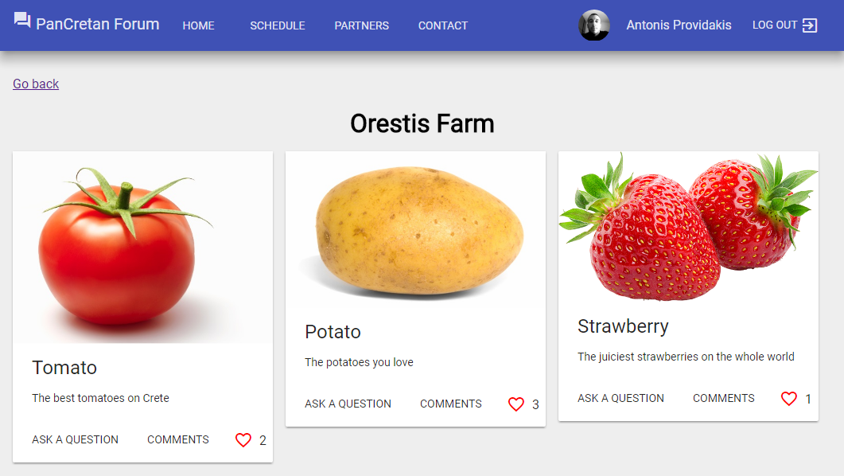
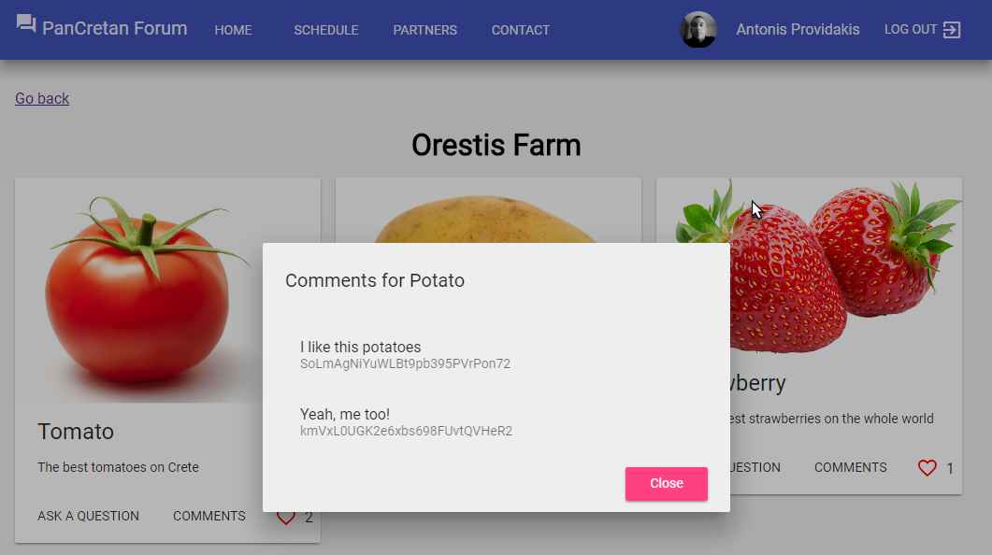
Exhibition Table of specific producer
Products
Endorsement by others
Comments

Slide 22
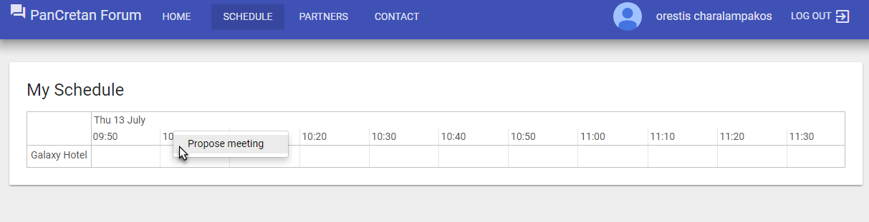
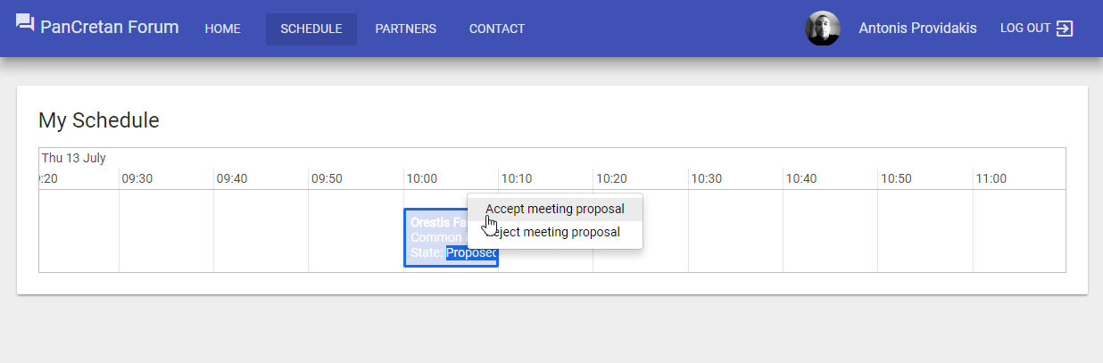
Scheduler
Action flow for meeting arrangement:
Meeting proposal by producer
An interim-state meeting is displayed on (hotelier’s) scheduler
Hotelier either accepts or rejects the meeting
If accepted, meeting is marked as “pending” on the scheduler
If rejected, interim-state meeting is removed from the scheduler
List of hoteliers with same interests
Producer
Hotelier

Slide 23
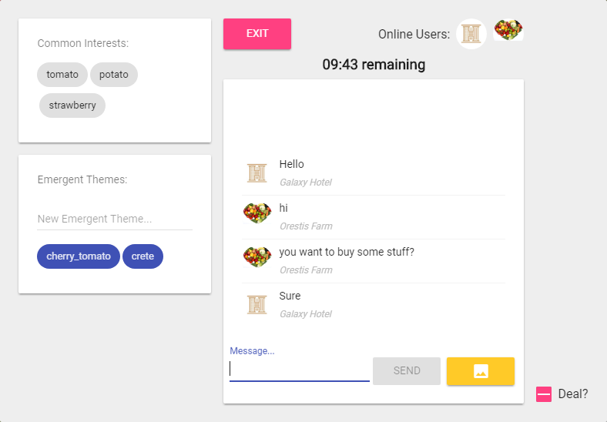
Negotiations Table
Common Interests that “connect” a Hotelier and a Producer
Themes that emerge during negotiations
Text messages/pictures exchange
Meeting outcome submission

Slide 24
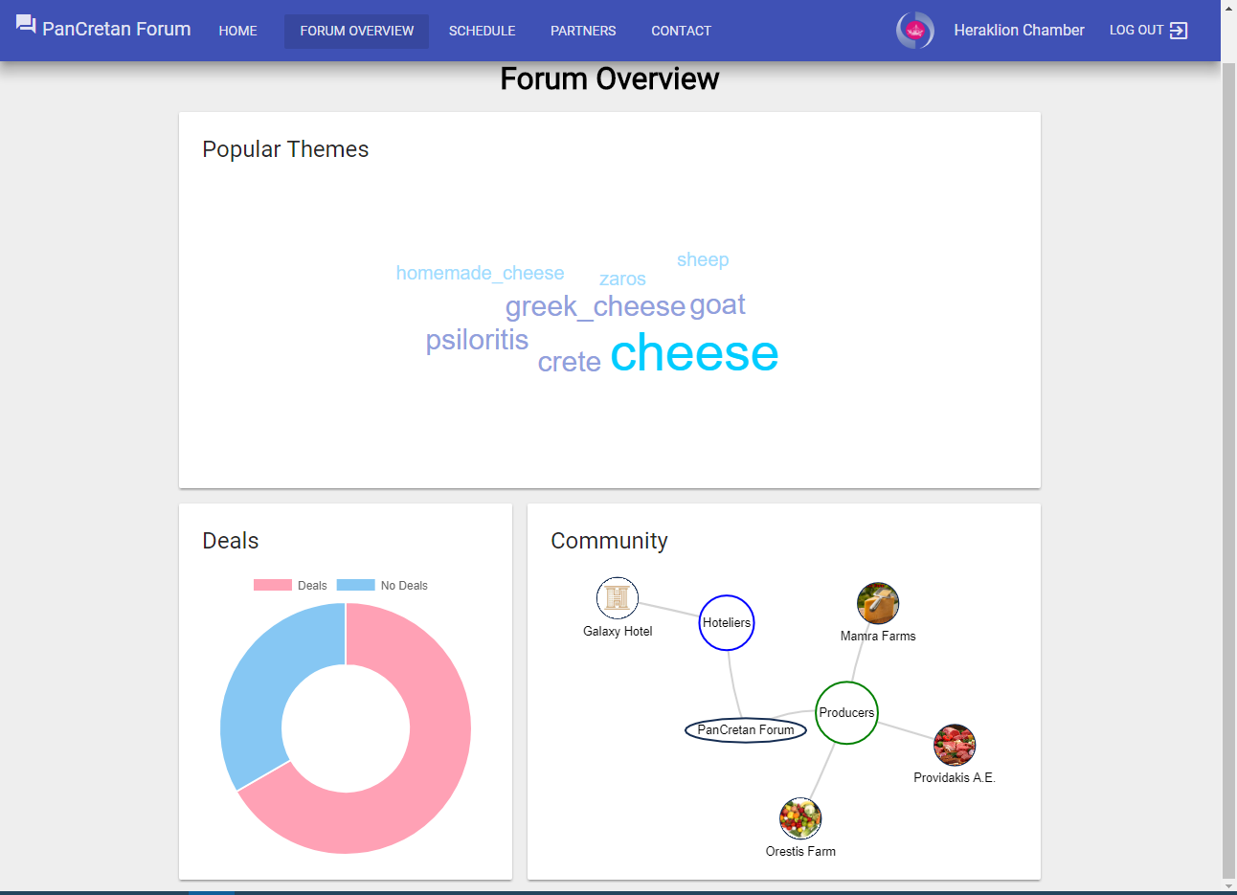
Forum Overview
Popular themes
Common Interests
Emergent Themes
State of Deals
Community Network

Slide 25
Demo

Slide 26

Thank you for your attention!

