Slide 1
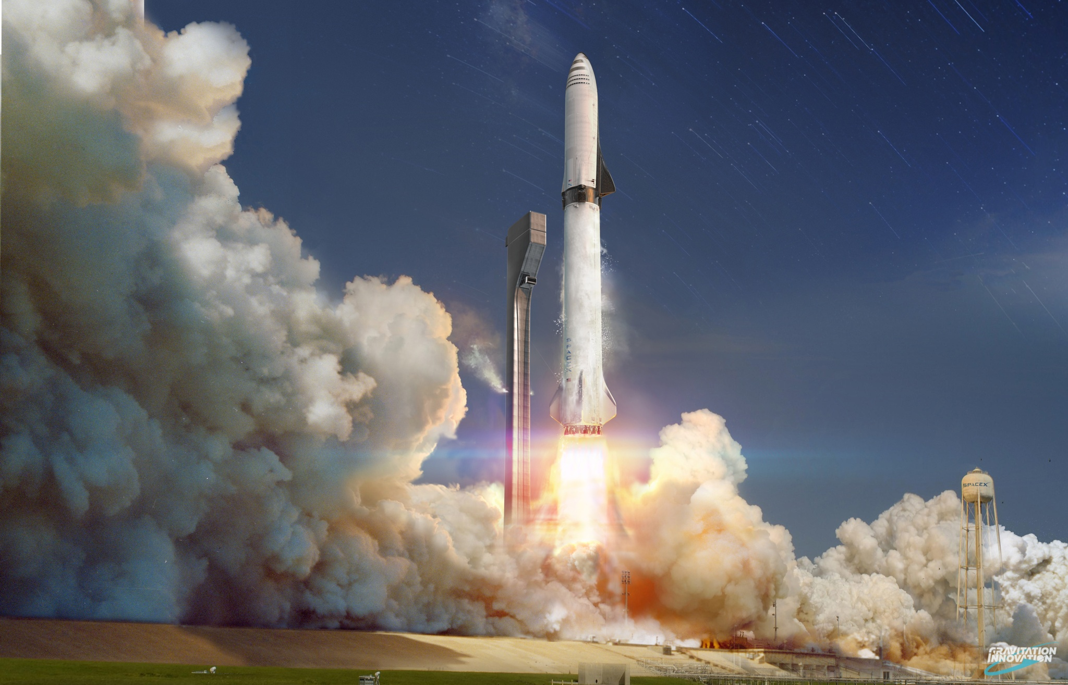
Winning Space Race with Data Science
Antonio Salgado
2023-06-10

Slide 2
Outline
Executive Summary
Introduction
Methodology
Results
Conclusion
Appendix

Slide 3
Executive Summary
Available data were analyzed with different methodologies
Web scraping and SpaceX API, in the Data Collection first step;
Data wrangling, data visualization and interactive visual analytics, in the EDA second step;
Machine Learning, in the Prediction last step. Decision Tree algorithm (83% accuracy) chosen as predictive tool.
Summary
Valuable data were collected from different public sources;
Best features to predict launchings success were identified with EDA;
Factors considered: payload, launch site, orbit type, etc;
Model to predict and manage this opportunity was developed using Machine Learning Prediction.

Slide 4
Introduction
Objective
Analyze the convenience (or not) of creating the new start up: SpaceY
Consider the current SpaceX market dominance as key factor to overcome
62M$ SpaceX launch cost (reusing first stage) vs 165M$ competitors cost
Key points to address
Launches cost estimation, based on first stage successful landing
Best place for launching
Predict launching success to bid against SpaceX

Slide 5

Section 1
Methodology

Slide 6
Summary
Data Collection
ML model building through calls to SpaceX API
Web Scraping was performed using Wikipedia
Data wrangling
Data uniformed tagging with landing results and device summary
Exploratory data analysis (EDA) using visualization and SQL
Interactive visual analytics using Folium and Plotly Dash
Predictive analysis using classification models
Data collected normalized and divided in training and test data sets
Evaluated by four different classification models
Accuracy evaluated with different parameters combinations

Slide 7
Data Collection – SpaceX API / Web Scraping
Data sets collected using web scraping technics in SpaceX API and Wikipedia
Request API and parse SpaceX launch data
Filter data to only include Falcon 9 launches
Deal with missing values
Request the Falcon 9 Launch Wiki page
Extract column / variables from HTML table header
Create data frame parsing launch tables
SpaceX offers an API with data to be used;
API used as per attached flowchart and data is persisted.
SpaceX launches data obtained from Wikipedia;
Request and BeautifulSoup libraries utilized;
Static URL converted to Panda DataFrame;
Data downloaded as per attached flowchart
Source Codes: Capstone-Project-Antonio-Salgado/antonio-salgado-jupyter-labs-spacex-data-collection-api.ipynb at main · Antoniosalgado208/Capstone-Project-Antonio-Salgado · GitHub
Capstone-Project-Antonio-Salgado/antonio-salgado-jupyter-labs-webscraping.ipynb at main · Antoniosalgado208/Capstone-Project-Antonio-Salgado · GitHub

Slide 8
Data Wrangling
Exploratory Data Analysis on database;
Data gathering
Summary launches per site, occurrences per orbit, mission outcome per orbit;
Data checking
Missing values, data type in columns, launches per site, counts per orbit type;
Landing outcome label from outcome column
EDA
Summary
Landing Outcome Label
Capstone-Project-Antonio-Salgado/antonio-salgado-labs-jupyter-spacex-data_wrangling_jupyterlite.ipynb at main · Antoniosalgado208/Capstone-Project-Antonio-Salgado · GitHub

Slide 9
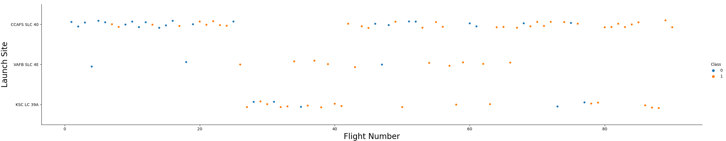
EDA with Data Visualization
First stage. Exploratory Data Analysis on database
Second stage. Data gathering
Summary launches per site
Occurrences of each orbit
Mission outcome per orbit
Last stage. Landing outcome label from outcome column
Capstone-Project-Antonio-Salgado/jupyter-labs-eda-dataviz.ipynb.jupyterlite.ipynb at main · Antoniosalgado208/Capstone-Project-Antonio-Salgado · GitHub

Slide 10
EDA with SQL
Queries performed
Unique launch sites names;
Top 5 launch sites starting with 'CCA’;
Total payload mass in NASA boosters (CRS);
Average payload mass in booster F9 v1.1;
First successful landing outcome in ground pad date;
Names of successful boosters with payload mass 4000 / 6000 kg;
Number of successful and failure mission;
Boosters with maximum payload mass names;
2015 failures in drone ship, booster versions, and launch site names;
Landing outcomes rank (Failure or Success) between 2010 and 2017.
Capstone-Project-Antonio-Salgado/antonio-salgado-eda-sql.ipynb at main · Antoniosalgado208/Capstone-Project-Antonio-Salgado · GitHub

Slide 11
Interactive Map with Folium
Functions utilized in Folium:
Markers, indicating map points;
Circles, indicating specific areas around coordinates;
Marker clusters, indicating groups of events in each coordinate;
Lines; indicating distances between coordinates.
Capstone-Project-Antonio-Salgado/antonio-salgado-lab_jupyter_launch_site_location.jupyterlite.ipynb at main · Antoniosalgado208/Capstone-Project-Antonio-Salgado · GitHub

Slide 12
Dashboard with Plotly Dash
Graphs and plots were used to visualize data
Percentage of launches by site
Payload range
They are key to:
Analyze relation between payloads and launch sites
Identify best place to launch, considering payload
(7 charts)
Capstone-Project-Antonio-Salgado/Plotly Dash 2.png at main · Antoniosalgado208/Capstone-Project-Antonio-Salgado · GitHub

Slide 13
Predictive Analysis
Classification models compared:
Logistic regression;
Support vector machine;
Decision tree;
K nearest neighbors.
Preparation /
Standarization
Hyperparameter Combination
Testing
Results
Analysis
Capstone-Project-Antonio-Salgado/antonio-salgado-SpaceX_Machine_Learning_Prediction_Part_5.jupyterlite1.ipynb at main · Antoniosalgado208/Capstone-Project-Antonio-Salgado · GitHub

Slide 14
Results
EDA Results
Utilized for different launch sites;
F9 v1.1 booster average payload: 2,928kg;
First successful landing in 2015;
Successful booster landing in drone ships;
Mission outcomes success near 100%;
Few booster versions failed: B1012 and B1015;
Landing outcomes substantial improvement since then.

Slide 15
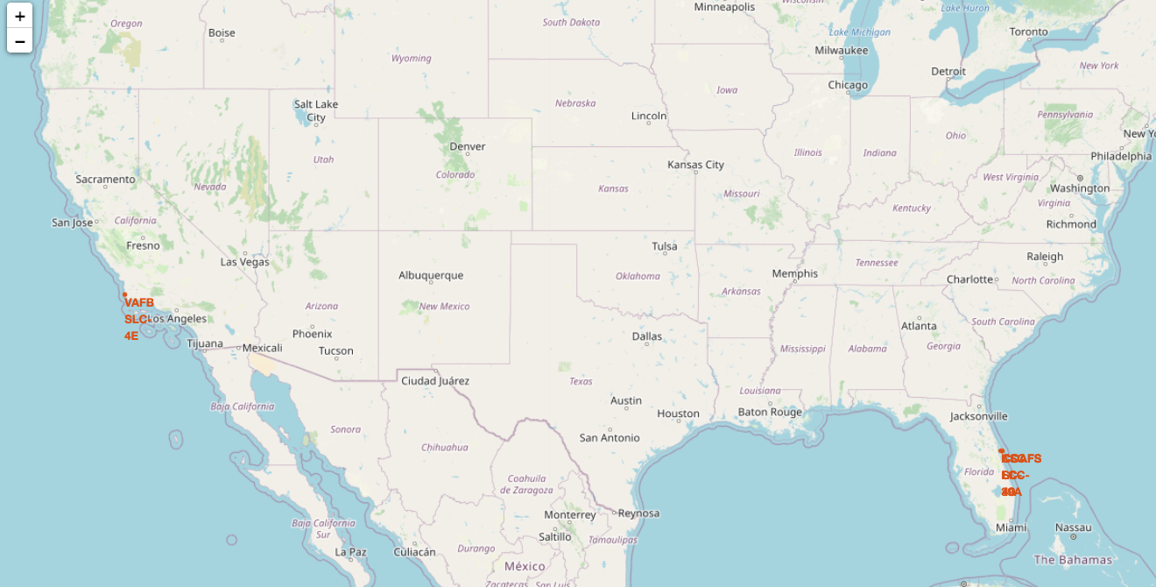
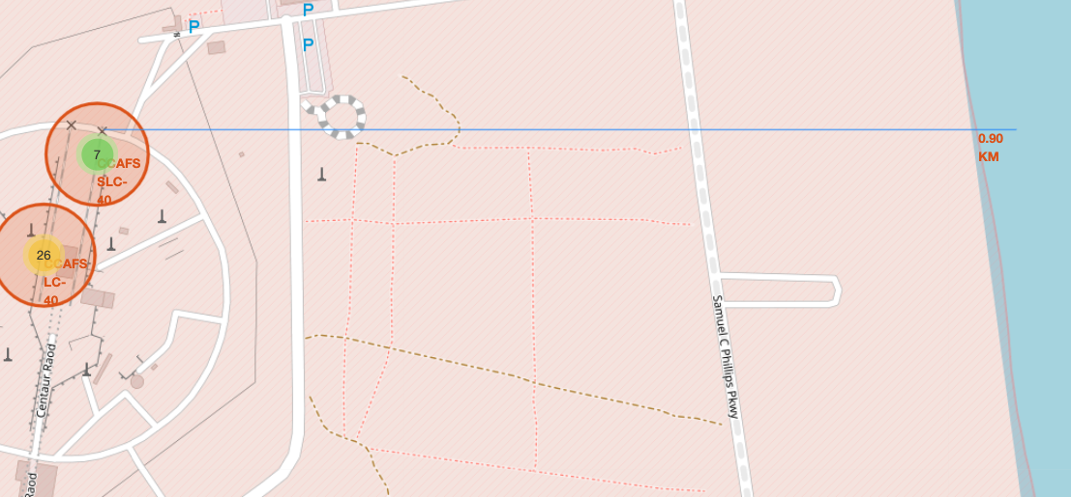
Results
EDA Results
Interactive analysis helps identifying safety launching places, near sea and with important infrastructure;
Most launches took place on USA east coast.

Slide 16
Section 2
Insights drawn
From EDA

Slide 17
EDA with SQL
Task 1
Display the names of the unique launch sites in the space mission
sql SELECT DISTINCT LAUNCH_SITE FROM SPACEXTBL ORDER BY 1
Task 2
Display 5 records where launch sites begin with the string 'CCA'
sql SELECT * FROM SPACEXTBL WHERE LAUNCH_SITE LIKE 'CCA%' LIMIT 5;
Task 3
Display the total payload mass carried by boosters launched by NASA (CRS)
sql SELECT SUM(PAYLOAD_MASS__KG_) AS TOTAL_PAYLOAD FROM SPACEXTBL WHERE PAYLOAD LIKE '%CRS%'

Slide 18
EDA with SQL
Task 4
Display average payload mass carried by booster version F9 v1.1
sql SELECT AVG(PAYLOAD_MASS__KG_) AS AVG_PAYLOAD FROM SPACEXTBL WHERE BOOSTER_VERSION = 'F9 v1.1'
Task 5
List the date when the first successful landing outcome in ground pay was achieved
sql SELECT MIN(DATE) AS FIRST_SUCCESS_GP FROM SPACEXTBL WHERE LANDING__OUTCOME = 'Success (ground pad)'
Task 6
List the names of the boosters which have success in drone ship and have payload mass
greater than 4000 but less than 6000
sql SELECT DISTINCT BOOSTER_VERSION FROM SPACEXTBL WHERE PAYLOAD_MASS__KG_ BETWEEN 4000 AND 6000 AND LANDING__OUTCOME = 'Success (drone ship)'

Slide 19
EDA with SQL
Task 7
List the total number of successful and failure mission outcomes
sql SELECT MISSION_OUTCOME, COUNT(*) AS QTY FROM SPACEXTBL GROUP BY MISSION_OUTCOME ORDER BY MISSION_OUTCOME;
Task 8
List the names of the booster_versions which have carried the maximum payload mass.
Use a subquery
sql SELECT DISTINCT BOOSTER_VERSION FROM SPACEXTBL WHERE PAYLOAD_MASS__KG_ = (SELECT MAX(PAYLOAD_MASS__KG_) FROM SPACEXTBL) ORDER BY BOOSTER_VERSION;
Task 9
List the records which will display the month names, failure landing_outcomes in drone ship ,booster versions, launch_site for the months in year 2015.
sql SELECT BOOSTER_VERSION, LAUNCH_SITE FROM SPACEXTBL WHERE LANDING__OUTCOME = 'Failure (drone ship)' AND DATE_PART('YEAR', DATE) = 2015;

Slide 20
EDA with SQL
Task 10
Rank the count of successful landing_outcomes between the date 04-06-2010 and 20-03-2017
in descending order
sql SELECT LANDING__OUTCOME, COUNT(*) AS QTY FROM SPACEXTBL WHERE DATE BETWEEN '2010-06-04' AND '2017-03-20' GROUP BY LANDING__OUTCOME ORDER BY QTY DESC

Slide 21

Flight Number vs Launch Site
Best launch site: CCAF5 SLC 4O. Most recent launches successful;
Second: VAFB SLC 4E. Third: KSC LC 39A;
Success Rate improvement over time.

Slide 22
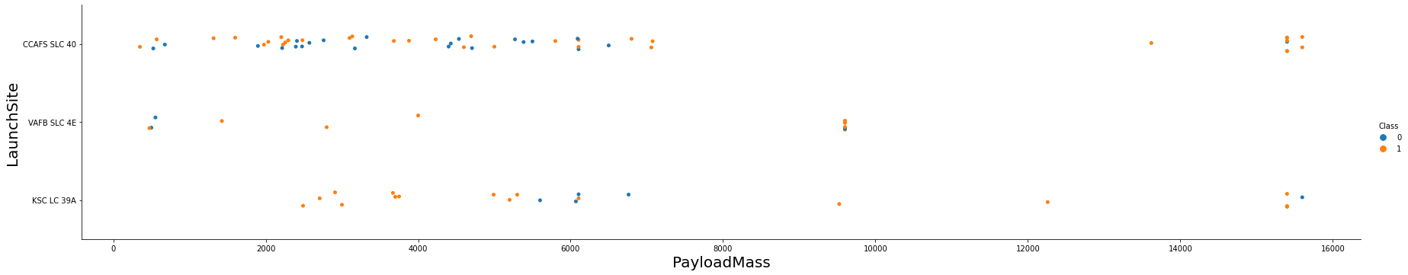
Payload vs Launch Site
Excellent success rates Payloads over 9,000+kg;
Payloads over 12,000kg only possible in CCAFS SLC 40 and KSC LC 39A Launch sites

Slide 23
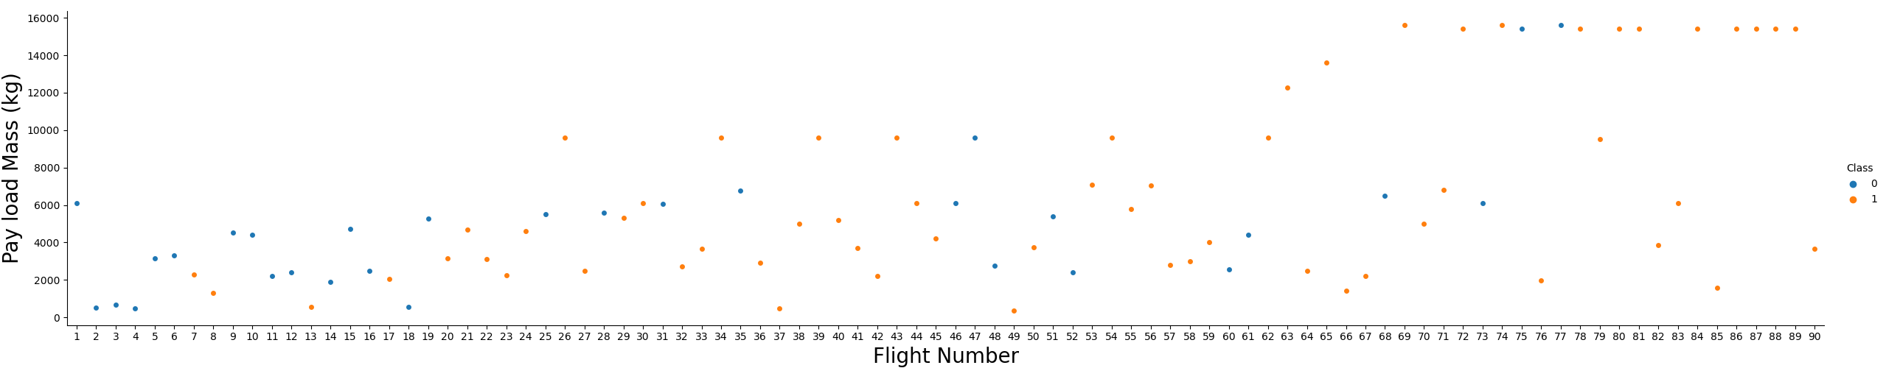
Payload vs Flight Number
When flight number increases, the first stage is more likely to land successfully;
The more massive the payload, the less likely the first stage will return.

Slide 24
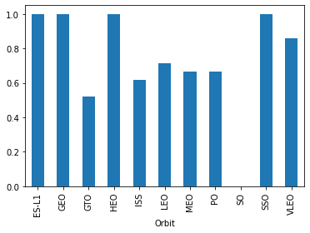
Success Rate vs Orbit Type
Very high success rates on orbits:
ES L-1;
GEO;
HEO;
SSO;
VLEO.

Slide 25
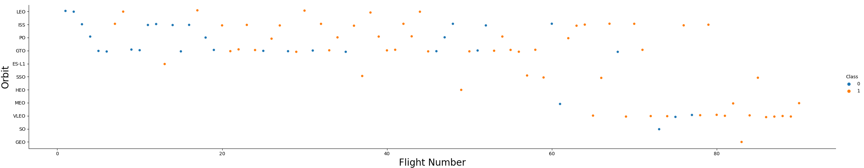
Flight Number vs Orbit Type
Success rate improvement in all orbits over time;
Opportunity: VLEO. Latest frequency increase.

Slide 26
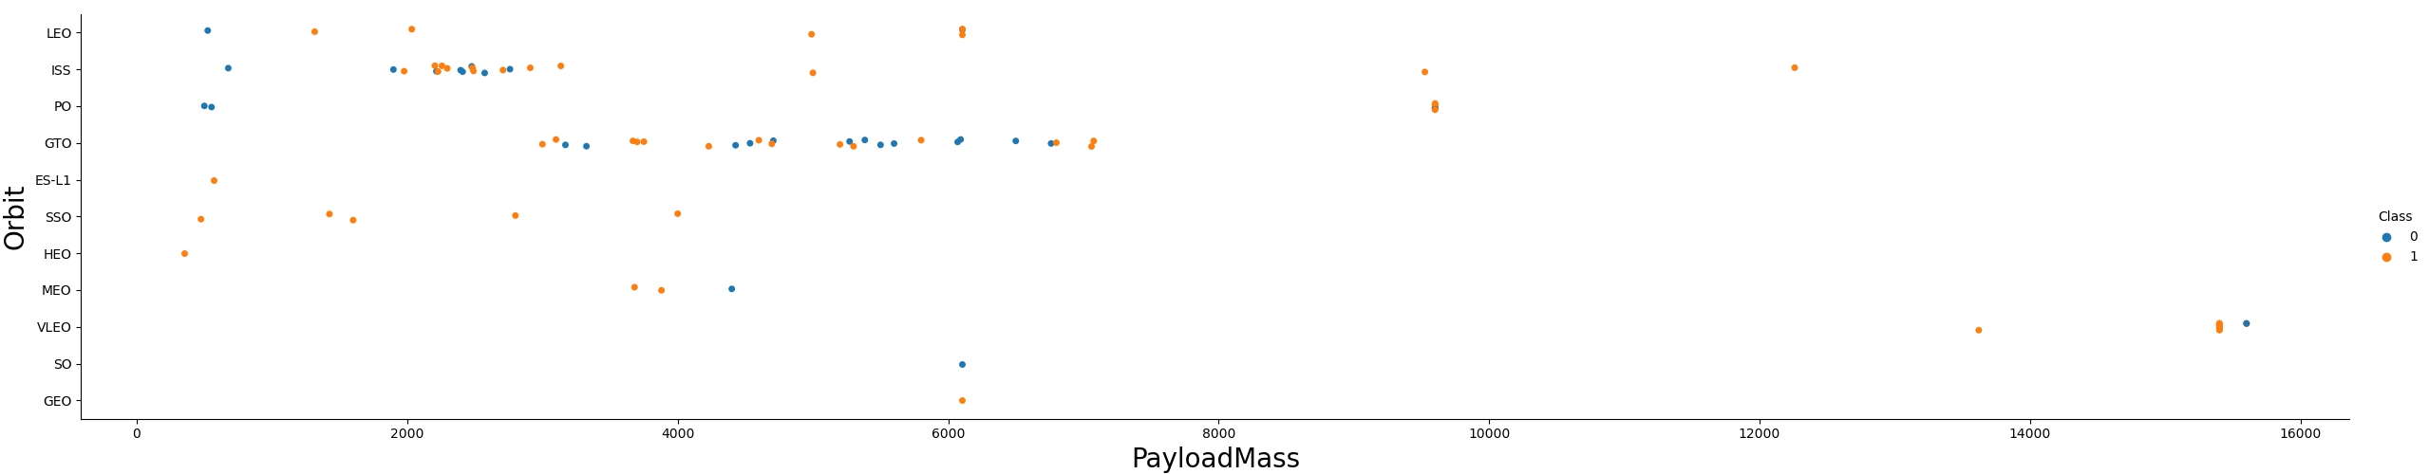
Payload vs Orbit Type
No relationship founded in GTO payload vs success rate;
ISS: payload widest rate and success good rate;
SO and GEO: few launches.

Slide 27
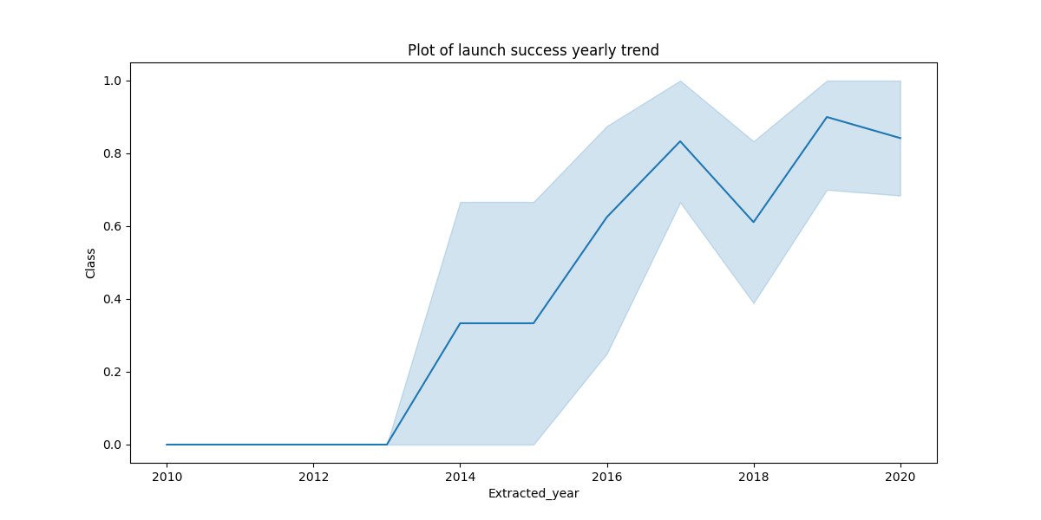
Launch Success Yearly Trend
Remarkable success rate increase during 2013 /2020 period;
Technology improvement during 2010 /2015 period.

Slide 28
All Launch names
Process to get them: select unique “launch_site” values from dataset;
Launch names are as follows:
Launch Site
CCAFS LC-40
CCAFS SLC-40
KSC LC-39A
VAFB SLC-4E

Slide 29
Launch sites names starting with “CCA”
They are five launches from Cape Cañaveral
Launch sites are the following:
Date | Time | Booster Version | Launch Site | Payload | Payload Mass kg | Orbit | Customer | Mission Outcome | Landing Outcome
2010-06-04 | 18:45:00 | F9 v1.0 B0003 | CCAFS LC-40 | Dragon Spacecraft | 0 | LEO | SpaceX | Success | Failure (Parachute)
2010-12-08 | 15:43:00 | F9 v1.0 B0004 | CCAFS LC-40 | Dragon demo flight C1 | 0 | LEO | NASA (COTS) | Success | Failure (Parachute)
2012-05-22 | 7:44:00 | F9 v1.0 B0005 | CCAFS LC-40 | Dragon demo flight C2 | 525 | LEO (ISS) | NASA (COTS) | Success | No attempt
2012-10-08 | 0:35:00 | F9 v1.0 B0006 | CCAFS LC-40 | SpaceX CRS-1 | 500 | LEO (ISS) | NASA (CRS) | Success | No attempt
2013-03-01 | 15:10:00 | F9 v1.0 B0007 | CCAFS LC-40 | SpaceX CRS-2 | 677 | LEO (ISS) | NASA (CRS) | Success | No attempt

Slide 30
4.2. Total payload mass
Total payload mass carried by boosters from NASA;
Adding all payloads with “CRS” codes
Total Payload (kg)
111.268

Slide 31
Average Payload Mass
Average payload mass carried by booster version F9 v1.1;
Filtering and calculating the Avg of above version:
Avg Payload (kg)
2.928

Slide 32
First successful landing date
Landing outcome on ground pad;
Filtering and getting the minimum date value:
Minimum Date
2015-12-22

Slide 33
Successful Drone landing. 4000 / 6000 mass
Successful Booster landing with 4000 / 6000 payload mass;
Four Booster version meeting above criteria:
Booster Version
F9 FT B1021.2
F9 FT B1031.2
F9 FT B1022
F9 FT B1026

Slide 34
Quantity of Successful / Failure missions
Number of successful and failure mission outcomes;
Grouping and counting records for each group:
Mission Outcome | Occurrences
Success | 99
Success (unclear status) | 1
Failure (in flight) | 1

Slide 35
Boosters carried maximum payload
Booster that carried maximum payload mass, included in database:
Booster Version (…)
F9 B5 B1048.4
F9 B5 B1048.5
F9 B5 B1049.4
F9 B5 B1049.5
F9 B5 B1049.7
F9 B5 B1051.3
Booster Version
F9 B5 B1051.4
F9 B5 B1051.6
F9 B5 B1056.4
F9 B5 B1058.3
F9 B5 B1060.2
F9 B5 B1060.3

Slide 36
2015 Launch records
Drone ship failed landing, booster versions and launch sites:
Booster Version | Launch Site
F9 V1.1 B1012 | CCAFS LC-40
F9 V1.1 B1015 | CCAFS LC-40

Slide 37
Landing outcomes ranking
Landing ranking between 2010-06-04 and 2017;
“No attempt” taken into account
Landing Outcome | Occurrences
No attempt | 10
Failure (drone ship) | 5
Success (drone ship) | 5
Controlled (ocean) | 3
Success (ground pad) | 3
Failure (parachute) | 2
Uncontrolled (ocean) | 2
Precluded (drone ship) | 1

Slide 38
Section 4
Launch Sites
Proximities Analysis

Slide 39
All launch sites proximity analysis
Sites near sea selected due to safety, not far from roads / railroads

Slide 40
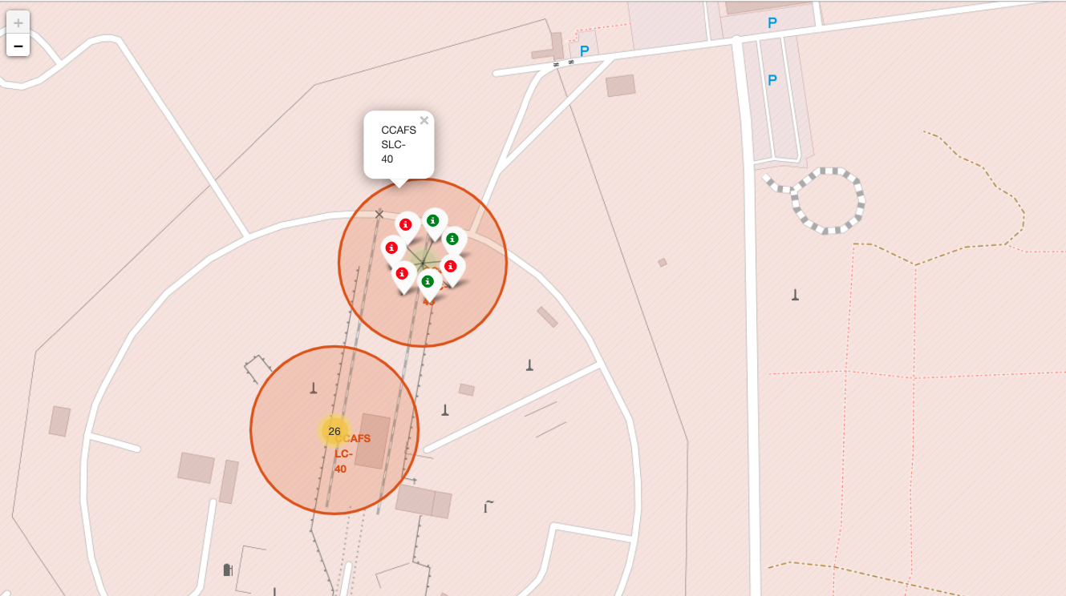
Launch outcomes by site
Color-labeled markers in clusters identify launch sites with high success rates.

Slide 41
Logistics and safety
Sites with favorable logistics and far from inhabitaded areas

Slide 42
Section 5
Build a Dashboard with Plotly Dash

Slide 43
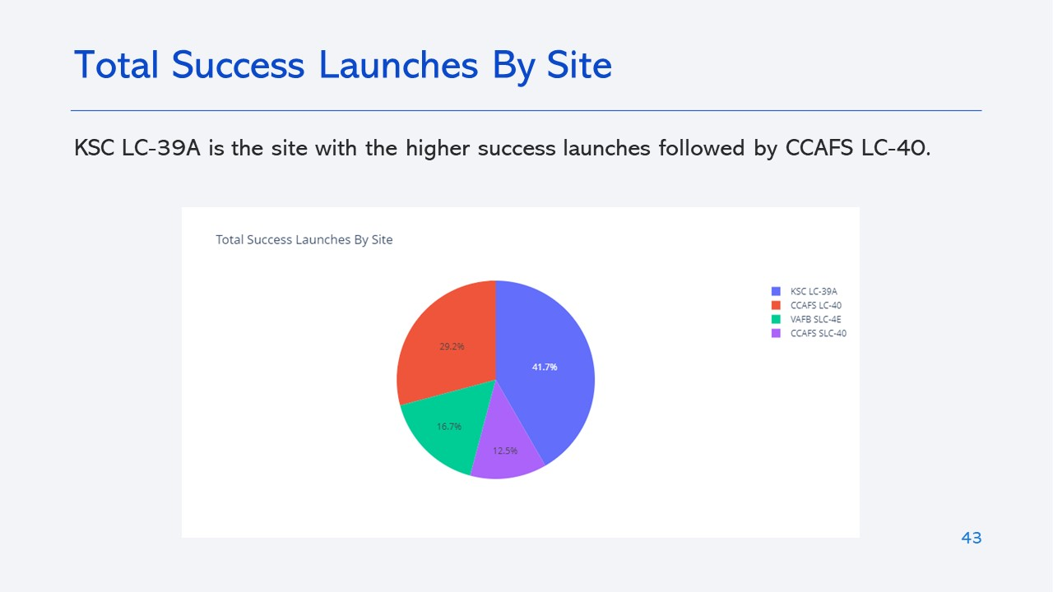
4.2. Dashboard with Plotly Dash
Sites near sea selected due to safety, not far from roads / railroads

Slide 44
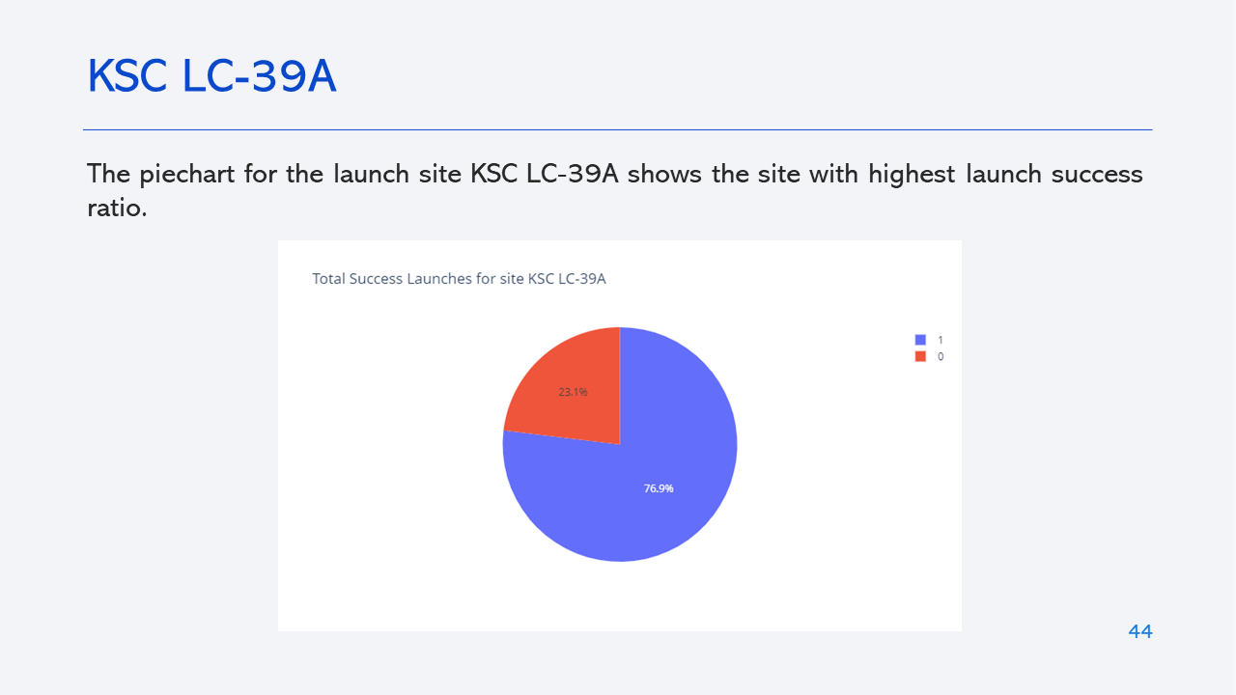
4.2. Dashboard with Plotly Dash
Sites near sea selected due to safety, not far from roads / railroads

Slide 45
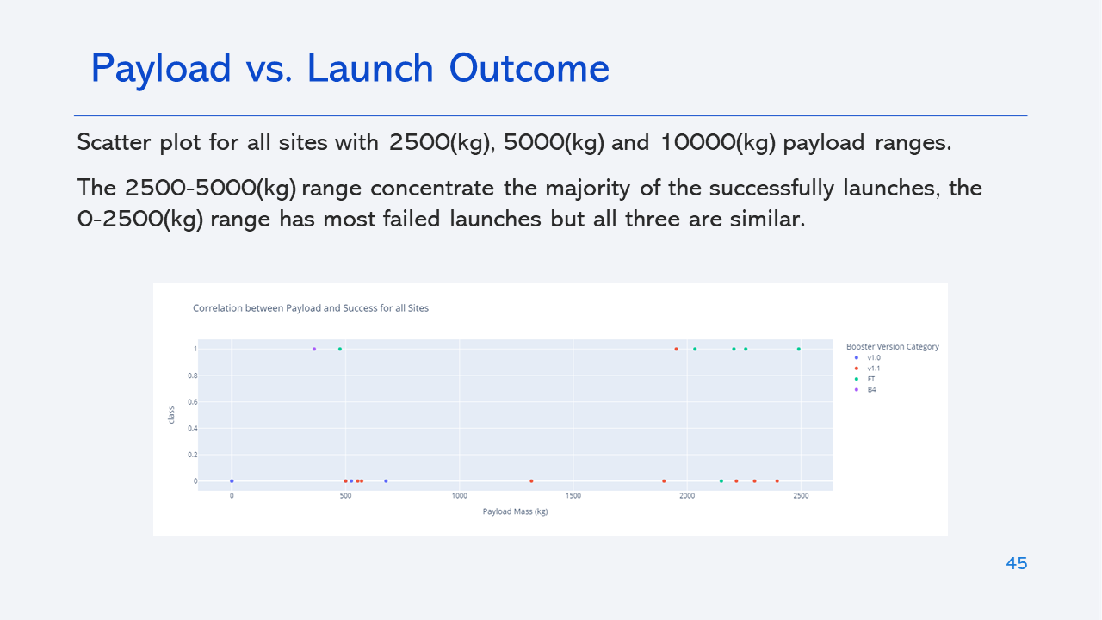
4.2. Dashboard with Plotly Dash
Sites near sea selected due to safety, not far from roads / railroads

Slide 46
Section 6
Predictive Analysis

Slide 47
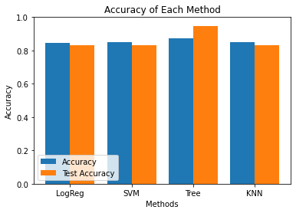
Classification Accuracy
Best model to predict successful landings: Decision Tree Classifier.
Accuracy: 87+%; Test Data Accuracy: 94+%.

Slide 48
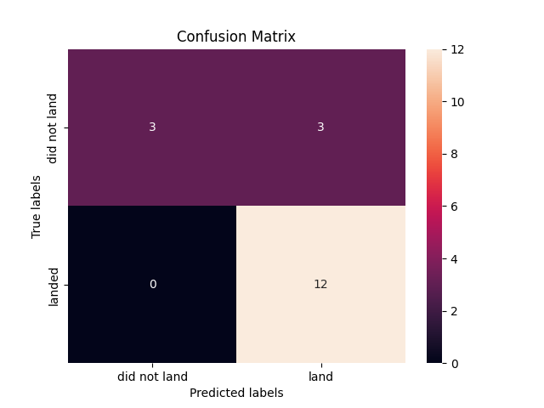
Predictive Analysis
Data Confusion Matrix proves accuracy by showing numbers of true positive and true negative vs false.

Slide 49
Section 7
Conclusions

Slide 50
Main Conclusions
Different data sources were analyzed and conclusions were refined with them;
The best launch site is KSC LC-39A and launches above 7,000kg are less risky;
Landing outcomes improve over time due to evolution of technology and processes;
Best performing models among four algorithms were sized;
Decision Tree Classifier outperformed others by 5%, with 88% accuracy;
Accuracy is key to decision making, but must be refined as false positive rate is 0 and negative 0.5;
With historical data, model predicted successful launches, but half of failed launches were also classified as successes;
It is key to SpaceY's business success to continuously improve the model by introducing the always evolving DS technologies and methods (see Recommendations)

Slide 51
Recommendations to SpaceY Board – Identifying the GAP
CRITERIA
AS-IS (NOW)
GAP
TO-BE (2050)
GLOBAL POPULATION
7.9 BILLION
9.8 BILLION
INTERNET USERS
5.0 BILLION (63%)
8.9 BILLION (90%)
AVAILABLE DATA
1,000 ZETABYTES
500,000+ ZETABYTES
GLOBAL ROBOT
WORKFORCE
9.4 BILLION
3.5 MILLION (0.003 BILLION)
GLOBAL IT INDUSTRY TECHNOL/PROCESS
CLOUD COMPUTING
ARTIFICIAL INTELLIGENCE
MACHINE LEARNING
QUANTUM COMPUTING
NEW NETWORKING TECHNOLOGIES
CLEAN ENERGIES
DATA SCIENCE
STATE OF ART
SQL
REALTIONAL DATABASES
NEURAL NETWORKS
ROBUST ANALYTICAL MODELS
SECURE PLATFORMS-CYBERATTACKS
HUMAN EMOTIONS DETECTION
AEROSPACE
INDUSTRY
ACCESS TO PRIVATE SECTORS
CONTINUOUS LEARNING
1ST STAGE RECOVERY
1,000 STARSHIPS TO MARS
100+ TIMES CHEAPER VS TODAY
ASTEROIDS MINING DEVELOPMENT
CRITICAL SUCCESS FACTORS (CSF)
DATA MINING / INTERPRETATION
BUSINESS FORECASTING
SMART DECISION MAKING
DS PROFS CONTINUOUS LEARNING
EFFICIENCY ADVANCED TOOLS
IT ORGS SHARING BUDGETS

Slide 52
SpaceY Board – Addressing 2050 vs 2020 GAP Initiatives
SpaceY needs to provision enough budget for Data Science professionals to:
Augment business process, amplifying databases for human-machine interactions;
Incorporate interdisciplinary concepts (sociology / psychology);
Amplify social media as source of data (Twitter, Facebook, others);
Develop Team Activity (from creating models to how to use once built them);
Increase Cybersecurity skills (safeguard business data);
Be ready for a growing Cloud Computing prevalence;
Bring apps to capture workflows and train on best practices;
DS Coding and AI essentials, but develop also more bussines oriented;
Quantum leap initiation. Algoritms to solve real-time problems.

