Slide 1
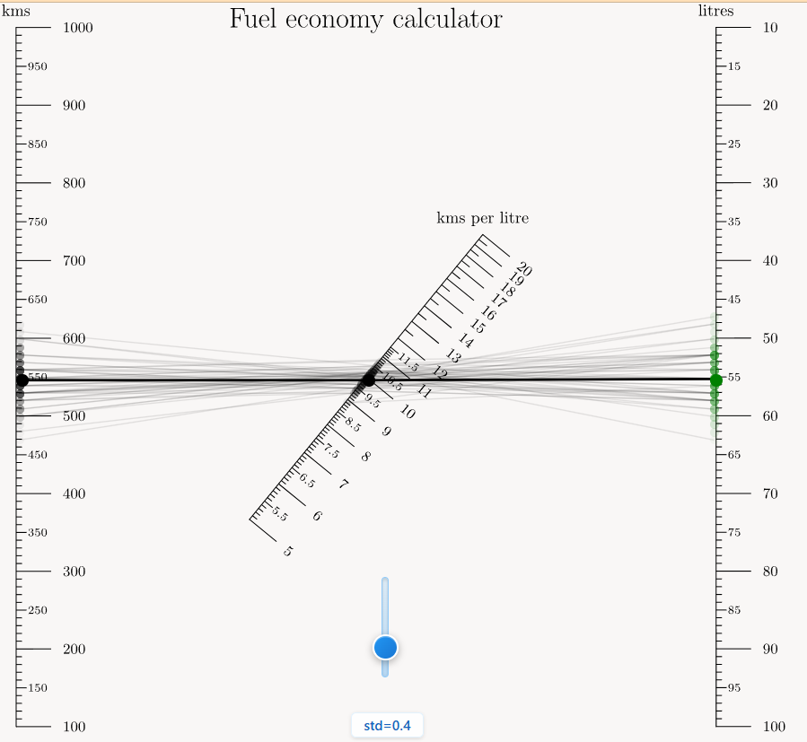

Probabilistic Nomograms
Level 4 Project
Student: Antonios Liles, 2578195L
Supervised by Dr John Williamson

Slide 2
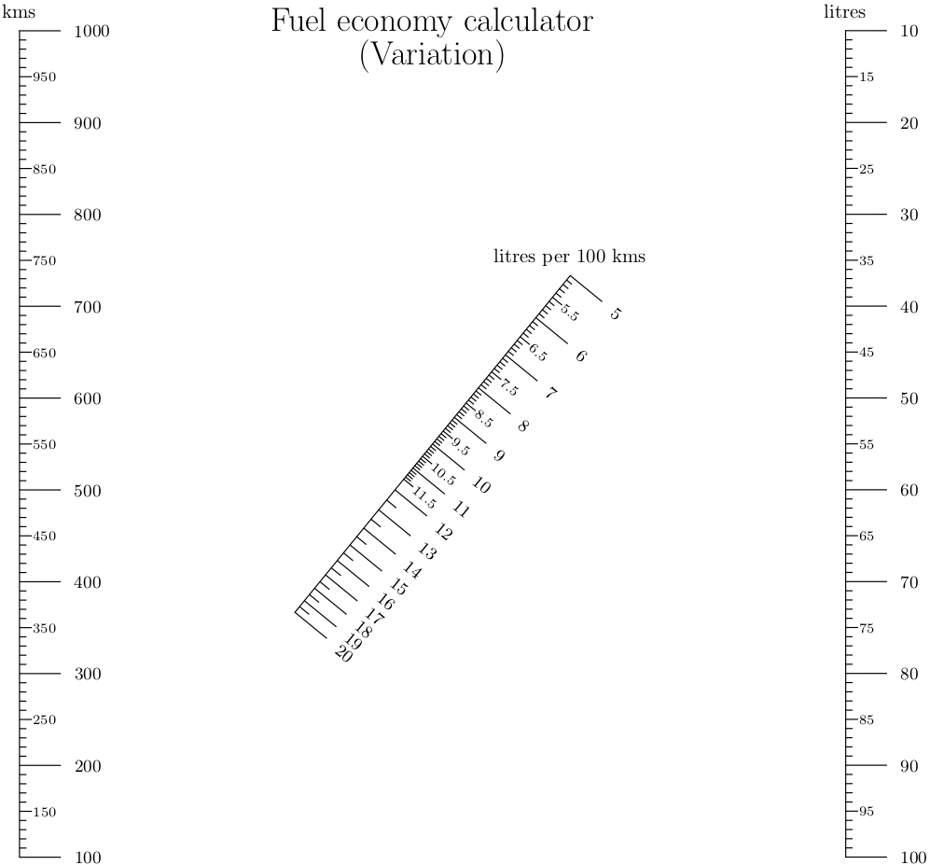
Traditional Nomograms
Graphical calculator
Ruler operated
Visualization tool
Exact inputs/outputs

Slide 3
Probabilistic Nomograms

Slide 4
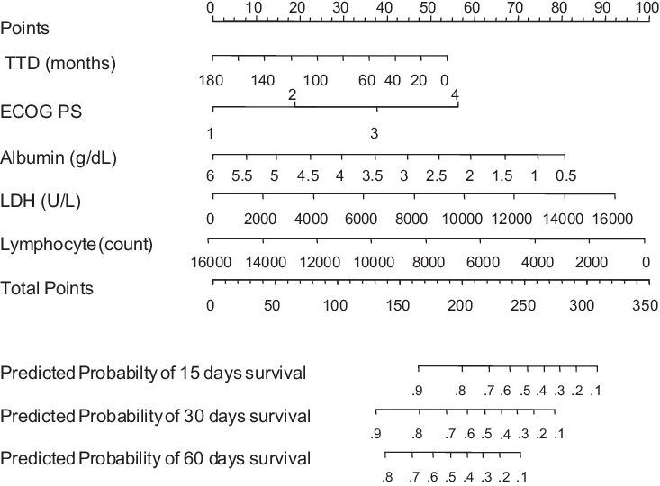
Dissertation overview
2. Background
History:
Devised in 1884
Was used by engineers
Now:
Visualization tool
Medicine
Finance

Slide 5
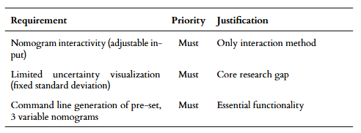
Dissertation overview
3. Requirements
MSCW table
User story: Nursing
Supplier (vendor)
Operator (nurse)
Viewer (patient)

Slide 6
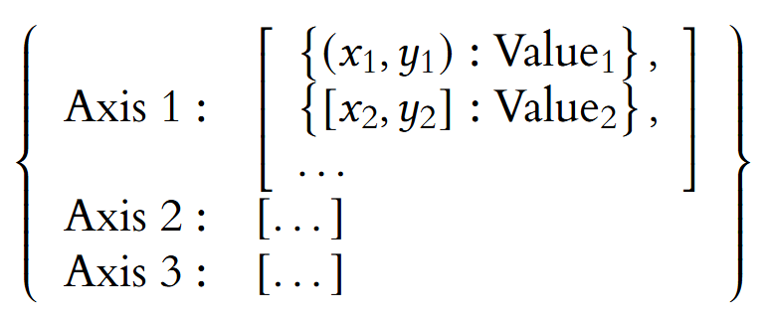
Dissertation overview
4-5. Design/Implementation
Choose nomogram
PyNomo generates image
Values + Coordinates extracted
Interactive nomogram generated
Uncertainty:
Noisy circles & lines around input

Slide 7
DEMO
Live link:
Interactive
Uncertain Input
Uncertain Output
Variable std
Full instructions on README file

Slide 8
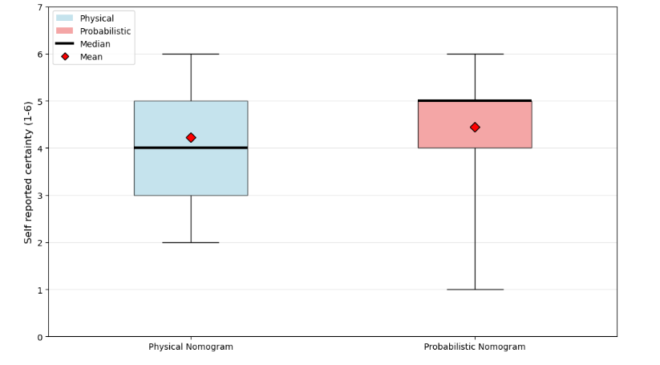
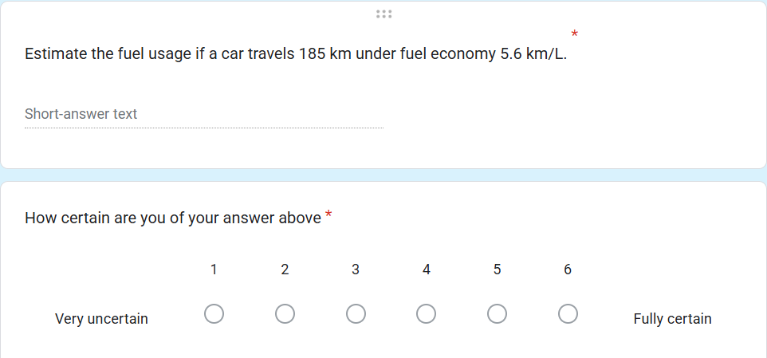
Dissertation overview
7. Evaluation- Simple tasks
N = 9
Computation & confidence score
Physical vs Probabilistic

Slide 9
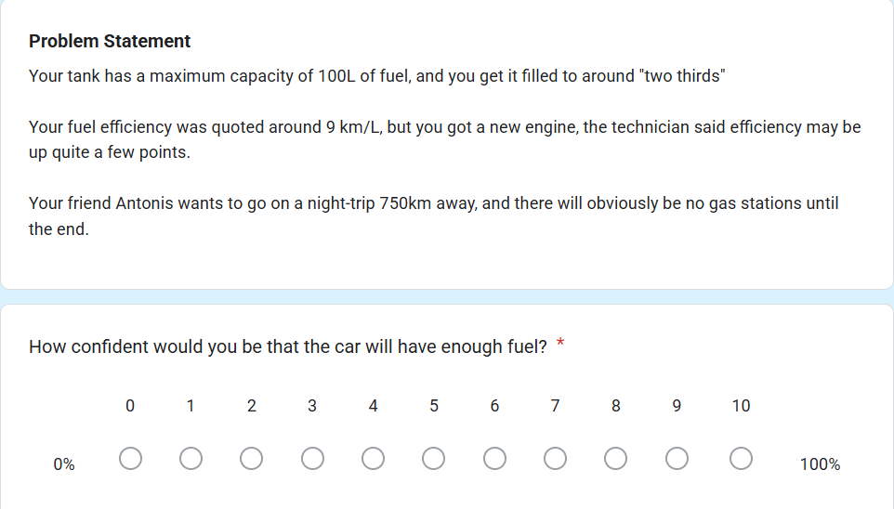
Dissertation overview
7. Evaluation- Uncertain tasks

Slide 10
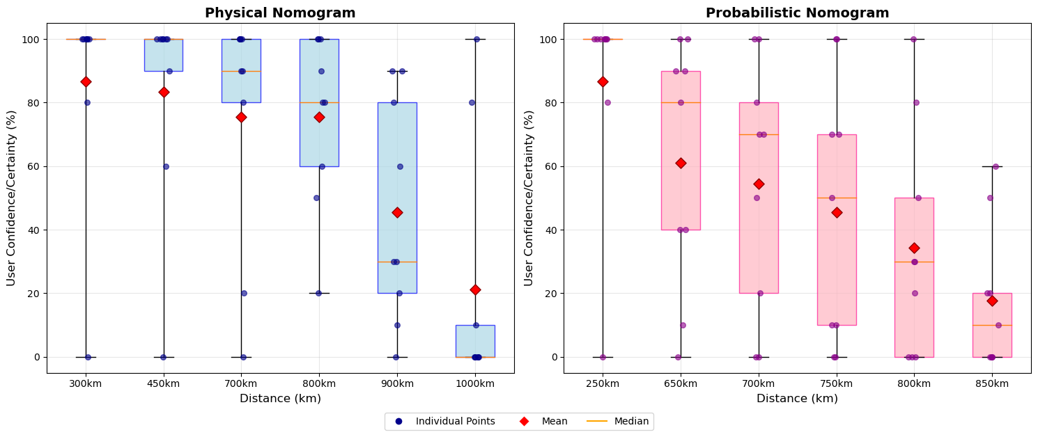
Dissertation overview
7. Evaluation- Uncertain tasks

Slide 11
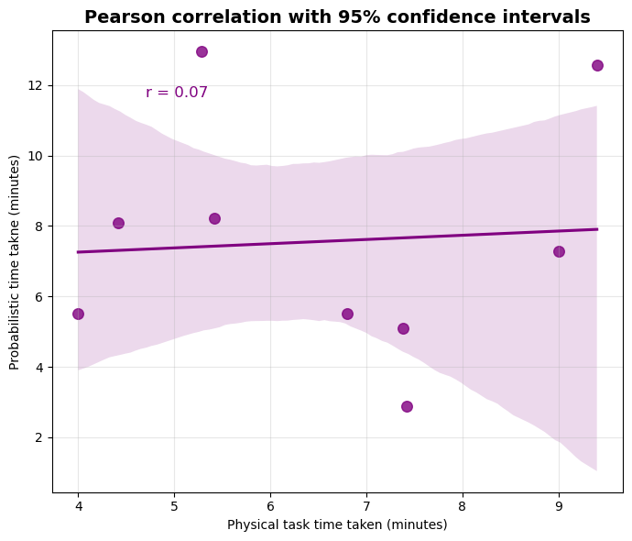
Dissertation overview
7. Evaluation : Time taken

Slide 12
Dissertation overview
8. Summary
Successful development
Users enjoyed the software
Noisy results
Building could be simpler
3+ axes?
😊

