Slide 1


Welcome to the Foodure.
This is a work of fiction. Any similarity to actual apps, Netflix or chilling, or actual events, is purely coincidental.

Slide 2
What is Foodflix?
This app was developed as a learning exercise for Project Future Mobile apps branch, powered by Code.Hub
Foodflix is a recipe app aimed at everyone! No subscription required!
The app allows you to retrieve recipes from a server, and filter them to find what you need.

Slide 3
Base Functionality
User accounts: You can create an account, but only if you want to!
Recipes: Shown in a list, browse to find the one you want.
Pick a recipe, start cooking!
Cooking can take a while, TV shows sold separately.

Slide 4
Extended Functionality (TBD)
Users: Favourite recipes, recommendations, friend requests, followers, shopping list.
Recipes: Feature of the month, most popular, trending, limited ingredients recipe finder (student mode).
Diversity: Checkboxes for gluten free, vegan, pescatarian, meat lover, allergy filters.
Trending ideas (could expire soon): Challenges, swipe recipes left/right and match, cooking streams, meet and eat events.

Slide 5
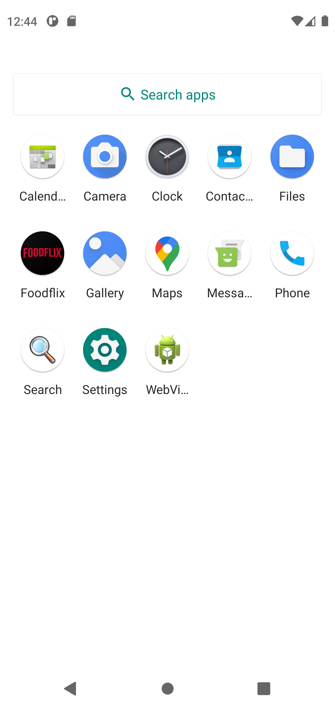
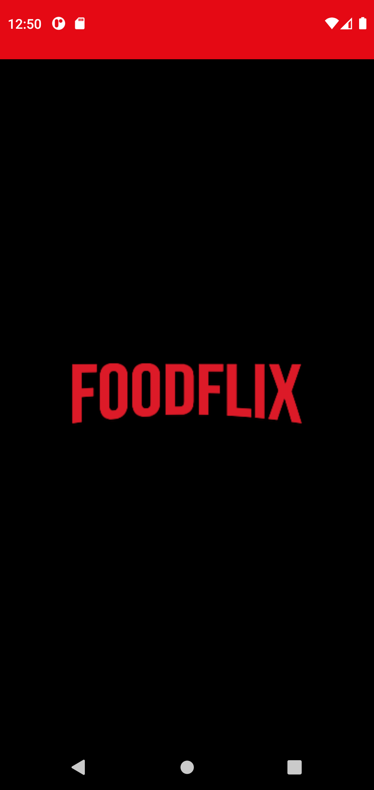
In the beggining...
Super fancy
launcher icon!
Super original
Splash screen!

Slide 6
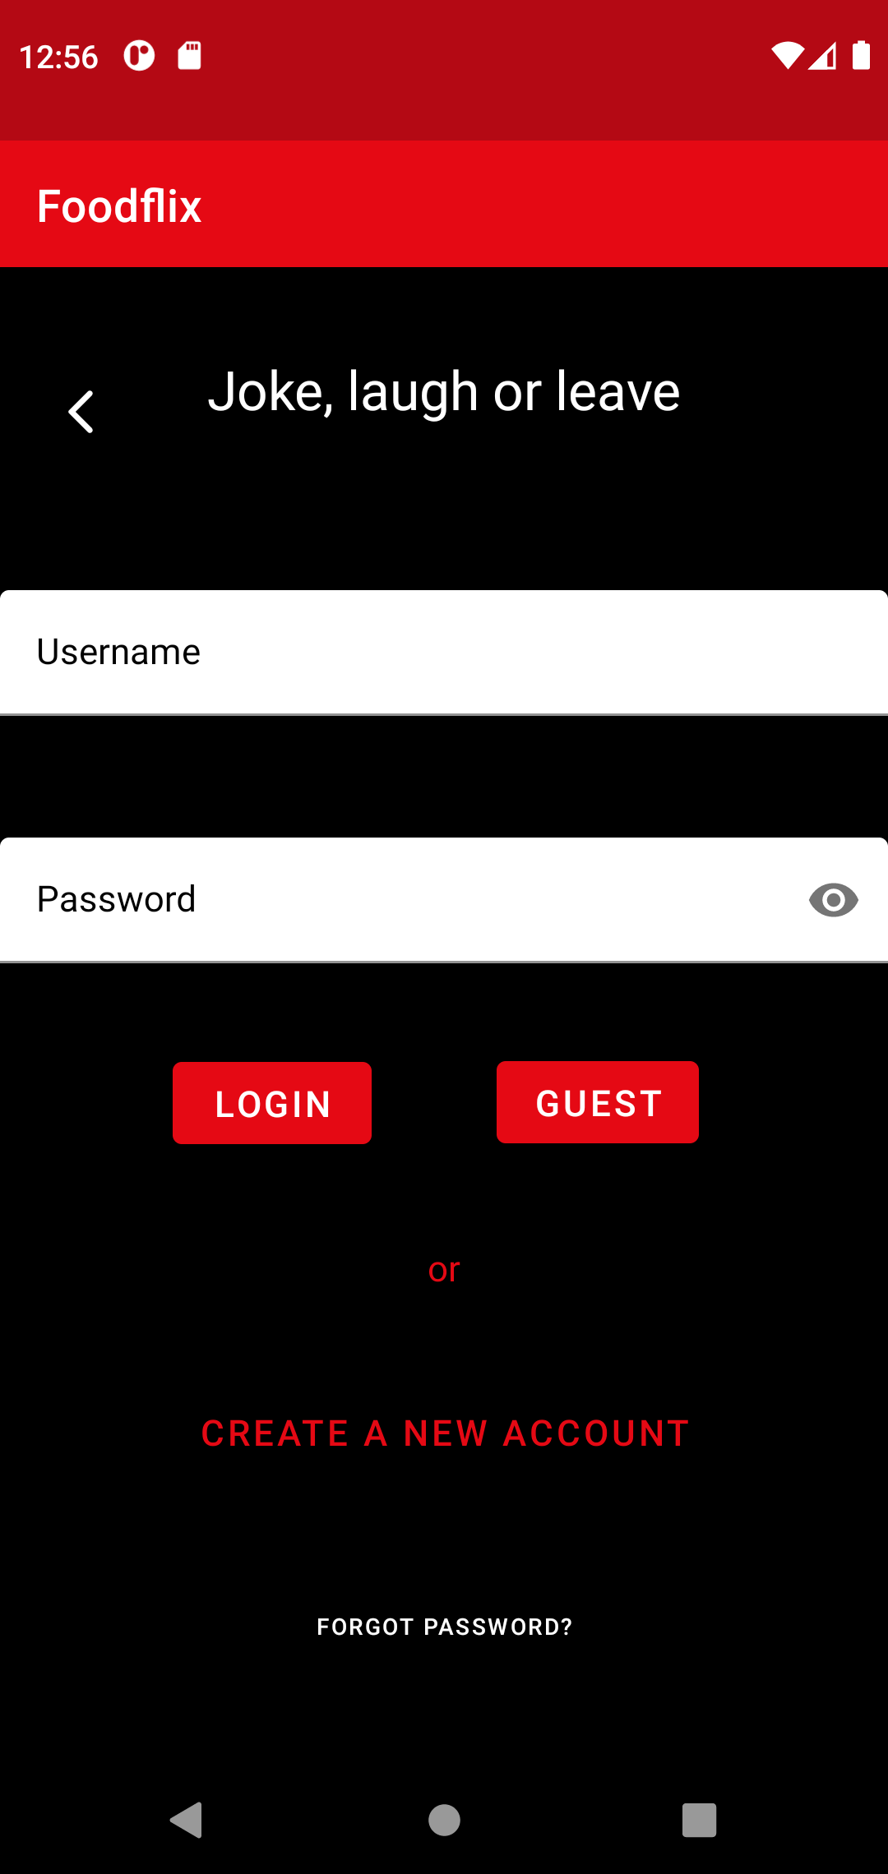
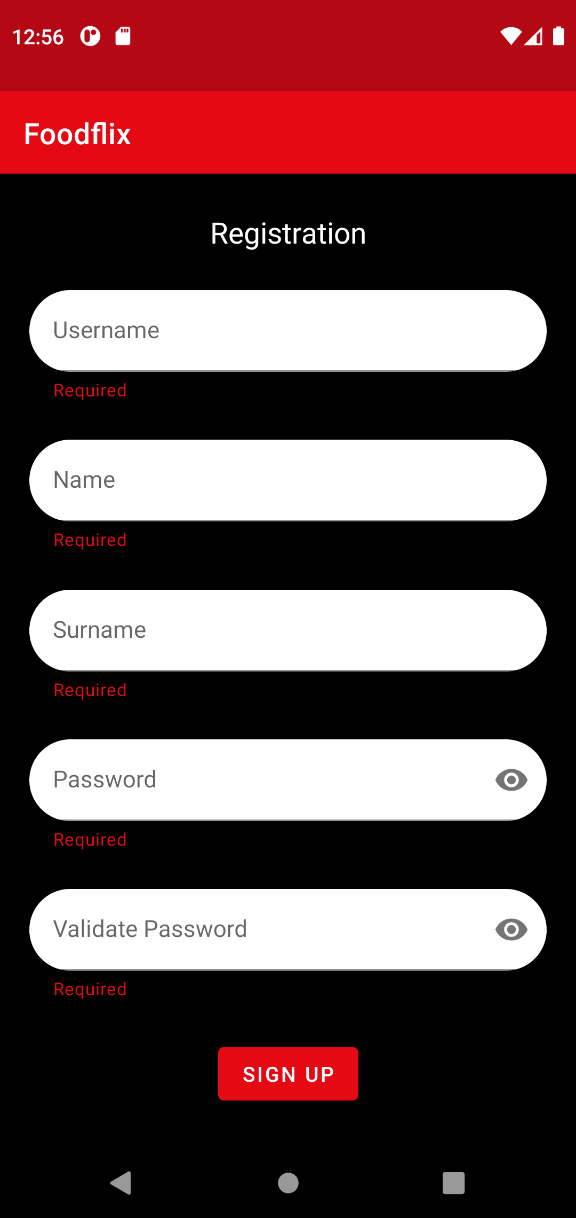
The second step...
Super simple login
page, self explaining
UI. If you need to explain,
It probably isn’t user friendly. Who reads the manual anyway?
Registration page, basic
requirements in place, explained by toast messages. See what we did there? Toast. Our favourite recipe.

Slide 7
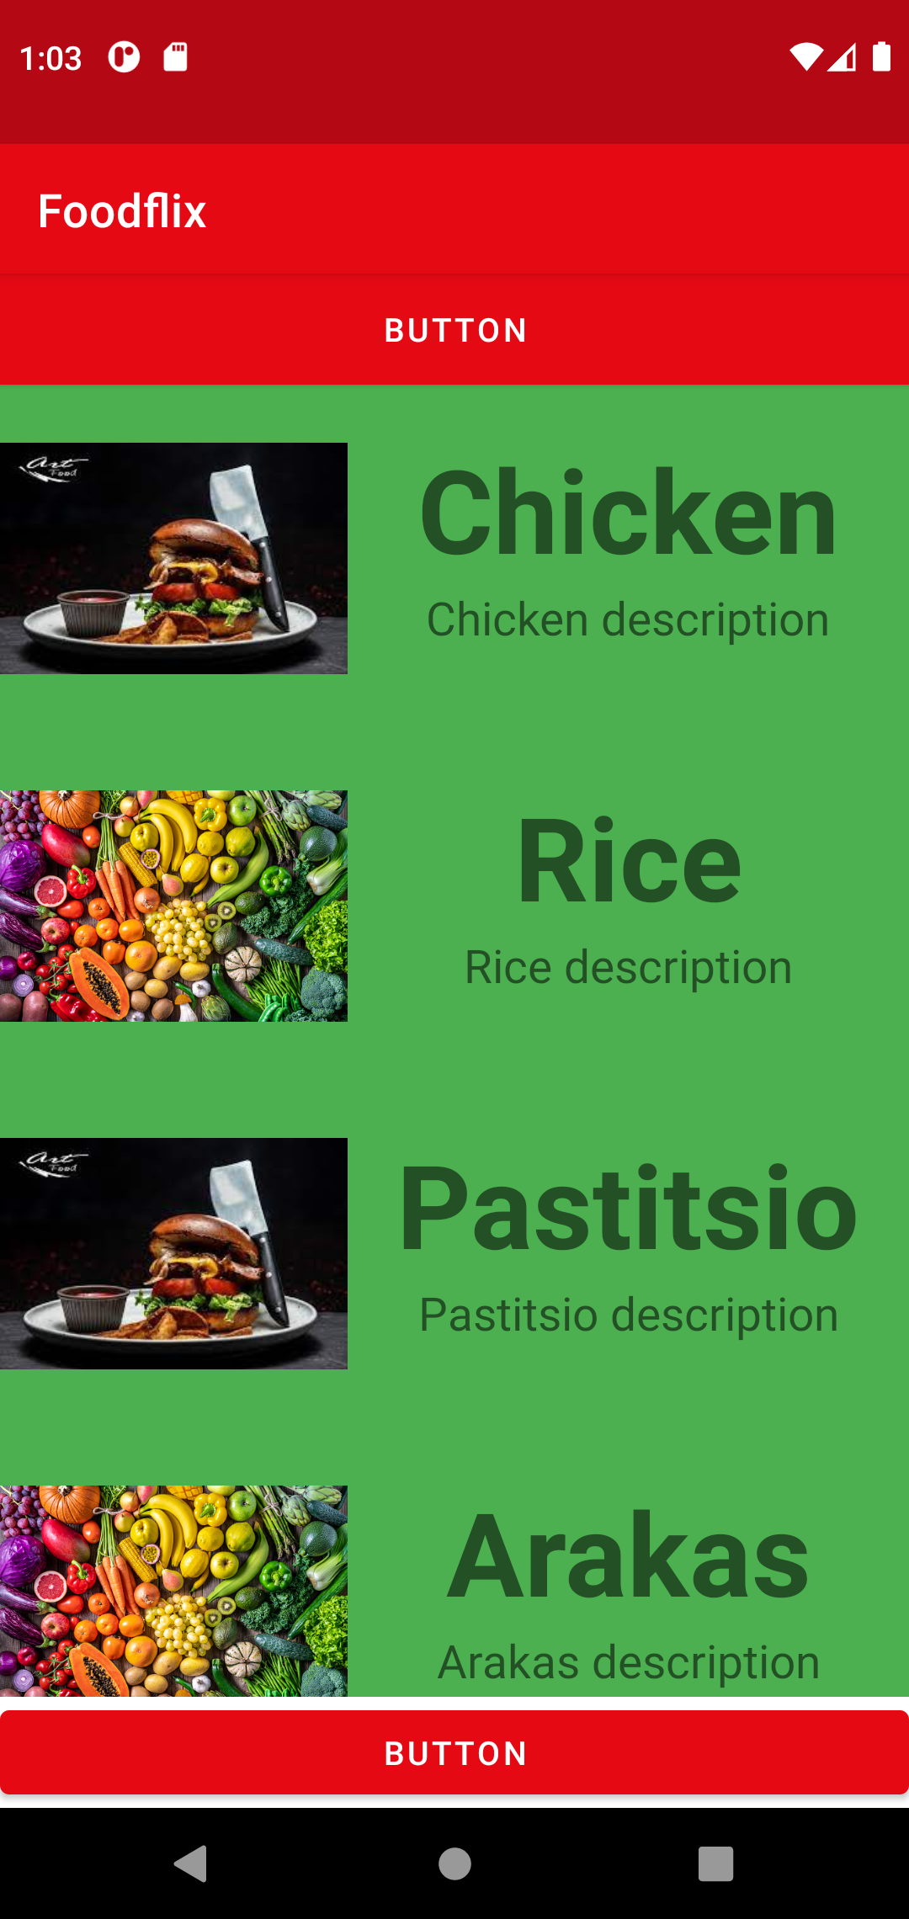
And finally...
Recipe list… Yummy! Time to cook!
Your recipe in detail… You’d better set your screen off timer to 30 minutes.

Slide 8
Thank you!
We’d like to thank everyone who helped us in our journey. This has definitely been a blast!
We’re off to dinner now, see you at the Play Store!

