Slide 1
Diversified Portfolio Stock Selection Agents
Reworking Markowitz model with RL

Slide 2
Reworking Markowitz Model
min Risk(x) such that….
TWO AGENTS
Agent 1: Says if it likes some stock
Agent 2: Gives some other constraint to make quadratic program have a non-trivial solution

Slide 3
Paper 0
What RL algorithms should we use?
Value Based -> Predict the exact reward
e.g. DQN
Policy Based -> Predict the probability of taking some action
e.g. DDPG, PPO

Slide 4
Paper 1
Used two agents to trade Bitcoin for long buys.
One of the two agents is similar to what I would like to do.
Starts with owning 0 units of BTC.
At each timestep, agent either buys an extra unit
or stays neutral
or sells everything it owns.

Slide 5
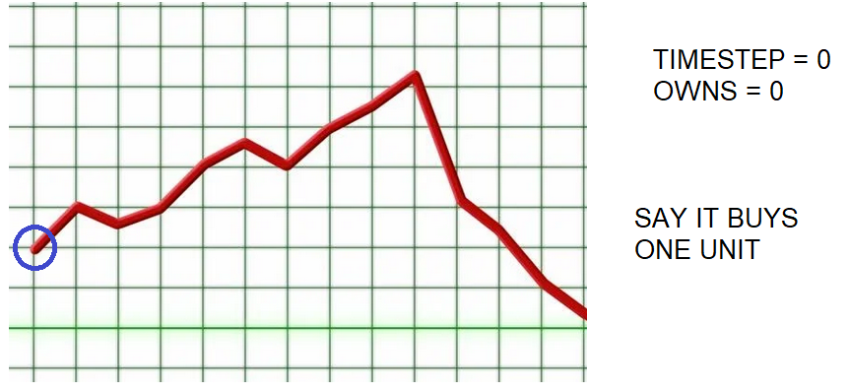

Slide 6
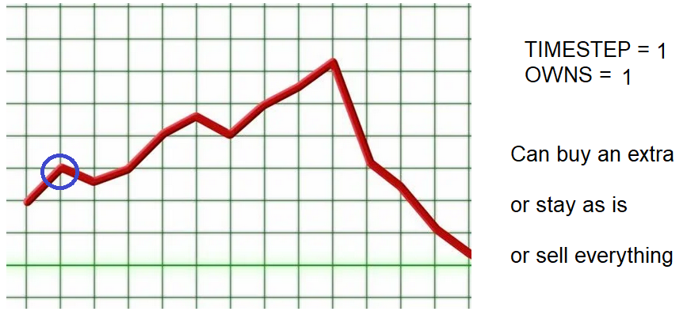

Slide 7
Paper 1
Reward is +1 for profitable units
and -1 for non-profitable units
Three notes:
Trains using DQN
Clips the reward
Allows stacking of units

Slide 8
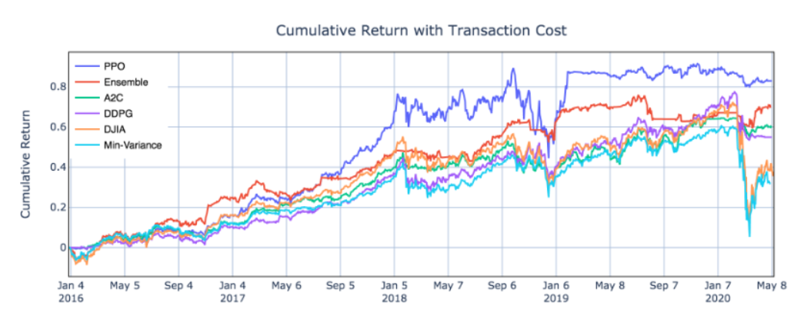
Paper 2
This paper compares all the policy based algorithm

Slide 9
Other Papers
Most papers use DQN
Force diversification

