Slide 1
Report on VGG-16 (PyTorch) Training on ImageNet
Matiur Rahman Minar
2019. January. 02

Slide 2
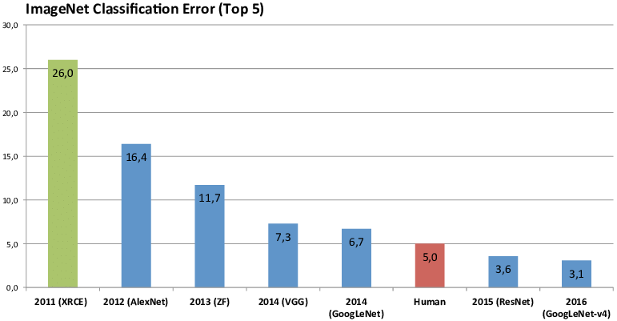
Motivation

Slide 3
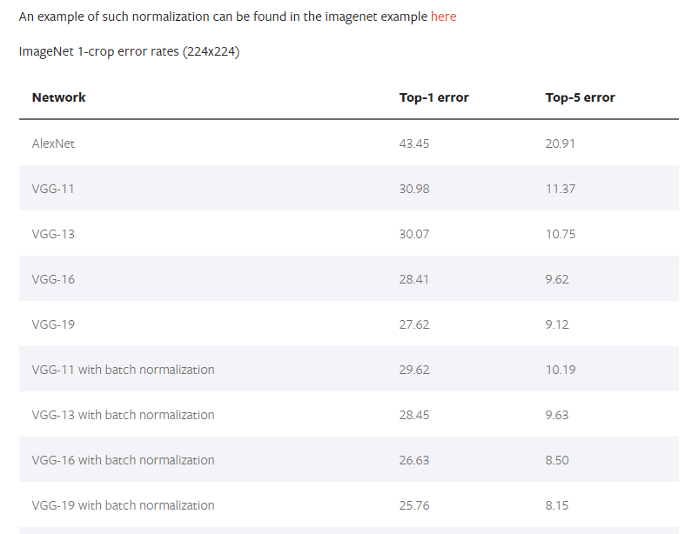
Background

Slide 4
Method
Prepare ImageNet Dataset
Prepare Dataset for PyTorch dataloader
Prepare training script
Prepare PyTorch example Script with dataset folders
Start training
Run the Training Script with Suitable Arguments

Slide 5
Prepare ImageNet Dataset
Download the ImageNet dataset and unzip the training and validation datasets
Move validation images to labeled subfolders using this script: https://raw.githubusercontent.com/soumith/imagenetloader.torch/master/valprep.sh

Slide 6
Prepare Training Script
Get script from PyTorch examples: https://github.com/pytorch/examples/tree/master/imagenet
Modify dataset paths for training and validation folders
Modify any other parameters if needed

Slide 7
Start Training
Run the training script with necessary arguments: https://github.com/pytorch/examples/tree/master/imagenet

Slide 8
Function Hierarchy
Main
Main_worker()
Create Model
Torchvision.models
Define Functions
Loss & Optimizer
Define Dataloaders
Train & Validation
Start Epochs
training
Train()
Validate()
Save Model

Slide 9
Experiment
Model | VGG-16
Batch Normalization | Yes (Conv layers)
Library | PyTorch
Source | TorchVision models (PyTorch Examples)
Weight Initialization | Kaiming (Conv layers)
Dropout ratio | 0.5 (First two FC layers)
Weight Regularization | L2 decay
Optimizer | SGD + Momentum 0.9
Learning Rate | 0.01 (initially, decreased exponentially every 30 epochs)
Batch Size | 16 (Because of OOM error)
Training Epochs | 52
Output Classes | 1000
Dataset | ImageNet (Training: 1281167, Validation: 50000)

Slide 10
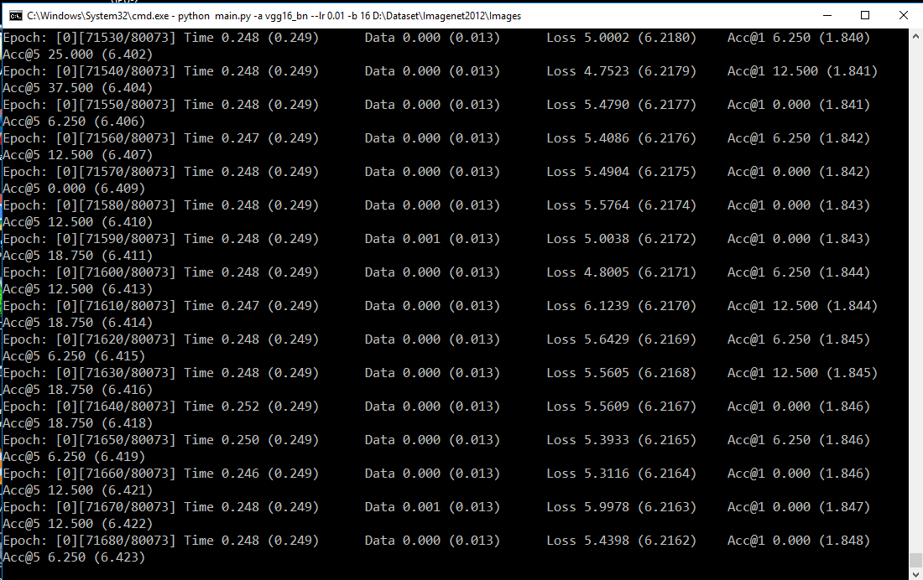
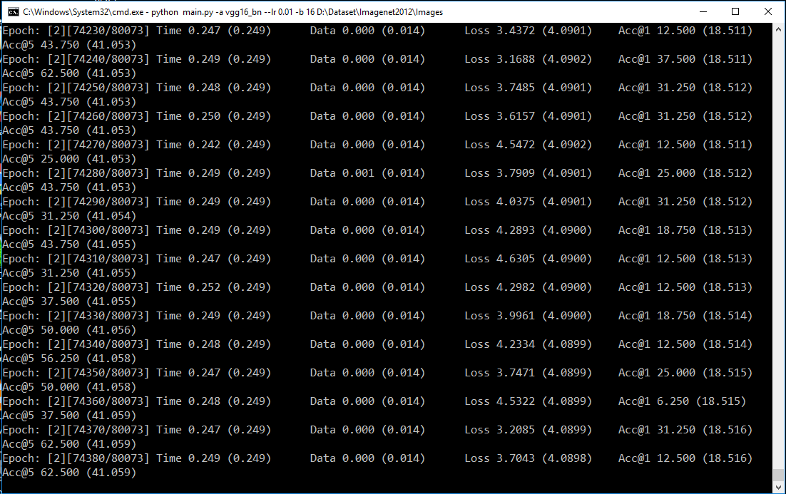
Training 1

Slide 11
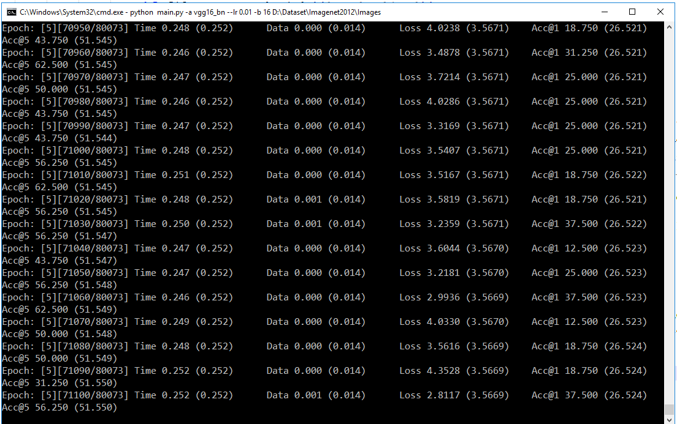
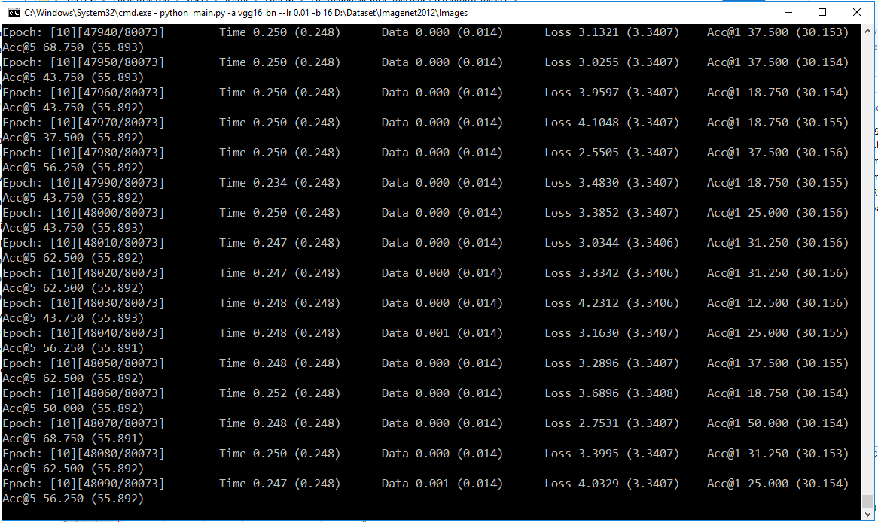
Training 2

Slide 12
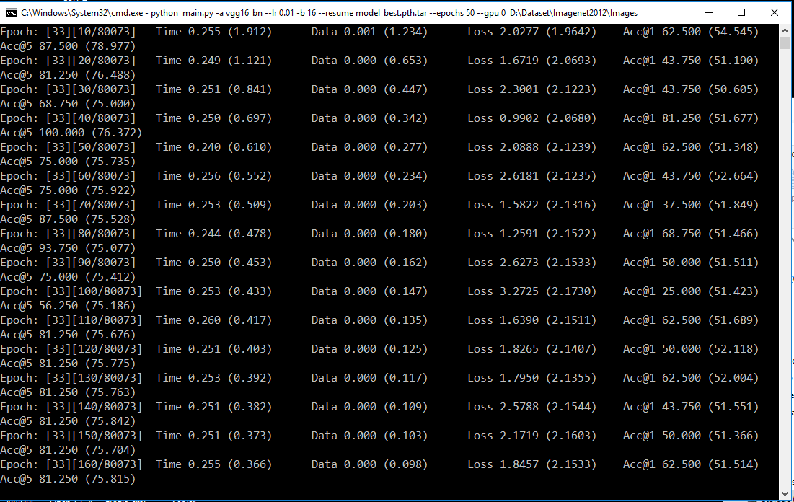
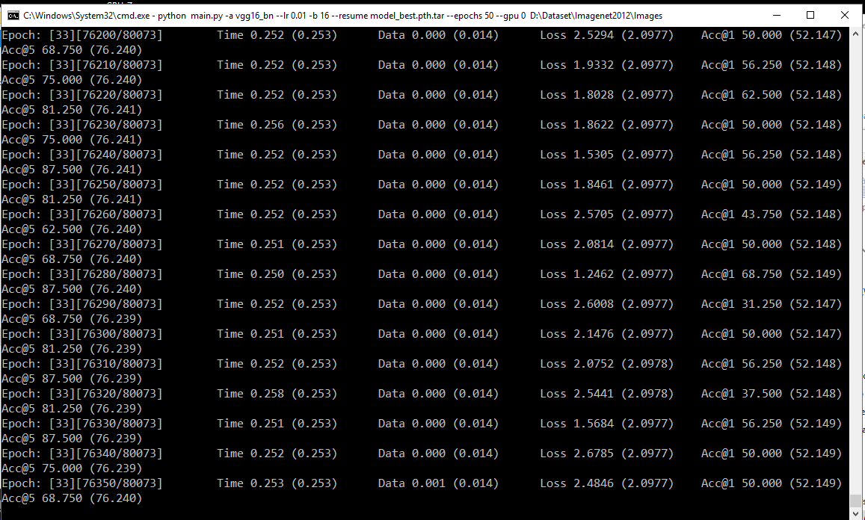
Training 3

Slide 13
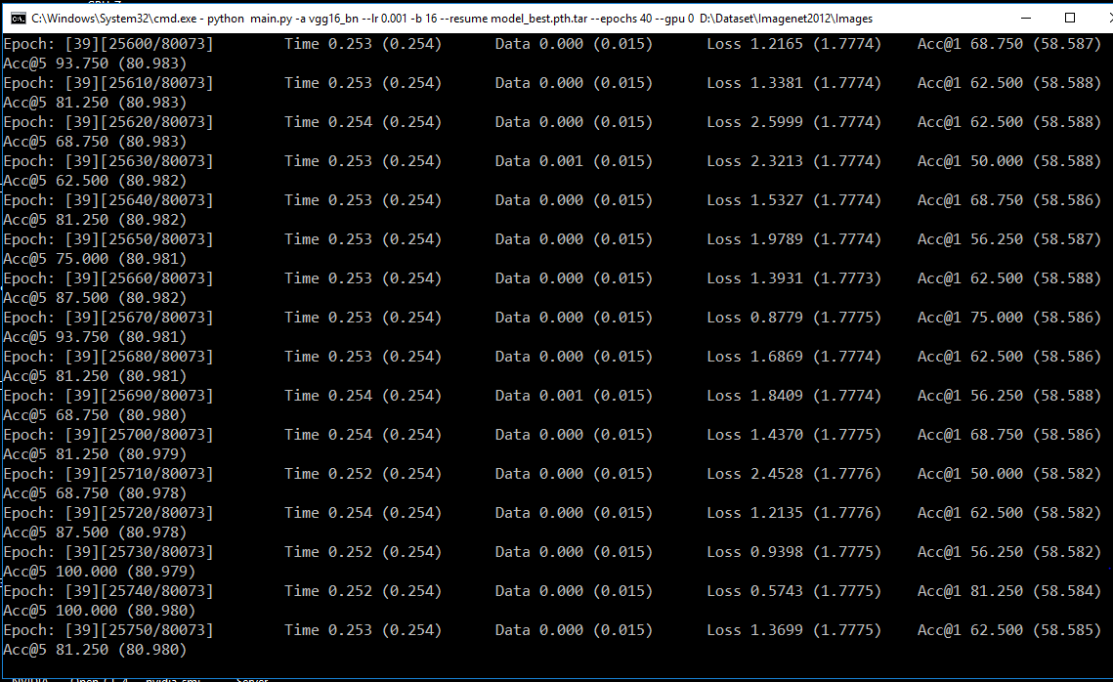
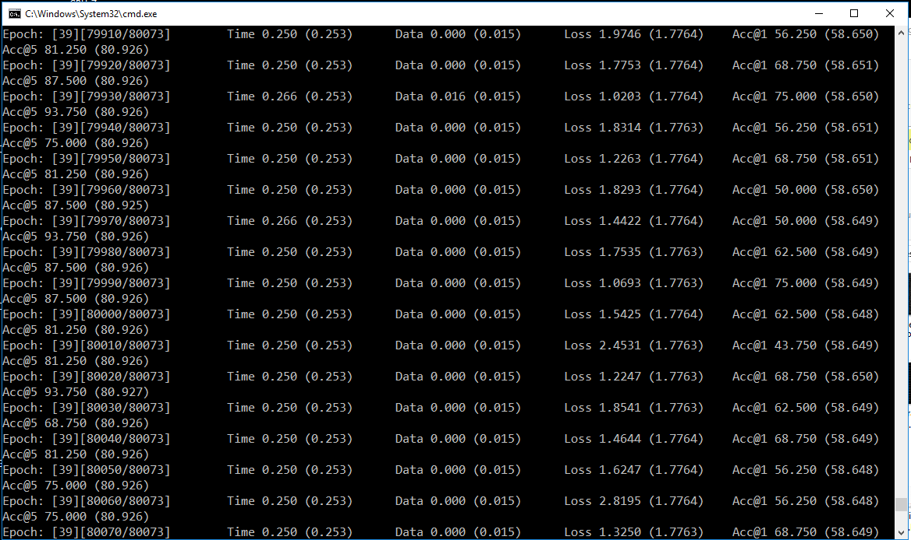
Training 4

Slide 14
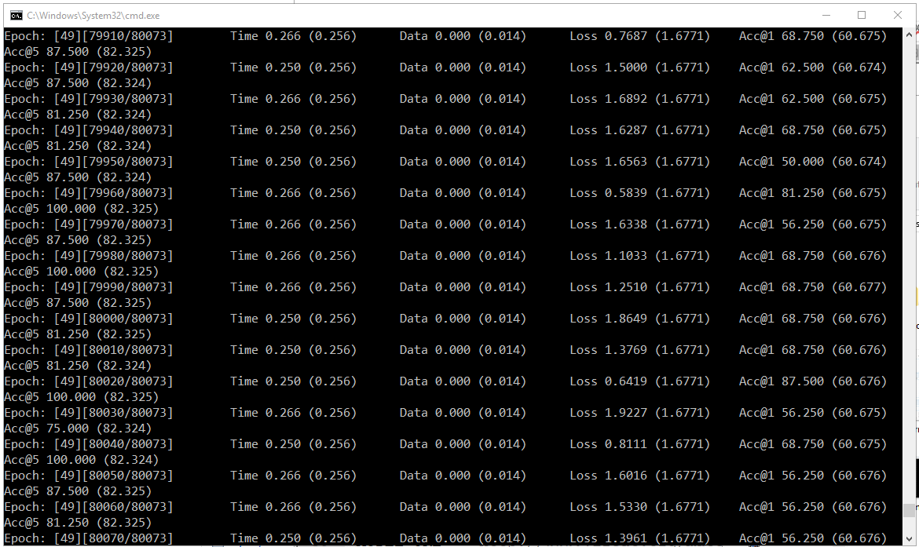
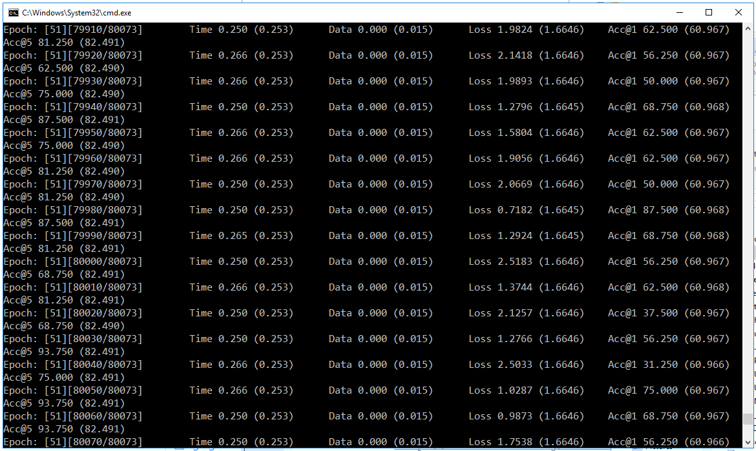
Training 5

Slide 15
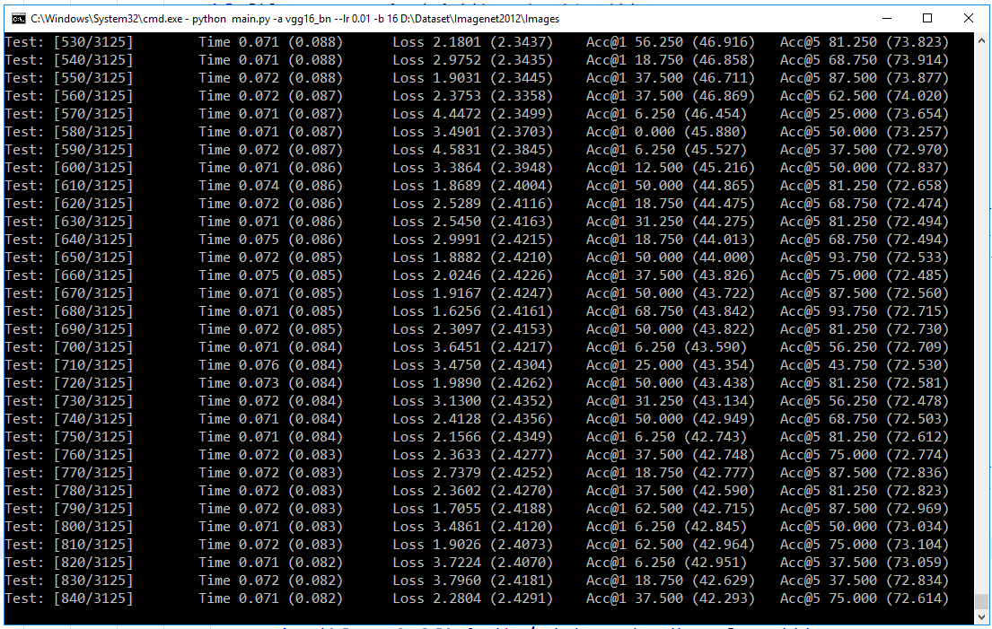
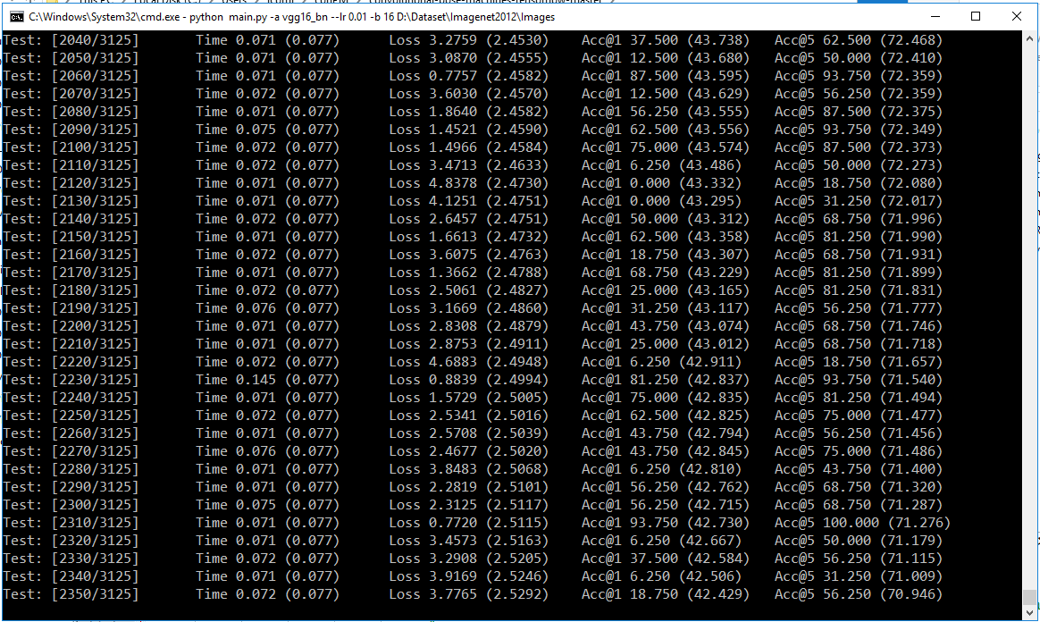
Validation 1

Slide 16
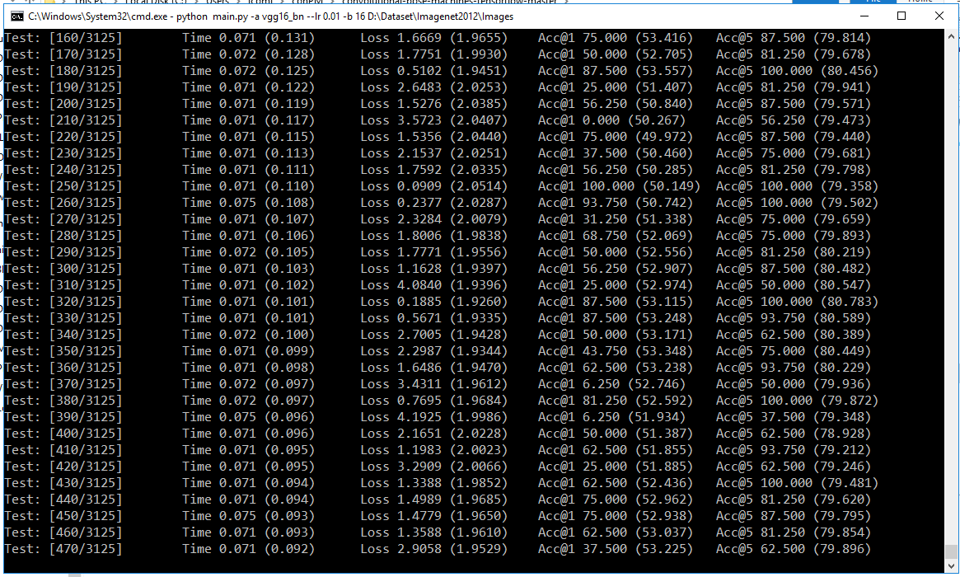
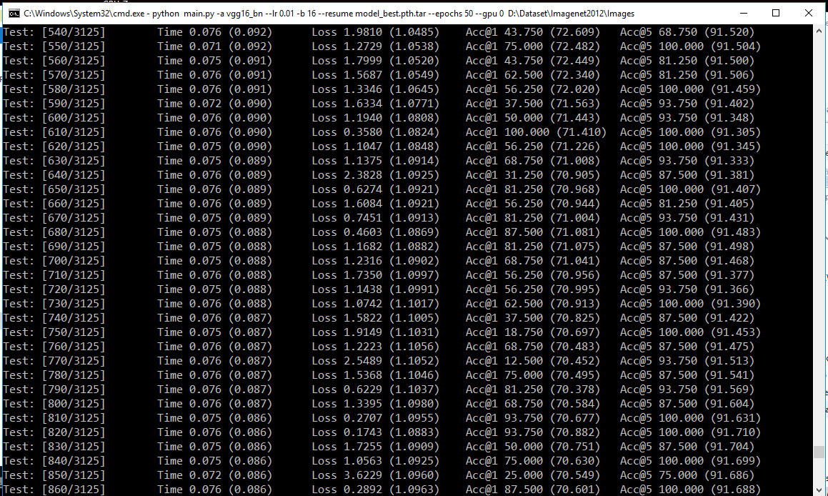
Validation 2

Slide 17
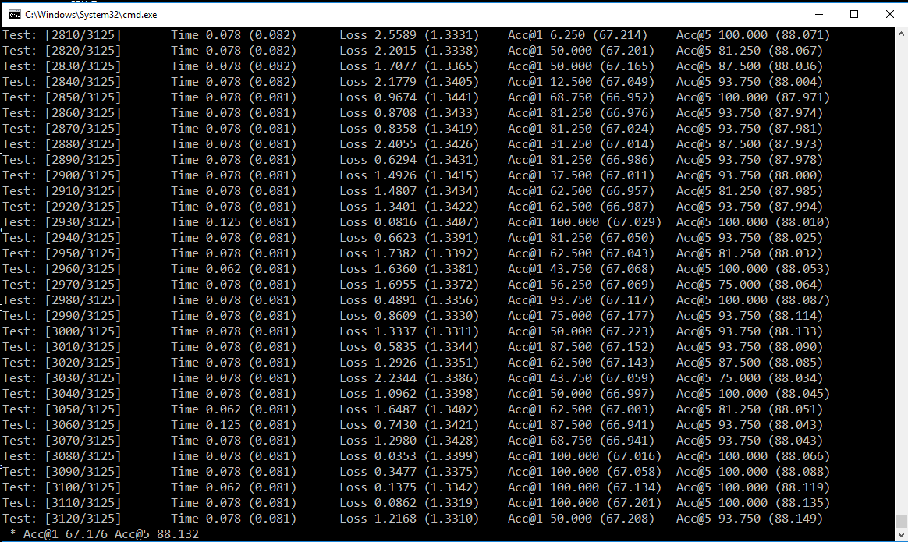
Validation 3

Slide 18
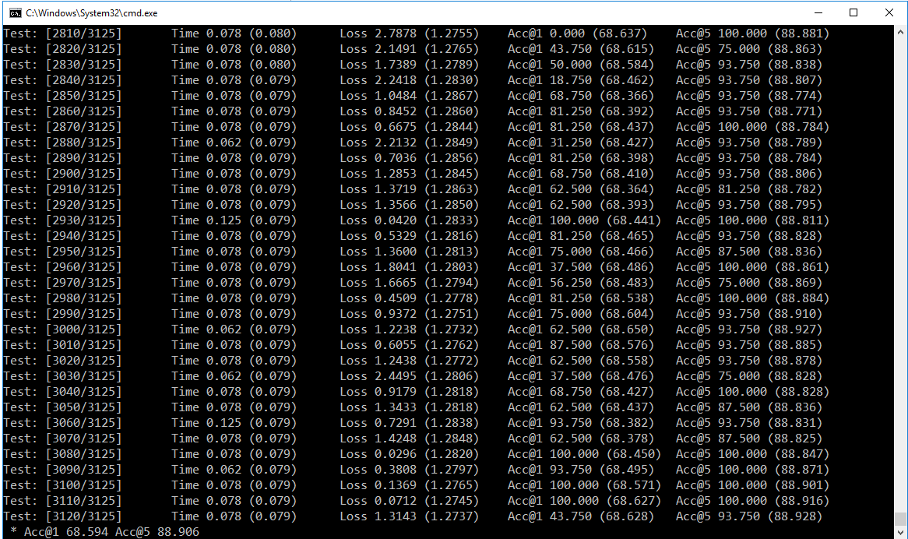
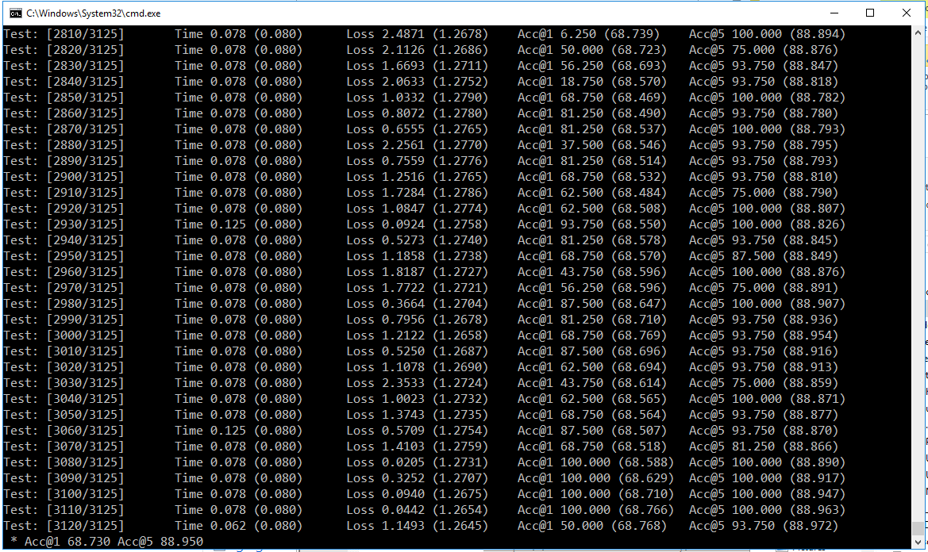
Validation 4

Slide 19
Results
# | Result | PyTorch Model Original
Epochs | 52 | 90
Training accuracy – Top 1 | 0.61
Training accuracy – Top 5 | 0.82
Validation accuracy – Top 1 | 0.69
Validation accuracy – Top 5 | 0.89
Batch training time (seconds) | 0.25
Batch validation time (seconds) | 0.09
Training Loss | 1.66
Validation Loss | 1.26
Validation Error – Top 1 | 0.33 | 0.2663
Validation Error – Top 5 | 0.12 | 0.0850

Slide 20
Discussion
Accuracy seems to be improving with more number of epochs
May able to achieve the original model performance
Plot a curve for loss/accuracies
Check what was wrong with tensorflow
Need to train with multiple gpus

