Slide 1
Machine Learning

Slide 2
Introduction
A heart attack occurs when the flow of blood to the heart muscle suddenly becomes blocked. From WHO statistics every year 17.9 million dying from heart attack. The medical study says that human lifestyle is the main reason behind this heart problem. Apart from this there are many key factors which warns that the person may/may not getting chance of heart attack.
This project will focus on predicting heart disease using machine learning.
We have a dataset which classified if patients have heart disease or not according to features in it. I will try to use this data to create a model which tries predicting if a patient has this disease or not.
We will be using some common Python libraries, such as pandas, numpy, seaborn and matplotlib. Furthermore, for the machine learning side of this project, we will be using sklearn.
The machine learning methods used in this project are:
Logistic Regression
K-Nearest Neighbor (kNN)
Support Vector Machine (SVM)
Decision Tree
Random Forest

Slide 3
About the Dataset
About the Dataset
I found this dataset (heart.csv) on Kaggle. It has 303 patients and contains 14 variables (features), 9 categorical and 5 continuous.
The structure of the dataset is given below:
age - age in years
sex - (male=1, female=0)
cp - chest pain type
0: Typical angina: chest pain related decrease blood supply to the heart
1: Atypical angina: chest pain not related to heart
2: Non-anginal pain: typically esophageal spasms (non-heart related)
3: Asymptomatic: chest pain not showing signs of disease

Slide 4
About the Dataset
About the Dataset
4. trestbps - Resting blood pressure (in mm Hg on admission to the hospital)
5. chol - serum cholesterol in mg/dl
6. fbs - (fasting blood sugar mg/ml)
0: Less than 120 mg/ml
1: Greater than 120 mg/ml
7. restecg - Resting electrocardiographic results
0: Nothing to note
1: ST-T Wave abnormality
can range from mild symptoms to severe problems
signals non-normal heart beat
2: Possible or definite left ventricular hypertrophy
Enlarged heart's main pumping chamber

Slide 5
About the Dataset
8. thalach - Maximum heart rate achieved
9. exang - exercise induced angina (yes=1, no=0)
10. oldpeak - ST depression induced by exercise relative to rest looks at stress of heart during exercise unhealthy heart will stress more
11. slope - the slope of the peak exercise ST segment
0: Upsloping: better heart rate with exercise (uncommon)
1: Flat sloping: minimal change (typical healthy heart)
2: Downslopins: signs of unhealthy heart

Slide 6
About the Dataset
12. ca - number of major vessels (0-3) colored by fluoroscopy
colored vessel means the doctor can see the blood passing through
the more blood movement the better (no clots)
13. thal - thalassemia types
1: normal
2: fixed defect: used to be defect but ok now
3: reversable defect: no proper blood movement when excercising
14. target - have heart disease or not (1=yes, 0=no) (= the predicted attribute)

Slide 7
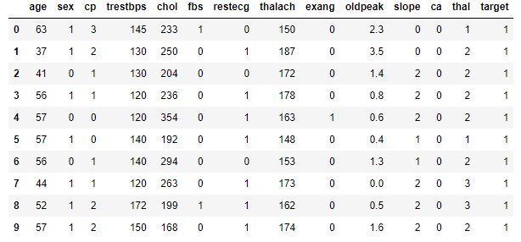
Data Analysis
Τhe csv file:

Slide 8
Data Analysis
-Checking the data for missing values (no missing value in the dataset).
-Renaming the column headers for better understanding of visualizations.
-Checking the dataset for wrong values:
Five patients having number of major vessels=4 which is incorrect (0-3)
Two patients having thalassemia type=0, which is incorrect (1-3)
The patients with the wrong values dropped, so the length of dataset now is 296 instead of 303 (296,14).
-Percentage of patients with presence of heart disease is 54.39% and percentage of patients with no presence of heart disease:
45.61%.
- Percentage of male patients is 68.58% and female patients: 31.42%.

Slide 9
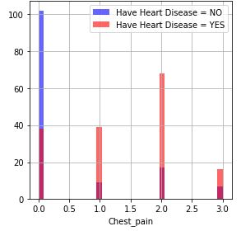
Data Analysis
-Let’s see the heart disease frequency based on the categorical features:
•Chest Pain: People with chest pain value equal to 1, 2, 3 are more likely to have heart disease than people with chest pain value equal to 0.

Slide 10
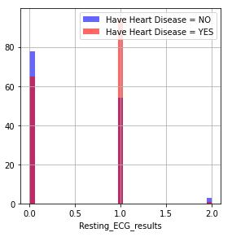
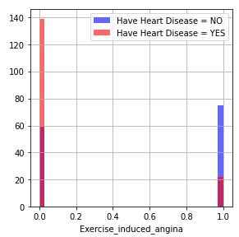
Resting electrocardiographic results: People with value 1 (signals non-normal heartbeat, can range from mild symptoms to severe problems) are more likely to have heart disease.
Exercise induced angina: People with value 0 (No angina) have heart disease more than people with value 1 (angina)

Slide 11
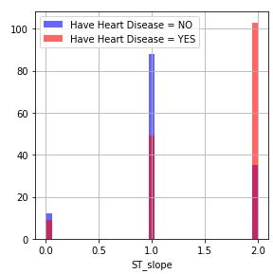
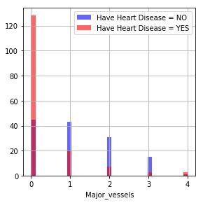
The slope of the peak exercise ST segment: People with slope value equal to 2 (Down sloping: signs of unhealthy heart) are more likely to have heart disease than people with slope value equal to 0 (Upsloping: better heart rate with exercise) or 1 (Flat sloping: minimal change (typical healthy heart).
Number of major vessels (0-3) colored by fluoroscopy: the more blood movement the better so people value equal to 0 are more likely to have heart disease.

Slide 12
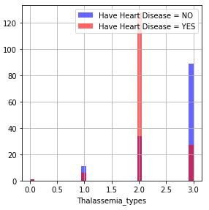
Thalassemia: People with thalassemia value equal to 2 (fixed defect: used to be defect but ok now) are more likely to have heart disease.

Slide 13
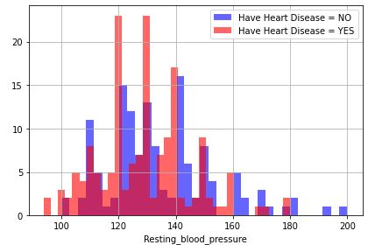
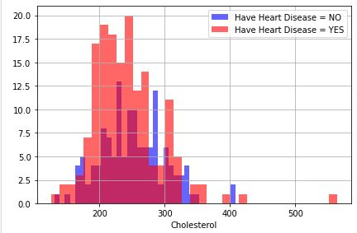
Let’s see the heart disease frequency based on the continuous features:
Resting blood pressure: anything above 130-140 is typically cause for concern
Cholesterol: above 200 is cause for concern.

Slide 14
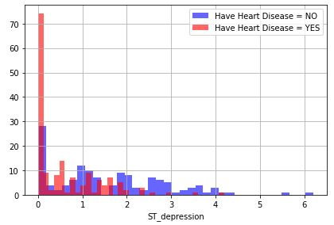
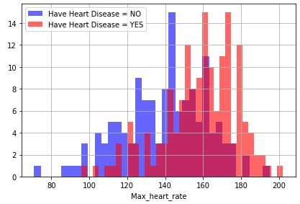
Maximum heart rate achieved: People achieved a maximum more than 140 are more likely to have heart disease.
Oldpeak ST depression induced by exercise relative to rest looks at stress of heart during exercise unhealthy heart will stress more.

Slide 15
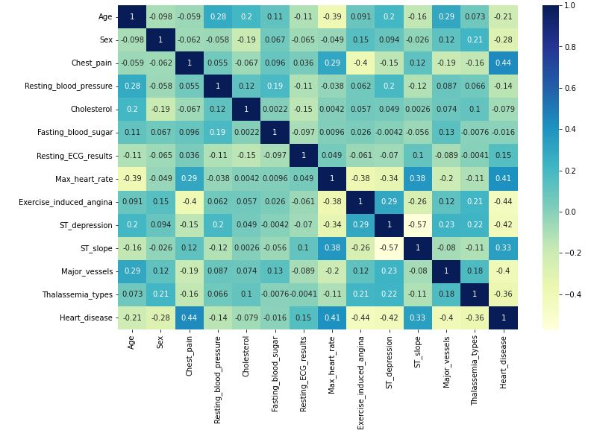
Correlation Matrix
In the matrix we can see that the features “Fasting_blood_sugar” and “Cholesterol” are the lowest correlated with the Heart Disease. The other features are more correlated with Heart Disease.

Slide 16
Data Processing
-Transforming categorical variables using one hot encoding technique. So I have created dummy variables for categorical data “Chest_pain”, “Resting_ECG_results”, “ST-slope”, “Major_vessels” and “Thalassemia_types” to increase the accuracy.
-Dropping the unnecessary categorical data.
-Using the 80% of the dataset for training.
-Using the 20% of the dataset for testing.
-Scaled the data for better result (MinMaxScaler()).

Slide 17
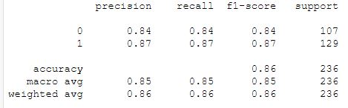
Model Building
Logistic Regression
Training Results
Logistic Regression Train Accuracy: 85.59 %
Confusion Matrix
[ 90,17 ]
[17,112]
Τhis means that 17 people predicted with heart disease while healthy and 17 people predicted as healthy while they have heart disease.
Classification Report

Slide 18
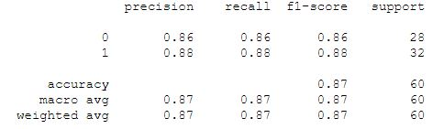
Testing Results
Logistic Regression Test Accuracy: 86.67 %
Confusion Matrix
[ 24,4 ]
[4,28]
Τhis means that 4 people predicted with heart disease while healthy and 4 people predicted as healthy while they have heart disease.
Classification Report

Slide 19
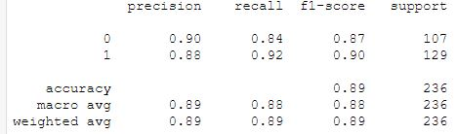
kNN
Training Results
KNeighborsClassifier Train Accuracy: 88.56 %
Confusion Matrix
[ 90,17 ]
[10,119]
Τhis means that 17 people predicted with heart disease while healthy and 10 people predicted as healthy while they have heart disease.
Classification Report

Slide 20
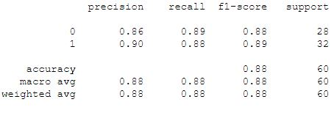
Testing Results
KNeighborsClassifier Test Accuracy: 88.33 %
Confusion Matrix
[ 25,3 ]
[4,28]
Τhis means that 3 people predicted with heart disease while healthy and 4 people predicted as healthy while they have heart disease.
Classification Report

Slide 21
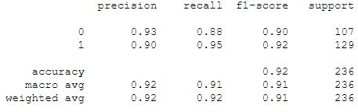
SVM
Training Results
SVC Train Accuracy: 91.53 %
Confusion Matrix
[ 94,13 ]
[7,122]
Τhis means that 13 people predicted with heart disease while healthy and 7 people predicted as healthy while they have heart disease.
Classification Report

Slide 22
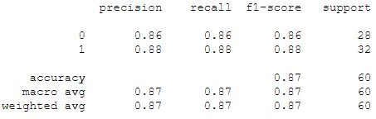
Testing Results
SVC Test Accuracy: 86.67 %
Confusion Matrix
[ 24,4 ]
[4,28]
Τhis means that 4 people predicted with heart disease while healthy and 4 people predicted as healthy while they have heart disease.
Classification Report

Slide 23
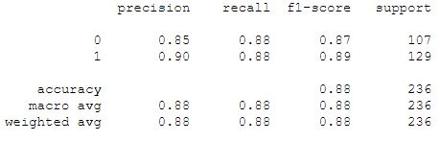
Decision Tree
Training Results
DecisionTreeClassifier Train Accuracy: 87.71 %
Confusion Matrix
[ 94,13 ]
[16,113]
Τhis means that 13 people predicted with heart disease while healthy and 16 people predicted as healthy while they have heart disease.
Classification Report

Slide 24
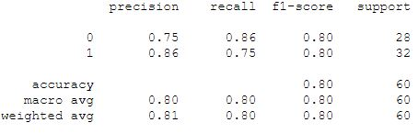
Testing Results
DecisionTreeClassifier Test Accuracy: 80.00 %
Confusion Matrix
[ 24,4 ]
[8,24]
Τhis means that 4 people predicted with heart disease while healthy and 8 people predicted as healthy while they have heart disease.
Classification Report

Slide 25
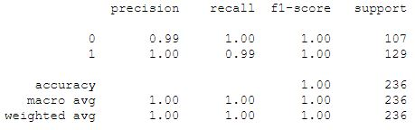
Random Forest
Training Results
RandomForestClassifier Train Accuracy: 99.58 % (Overfitting)
Confusion Matrix
[ 107,0 ]
[1,128]
Τhis means that no one predicted with heart disease while healthy and 1 person predicted as healthy while they have heart disease.
Classification Report

Slide 26
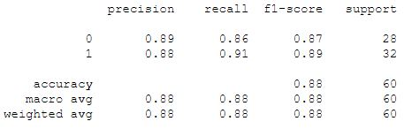
Testing Results
RandomForestClassifier Test Accuracy: 88.33 %
Confusion Matrix
[ 24,4 ]
[3,29]
Τhis means that 4 people predicted with heart disease while healthy and 3 people predicted as healthy while they have heart disease.
Classification Report

Slide 27
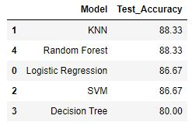
Model Evaluation
The accuracy of each model in testing is:

Slide 28
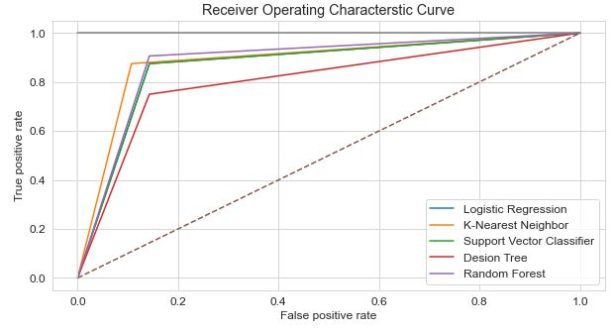
I am using ROC curves and AUC scores to choose the best of the 5 machine learning models:
AUC Scores
LogisticRegression | 0.866
KNeighborsClassifier | 0.883
SVC | 0.866
DecisionTreeClassifier | 0.803
RandomForestClassifier | 0.881
AUC can be classed as follows,
0.90 - 1.00 = excellent
0.80 - 0.90 = good
0.70 - 0.80 = fair
0.60 - 0.70 = poor
0.50 - 0.60 = fail
The KNeighborsClasifier has the best AUC score and the best test accuracy (same with the RandomForestClassifier ).

