Slide 1

Data Structure [09CE2303] Unit:-1
PRESENT BY
DOLLY N SHILU
Assistant Professor
Diploma-CE

Slide 2
OUTLINE
Introduction
Data Structure
Data representation
Primitive data type
Non-primitive data type
Algorithm
Time complexity
Space complexity

Slide 3
Introduction
What is Data:
Data is raw fact or unprocessed information.
Data is nothing but collection of numbers, alphabets, and symbols.
It can't be used for decision making.
What is Information
When data is processed, organized, structured or presented in a given context so as to make it useful, it is called information.
Information is derived from data, It can be used for decision making.

Slide 4
Example
Example:-
Data : Each student's test score is one piece of data
Information: The average score of a class or of the entire school is information that can be derived from the given data.

Slide 5
What is data structure
The data structures are nothing but a meaningful way of arranging, and storing the data in the computer for efficient utilization and processing depending upon the situation.
There are two types of Data Structures:
1) primitive data structure
2) non primitive data structures.

Slide 6
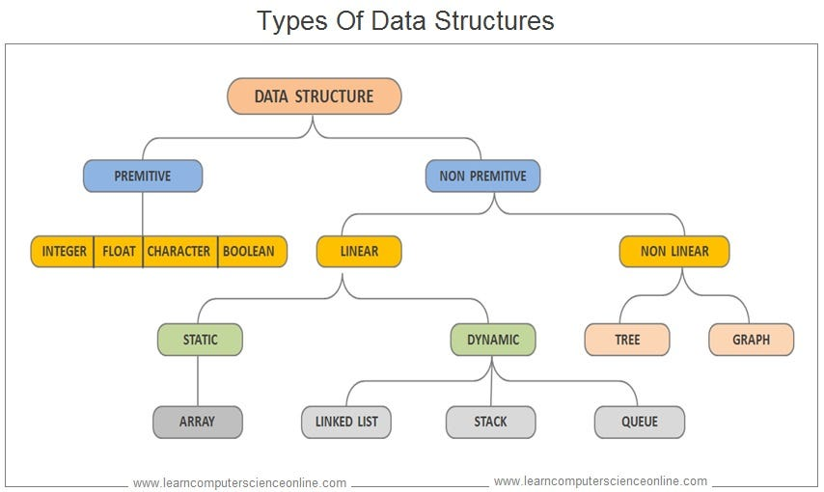
Types of Data Structure

Slide 7
Operations on data Structure
Create: Reserve some memory for program element.
Destroy: Destroy (delete) some memory space allocated for specified data structure.
Select: It access a particular data from data structure.
Traversal: Accessing each data element once in such a way that all the data elements are processed.
Insertion : Adding a new element into DS
Deletion : Removing element from DS.
Update : It update or modify data in the data structure.
Searching : Finding location for specific data in the array
Sorting : Arranging the data in logical order.
Merging : Combining the two data items into single data item..

Slide 8
Primitive Data Structure
A primitive data structure can store the value of only one data type.
Primitive data structures, also known as basic data types, are the simplest and most fundamental types of data structures used in programming.
They are pre-defined data types have a fixed size and format. Primitive data structures are used to represent simple data values, such as numbers and characters.
Examples of the primitive data type are integer, character, Boolean, float, double, long,Pointer etc.

Slide 9
Non-primitive Data Structure
A non-primitive data structure can store the value of more than one data type.
non-primitive data structure, it is categorized into two parts such as linear data structure and non-linear data structure.

Slide 10
Linear Data structure
Linear data structure is a sequential type of data structure, and here sequential means that all the elements in the memory are stored in a sequential manner; for example, element stored after the second element would be the third element, the element stored after the third element would be the fourth element and so on. We have different linear data structures holding the sequential values such as Array, Stack , Linked List, Queue etc..

Slide 11
Non- Linear Data Structure
Non-linear data structure is a kind of random type of data structure. The non-linear data structures are Tree and Graph.

Slide 12
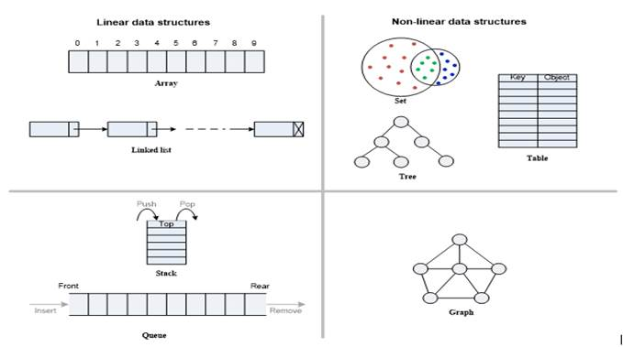
Linear – Non-Linear

Slide 13
Primitive VS Non-Primitive
Primitive data structure | Non Primitive Data structure
Primitive data structure is the data structure that allows you to store only single data type values. | Non-Primitive data structure is a data structure that allows you to store multiple data type values.
integer, boolean, character, float, etc. are some examples of primitive data structures. | Array, Linked List, Stack, etc. are some examples of non-primitive data structures.
Primitive data structure,do not allow you to store NULL values. | You can store a NULL value in the non-primitive data structures.
The size of the primitive data structures is dependent on the type of the primitive data structure. | The size of the non-primitive data structure is not fixed.

Slide 14
Linear VS Non-Linear
Linear Data Structure | Non-linear Data Structure
In linear data structure, single level is involved. | Non-linear data structure, multiple levels are involved.
Its implementation is easy in comparison to non-linear data structure. | While its implementation is complex in comparison to linear data structure.
Linear data structure, data elements can be traversed in a single run only. | Non-linear data structure, data elements can’t be traversed in a single run only.
Examples are: array, stack, queue, linked list, etc. | Examples are: trees and graphs.
utilization of memory is not efficient. | Memory utilization is efficient.
It is easy to implement. | It is complex to implement.

Slide 15
Linear VS Non-linear
Linear | NonLinear
A data structure is said to be linear if its elements form sequence or linear list. | A data structure is said to be non linear if its elements do not form sequence or linear fashion.
Every item(value) is related to its previous and next item. | Every item is attaached with many other items.
Data items can be traversed in a single run. | Data items can not be traversed in a single run.
Implement is easy | Implement is difficult
Ex: Array,stack,linked list ,queue | Ex:tree,graph

Slide 16
Data Representation
Data is can be anything which represents the specific result or any number, text, image, audio, video etc.
For example, example of human being then data for a human being such that name, personal id, country, profession, bank account details etc.

Slide 17
Data Representation
Forms of data representation: At present Information comes in different forms such as follows.
Numbers
Text
Images
Audio
Video

Slide 18
Data Representation
Numbers are directly converted into binary representation to specify mathematical operations. The 0s and 1s used to represent digital data.
Number File Formats – Integer, Fixed point, Date, Boolean, Decimal, etc.
Text is also represented as bit pattern or sequence of bits(such as 0001111). Various types of bits are assigned to represent text symbols. A code where each number represents a character can be used to convert text into binary. It is ASCII code, Unicode etc
Text File Formats – .doc,.docx, .pdf, .rtf, .txt, etc.
Example : The letter ‘a’ has the binary number 0110 0001.

Slide 19
Data Representation
Images are also represented as bit patterns. An image is composed of matrix of pixels with different values of pixels each where each pixel is represented as dots. Size of the picture is dependent on its resolution. Consider a simple black and white image. If 1 is black (or on) and 0 is white (or off), then a simple black and white picture can be created using binary.
Image File Formats – Image can be in the format of jpeg, PNG, TIFF, GIF, etc.

Slide 20
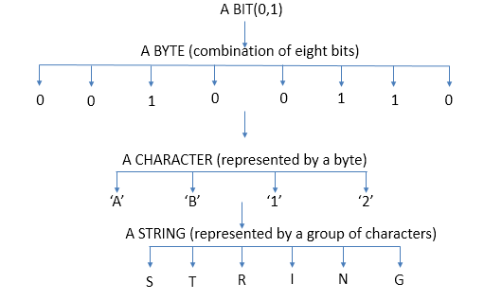
Data Representation

Slide 21
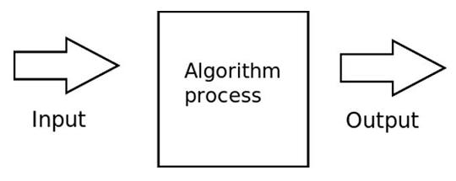
What is Algorithm
Algorithm is a step-by-step procedure, which defines a set of instructions to be executed in a certain order to get the desired output.

Slide 22
Example
Algorithm to add two numbers and display the result.
Step 1 − START
Step 2 − declare three integers a, b & c
Step 3 − define values of a & b
Step 4 − add values of a & b
Step 5 − store output of step 4 to c
Step 6 − print c
Step 7 − STOP

Slide 23
Advantages of Algorithms:
It is easy to understand.
An algorithm is a step-wise representation of a solution to a given problem.
In an Algorithm the problem is broken down into smaller pieces or steps hence, it is easier for the programmer to convert it into an actual program.

Slide 24
Disadvantages of Algorithms
Writing an algorithm takes a long time so it is time-consuming.
Understanding complex logic through algorithms can be very difficult.
Branching and Looping statements are difficult to show in Algorithms.

Slide 25
Characteristic of Algorithm
Input: Every algorithm should have at least zero or more input.
Output: Every algorithm should produce very effective one or more output.
Finiteness: Each instruction is clear and unambiguous, it should not be very complex.
Effectiveness: Each instruction must be so enough to understand by user.
Definiteness: Every algorithm should terminate after some specific amount of time interval it means it should not go in infinite state.

Slide 26
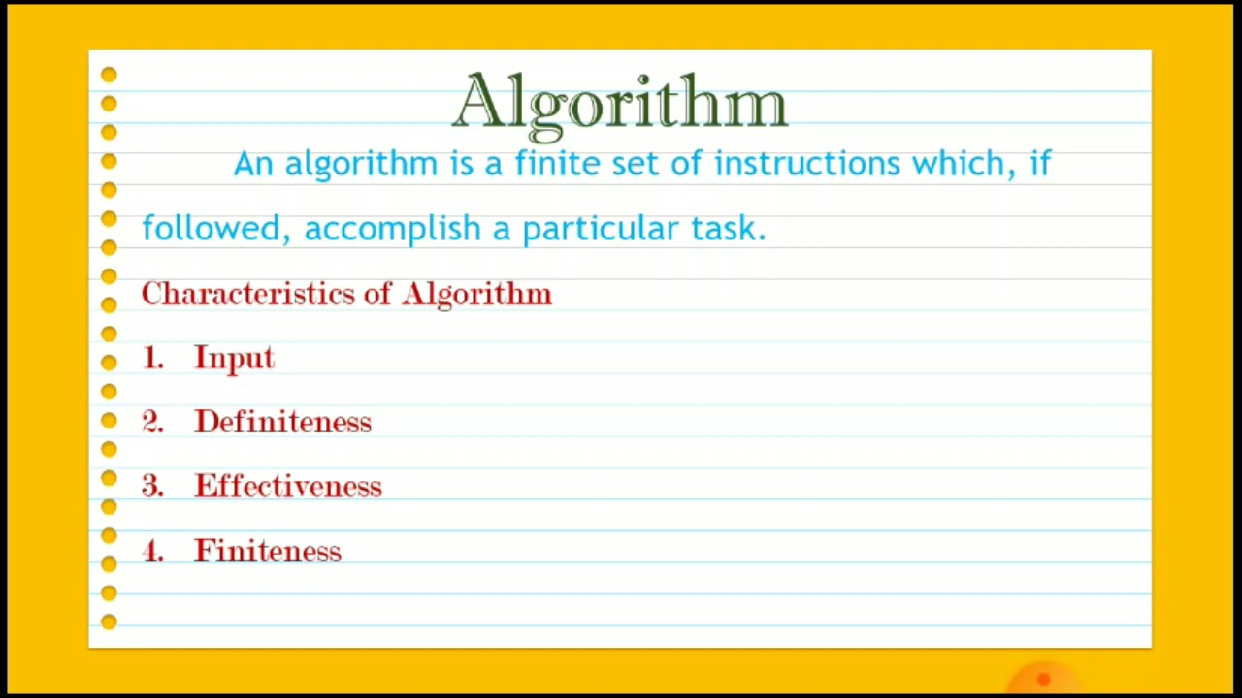
Characteristics

Slide 27
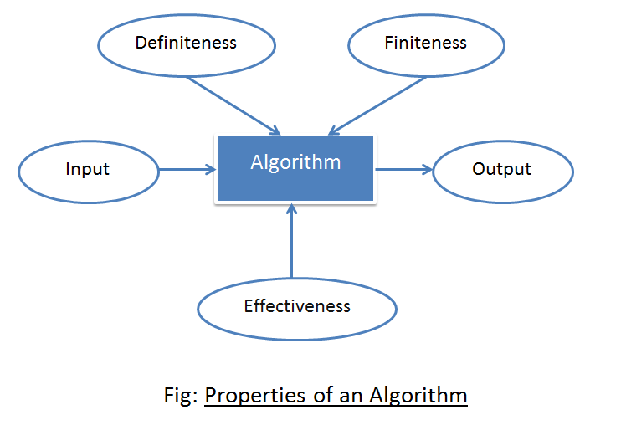
Characteristics

Slide 28
Analysis of Algorithms
We have many algorithm for same situation. Some algorithms are more efficient than others. We would like to choose efficient algorithm.
Complexity of algorithm is function describing the efficiency of the algorithm.
There are two types of analysis
1) Time complexity
2) Space Complexity

Slide 29
Time Complexity
Time complexity is defined in terms of how many times it takes to run a given algorithm, based on the length of the input.
The Time complexity can be defined as the amount of time(CPU time)taken by an algorithm to execute each statement of code of an algorithm till its completion with respect to the function of the length of the input.
It is amount of time (or number of steps) needs by a program to complete its task (to execute particular algorithm).
Time complexity depends on Operations, comparisons Loop, pointer reference,function calls etc is factors of time complexity
There are two types of Time Complexity
1) Run Time
2) Compilation Time

Slide 30
Time Complexity
1) Compile Time
Compilation time is the time taken to compile an algorithm
While compiling it checks for the syntax and semantic error in the program and links it with the standard libraries
2) Run Time
It is the time to execute the compiled program
The run time of an algorithm depend upon the number of instruction present in the algorithm.
Run time is calculated only for executable statement and not for declaration statements

Slide 31
Analysis
There are tree types of analysis.
1) Best case (shortest time)
2) Average case(medium time)
3) Worst case(Longest time)
Limites
Better Solution
Less
Time & Space(Complexity)
More

Slide 32
Aynalisis
Best case:- When an algorithm takes minimum amount of time to run for completion for given input parameter then it is said to be in Best case behavior.
Ex: if searching no is 1 and i/p : 1 2 3 4 5
Worst case :-When an algorithm takes maximum amount of time to run for completion for given input parameter then it is said to be in worst case behavior.
Ex: if searching no is 1 and i/p : 5 4 3 2 1
Average case :-When an algorithm takes average amount of time to run for completion for given random input parameter then it is said to be in average case behavior.
Ex: if searching no is 1 and i/p : 2 3 4 5 1 5 9 3

Slide 33
Space Complexity
Space complexity of an algorithm represents the amount of memory space needed the algorithm in its life cycle.
It is measure of how much storage is required by algorithm.
There are some factors space complexity depends:-
Variables, data structure, allocation memories, function calls etc
There are two types of Space complexity
1) Fixed space or static space or constant space(part).
2) Linear space or Dynamic space or Variable space(part)

Slide 34
Types
1)Fixed space or static space or constant space(part)
A fixed part that is a space required to store certain data and variables (i.e. simple variables and constants, program size etc.), that are not dependent of the size of the problem.
Fixed Part (C)
Variable Part SP(I)
Space ComplexityS(P)

Slide 35
2)Linear space or Dynamic space or Variable space(part)
A variable part is a space required by variables, whose size is totally dependent on the size of the problem. For example, recursion , dynamic memory allocation etc.
Space complexity S(p) of any algorithm p is
S(p) = C + Sp(I)
C is as the fixed part and S(I) is as the variable part of the algorithm.

Slide 36
Thank You

