Slide 1

Data Structure [09CE2303] Unit:-2
PRESENT BY
DOLLY N SHILU
Assistant Professor
Diploma-CE

Slide 2
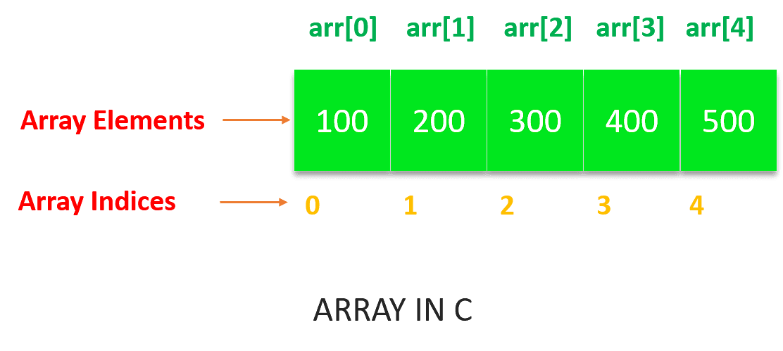
Array
Array in C is one of the most used data structures in C programming. It is a simple and fast way of storing multiple values under a single name.

Slide 3
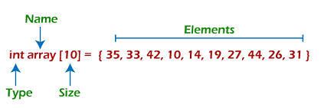
Representation of an array
We can represent an array in various ways in different programming languages.
Index starts with 0.
The array's length is 10, which means we can store 10 elements.
Each element in the array can be accessed via its index.

Slide 4
Basic Terms of An Array Data Structure
In arrays, an element refers to a particular item that is stored.
Each element carries an index - a location with respect to a base value.
The base value is the memory location of the first element of the array.
We simply add offsets to this value which makes it easier for us to use the reference and identify items.
Array length – the number of elements an array can store is defined as the length of the array. It is the total space allocated in memory while declaring an array.

Slide 5
Array
An array is a fixed-size collection of similar data items stored in contiguous memory locations. It can be used to store the collection of Non-primitive data structure.
Syntax of Array Declaration
data _type array _name [size];
or
data_type array_name [size1] [size2]...[size N];
data_type: what kind of value will be stored. for e.g: marks are of int data type, percentage to be stored will be float data type, grade would be char data type, etc.
array_name: The name using which the array will be identified. e.g: marks, temp etc.
array_size: the number of elements that the array would comprise of.

Slide 6
Properties of Array in Data Structure
Order: Arrays are linear data structures that store items in a specific order.
Searching: The time complexity of searching an element in arrays.
Access: Arrays offer direct access to any element with its index or position number.
Insertion and Deletion: Insertion and deletion operations take more time than searching an element as it requires shifting elements from one location to another.
Size: It can only store a fixed amount of elements as their size is predetermined during declaration.

Slide 7
Array Traversal
Traversal is the process in which we visit every element of the data structure. For C array traversal, we use loops to iterate through each element of the array.
Array Traversal using for Loop
for (int i = 0; i < N; i++)
{
array_name[i];
}

Slide 8
Algorithm
Step-1: Start
Step2. Create an Array of a desired data type and size.
A[N size]
Step3. (Initialize a variable) ‘i’ as 0.
Step4. Enter the element at ith index or element of
the array.
Step5. (Increment) i by 1.
Step6. Repeat Steps 4 & 5 until the end of the array.
Step7. Stop

Slide 9
Another Algorithm
St1:- Start
St2. (Initialize )Set i = 0
St3. Repeat steps 4 and 5 while i < N
St4. IF A[i] is equal element Then, GOTO next
step
St5. Set i = i +1
St6. Show element
St7. Stop

Slide 10
Array Insertion
Insertion is the process of adding new elements into an existing array. This can be done by providing an index for where the insertion should occur and then shifting other elements in the array to make space for the insertion.
Algorithm
INSERT(A, POS, N, VAL)
A is an array
POS indicates position at which you want to insert element.
N indicates number of elements in an array which is updated by 1.
VAL indicates value(element) to be inserted.

Slide 11
Algorithm
Step-1 :-(Initialize) I to N-1 .
Step-2:-(Move the elements one position down) Repeat While (I ≥ POS-1)
Step-3:- a) Shift A[ i] to A [ i+ 1]
b)decrement I= I-1 or I by 1
Step-4:- (Insert new element) A [POS-1] = VALUE .
Step-5:- (Increase size of array) return with N=N + 1
Step-6:-(Finished) Exit

Slide 12
Array deletion
Deletion is the opposite of insertion and involves removing elements from an existing array. After deleting an element, all other elements in the array must be shifted to fill any gaps left from deletion.
Algorithm
DELETE (A, POS, N, VALUE)
A is an array
POS indicates position at which we want to deleted element.
N indicates number of elements in an array.
VALUE indicates value(element) to be inserted.

Slide 13
Algorithm
Step1:-(Initialization) i=POS-1 or I=N-1
(Move the elements one position up)
Step2:- Repeat steps for I=I+1 to N-1
Step3:-a) Shift A[i] to A[i - 1]
b) I=I+1 or increment I by 1
step4:-(Decrease size of array) N= N – 1 . Step5:-[Finished] Exit

Slide 14
Types of Array
There are two types of arrays
One Dimensional Arrays (1D Array)
Multidimensional Arrays(2D and 3D dimensional)
The One-dimensional arrays, also known as 1-D arrays in C are those arrays that have only one dimension.
Syntax of 1D Array in C
array_name [size];

Slide 15
2D Array
Multi-dimensional Arrays in C are those arrays that have more than one dimension. Some of the popular multidimensional arrays are 2D arrays and 3D arrays.
A Two-Dimensional array or 2D array in C is an array that has exactly two dimensions. They can be visualized in the form of rows and columns organized in a two-dimensional plane.
Syntax of 2D Array in C
array_name[size1] [size2];

Slide 16
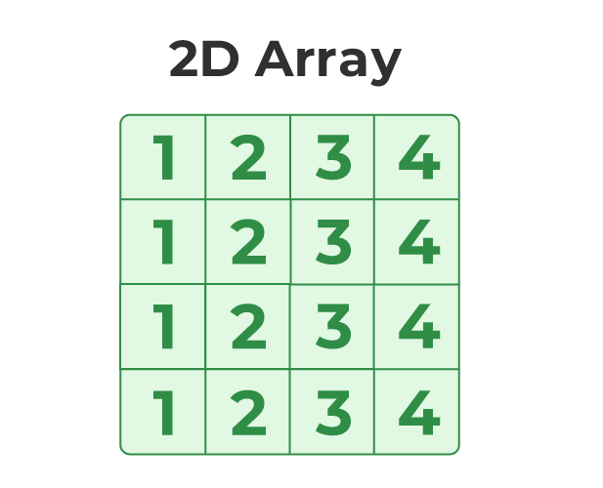
2D Array

Slide 17
3D Array
Another popular form of a multi-dimensional array is Three Dimensional Array or 3D Array. A 3D array has exactly three dimensions. It can be visualized as a collection of 2D arrays stacked on top of each other to create the third dimension.
Syntax of 3D Array in C
array_name [size1] [size2] [size3];

Slide 18
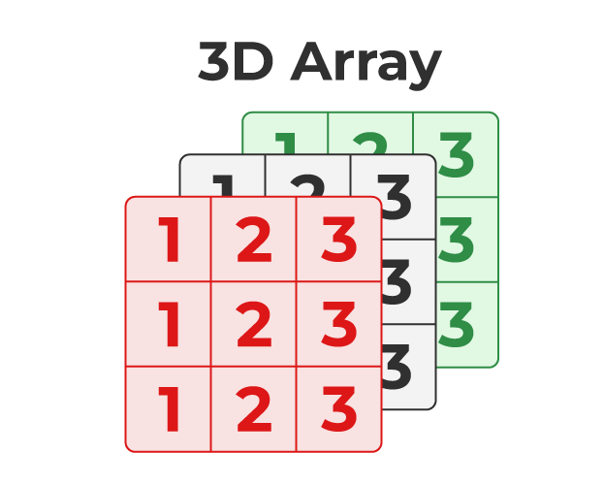
3D Array

Slide 19
Advantages of Array
Arrays help in code optimization. We can store a large number of values in a single array by writing a small piece of code rather than declaring each variable separately.
Arrays are easy to use as many algorithms like searching and sorting techniques, finding maximum and minimum values, reversing can be easily implemented using arrays.

Slide 20
Disadvantage of Array
The size of an array is fixed. Once the memory is allocated to an array, it cannot be increased or decreased. This prevents us from storing extra data in case we want to. These arrays of fixed size are called static arrays.
Allocating less memory than the required to an array leads to loss of data.
A single array cannot store values of different data types, i.e, an array is homogenous in nature.

Slide 21
Characteristics of an Array
1) An array holds elements that have the same data type.
2) Array elements are stored in subsequent memory locations.
3) Two-dimensional array elements are stored row by row in subsequent memory locations.
4) Array name represents the address of the starting element.
5) Array size should be mentioned in the declaration. Array size must be a constant expression and not a variable.

Slide 22
Stack
A stack is non primitive, linear Data Structure in which insertion and deletion can be done only from one end, called top of stack.
It is also called last in first out(LIFO)type Data Structure.
It is ordered list in which insertion and deletion of data is done from only one end known as TOP of stack.

Slide 23
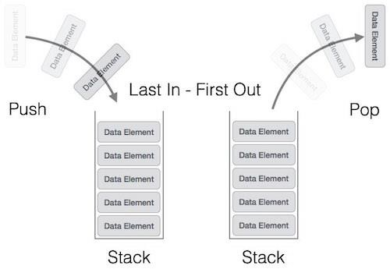
Stack
Last In First Out LIFO or
First In Last Out FILO

Slide 24
Stack
Stack can be easily implemented using an Array or a Linked List.
In the computer’s memory, stack can be represented as a linear array.

Slide 25
Stack (Top)position
Position of Top | Status of Stack
-1 | Stack is Empty
0 | Only one element in Stack
N-1 or T-1 | Stack is Full
N | Overflow state of Stack

Slide 26
There are some basic operations
Push: Add an element to the top of a stack
Pop: Remove an element from the top of a stack
IsEmpty: Check if the stack is empty
IsFull: Check if the stack is full
Peek/Peep: Get the value of the top element without removing it

Slide 27
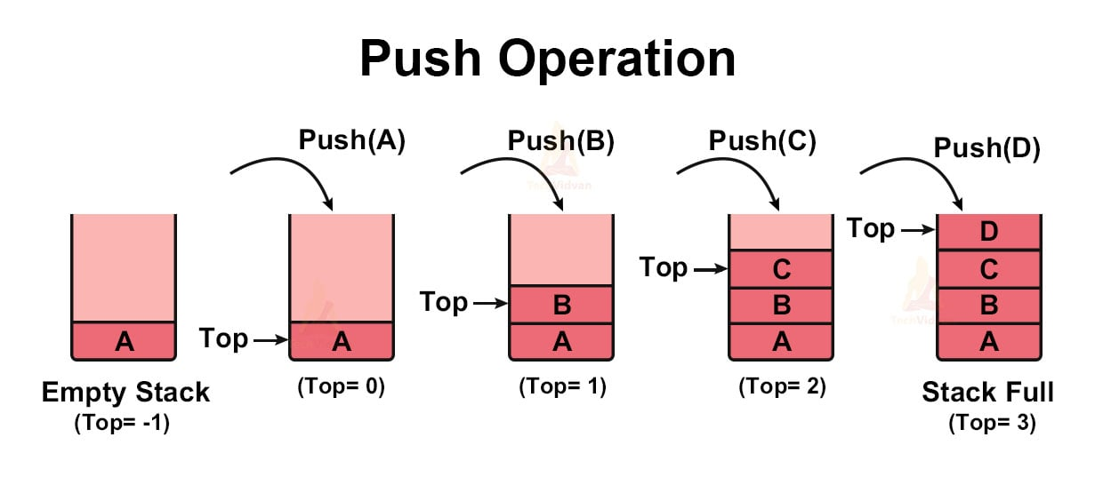
Push()
push() is an operation that inserts elements into the stack.
Adds an item to the stack. If the stack is full, then it is said to be an Overflow

Slide 28
Algorithm of Stack
Push()
Step-1:- (check stack is full )
Step-2:- Top ==Top-1
(stack is overflow or full)
Step-3:- Top++ or Top=Top+1
(Increment Top by One)
Step-4:- St[Top]=N(Element)
Add or Insert element in new Top Position
Step-5:- Stop
Exit

Slide 29
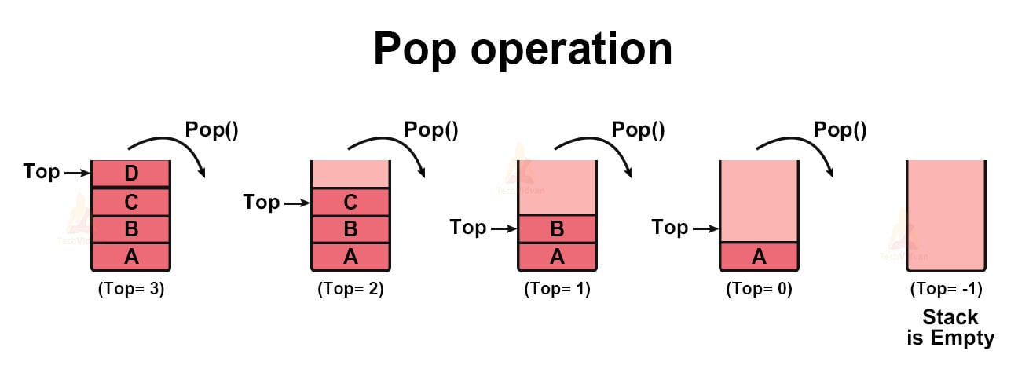
Pop()
Removes an item from the stack. The items are popped in the reversed order in which they are pushed. If the stack is empty, then it is said to be an Underflow condition.

Slide 30
Algorithm of Stack
POP()
Step-1:- (check stack is Empty )
Step-2:- Top = -1 , then
(stack is Underflow or empty)
exit
Step-3:- Top-- or Top=Top-1
(Decrement Top by One)
Step-4:- x=St[Top]
return x
Step-5:- Stop

Slide 31
Peep() /Peek()
The peek() is an operation retrieves the topmost element within the stack, without deleting it. This operation is used to check the status of the stack with the help of the top pointer.

Slide 32
Algorithm of Stack
Peep()/Peek()
Step-1:- (check stack is Empty )
Step-2:- if Top =-1 ,then
(stack is underflow )
Step-3:- (Check Top Element )
x=St[Top]
return x
Top=Top+1
Step-4:- Stop
Exit

Slide 33
Application of Stack
Infix to Postfix and Prefix Stack: This type of stack is used to convert infix expressions to postfix expressions and Prefix.
Expression Evaluation Stack: This type of stack is used to evaluate postfix expressions.
Recursion Stack: This type of stack is used to keep track of function calls in a computer program and to return control to the correct function when a function returns.
Memory Management Stack: This type of stack is used to store the values of the program counter and the values of the registers in a computer program, allowing the program to return to the previous state when a function returns.
Balanced Parenthesis Stack: This type of stack is used to check the balance of parentheses in an expression.

Slide 34
THANK YOU

