Slide 1

Data Structure [09CE2303] Unit:-3
PRESENT BY
DOLLY N SHILU
Assistant Professor
Diploma-CE

Slide 2
Queue and Linked List

Slide 3
Out line
Introduction
Queue
Types of Queue
Linked List

Slide 4
Types of Queue
Simple Queue or linear Queue
Circular Queue
Double ended Queue
Priority Queue

Slide 5
Introduction of Queue
Queue is an abstract data structure, somewhat similar to Stacks.
A queue is open at both its ends. One end is always used to insert or insertion data (enqueue) and the other is used to remove or Deletetion data (dequeue). Queue follows First-In-First-Out methodology, i.e., the data item stored first will be accessed first.

Slide 6
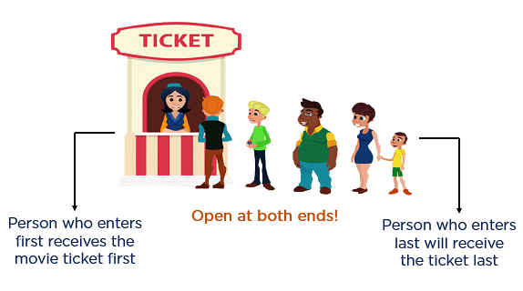
Example
A real-world example of queue can be a single-lane one-way road, where the vehicle enters first, exits first. More real-world examples can be seen as queues at the ticket window and bus-stops.

Slide 7
Queue
Queue is a non-primitive linear data structure that permits insertion of an element at one end and deletion of an element at the other end. The end at which the deletion of an element take place is called front, and the end at which insertion of a new element can take place is called rear.
The deletion or insertion of elements can take place only at the front and rear end of the list respectively.

Slide 8
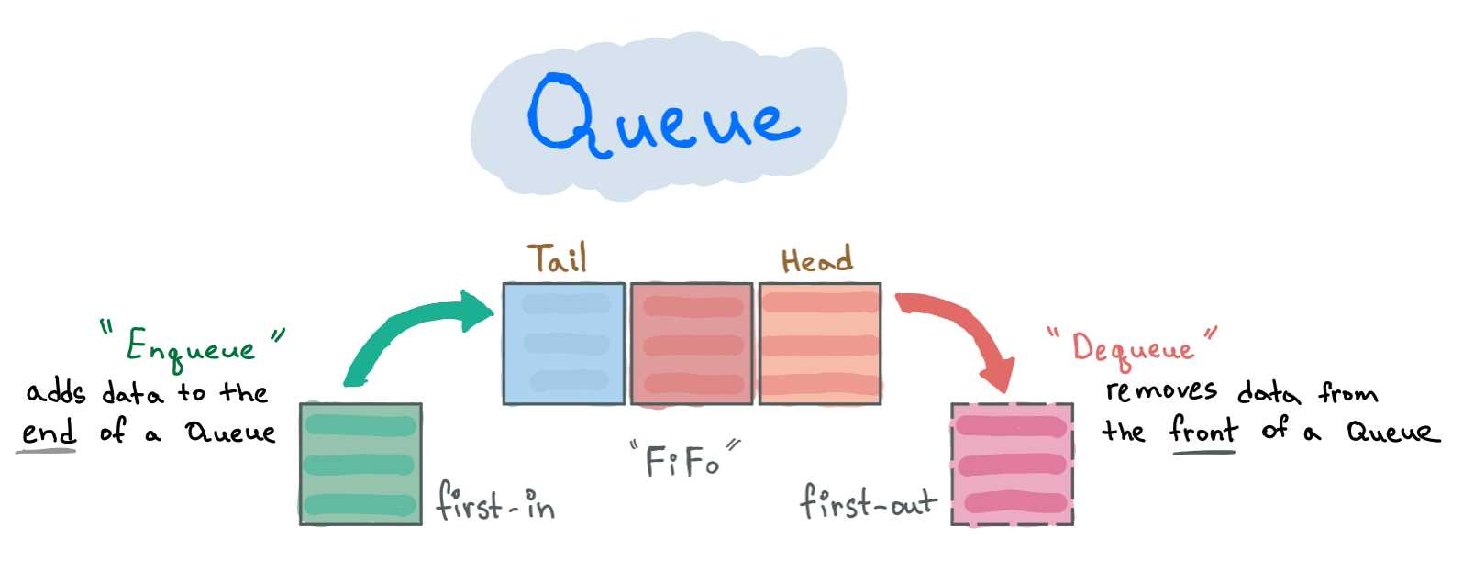
Queue

Slide 9
Queue Operation
Basically There are only main two Operation performed on a Queue.
Insertion (Enqueue): Used to insert an element in a Queue. Insertion operation always performed from the REAR end,
Deletion (Dequeue): Used to delete an element from the Queue. Deletion operation is always performed from the FRONT end.

Slide 10
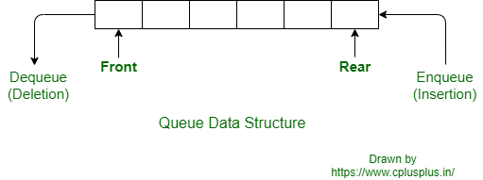
Simple queue
Front ( f ) and Rear (r) both are -1 when Queue Empty.

Slide 11
Continue
Enqueue Queue perform as FIFO. First enter(Insert) value 10 then after 8,12,16,9,20,18,5
Now queue is full last value is 5. that is last value of queue so that is Rear and first value is 10 so that is Front of queue.
Now, Dequeue Queue work on FIFO so after queue full Remove (Delete) element or value 10 then after 8 then 12 and so on.

Slide 12
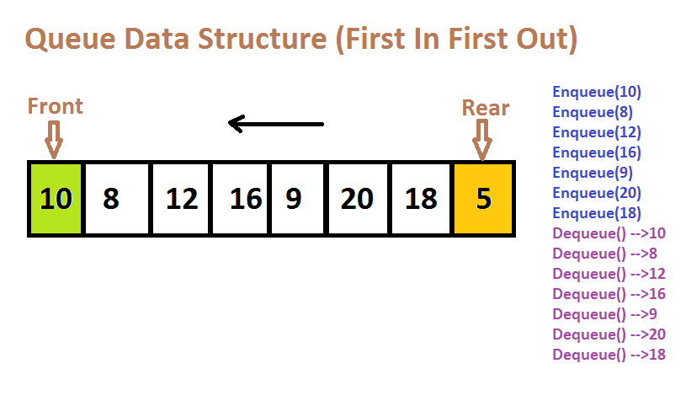
Simple queue

Slide 13
Simple Queue Enque () Algorithm
Step 1:Initially front=-1,rear= -1
Insert(Q, front ,rear,X)
Step 2: [Check for overflow]
If rear>=N-1 then
Write “queue overflow”
Exit
Step 3: [increment rear ]
Rear = Rear+1
Step 4: [check queue insertion]
Q[Rear]=X
Step5: If (front=-1) then
front=0[queue empty]
exit
Step 6: [finished]
Exit

Slide 14
Deque() Algorithm
Step 1: Initially front=-1,rear= -1
Delete (Q,front,rear,X)
Step 2: [Check for underflow]
If (front=-1) then
Write “queue underflow”
Exit
Step 3: [delete element]
X=q[front]
Step 4: [increment front]
If (front==rear) then
Front = rear = -1
Else
Front = front+1
Step 5: [finished]
Exit

Slide 15
Disadvantage
Disadvantages is that in last operation rear reaches to end of queue and queue overflow condition (rear>=n-1) is true. So we cannot insert new element. Even though there is space in queue.
So this type of problems can be solved by using new concept, which is called circular queue.

Slide 16
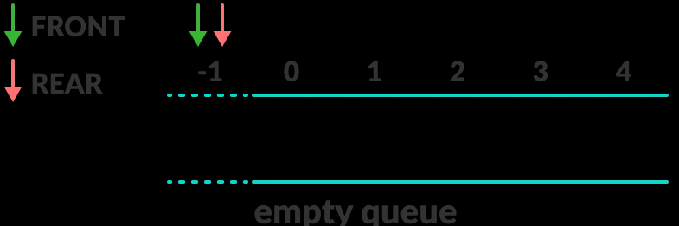
Circular queue
Circular queue is one in which the insertion of new element is done at very first location of queue if last location of queue is full.
The circular queue solves the major limitation of the normal queue. In a normal queue, after a bit of insertion and deletion, there will be non-usable empty space.

Slide 17
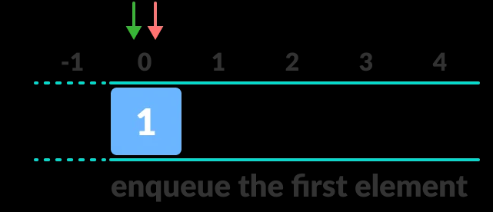
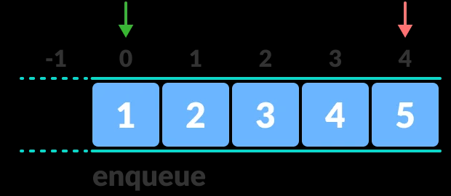
Circular queue

Slide 18
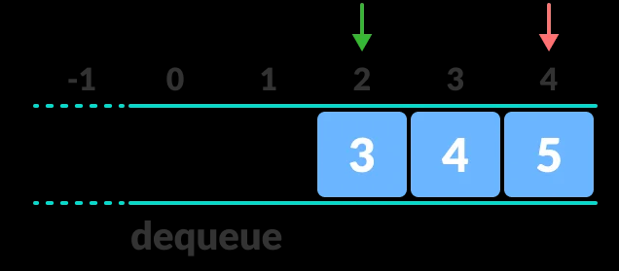
Continue…
After queue is full now dequeue() an element

Slide 19
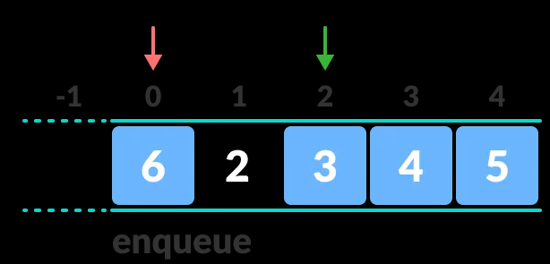
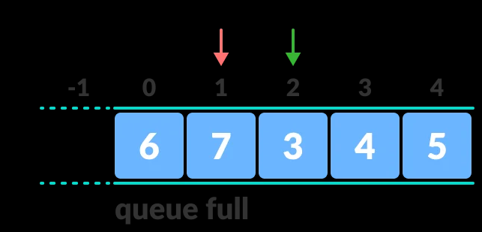
Continue…
After queue is deque some element then after it is enque some element in blank space or memory

Slide 20
Advantage
Do not waste memory space
Faster then Simple queue

Slide 21
Algorithms of Circular queue Insert
Q:- implementation queue
Front:- front end
Rear:- rear end
N:-size of queue
i:- data item to be insertion

Slide 22
Continue…
Step1:-[ check for overflow ]
front==0 && rear==n-1 front == rear+1
Write “queue overflow”
Exit
Step 2: [rear pointer ]
If (rear==n-1) then
rear=0
else
rear = (rear+1)
Step 3: Q[rear]=I
if(front ==-1)
front=0
Step 4: [finished]
Exit

Slide 23
Algorithms of Circular queue delete
Q:- implementation queue
Front:- front end
Rear:- rear end
N:-size of queue
i:- data item to be deletion

Slide 24
Continue…
Step 1: [Check for underflow]
If (front=-1) then
Write “queue underflow”
Exit
Step 2: [delete element]
i =q[front]
Step 3: [increment front pointer]
If (front==rear) then
Front = rear = -1 return (i)
[set front] (front==n-1)
front=0
Else
` front = (front+1)
Step 4: [finished]
Exit

Slide 25
Simple VS Circular Queue
S.no. | Linear Queue | Circular Queue
1. | Arranges the data in a linear pattern. | Arranges the data in a circular order where the rear end is connected with the front end.
2. | The insertion and deletion operations are fixed i.e, done at the rear and front end respectively. | Insertion and deletion are not fixed and it can be done in any position.
3. | Linear queue requires more memory space. | It requires less memory space.
4 | It is inefficient | It is more efficient
5 | It follows the FIFO principle in order to perform the tasks. | It has no specific order for execution.

Slide 26
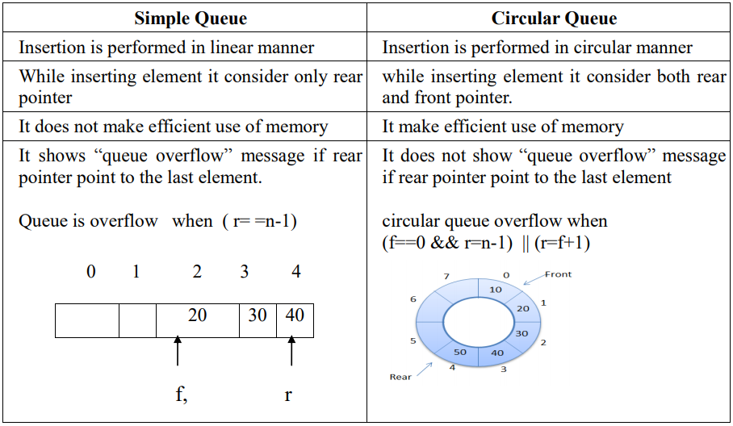
Other different

Slide 27
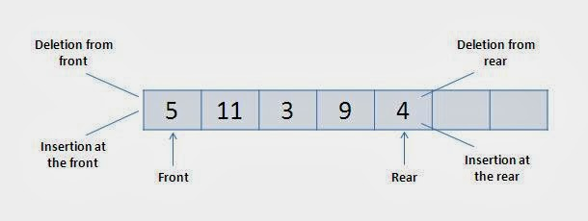
Double Ended Queue(DEqueue)
Double Ended Queue is a linear DS in which insertion and deletion operations are performed from both ends. Hence it is called Double Ended Queue or DEQueue.
We can insert and delete the element in both end

Slide 28
DEQueue
There are two types of dequeue:
1.Input Restriction DEQueue
2.Output Restriction DEQueue.

Slide 29
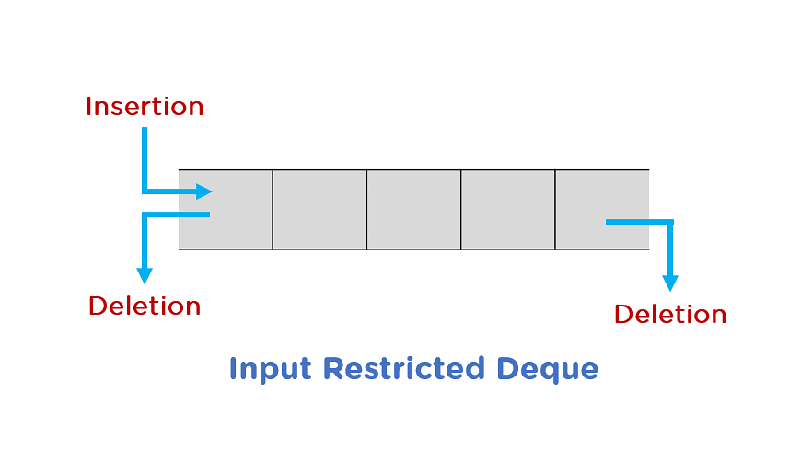
DEQueue
1. Input restriction dequeue:
Insertion at one end but deletion are possible on both end.

Slide 30
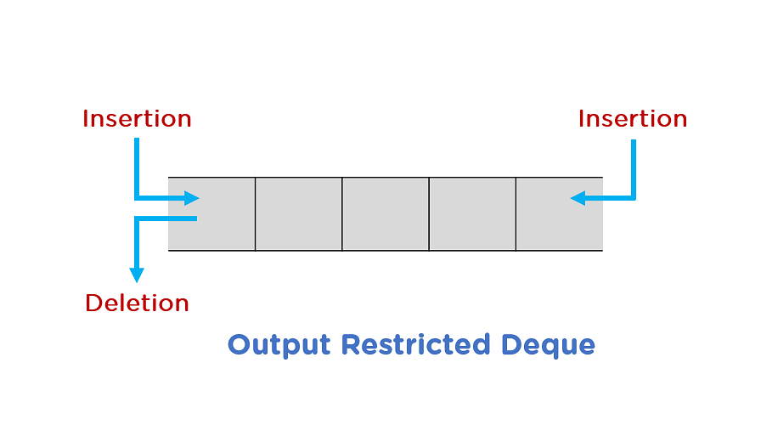
DEQueue
2. Output restriction dequeue:
Deletion at one end but insertion are possible on both end.

Slide 31
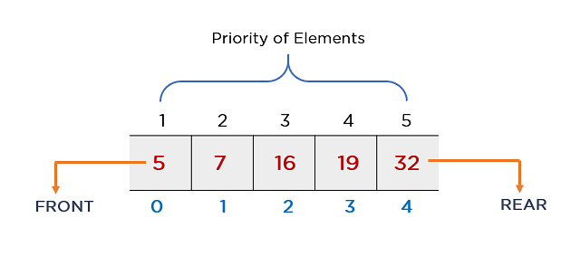
Priority Queue
A priority queue is a type of queue that arranges elements based on their priority values.

Slide 32
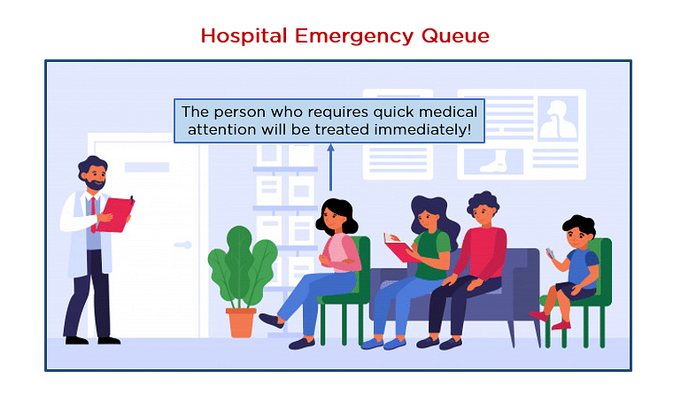
Example
This is best example of priority queue

Slide 33
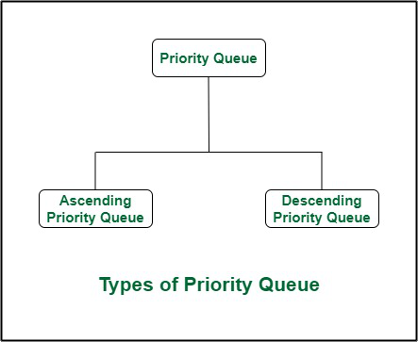
Continue …
If the element with the smallest value has the highest priority, then that priority queue is called the ascending priority queue(min priorty).
If the element with a higher value has the highest priority, then that priority queue is known as the descending priority (max priority) queue.

Slide 34
THANK YOU

