Slide 1

Data Structure [09CE2303] Unit:-5
PRESENT BY
DOLLY N SHILU
Assistant Professor
Diploma-CE

Slide 2
Sorting And Searching Techniques

Slide 3
Outline
Sorting
Quick sort
Bubble sort
Selection sort
Insertion sort
Searching
Linear Search
Binary Search

Slide 4
What is Sorting
The arrangement of data in a preferred order is called sorting.
Sorting techniques in data structures is a process of rearranging data elements in an array or list in order to make it easier to search.
There are many sorting algorithms are available to sort a data in any of the order as per requirement.

Slide 5
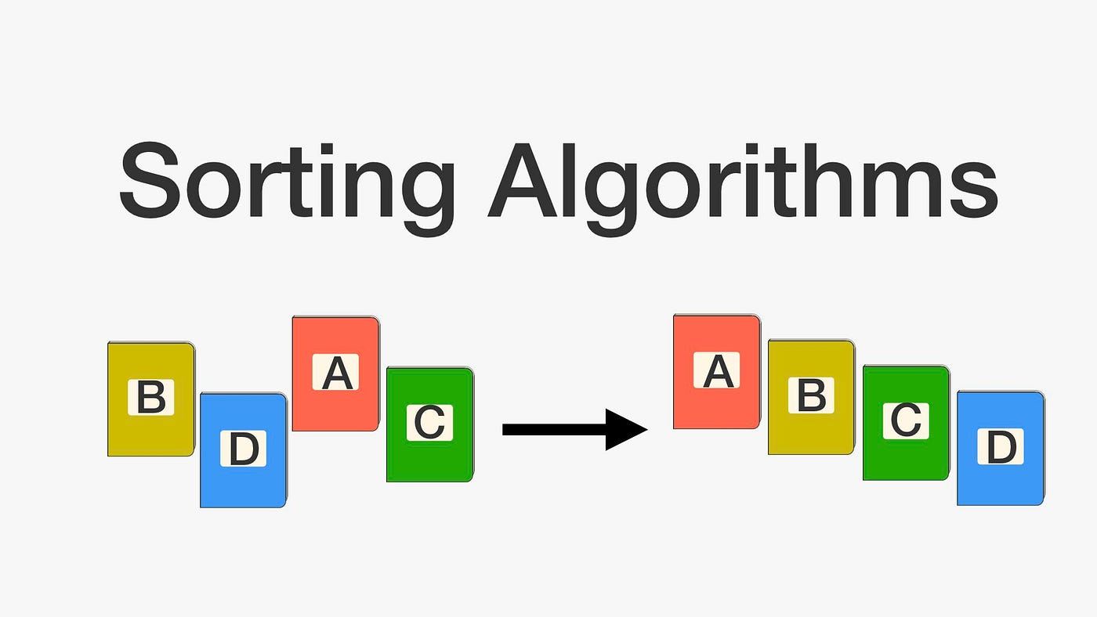
Sorting

Slide 6
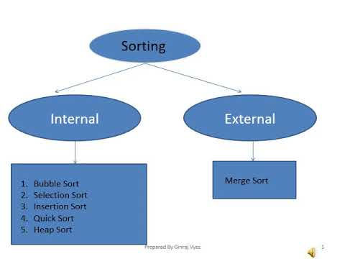
Sorting

Slide 7
Quick sort
The key function in quick sort is a partition. The target of partitions is to put the pivot in its correct position if the array is sorted and the smaller (or equal) to its left and higher elements to its right and do all this in linear time.

Slide 8
Algorithm Quick Sort
St-1:-partition (arr[], low, high)
{ // first element as pivot
st2:- pivot = arr[low] k = high for (i = high; i > low; i–)
{ st3:- if (arr[i] > pivot){ swap arr[i] and arr[k]; k–; } } st4:- swap arr[k] and arr[low] st5:- return k-1;
}

Slide 9
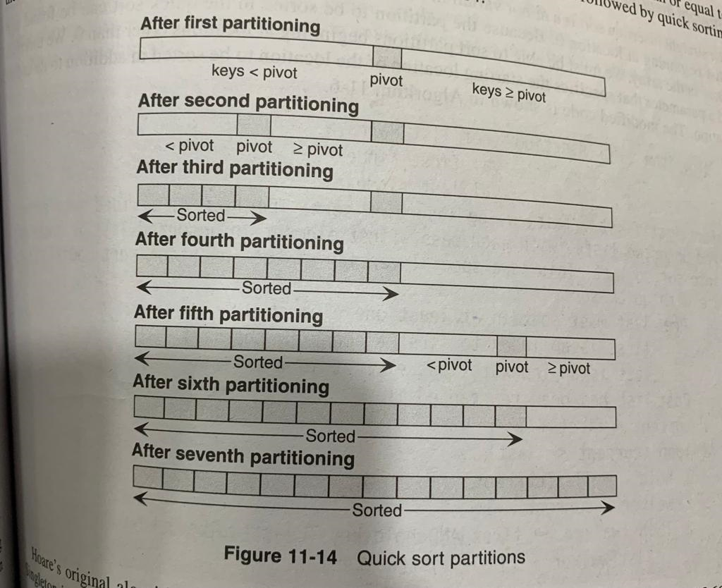

Slide 10
Bubble Sort
It is simple and easy tech. In this tech., start with first element .
each element is compared with its very (next) element.
If first element is larger than second element then position of
elements are interchanged(swap that two numbers) otherwise it is
not changed.
Then next element is compared with its very next element and same
process is repeated for all elements.
Each pass places maximum value in last position.

Slide 11
Algorithm Bubble Sort
Step 1:[Initialization ]
i←0
Step 2:repeat step 2 to 7 while i< n-1
Step 3:set j ←0
Step 4:repeat step 5 to 6 while j < n -i- 1
Step 5: if a[ j ] > a [ j+1]
then
Set temp = a[ j ]
Set a[ j ] = a[ j+1]
Set a[ j+1] = temp
End if
Step 6:j=j+1
Step 7:i=i+1
Step 8:[finished] Exit

Slide 12
Selection Sort
In this first element and searches entire list until it
finds minimum values.
Compare first element with second element If first element is larger than second element of elements are interchanged(swap that two numbers) otherwise it is not changed.
Then again compare first element with third, then compare firstelement with forth and soon.
same process is repeated for all elements.
Each pass minimum value comes in first position.

Slide 13
Algorithm Selection Sort
Step 1:[Initialization ]
i←0
Step 2:repeat step 2 to 7 while i< n-1
Step 3:set j ←i+1
Step 4:repeat through step 5 while j < n
Step 5:if a[ i] > a [ j ] then
Set temp = a[ i]
Set a[ i] = a[ j ]
Set a[ j ] = temp End if
Step 6: j=j+1
Step 7: i=i+1
Step 8: [finished]
Exit

Slide 14
Insertion Sort
In insertion sort element is inserted at appropriate place
For ex: to sort cards in one’s hand one extract card ,shift remaining
cards, then insert extracted card in the correct place.
This process is repeated until all the cards are in the correct
sequence.

Slide 15
Algorithm Insertion Sort
Step1:-Insertion t into a[0:i-1]
Int j;
Step2:-[Elements inserted ]
Shift x element from the last member to right by one position
Step3:- for(j=i-1;j>=0;&& a[j];j--)
A[j+1]=a[j];
Insert t at j+1 location
A[j+1]=x
Step4:- exit

Slide 16
Merge Sort
Merging means combining two sorted arrays or list into single sorted Array or list
It maintains two pointer i,j for each sorted list initially pointing first Value in list. K is used for final array
Merge sort compares value at ith position in first list and jth position in second list and copies whichever is smaller at kth position into final array list.(if equals any one can be copied)
Then increments corresponding pointer either i , j from which value has been copied to k and also k is incremented to store next value at next position.

Slide 17
Algorithm Merge Sort
MERGE_SORT(arr, low, high)
if low < high
set mid = (low + high)/2
MERGE_SORT(arr, low, mid)
MERGE_SORT(arr, mid + 1, high)
MERGE (arr, low, mid, high)
end of if
END MERGE_SORT

Slide 18
Searching
Process to find whether key element is present or not in an array is called searching.
There are two types of search method used
1) Binary Search Method
2) Linear/Sequential Search Method

Slide 19
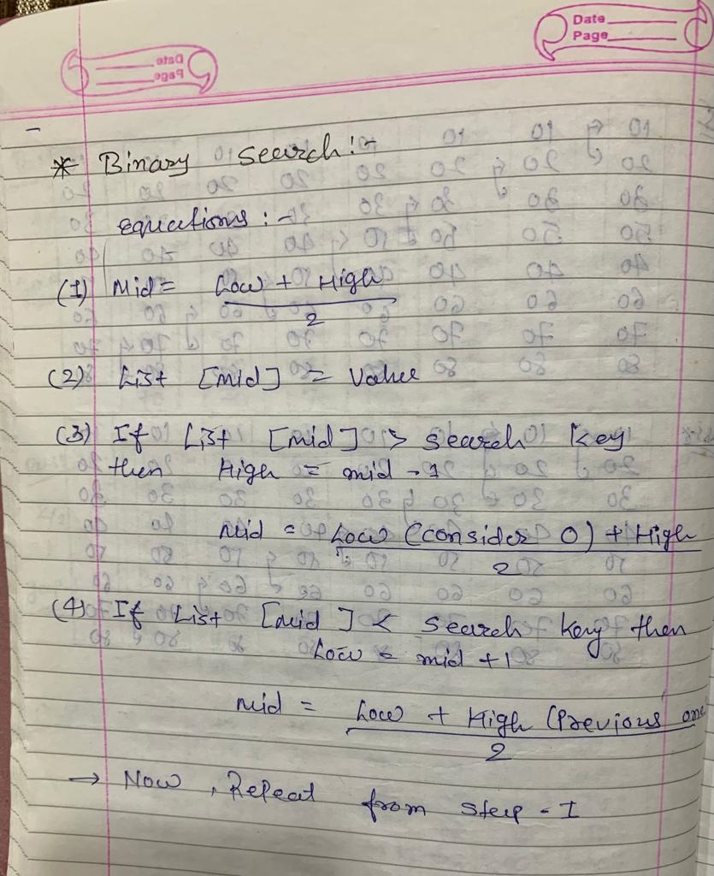
Binary Search

Slide 20
Binary Search
Binary Search is a searching technique used in a sorted array by repeatedly dividing the search interval in half.
Note: A sorted list of items is the only type of list on which a binary search can be used. We must first sort the elements if they are not already sorted.
The array that will be used for searching is as follows: x= 4 serve as the search element.

Slide 21


Example
2.Place two pointers in the lowest and highest positions, respectively, at low and high.
Determine the array’s middle element, arr[(low+ high)/2], which equals 6.

Slide 22

Continue…
4.Return mid if x== mid. Otherwise, compare the searchable element with m.
5.If x > mid, evaluate x against the middle element of the elements to its right. Setting low to low = mid + 1 achieves this.
6.Else, make a comparison of x with the element in the middle of the elements to the left of mid. Setting high to high = mid – 1 accomplishes this.

Slide 23


Continue…
7.Carry on in this manner until low and high are met.
8.x = 4 is found.

Slide 24
Binary Search Method Algorithm
mid = (low + high)/2
if (x == arr[mid])
return mid
else if (x > arr[mid]) // x is on the right side low = mid + 1
else // x is on the left side
high = mid - 1

Slide 25

Linear Search/Sequential Search
Linear search, also known as sequential search, is a simple algorithm used to search for a target value within a list or an array.
The linear search algorithm sequentially checks each element of the list or array until it finds the target value, or until it has checked every element and determined that the target value is not present.
Sequential search works for both sorted and unsorted data.
If value is found the index of value is return.
k=41

Slide 26
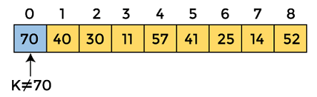
Example
start from the first element and compare K with each element of the array.
The value of K 41, is not matched with the first element of the array. So, move to the next element. And follow the same process until the respective element is found.

Slide 27
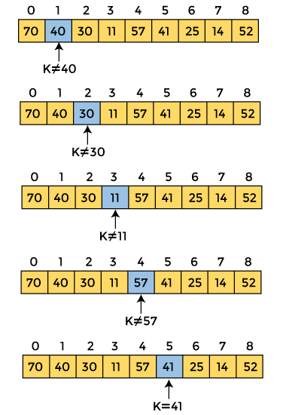

Slide 28
THANK YOU

