Slide 1

Data Structure [09CE2303] Unit:-6
PRESENT BY
DOLLY N SHILU
Assistant Professor
Diploma-CE

Slide 2
Hashing

Slide 3
Out line
Introduction
Hash function
Division method
Mid-square method
Multiplication method
Application of hashing

Slide 4
Introduction
Hashing is a technique which determines the location or position where the data should be stored by using a data structure known as Hash table.
Hashing technique uses a new data structure called hash table whose search is independent of the no. of entries in a table.
This is the position of a particular record in the table is determined by the value of a key for that record.

Slide 5
What is Hashing
Hashing is a technique or process of mapping keys, and values into the hash table by using a hash function. It is done for faster access to elements.
Hashing in the data structure is a technique of mapping a large no. of data into small tables using a hashing function.
That is storing and retrieving data in one(1) time(constant time).
That is some hash functions used for hash table

Slide 6
Hashing
A Hash table is a common data structure that consist of an array and mapping.
Array (Hash Table)
+
Mapping (Hash Function)

Slide 7
Hash functions
Division method
Mid square method
Folding method and
Multiplicative method

Slide 8
Division method
In division method there are two type of formula or function used
1) k mod N
2) k mod 10
This is the most simple and easiest method to generate a hash value. The hash function divides the value k by N and then uses the remainder obtained.
Formula:
h(K) = k mod N or h(K)=k mod 10
Here, k is the key value, and N is the size of the hash table.

Slide 9
Example
Hash key:- 10,11,12,13,14,15
Using k mod 10
In this method hash table size is 10
H(k)= k mod 10 here k=key
k=10
10 mod 10 that mean 10 % 10
reminder obtain 0 so hash key 10 put into 0 place which is hash index, now 11 mod 10 reminder 1
11 put into 1st place
Hash Table
Hash index
0 | 1 | 2 | 3 | 4 | 5 | 6 | 7 | 8 | 9
10 | 11 | 12 | 13 | 14 | 15
Hash key

Slide 10
Example
Hash key:- 10,11,12,13,14,15
Using k mod N
In this method hash table is put the value in number of key size so table size is N= N-1 N=6 key size is N size
So N=6-1=5 now
N=5
H(k)= k mod N here k=key
10 mod 5 and
Hash Table
Hash index
0 | 1 | 2 | 3 | 4 | 5
10 | 11 | 12 | 13 | 14 | 15
Hash key

Slide 11
Another Example
it is best suited that N is a prime number as that can make sure the keys are more uniformly distributed. The hash function is dependent upon the remainder of a division.
Example
k = 12345 N = 95 h(12345) = 12345 mod 95 = 90
k = 1276 N = 11 h(1276) = 1276 mod 11 = 0
In this case value put into table in that perticular way.

Slide 12
Advantage and Disadvantage
Pros:
This method is quite good for any value of N.
The division method is very fast since it requires only a single division operation.
Cons:
This method leads to poor performance since consecutive keys map to consecutive hash values in the hash table.
Sometimes extra care should be taken to choose the value of N.

Slide 13
Mid square
Mid-Square hashing is a hashing technique in which unique keys are generated. In mid Square method you can put the keys in two way.
1) In this technique, a value is taken and it is squared. Then, some digits from the middle are extracted. These extracted digits form a number which is taken as the new value. This technique can generate keys with high randomness if a big enough value is taken.
Suppose the size of the Hash Table (N)=10(0- 9)
key (k) = 12 ⇒ k² k*k 12*12 =144 so 4 is mid number of 12 square
Hash Table
Hash index
0 | 1 | 2 | 3 | 4 | 5 | 6 | 7 | 8 | 9
 |  |  |  | 12
Hash key

Slide 14
Mid Square
2) suppose the key =123 and
The size of the Hash Table (N)=10(0- 9)
So get the mid value of key 123 is 2 so 2*2=4 you can put the key value on hash index 4
Hash Table
Hash index
0 | 1 | 2 | 3 | 4 | 5 | 6 | 7 | 8 | 9
 |  |  |  | 123
Hash key

Slide 15
Folding method
Folding Method in Hashing: It breaks up a key value into precise segments that are added to form a hash value.
H(k)= k1+k2+k3…+kn
Suppose key=123456 size of hash table is 1000(0-999)
123
+ 456 fold the value pair of 2 or 3 or so on
= 579 here, we can use pair of 3
k1 + k2 = 579
Hash Table
Hash index
0 | 1 | 2 | ….. | … | 579 | … | … | … | 999
 |  |  |  |  | 123456
Hash key

Slide 16
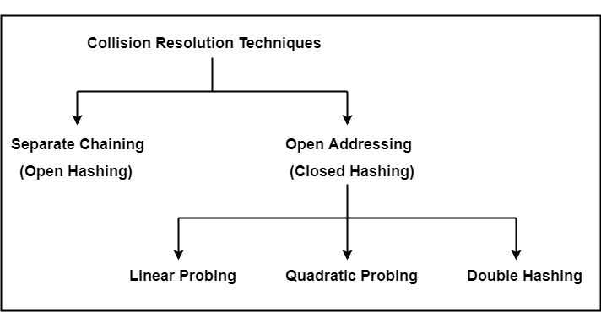
Collision Resolution Technique

Slide 17
Open Hashing(chaining)
Open Hashing is also called Chaining
Suppose keys 10,11,12,22 and size of table N=10(0-9)
Using division method
h(k)=k mod 10
10 mod 10 = 0 ,11 put in 1, and 12 put in 2 now 22 is also put in 2 so in this case collision occurs
In this situation we need some technique which is open hashing or chain technique in this technique This method involves making a linked list out of the slot where the collision happened, then adding the new key to the list.
Hash Table
Hash index
0 | 1 | 2 | 3 | 4 | 5 | 6 | 7 | 8 | 9
10 | 11 | 22
Hash key
12

Slide 18
Chaining Technique
In this technique create a chain of hash key value
now new key is suppose 20 so put into 0 index
0 | 1 | 2 | 3 | 4 | 5 | 6 | 7 | 8 | 9
10 | 11 | 22
20
12

Slide 19
Time complexity
Its worst-case complexity for searching is o(n).
Its worst-case complexity for deletion is o(n).
Advantages of chaining
It is easy to implement.
The hash table never fills full, so we can add more elements to the chain.
It is less sensitive to the function of the hashing.
Disadvantages of chaining
In this, the cache performance of chaining is not good.
Memory wastage is too much in this method.
It requires more space for element links.

Slide 20
Closed Hashing (open Addressing)
Closed Hashing also known as open addressing .
Closed hashing technique used three types
1) Linear probing
2)Quadratic probing
3)Double hashing
1) Linear:- this involves doing a linear probe for the following slot when a collision occurs and continuing to do so until an empty next available slot is discovered.
H(k)= h(k)+i mod 10
Here, i is probe number

Slide 21
Linear probing
Suppose key 10,12,20,23,22 and size of hash table N=10(0-9)
In this technique using with k mod 10
K mod 10 , 10 mod 10 =0 20 is also put in 0 position but using this technique next available slot is 1 so 20 put in next slot which is 1
23 is put into using k mod 10 method and now 22 is put into next available slot so 23 put space 3 so very next available slot is 4 so 22 put in place 4
For 20 h(k) 0 +1=1 so 20 put in 1
Hash Table
Hash index
0 | 1 | 2 | 3 | 4 | 5 | 6 | 7 | 8 | 9
10 | 20 | 12 | 23 | 22
Hash key

Slide 22
Quadratic probing
When a collision happens in this, we probe for the i2-nd slot in the i^{th} iteration, continuing to do so until an empty slot is discovered. In comparison to linear probing, quadratic probing has a worse cache performance. Additionally, clustering is less of a concern with quadratic probing.
H(k,i)= h(k)+ i2 mod 10
i is probe number
https://youtu.be/j612Fj-mgCY?feature=shared
More doubt you can use this link. This is very helpful video.

Slide 23
THANK YOU

