Slide 1




Computer Engineering Department
• Author Detail

Slide 2

INDEX
History,
Java Introduction,
Byte Code,
JVM & JDK,
Data types,
Java Operator,
Statement : If, else, Switch condition, while, do-while, for loop, break and continue statement
• Author Detail

Slide 3

HISTORY
James Gosling, Mike Sheridan, and Patrick Naughton initiated the Java language project in June 1991.
Java was originally designed for interactive television, but it was too advanced for the digital cable television industry at the time.
The language was initially called Oak after an oak tree that stood outside Gosling's office. Later the project went by the name Green and was finally renamed Java, from Java coffee.
Gosling designed Java with a C/C++-style syntax that system and application programmers would find familiar.
Sun Microsystems released the first public implementation as Java 1.0 in 1996.
• Author Detail

Slide 4

INTRODUCTION
Java is a programming language and a platform.
It is an object-oriented, class-based, concurrent, secured and general- purpose computer-programming language.
Java is a high level, robust and secure programming language.
Platform: Any hardware or software environment in which a program runs, is known as a platform. Since Java has a runtime environment (JRE) and API, it is called a platform.
• Author Detail

Slide 5

APPLICATION
1. Desktop
Applications such as acrobat reader, media
player,
antivirus, etc.
Web Applications such as irctc.co.in, javatpoint.com, etc.
Enterprise Applications such as banking applications.
Mobile
Embedded System
Robotics
Games, etc.
• Author Detail

Slide 6

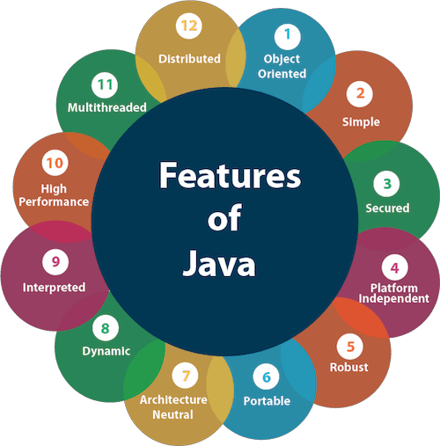
Features of Java
Simple
Object-Oriented
Portable
Platform independent
Secured
Robust
Architecture neutral
Interpreted
High Performance
Multithreaded
Distributed
Dynamic
• Author Detail

Slide 7
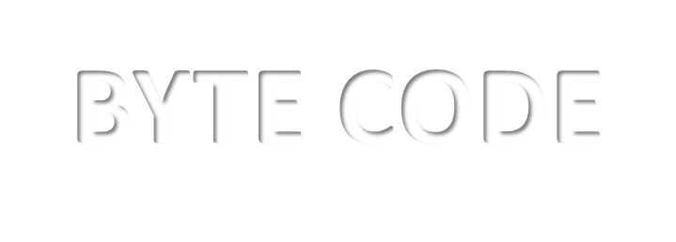
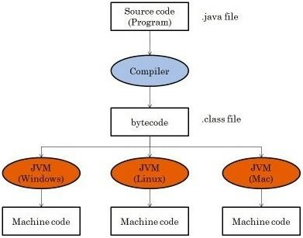
BYTE CODE
Java bytecode is the instruction set for the Java Virtual Machine.
Firstly, the compiler compiles that program (.java file) and a bytecode (.class file) is generated for that piece of code.
Then now
the bytecode generated is run by the Java
• Author Detail
Virtual
any
Machine irrespective to
operating system, which makes java a platform independent language.

Slide 8

JVM
JVM (Java Virtual Machine) is an abstract machine.
It is called a virtual machine because it doesn't physically exist.
It is a specification that provides a runtime environment in which Java bytecode can be executed.
The JVM performs the following main tasks:
Loads code
Verifies code
Executes code
Provides runtime environment
• Author Detail

Slide 9

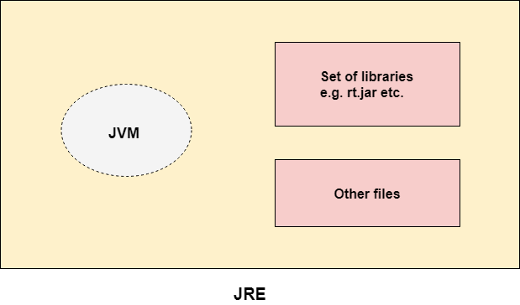
JRE
JRE is an acronym for Java Runtime Environment.
The Java Runtime Environment is a set of software tools which are used for developing Java applications.
It is
used to provide the runtime
environment.
It is the implementation of JVM. It
physically exists.
It contains a set of libraries + other
files that JVM uses at runtime.
• Author Detail

Slide 10

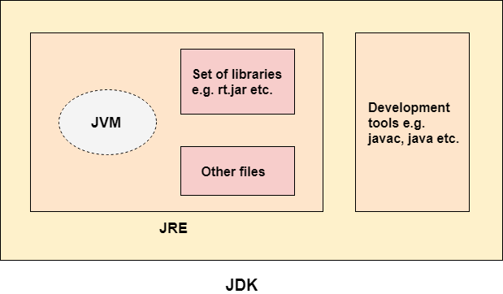
JDK
JDK is an
acronym Kit.
for Java The Java
Development
Development Kit (JDK) is a software
development environment which is
used to develop Java applications.
JDK is an implementation of any one of
the below given Java Platforms
released by Oracle Corporation:
Standard Edition Java Platform
Enterprise Edition Java Platform
Micro Edition Java Platform
• Author Detail

Slide 11

PROGRAM 1 A/B
Demonstrate HelloWorld Application with Single and Multiple Main in a java program.
To compile: | javac HelloWorld.java
To execute: | java HelloWorld
• Author Detail

Slide 12

DATA TYPES
Data types specify the different sizes and values that can be stored in the variable.
There are two types of data types in Java:
Primitive data types: The primitive data types include boolean, char, byte,
short, int, long, float and double.
Non-primitive data types: The non-primitive data types include Classes,
Interfaces, and Arrays.
• Author Detail

Slide 13
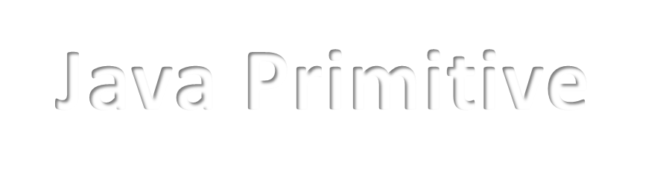

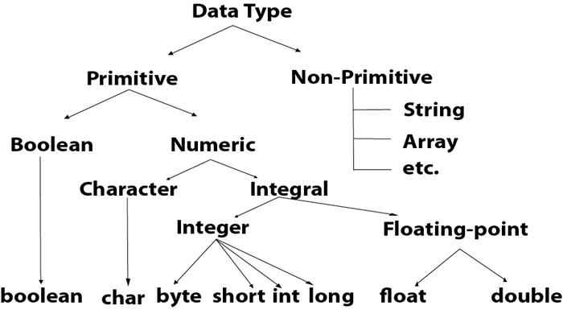
Java Primitive Data Types
There are 8 types of primitive data types:
boolean data type
byte data type
char data type
short data type
int data type
long data type
float data type
double data type
• Author Detail

Slide 14


Data Types : Size
Data Type | Default Value | Default size
boolean | false | 1 bit
char | '\u0000' | 2 byte
byte | 0 | 1 byte
short | 0 | 2 byte
int | 0 | 4 byte
long | 0L | 8 byte
float | 0.0f | 4 byte
double | 0.0d | 8 byte
• Author Detail

Slide 15

JAVA OPERATOR
Operator in java is a symbol that is used to perform operations.
For example: +, -, *, / etc.
There are many types of operators in java which are given below:
Unary Operator,
Arithmetic Operator,
Shift Operator,
Relational Operator,
Bitwise Operator,
Logical Operator,
Ternary Operator and
Assignment Operator.
• Author Detail

Slide 16



Java Operator Precedence
Operator Type | Category | Precedence
Unary | postfix | expr++ expr--
 | prefix | ++expr –expr
Arithmetic | multiplicative | * / %
 | additive | + -
Shift | shift | << >>
Relational | comparison | < > <= >=
 | equality | == !=
Bitwise | bitwise AND | &
 | bitwise exclusive OR | ^
 | bitwise inclusive OR | |
Logical | logical AND | &&
 | logical OR | ||
Ternary | ternary | ? :
Assignment | assignment | = += -= *= /= %= &=
• Author Detail

Slide 17

Unary Operator
class OperatorExample{
public static void main(String args[]){ int x=10;
System.out.println(x++);
System.out.println(++x); System.out.println(x--); System.out.println(--x);
}}
• Author Detail

Slide 18

OUTPUT
10
12
12
10
• Author Detail

Slide 19

Arithmetic Operator
class OperatorExample{
public static void main(String args[]){ int a=10;
int b=5;
System.out.println(a+b); System.out.println(a-b); System.out.println(a*b); System.out.println(a/b); System.out.println(a%b);
}}
• Author Detail

Slide 20
OUTPUT
15
5
50
2
0
• Author Detail

Slide 21

Ternary Operator
class OperatorExample{
public static void main(String args[]){ int a=2;
int b=5;
int min=(a<b)?a:b; System.out.println(min);
}
}
• Author Detail

Slide 22

Control Statement
Java If-else
Java Switch condition
Java while loop,
Java do-while loop,
Java for loop,
Java break
Java continue statement
• Author Detail

Slide 23
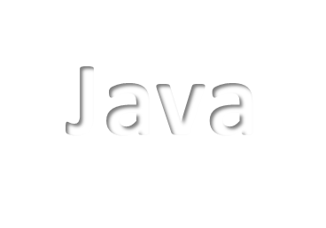



Java If-else
public class IfExample {
public static void main(String[] args) {
//defining an 'age' variable int age=20;
//checking the age
if(age>18){
System.out.print("Age is greater than 18");
}
}
}
OUTPUT: Age is greater than 18
• Author Detail

Slide 24

Switch condition
public class SwitchExample {
public static void main(String[] args) {
int number=20; switch(number){
case 10: System.out.println("10");
break;
case 20: System.out.println("20");
break;
case 30: System.out.println("30"); break;
default:
System.out.println("Not in 10, 20 or 30");
}
}
}
• Author Detail
OUTPUT : 20

Slide 25

Java while loop
public class WhileExample {
public static void main(String[] args) { int i=1;
while(i<=10){ System.out.println(i);
i++;
}
}
}
OUTPUT :
1
2
3
4
5
6
7
8
9
10
• Author Detail

Slide 26

Java for loop
public class ForExample {
public static void main(String[] args) {
//Code of Java for loop for(int i=1;i<=10;i++){
System.out.println(i);
}
}
}
OUTPUT :
1
2
3
4
5
6
7
8
9
10
• Author Detail

Slide 27
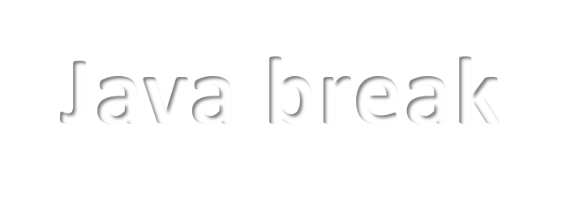
Java break
public class BreakExample {
public static void main(String[] args) {
//using for loop for(int i=1;i<=10;i++){
if(i==5){
//breaking the loop break;
}
System.out.println(i);
}
}
}
OUTPUT:
1
2
3
4
• Author Detail

Slide 28

Continue statement
public class ContinueExample { public static void main(String[] args) {
//for loop
for(int i=1;i<=10;i++){ if(i==5){
//using continue statement continue;
}
System.out.println(i);
}
}
}
OUTPUT :
1
2
3
4
5
6
7
8
9
10
• Author Detail

Slide 29
THANK YOU
• Author Detail

