Slide 1



UNIT-5
• Author Detail

Slide 2

INDEX
Overview of Different Stream (Byte Stream, Character stream),
Readers and Writers class,
File Class,
File InputStream,
File Output Stream,
InputStreamReader and OutputStreamWriter class,
File reader and writer class,
Buffered Reader class
• Author Detail

Slide 3
Overview
The java.io package contains nearly every class you might ever need to perform input and output (I/O) in Java.
All these streams represent an input source and an output destination.
• Author Detail

Slide 4

Stream
A stream can be defined as a sequence of data. There are two kinds of Streams −
InPutStream − The InputStream is used to read data from a source.
OutPutStream − The OutputStream is used for writing data to a destination.
• Author Detail

Slide 5



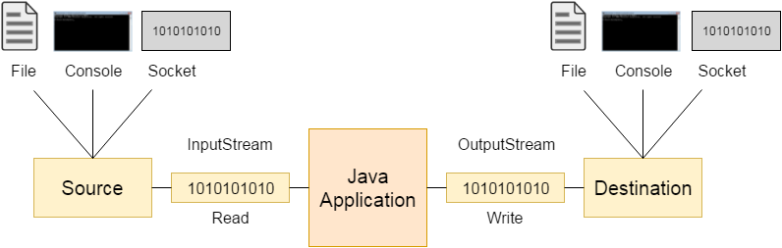
InPutStream vs OutPutStream
Java application uses an input stream to read data from a source; it may be a file, an array, peripheral device or socket.
Java application uses an output stream to write data to a destination; it may be a file, an array, peripheral device or socket
• Author Detail

Slide 6

Byte Streams
Java byte streams are used to perform input and output of 8-bit
information.
Though there are many classes related to byte streams but the most frequently used classes are, FileInputStream and FileOutputStream.
• Author Detail

Slide 7

Example 1
import java.io.*; |  | while ((c = in.read()) != -1) {
public class CopyFile { |  | out.write(c);
public static void main(String args[]) |  | }
throws IOException { |  | }catch(Exception e)
FileInputStream in = null; |  | {
FileOutputStream out = null; |  | System.out.println(e);
try { |  | }
in = new |  | in.close();
FileInputStream("input.txt"); |  | out.close();
out = new |  | }
FileOutputStream("output.txt"); | }
• Author Detail
int c;

Slide 8

Character Streams
Java Byte streams are used to perform input and output of 8-bit , whereas Java Character streams are used to perform input and output for 16-bit.
Though there are many classes related to character streams but the most frequently used classes are, FileReader and FileWriter.
Though internally FileReader uses FileInputStream and FileWriter uses FileOutputStream but here the major difference is that FileReader reads two bytes at a time and FileWriter writes two bytes at a time.
• Author Detail

Slide 9

Example 2
import java.io.*; public class CopyFile {
public static void main(String args[])
throws IOException { FileReader in = null; FileWriter out = null; try {
in = new FileReader("input.txt");
out = new FileWriter("output.txt"); } int c;
while ((c = in.read()) != -1) { out.write(c);
}
}catch(Exception e)
{
System.out.println(e);
}
in.close();
out.close();
}
• Author Detail

Slide 10


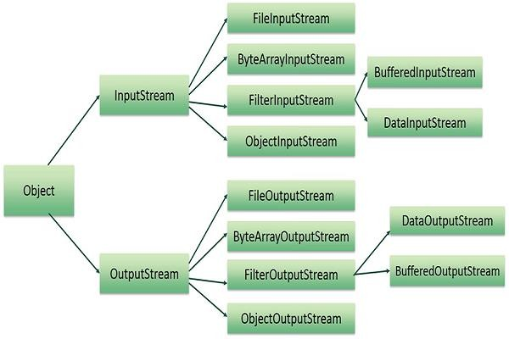
hierarchy of I/O Stream
• Author Detail

Slide 11
import java.io.FileInputStream; import java.io.FileOutputStream;
System.out.println(e);
}
System.out.println("-------Retrive Data From File-------");
try {
public class Student {
FileInputStream FileInputStream("stdinfo.txt");
int i = 0;
fin = new
public static void main(String[] args) { System.out.println("-------Writing Data in File-------"); try {
while ((i = fin.read()) != -1) { System.out.print((char) i);
}
fin.close();
} catch (Exception e) { System.out.println(e);
}
FileOutputStream
FileOutputStream("stdinfo.txt");
String str = "Name : Engineering, Sem : 5th Sem";
byte b[] = str.getBytes(); fout.write(b); fout.close();
fout =
Sachin, Stream
new
: Computer
• Author Detail
}
System.out.println("successful write.");
} catch (Exception e) {
}

Slide 12
files
import java.io.*;
String str;
while ((str = dataIS.readLine()) != null) { String upper = str.toUpperCase(); System.out.println(upper); dataOS.writeBytes(upper + " ");
}
new dataIS.close();
dataOS.close();
public class Dataio {
public static void IOException {
main(String
args[])
throws
DataInputStream dataIS DataInputStream(new FileInputStream("stdinfo.txt"));
=
}
• Author Detail
}
new
DataOutputStream dataOS = DataOutputStream(new
FileOutputStream("newstdinfo.txt"));
// manipulate the student information from

Slide 13
THANK YOU
• Author Detail

