Slide 1
Ctrl+Voice
Say it messy. Send it clean.
Edit a voice message like text, before you send it. It still sounds like you.
Lovable Hackathon · Make It Better
Notes:
0:00–0:07 (7 s)
SAY:
"We're Ctrl+Voice. You can edit a voice message like text, before you send it. And it still sounds like you."
ON SCREEN: the waveform of the demo message draws in. The dim bars are the parts Ctrl+Voice will cut later.
One click goes to the next slide; everything on every slide plays by itself.

Slide 2
THE PROBLEM
You can’t edit speech.
TEXT
VOICE
I’m free on Thrusday
I’m free on Thursday
0:15
Backspace
“I’m free on Thursday… no no no, on Wednesday.”
Backspace
Re-record
Send anyway
A typo: one keystroke.
A slip: re-record, or send it anyway.
7 billion
voice messages are sent on WhatsApp every day.
Every one of them is write-once.
WhatsApp, March 2022
Notes:
0:07–0:19 (12 s)
SAY:
"In text, a typo is one keystroke. In a voice note, one slip and you re-record, or send it anyway. And WhatsApp alone carries seven billion voice messages a day. Here's a messy one."
ON SCREEN: Backspace fixes the typo (0:01.5); the voice note appears with Re-record / Send anyway (0:03-0:04); the stat (0:06.5).
SOURCE: WhatsApp blog, "Making voice messages better" (30 March 2022): "Every day on WhatsApp, our users send 7 billion voice messages on average." https://blog.whatsapp.com/making-voice-messages-better (also TechCrunch, 30 March 2022).

Slide 3
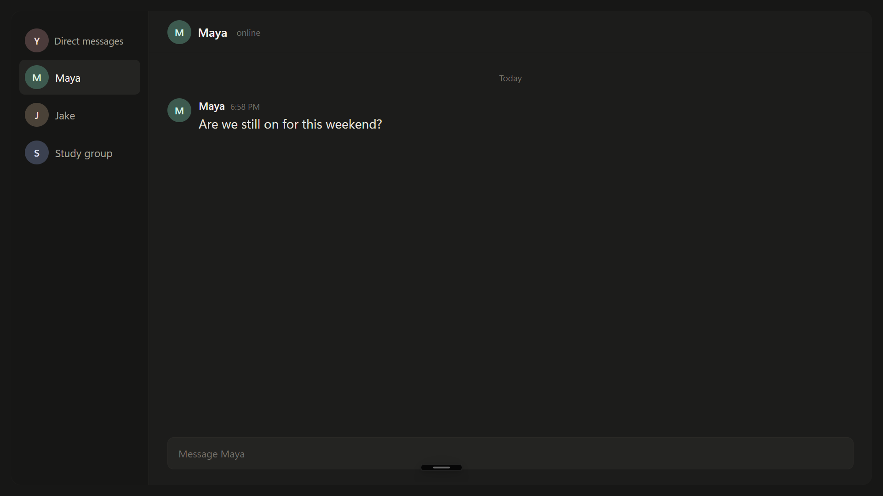
Alt+` and talk
Alt+` and talk
“Scratch that”
“Scratch that”
Alt+` again
Alt+` again
Cleaned and sent
1
Cleaned and sent
1
2
2
3
3
4
LIVE DEMO
4
Notes:
0:19–0:41 (22 s)
SAY (stay quiet while the voice note plays; it ends about 17 s into the clip):
"... 'Scratch that' was removed while it was still recording. One key, and it's cleaned up and sent."
ON SCREEN: the clip starts by itself. Alt+` opens the recording bar over a chat; the live caption follows the audio; at 0:16 "Also, I talked to Jake ... Scratch that." is struck and disappears; Alt+` again: "Cleaning up..." then "Sent to Discord"; the cleaned file (8 s) lands in the chat. The four steps at the top light up with it.
HOW THE CLIP WAS MADE: the real Ctrl+Voice recording bar (its own HTML/JS), driven offscreen with this message's real transcript and cuts, over a generic chat window. In the app only "scratch that" and Undo strike words live; fillers and the correction are cut when you finish (next slide). The live detector needs a short pause after "scratch that", so the clip adds 0.94 s of silence there (the live test did the same). Caption cadence (about 0.9 s per update, 0.45 s behind) is from a live test; the send-step timing is illustrative.
PLACEHOLDER AUDIO: the voice in this demo is synthetic (F5-TTS cloning a DisfluencySpeech voice; respeak docs/HANDOFF.md). It is not a recording of you or anyone on the team; don't call it one. Swap in your own recording before presenting (deck/SWAP.md).

Slide 4
BEFORE
Hey, Maya! So, about this weekend, um, I'll meet you on Monday, no wait, Wednesday at 5 at the cafe. And can you bring the, uh, the board game? Also, I talked to Jake and honestly he's being kind of annoying about the whole thing. Scratch that. Okay, see you then!
FILLER
CORRECTION
FILLER
TAKEN BACK
14.7 s
Notes:
0:41–0:49 (8 s)
SAY:
"Here's what it found: the fillers, a correction, 'Monday, no wait', and the whole sentence that was taken back."
ON SCREEN: each cut is struck and labelled in turn (filler, correction, filler, taken back) and its stretch of the waveform turns red.
DATA: transcript and cuts are the engine's own output for this message (media/deck_data.json, sid 5eef2781). Nothing on this slide is drawn by hand.
PLACEHOLDER AUDIO: the voice in this demo is synthetic (F5-TTS cloning a DisfluencySpeech voice; respeak docs/HANDOFF.md). It is not a recording of you or anyone on the team; don't call it one. Swap in your own recording before presenting (deck/SWAP.md).

Slide 5

AFTER
Hey, Maya! So, about this weekend, I'll meet you on Wednesday at 5 at the cafe. And can you bring the, the board game? Okay, see you then!
8.0 s
6.7 s shorter
4 cuts · cleaned in 0.7 s · nothing regenerated: every word is the original audio
Before
After
Notes:
0:49–1:02 (13 s)
SAY (after the audio, about 10 s into the slide):
"15 seconds down to 8, cleaned in 0.7 seconds. Nothing was regenerated: every word you just heard is the original audio, only cut."
ON SCREEN: Morph. The cut words drop out and the rest slide together; the waveform closes up to 8.0 s; the cleaned audio plays by itself with the playhead.
BUTTONS: "Before" and "After" play the two versions when clicked (handy in Q&A). Clicking anywhere else goes on.
SOURCE: respeak docs/RESULTS.md, End to end: "14.7 s test message cleaned to 8.0 s in 0.7 s (4 cuts)". This is that message. If you swap the recording, set clean_seconds in build/config.json to the new time (or null).
KNOWN: "the, the" stays: the cleanup did not mark that repeat.
PLACEHOLDER AUDIO: the voice in this demo is synthetic (F5-TTS cloning a DisfluencySpeech voice; respeak docs/HANDOFF.md). It is not a recording of you or anyone on the team; don't call it one. Swap in your own recording before presenting (deck/SWAP.md).

Slide 6
THE IDEA
Speech in. Speech out.
Ctrl+F
Ctrl+F
Ctrl+X
Ctrl+X
Ctrl+V
Ctrl+V
Find
Cut
Voice
Find the slip in your recording.
Cut out only that moment of audio.
Say the fix in your own voice, matched to the audio around it.
Text is only used to find the edit. What you get back is audio.
Notes:
1:02–1:14 (12 s)
SAY:
"So think of it as three shortcuts for your voice. Find the slip. Cut it. And when a cut isn't enough: Voice. Say the fix, in your own voice."
ON SCREEN: Ctrl+F, Ctrl+X and Ctrl+V light up as you say Find (0:03), Cut (0:04) and Voice (0:06). Voice lights green: green means AI-made audio, as in the app.

Slide 7
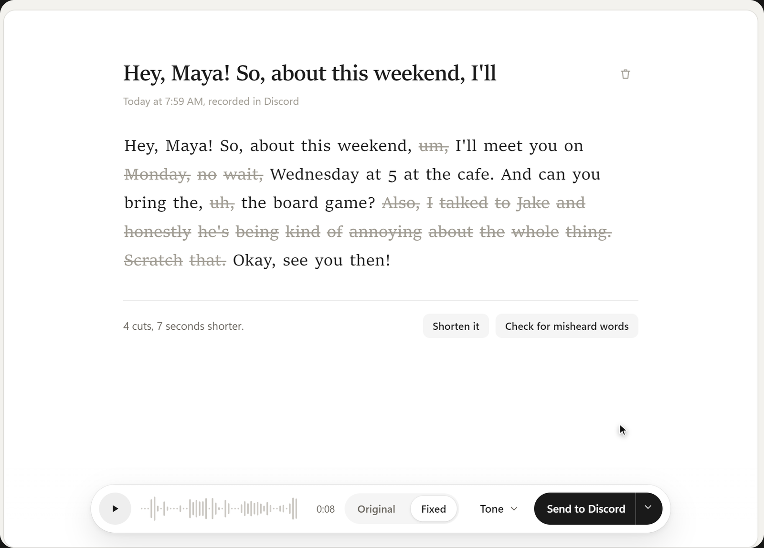
DEMO · THE EDITOR
Change a word.
Keep the voice.
Original or fixed, one click.
1
Original or fixed, one click.
1
Select a word, type a new one.
2
Select a word, type a new one.
2
Said in your voice, checked by re-transcribing.
3
Said in your voice, checked by re-transcribing.
3
3.1–4.2 s
per replaced word, ASR-verified
Notes:
1:14–1:30 (16 s)
SAY:
"In the editor: original or fixed, one click. Select a word, type a new one." (while it works) "It's said in your voice, then re-transcribed to check." (let the phrase play) "Three to four seconds a word."
ON SCREEN: Original / Fixed (0:01-0:03), select "cafe" (0:04), Replace, type "park"; the engine's result arrives after its real 3.5 s and "park" turns green (0:10); then the edited phrase plays from the engine's real audio.
SOURCE: the replacement and its audio are a real engine run on this message (playdiff, ASR-verified). RESULTS.md End to end: "'cafe' -> 'park' in 3.1-4.2 s, ASR-verified". The clip is the real app UI (its own HTML/JS) with engine calls answered from saved engine output.
PLACEHOLDER AUDIO: the voice in this demo is synthetic (F5-TTS cloning a DisfluencySpeech voice; respeak docs/HANDOFF.md). It is not a recording of you or anyone on the team; don't call it one. Swap in your own recording before presenting (deck/SWAP.md).

Slide 8

DEMO · TONE
Same words.
Different tone.
Confident
Confident lower and quicker
Warm
Warm brighter and livelier
Calm
Calm slower and steadier
Pitch and pace of your own recording. Your voice is untouched.
about 0.1 s per preset
Notes:
1:30–1:40 (10 s)
SAY:
"Same words, different tone: confident, warm, calm. It only moves pitch and pace, so it's still your voice."
ON SCREEN: the tone panel of the real app; each character lights up as its slider rises (confident 0:02, warm 0:04, calm 0:06). No tone audio is played on this slide.
SOURCE: RESULTS.md Round 2, Tone: "Natural presets: 0.1 s, voice untouched (pitch/pace only)." The AI tone engine is a separate, experimental option and is not shown.

Slide 9
UNEDITED SCREEN RECORDING
Ctrl+Voice in Discord
PLACEHOLDER
Real screen recording goes here
Ctrl+Voice in Discord (Vesktop): press Alt+`, talk, say “scratch that”, press Alt+` again, the message arrives. Then open it in the editor.
Save it as media/screen.mp4 and rebuild (SWAP.md).
Notes:
1:40–1:54 (14 s)
PLACEHOLDER: there is no real screen recording in the deck yet. Record the real app in Discord/Vesktop (Alt+`, talk, "scratch that", Alt+`, the message arrives; then open it in the editor), trim to about 14 s, save as deck/media/screen.mp4 and rebuild (SWAP.md). Until then, hide this slide and give its time to How it works.
SAY:
"And this is the real app, unedited: one key to record, one key to send, straight into Discord."

Slide 10
HOW IT WORKS
Three paths, one rule: cut first.
LIVE
Mic stream
24 kHz audio to the engine
Whisper large-v3-turbo
re-transcribes about once a second
Forced aligner
wav2vec2 re-times every word
Undo / “scratch that”
an LLM picks where the thought began
while you talk
CLEAN
Qwen3.6-35B-A3B
marks fillers, corrections, scratched thoughts
Rule checks
delete-only; numbers, dates, “not” protected
Render
cuts at the quietest point, 12 ms crossfades
Send
pasted into the chat you were in
when you stop
REGENERATE
Context
about 4 s of your audio on each side
PlayDiffusion ‖ F5-TTS
two speech models in parallel
Splice
only the new word enters the original
Verify
re-transcribe, keep the closest voice
one word
Notes:
1:54–2:14 (20 s)
SAY:
"Three paths. Live: Whisper re-transcribes the whole message about once a second and a forced aligner times each word, so 'scratch that' works mid-sentence. Clean: an LLM marks what to cut; rule checks only let it delete, and it can't drop a number, a date or a 'not' unless you corrected it. Regenerate: two speech models race, and we keep the take that passes re-transcription and sounds most like you."
ON SCREEN: the three lanes appear as you reach them (0:00, 0:06, 0:12). The green-outlined box (Splice) is the key idea of the next slide.
SOURCE: respeak docs/HANDOFF.md §2: the server re-transcribes every 0.7 s (the live test saw an update about every 0.9 s), wav2vec2 CTC forced aligner, Qwen3.6-35B-A3B with delete-only validators that protect negations/numbers/dates unless a correction replaces them with the same type, 12 ms equal-power crossfades at the quietest frame, PlayDiffusion and F5-TTS in parallel on a window of up to about 4 s each side, verified by re-transcription, best by speaker similarity (ECAPA). Ctrl+Voice README: the file is pasted into the window you were in.

Slide 11
THE KEY INSIGHT
Regenerate one word, not the clip.
Regenerate the whole clip
0.733
every sample is AI audio
voice similarity
Splice one word into the original
0.976
the rest is your real recording
voice similarity
Similarity of the edited clip to the original voice. PlayDiffusion on 10 real recordings (LibriSpeech, AMI, DisfluencySpeech); same engine, same edits. Green = AI-generated audio.
Notes:
2:14–2:26 (12 s)
SAY:
"Here's what makes it work. Regenerate the whole clip and the voice drifts: 0.73 similarity. Regenerate only the new word and splice it into the untouched original: 0.98. Same engine, same edits."
SOURCE: respeak docs/RESULTS.md Round 1, word/phrase replacement, 10 real recordings: "PlayDiffusion raw (no splice)" voice sim 0.733; "PlayDiffusion + splice" 0.976 (both 10/10 vs 9/10 correct, WER 0.046).

Slide 12
BENCHMARKS
Measured on real speech.
STEP
WHAT WE COMPARED
BEST RESULT
Clean up
Qwen3-8B, Qwen3.6-35B-A3B, + a repair rule
28 messages, 10 of them trick sentences
24/28 exact
0/10 wrong deletions (first try: 9/28, 2/10)
Live undo
Undo and “scratch that” while recording
6 partial messages
351 ms
6/6 correct; 395 ms through the public proxy
Replace a word
dots.tts.edit, PlayDiffusion, F5-TTS, AuK-Flash
10 real recordings
9/10 correct
PlayDiffusion + splice, 1.5 s per edit
Mispronunciation
training-free scores vs our trained detector
speechocean762, 15,967 words
AUC 0.88
training-free: 0.73
Grammar
fix said in the speaker’s own voice
8 non-native speakers (EdAcc)
8/8 rendered
heard correctly; clips were pre-selected
All on one A100 80 GB. Small test sets: engineering measurements, not paper results. The grammar clips were pre-selected, so 8/8 measures rendering, not detection.
Notes:
2:26–2:38 (12 s)
SAY:
"We measured every stage on real speech. Cleanup: 24 of 28 messages exactly right, with zero wrong deletions on trick sentences. Undo in 351 milliseconds. Word replacement: 9 of 10 correct."
SOURCE: respeak docs/RESULTS.md. Clean up: Qwen3-8B word indices 9/28, 2/10 wrong deletions; Qwen3.6-35B-A3B inline markup 15/28, 0/10; + repair post-processor 24/28, 0/10; undo 4/6 -> 6/6. End to end: live undo 351 ms (395 ms through the public HTTPS proxy). Replacement: PlayDiffusion + splice 9/10, WER 0.046, voice sim 0.976, 1.5 s/edit (dots.tts.edit + splice was 10/10 but 12.7 s/edit). Detector: AUC 0.88 (acc <= 5) vs 0.73 training-free; correlation with experts 0.53 (published GOPT 0.53). Grammar: 8/8 rendered and heard correctly on EdAcc, 2.3-6.2 s each; utterances were pre-selected by the same prompt.
NOTE: from the desktop app over the pod proxy, undo round trips measured 375 ms in one live test and about 1.8 s in another. Quote 351 ms as the engine number.

Slide 13
WHO IT’S FOR
For anyone who’s ever hit re-record.
44%
“didn’t got” → “didn’t get”
“…scratch that.”
of people play voice notes at double speed. Shorter, cleaner notes respect their time.
Second-language speakers: the grammar is fixed in their own voice.
Anyone mid-rant: take it back before it’s sent.
Sky Mobile poll of 2,000 UK adults, 2025
8/8 fixes rendered on non-native speakers
live undo in 351 ms
Notes:
2:38–2:50 (12 s)
SAY:
"For listeners: 44% play voice notes at double speed. For second-language speakers: 'didn't got' becomes 'didn't get', in their own voice. And for anyone who'd like to take it back."
SOURCE: Sky Mobile poll of 2,000 UK adults (2025): 44% listen to voice notes at double speed; the average voice note is 3 minutes, people want 2. https://www.skygroup.sky/article/voice-no-brits-call-time-on-long-voice-notes
RESULTS.md Round 2, Grammar: 8/8 fixes rendered and heard correctly on 8 EdAcc non-native speakers ("didn't got" -> "didn't get"); utterances were pre-selected, so this measures rendering, not detection.

Slide 14
Ctrl+Voice
Say it messy. Send it clean.
Antony
Nikoloz
[Name]
[Name]
[Name]
ML Engineer
ML Engineer
Data Analyst
MLOps / API Engineer
Software Engineer
Lovable Hackathon · Make It Better
Notes:
2:50–3:00 (10 s)
SAY:
"We're Ctrl+Voice. Say it messy. Send it clean. Thank you."
TO DO: 3 team names are still [Name] (amber). Fill them in build/config.json -> team and rebuild.

Slide 15
APPENDIX · FOR QUESTIONS
What we haven’t solved yet
Grammar: 8/8 measures rendering only; the clips were pre-selected. False corrections on native speech are unmeasured.
Whisper drops some repeats and restarts, so very disfluent speech is only partly cleaned (the “the, the” in the demo stays).
No blind listening test of the splice seams yet.
AI tone changes the voice (similarity 0.72–0.86); the natural presets are not listener-tested.
“Did you mean?” is experimental: a suggestion only, often wrong.
Accent removal was dropped: no measurable change.
Licences: F5-TTS weights are CC-BY-NC, PlayDiffusion’s repo is archived. Fine for a hackathon, not a product.
WORD REPLACEMENT · 10 REAL RECORDINGS
Engine
Correct
WER
Voice sim
s/edit
dots.tts.edit + splice
10/10
0.045
0.975
12.7
PlayDiffusion + splice
9/10
0.046
0.976
1.5
F5-TTS + splice
7/10
0.053
0.982
1.0
AuK-Flash + splice
7/10
0.066
0.987
0.5
PlayDiffusion, no splice
10/10
0.046
0.733
1.5
MISPRONUNCIATION DETECTOR · SPEECHOCEAN762
Correlation with experts 0.53 (published GOPT 0.53, 3MH 0.68, Azure 0.62). AUC 0.88 for words experts rated ≤ 5, 0.91 for any mispronunciation; training-free 0.73 / 0.77.
AI-made words are marked green for the listener; the original recording is never changed.
Notes:
Hidden appendix slide (not shown in the slide show). Open it in Q&A if asked about limits or full numbers.
SOURCE: respeak docs/RESULTS.md and docs/HANDOFF.md §7 Known issues.

