Slide 1
Employee Data Analysis using Excel
STUDENT NAME: Antony Joice A
REGISTER NO: 312209264
Naan Mudhalvan ID: asunm1353312209264
DEPARTMENT: B.com (General)
COLLEGE: Anna Adarsh College For Women

Slide 2
PROJECT TITLE
Employee Performance Analysis using Excel

Slide 3


AGENDA
Problem Statement
Project Overview
End Users
Our Solution and Proposition
Dataset Description
Modelling Approach
Results and Discussion
Conclusion
3/21/2024 Annual Review

Slide 4

PROBLEM STATEMENT
Employees Performance Analysis is done to know the performance of each employee in an organization.
It is also prepared for the individual growth and organization growth.

Slide 5

PROJECT OVERVIEW
Downloaded employee dataset from kaggle website. Then I selected few features from that dataset.
Applied formula to find the employees performance level.
And I also applied pivot table for the summary of employee performance.
Finally I inserted a chart for data visualization.

Slide 6

WHO ARE THE END USERS?
Employees
Employers
Organizations
Business Units
IT Sectors etc.

Slide 7

OUR SOLUTION AND ITS VALUE PROPOSITION
Formula is used to identify the performance Level of each employee.
Pivot table is used for the Summary of employee performance.
Finally chart is inserted for the final report and for data visualization.

Slide 8
Dataset Description
Employee dataset is taken from kaggle website.
Features:
Employee ID - Numerical
First Name - Text
Last Name - Text
Business Unit - Text
Employee Status - Text
Employee Type - Text
Employee Classification Type - Text
Gender Code - Male, Female
Performance Score - Text
Current Employee Rating - Numerical
Performance Level - Text

Slide 9

THE "WOW" IN OUR SOLUTION
Pivot Table:
Pivot table is used for the summary of employee performance.
Chart:
Chart is inserted for the clear understanding or visualization of the data.
3/21/2024 Annual Review
9

Slide 10
MODELLING
Employee Dataset:
Downloaded Employee dataset from kaggle website.
Feature Selection:
Employee ID, First Name, Last Name, Business Unit, Employee Status, Employee Type, Employee Classification Type, Gender Code, Performance Score, Current Employee Rating, Performance Level.
Formula:
Performance Level computation using formula: =IFS(Z2>=5,“VeryHigh”,Z2>=4,“High”,Z2>=3,“Medium”,TRUE,“Low”)
10

Slide 11
Pivot Table:
Pivot table is used for the summary of the employee performance. (Business Unit - Rows, Performance Level - Columns, Count of First Name - Values)
Chart:
Chart is inserted for the data visualization and for the better understanding of the collected employee data. Chart is also used for the final output for our data.

Slide 12
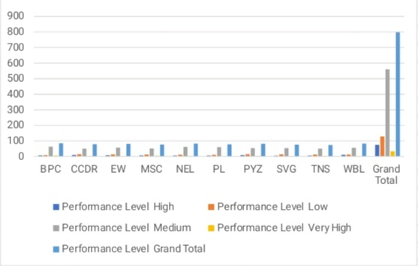
RESULTS
Employee Performance Level:
12

Slide 13
conclusion
I would like to conclude my report by saying that employee performance analysis is done to know the performance level of each and every employee of an organization. This analysis is helpful for the individual growth as well as the organization growth.

